Slide 1
Week 04
Object Orientation
Alexandra Rujzam https://github.com/greenfox-academy/szapszap

Slide 2
What we learned this week
Stress Management Training
Trial Exam
Alexandra Rujzam https://github.com/greenfox-academy/szapszap

Slide 3

What we learned this week
Stress Management Training
Trial Exam
Inheritance
Alexandra Rujzam https://github.com/greenfox-academy/szapszap

Slide 4
What we learned this week
Stress Management Training
Trial Exam
Inheritance
Abstracts and Interfaces
Alexandra Rujzam https://github.com/greenfox-academy/szapszap

Slide 5
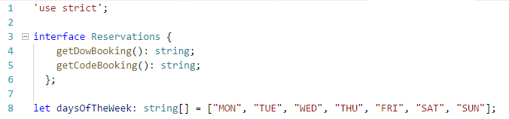

Slide 6
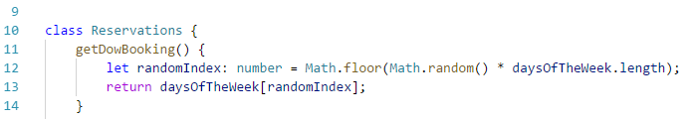

Slide 7
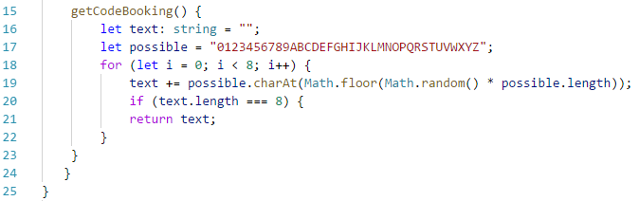

Slide 8
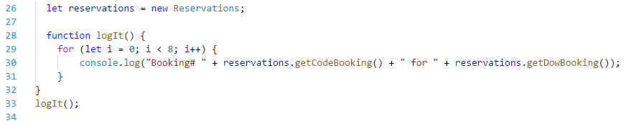

Slide 9
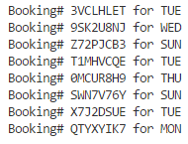

Slide 10
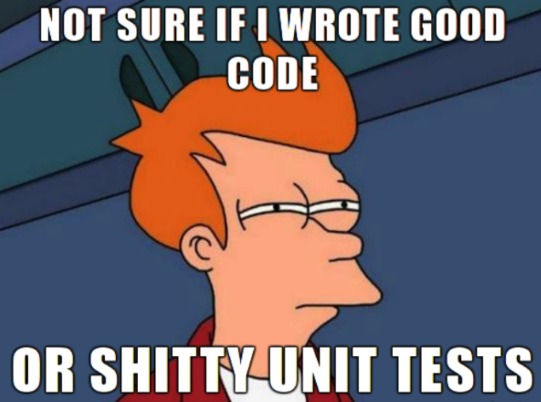
What we learned this week
Stress Management Training
Trial Exam
Inheritance
Abstracts and Interfaces
Unit Testing
Alexandra Rujzam https://github.com/greenfox-academy/szapszap

Slide 11
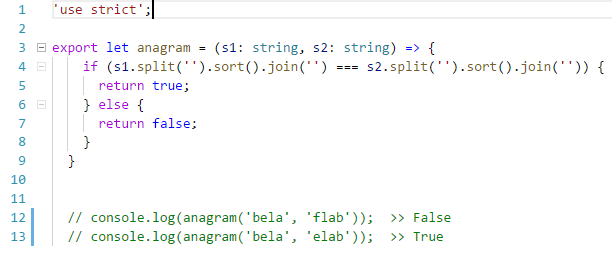
Sorting by Unicode

Slide 12
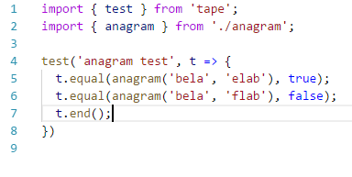

Slide 13
What we learned this week
Stress Management Training
Trial Exam
Inheritance
Abstracts and Interfaces
Unit Testing
Todo App
Alexandra Rujzam https://github.com/greenfox-academy/szapszap

Slide 14
Thanks for watching!
(Or listening)
Alexandra Rujzam https://github.com/greenfox-academy/szapszap

