Slide 1

Tamás Kamarás
1# Week ending demo
24/NOV/2017
Green Fox Academy
Corsac cohort
Badcat team

Slide 2
Progress of the week
Monday - Get to know the team members
Tuesday - HTML/CSS basics
Wednesday - Command line & Git
Thursday - Sitebuilding basics
Friday - CSS forms

Slide 3
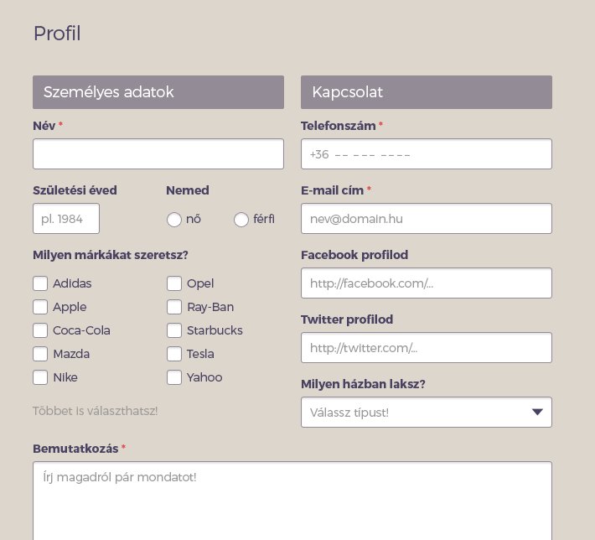
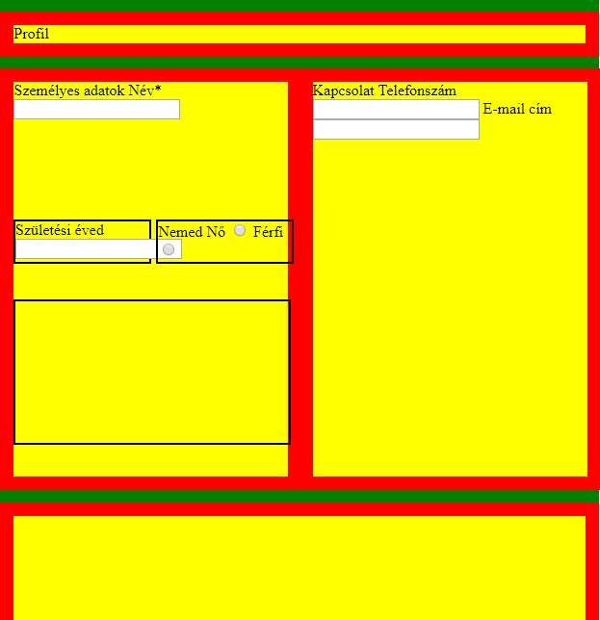
Sitebuilding progress

Slide 4
HAVE A NICE WEEKEND!

