Slide 1
Emotional
Coder Coaster
Tamás Kamarás
Green Fox Academy
Corsac Cohort - Badcat Class

Slide 2
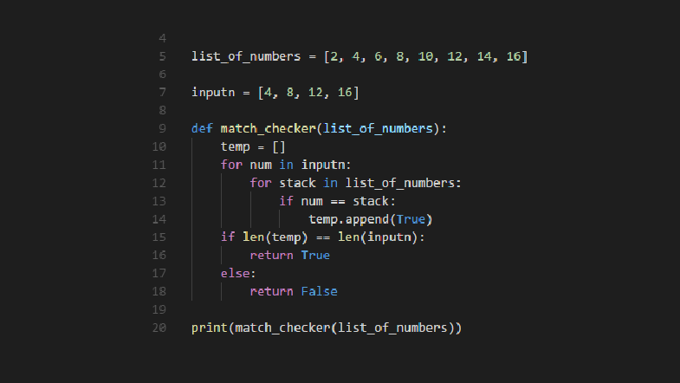

Slide 3
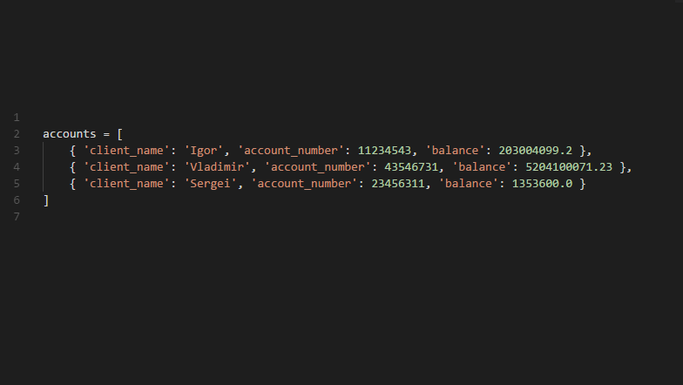
Task: transfer money from one account to another

Slide 4
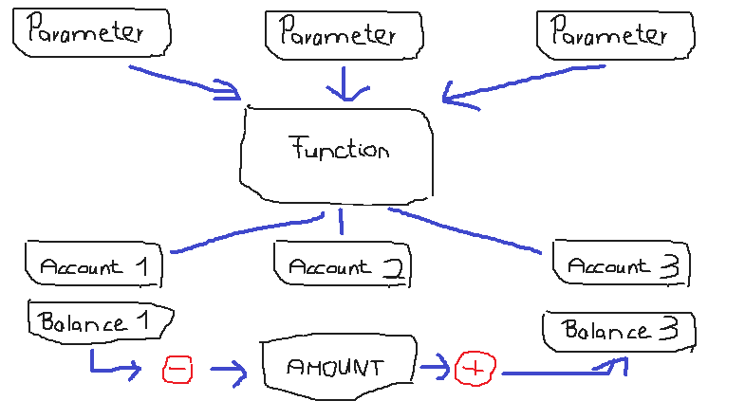

Slide 5
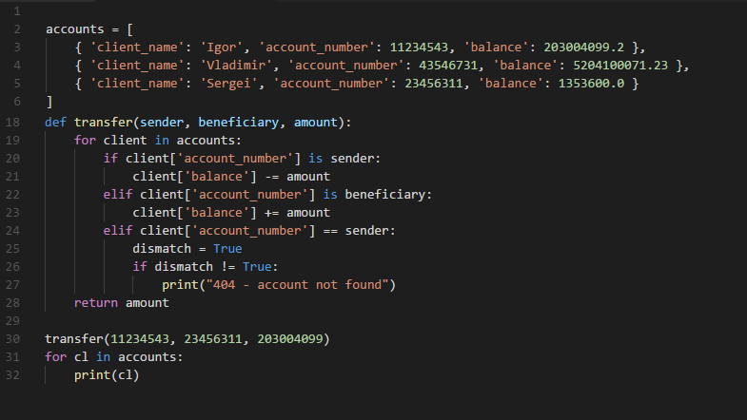

Slide 6
HAVE A NICE WEEKEND!

