Slide 1
Cleaning my code
github: greenfox-academy / tamaskamaras

Slide 2
Achievements of the day
Drawing with TKinter
Simplifying my code (clean code)
github: greenfox-academy / tamaskamaras

Slide 3
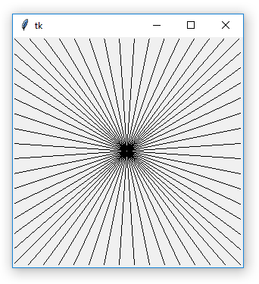
TASK
SOLUTIONS
Loops
Recursion
github: greenfox-academy / tamaskamaras

Slide 4
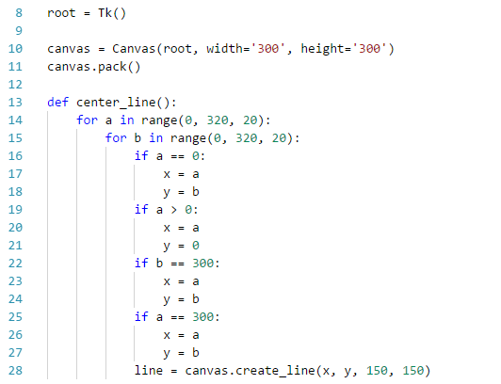
LOOPS
github: greenfox-academy / tamaskamaras

Slide 5
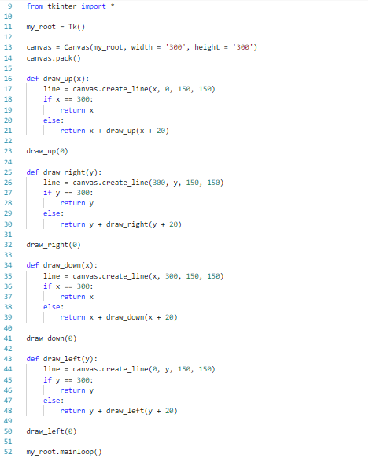
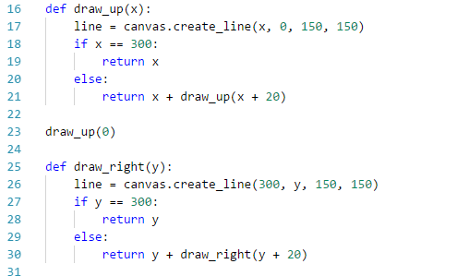
RECURSION
github: greenfox-academy / tamaskamaras

Slide 6
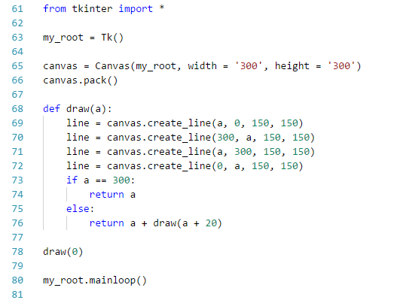
Simplified
Recursion
CLEAN CODE
github: greenfox-academy / tamaskamaras

Slide 7
Thank you for your attention!
Github:
greenfox-academy / tamaskamaras

