Slide 1
MVC
coding
github: greenfox-academy / tamaskamaras

Slide 2
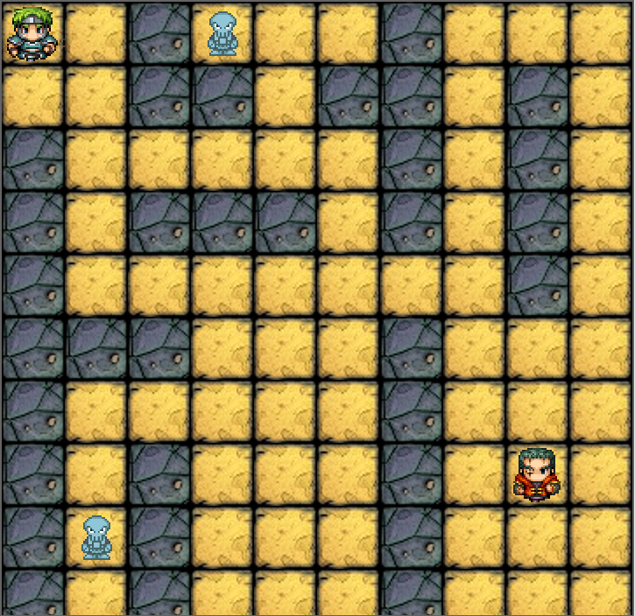
Wanderer game in Python
github: greenfox-academy / tamaskamaras

Slide 3
Moduls
Model
View
Controller
github: greenfox-academy / tamaskamaras

Slide 4
Model
Characters
Hero
Skeleton
Boss
github: greenfox-academy / tamaskamaras

Slide 5
View
Tile
Floors
Walls
Map
github: greenfox-academy / tamaskamaras

Slide 6
Mainloop
Gamelogic
Gamecontroller
Characters
Map
github: greenfox-academy / tamaskamaras

Slide 7
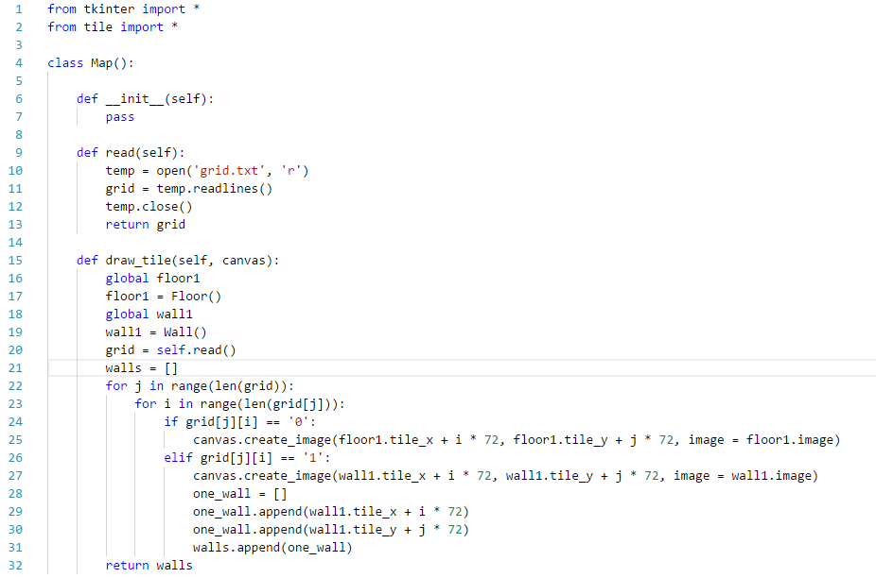
Map
github: greenfox-academy / tamaskamaras

Slide 8
Thank you for your attention!
Github:
greenfox-academy / tamaskamaras

