Slide 1
Tamás Kamarás
JavaScript
Python
github: greenfox-academy / tamaskamaras

Slide 2
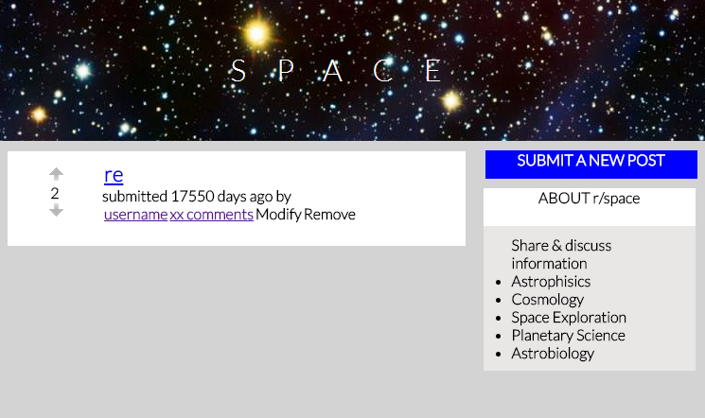
github: greenfox-academy / tamaskamaras

Slide 3
Achievements
CSS skills, Full scale layout is 1 hour,
AJAX requests (GET, POST, PUT, DELETE),
Decoupled coding
github: greenfox-academy / tamaskamaras

Slide 4

Select the correct Tag
github: greenfox-academy / tamaskamaras

Slide 5
Edifications
Refactoring (235 lines in total),
Callback functions,
github: greenfox-academy / tamaskamaras

Slide 6
Thank you for your attention!
Github:
greenfox-academy / tamaskamaras

