Slide 1
Tamás Kamarás
JavaScript
Python
github: greenfox-academy / tamaskamaras

Slide 2
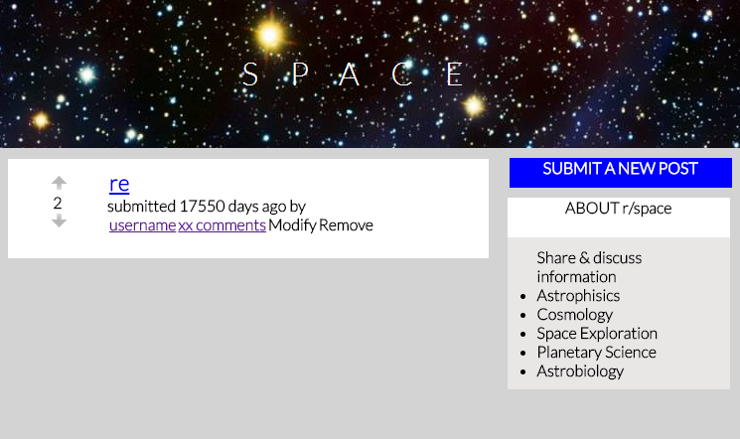
github: greenfox-academy / tamaskamaras

Slide 3
Panic Mode
github: greenfox-academy / tamaskamaras

Slide 4
Relax
Step back
and
PLAN!!!
github: greenfox-academy / tamaskamaras

Slide 5
STRUCTURE
client
server
DB
github: greenfox-academy / tamaskamaras

Slide 6
BLUEPRINT
create DB
Get requests
Endpoints:
“/” : load, feed,
“create/”,
“upvote/”,
“downvote/”,
“delete/”,
“modify/”,
create server
Send responses
github: greenfox-academy / tamaskamaras

Slide 7
Conclusions
Break up to small UNITS,
Proceed step by step,
github: greenfox-academy / tamaskamaras

Slide 8
Thank you for your attention!
Github:
greenfox-academy / tamaskamaras

