Slide 1
Task: Concat strings
DIFFERENCE BETWEEN
ARRAY AND POINTER
PRESENTED BY LILLA TÓTH

Slide 2

Introduction
L
Workexperiences
  Project manager
  Financial assistant
Hobbys and dreams
  Reading, turtles, series, garden
toth.lilla88@gmail.com

Slide 3
Sixth week tasks - Monday
Basic of strings
  <stdio.h>, <stdlib.h>, <string.h>
  <main.c>, <*.h>, <*.c>
  macros
  func_type func_name(para_type para_name);
  func_type func_name(para_type para_name[]);
  func_type * func_name(para_type para_name[]);
  func_type func_name(para_type * para_name);
  func_type * funct_name(para_type * para_name);

Slide 4
Sixth week tasks - Tuesday
Custom Data Types - your own data type in C
  struct{}, union{} and typedef{}
  typedef enum{}
  special cases: typedef struct {} bitfield_t
File input/output handling
  FILE * filepointer;
  fopen(), fclose()
  fprintf(), fscanf(), fputs(), fgets(), fputc(), fgets()
  feof()

Slide 5
Sixth week tasks - Wednesday
Dynamic memory allocation
  Task: concat strings

Slide 6
Sixth week tasks – Thursday/Friday
Advanced data structures
  Single linked list
  Vector
  Additional data structures
    Queue
    Doubly linked list
    Stack
    Heap
    Circular linked list

Slide 7
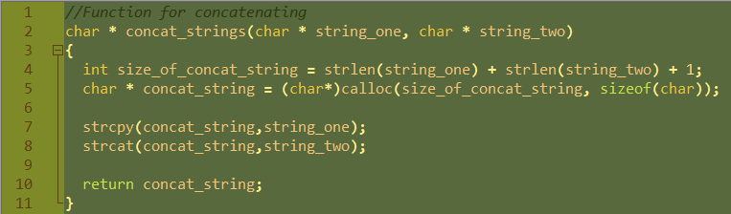
Sixth week tasks - Wednesday
Dynamic memory allocation
  Task: concat strings

Slide 8
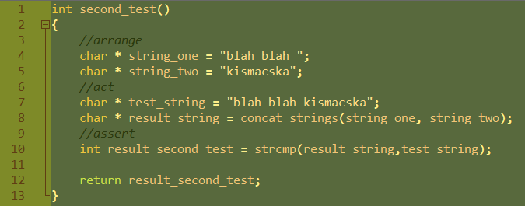
Sixth week tasks - Wednesday
Dynamic memory allocation
  Task: concat strings

Slide 9
THANK YOU FOR WATCHING!
SEE YOU NEXT TIME!

