Slide 1



Week 02 – Demo
Tunde Csapo
Green Fox Academy / Fulvipes / Secret
Find me on GitHub:
tundecsapo
Find me on LinkedIn:
Tunde Csapo

Slide 2
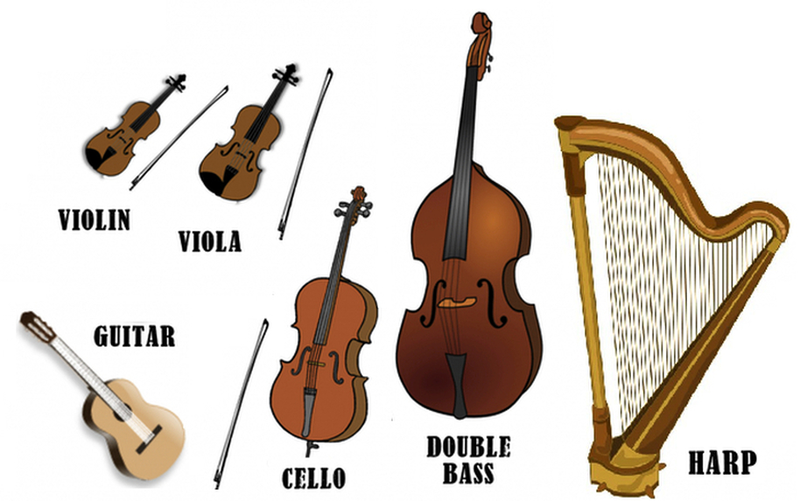
< What strings meant for me a few months ago… >

Slide 3
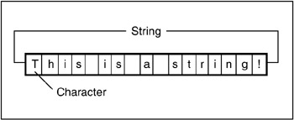
< What strings mean for me now… >

Slide 4
< Day-01 & Day-02 & Day-03 >
< String and array functions >
< Reading, writing files. Errors >

Slide 5




< Drawing >
Generating random colours
Make sure every element of your drawing is visible
Checkboard:
Defining a checker variable (by checking the sum of “end indexes”

Slide 6
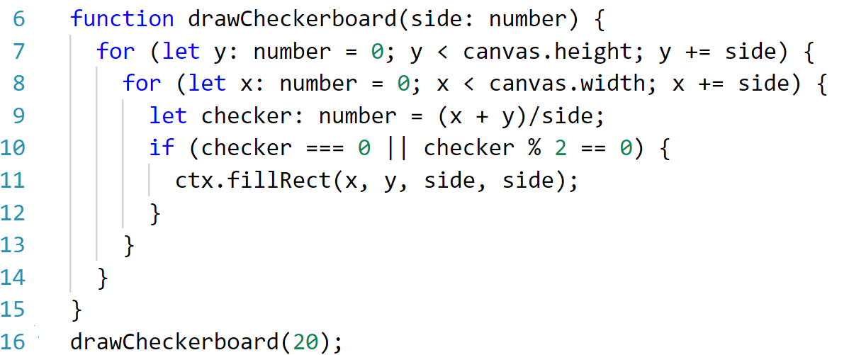
< Checkerboard >
0 | 1 | 2
1 | 2 | 3
2 | 3 | 2

Slide 7

< My favourite exercise - Starry Sky >

Slide 8

< Summary / Takeaway >
Try to establish the foundations
Using your time efficiently
Breaking the code into functions helps
Things to improve on:
Using ‘ => ‘ with functions
Using two space indentation
Checking the style guide again
My takeaway from this week:
…even if it seems scary at first, just do it! ☺

Slide 9
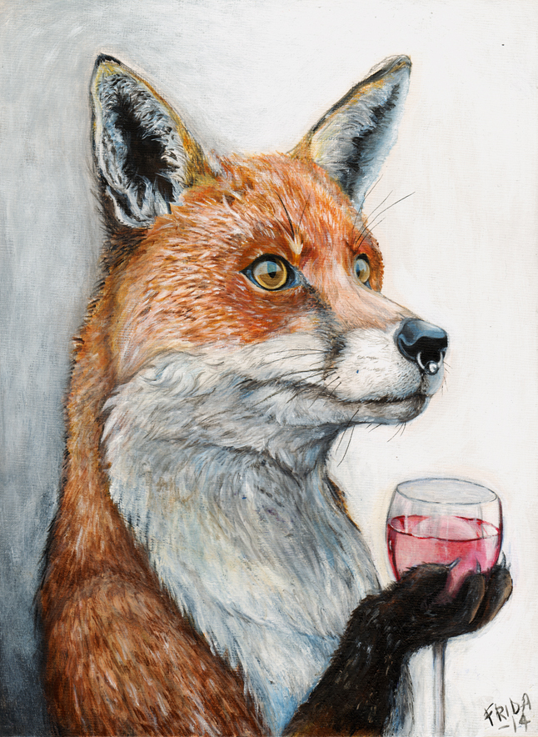
Thank you! Enjoy the weekend!
Find me on:
GitHub:
tundecsapo
LinkedIn:
Tunde Csapo

