Slide 1






Week 03 – Demo
Tünde Csapó
Green Fox Academy / Fulvipes / Secret
tundecsapo
Tunde Csapo

Slide 2
< Classes and objects >
Fleet of Things
  Private vs. public access modifiers
  How can we retrieve a private data outside of the Object?

Slide 3
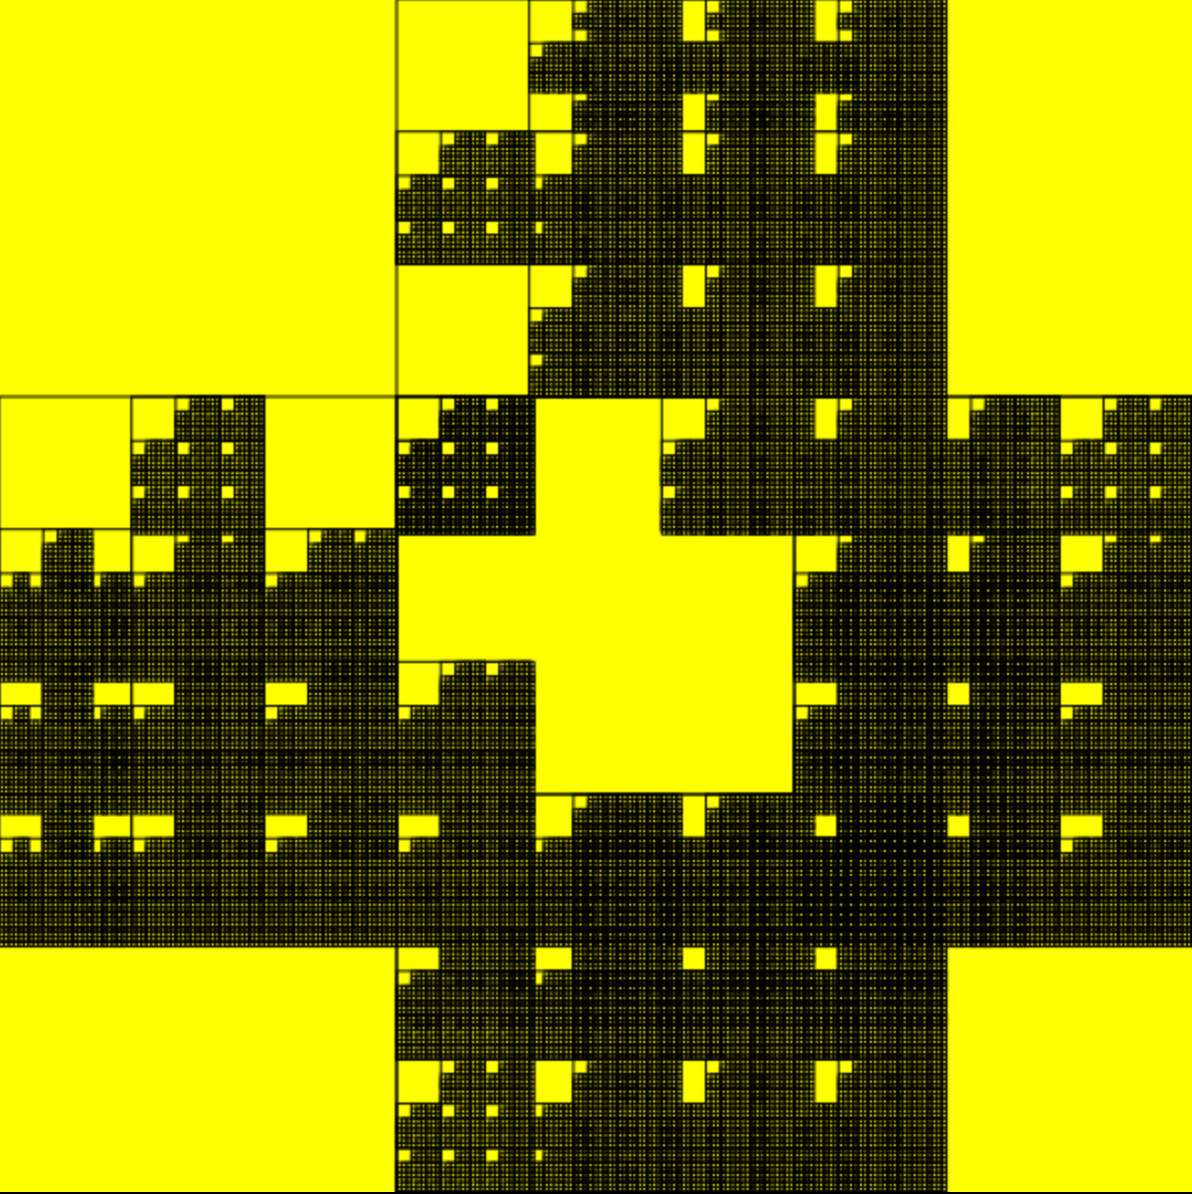
< Draw squares recursively >

Slide 4
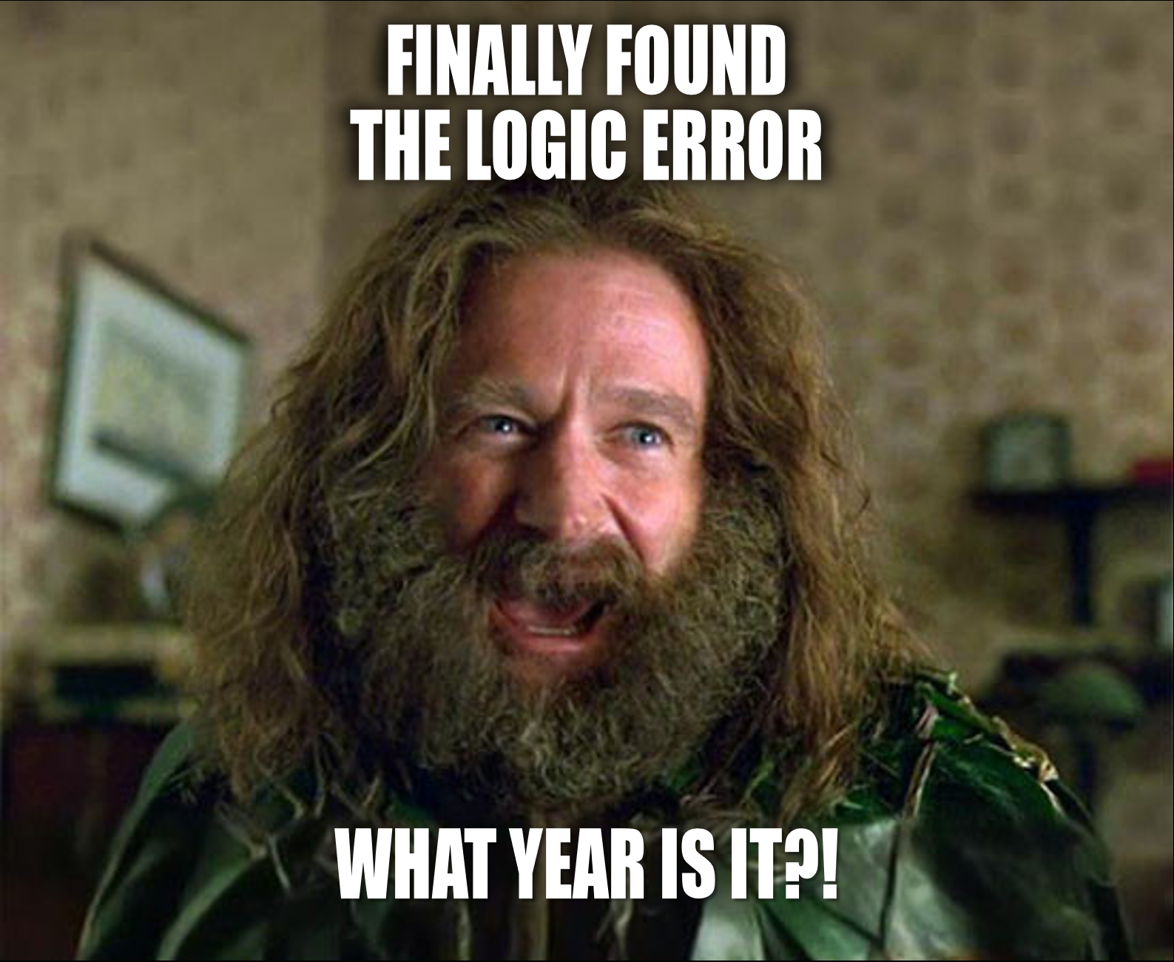

Slide 5
< Draw squares recursively >
boxSize
1st col endPoint
boxSize | 1st col (endPoint) | 2nd col (endPoint) | 3rd col (endPoint)
600 x 600 (canvas size) | 200 | 400 | 600
200 x 200 | 66.666… | 133.3333… | 199.999…
66.66..X 66.66.. | 22.222… | 44.444…. | 66.66…(but less than boxSize)
Etc. | Etc. | Etc. | Etc.

Slide 6
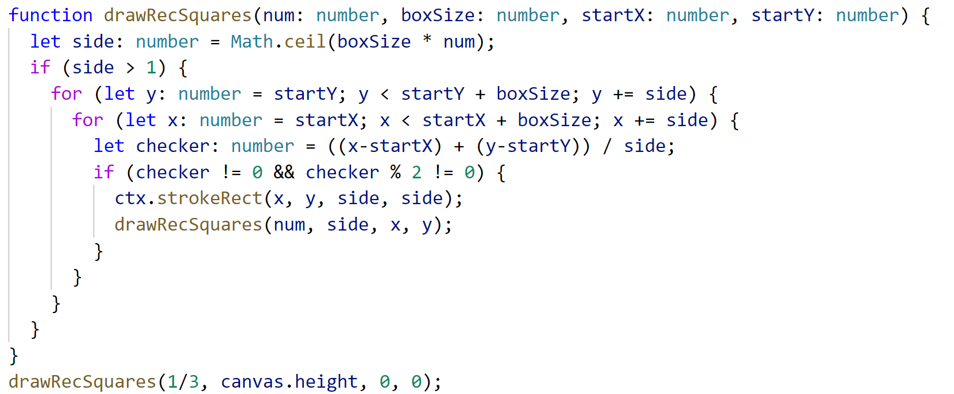
< Draw squares recursively >

Slide 7
< Draw squares recursively >

Slide 8
< Draw squares recursively >

Slide 9
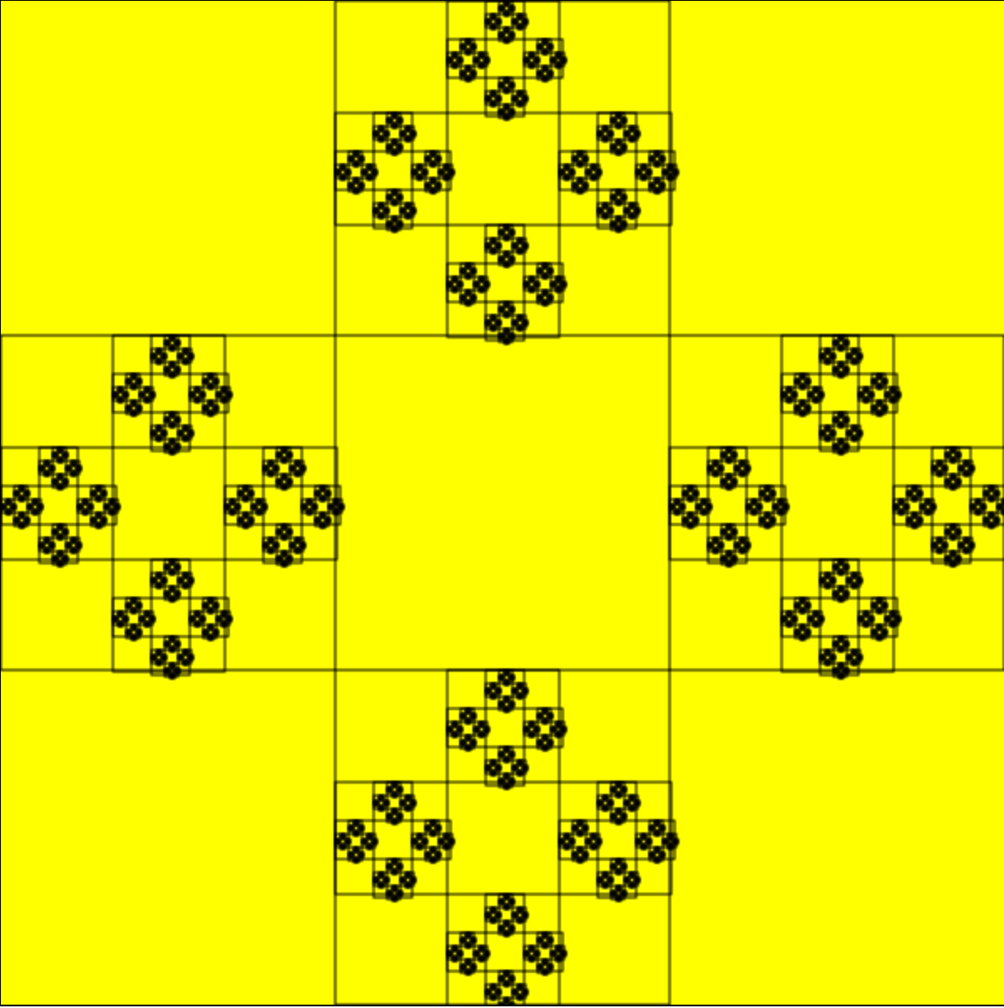
< Draw squares recursively >

Slide 10
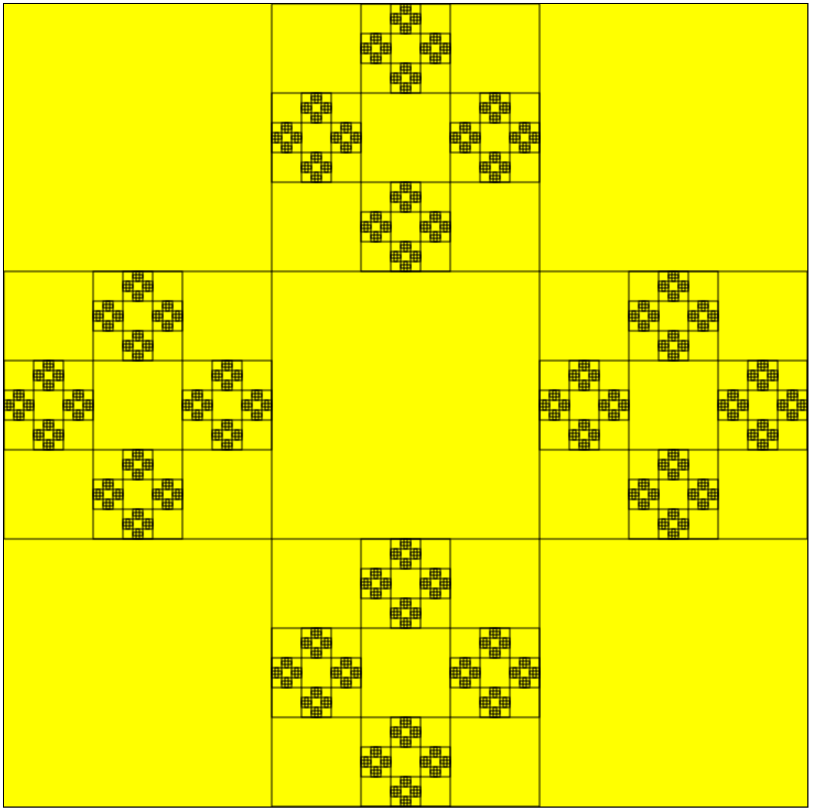
< Final>
0 | 1 | 2
1 | 2 | 3
2 | 3 | 2

Slide 11

< Summary / Takeaway >
If I prepare during the weekend, I should check the homework during the week as well
Drawing: use paper and pen
Drawing II: test your drawing in pieces
Using FAT arrow functions
STYLEGUIDE!!!!
indentation… single quotes…
semicolon…semicolon….SEMICOLONS!!
space here…space there….SPACES!! ☺

Slide 12


Slide 13
Thank you!
tundecsapo
Tunde Csapo

