Slide 1
Presentation 1.0
Viktor Hegyi
Green Fox Academy

Slide 2
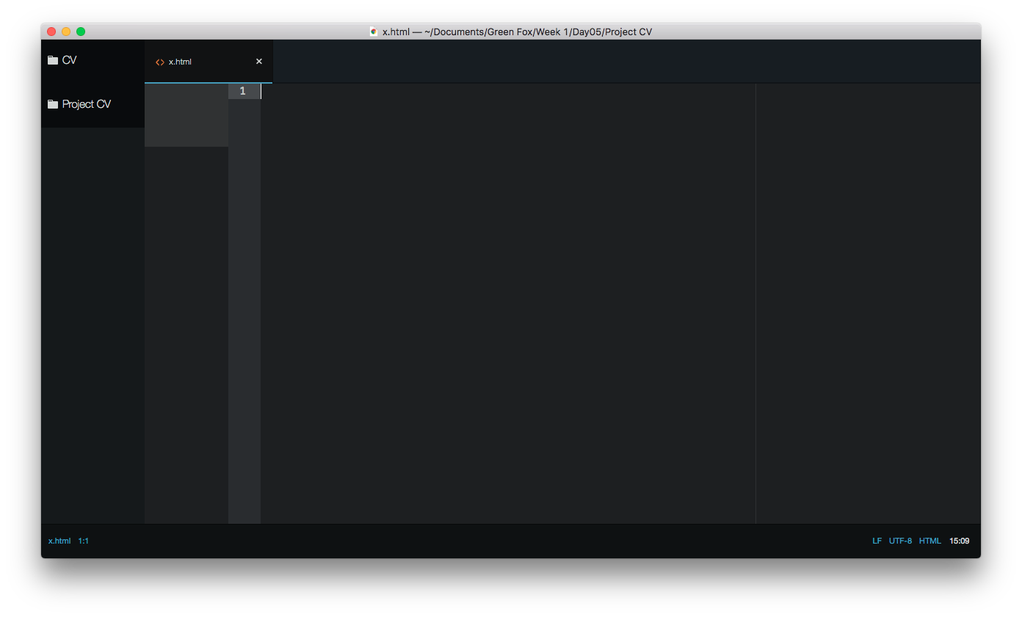
Lesson 1

Slide 3
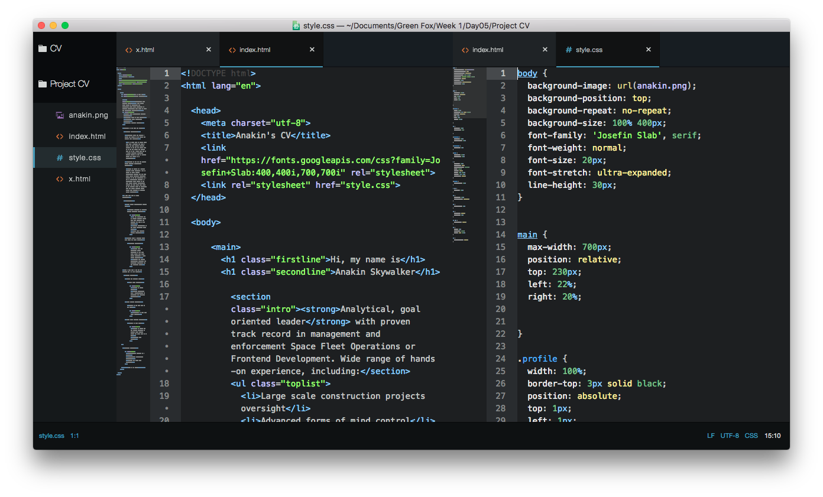

Slide 4
Problems
during the week:

Slide 5
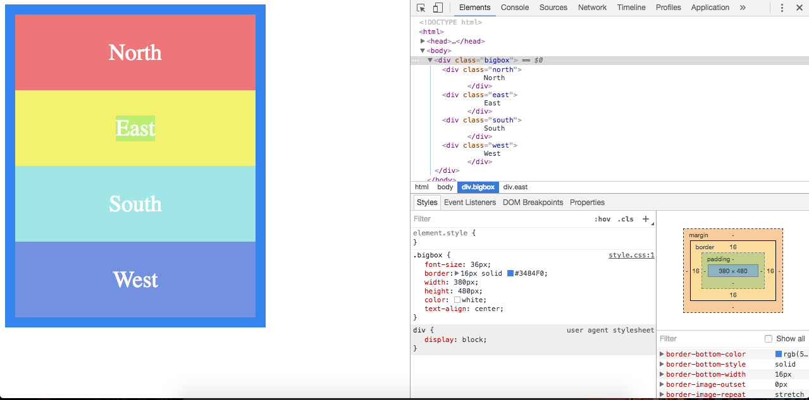
Box model

Slide 6
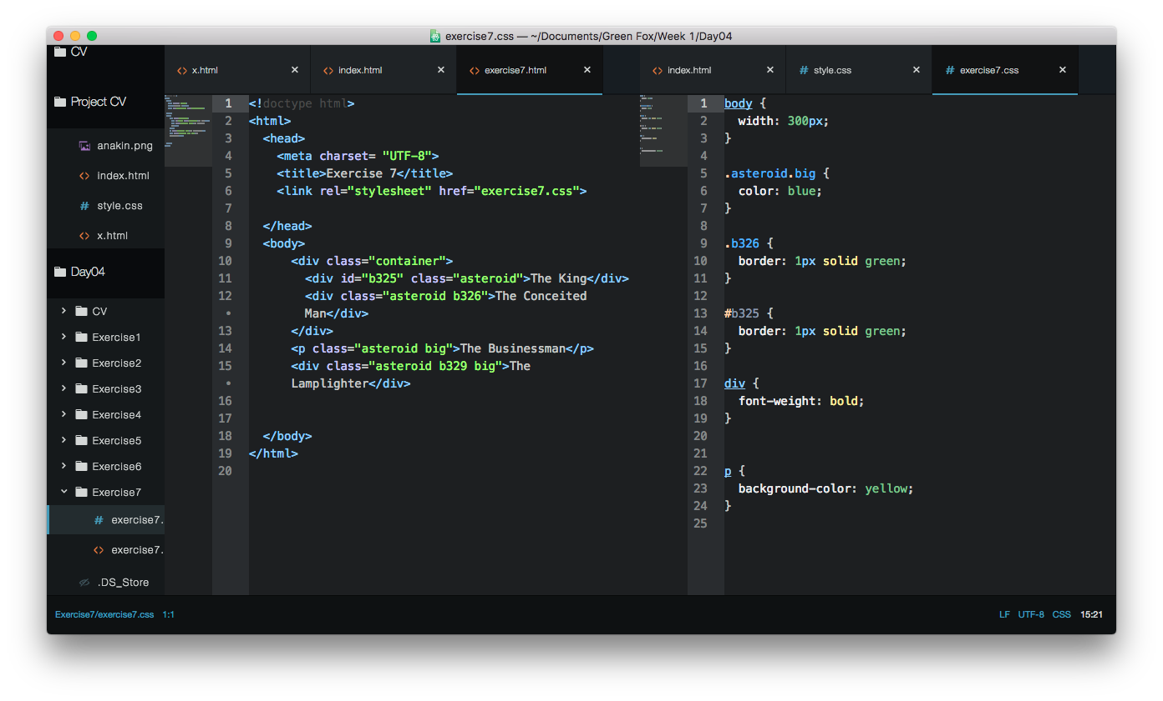
Selector

Slide 7
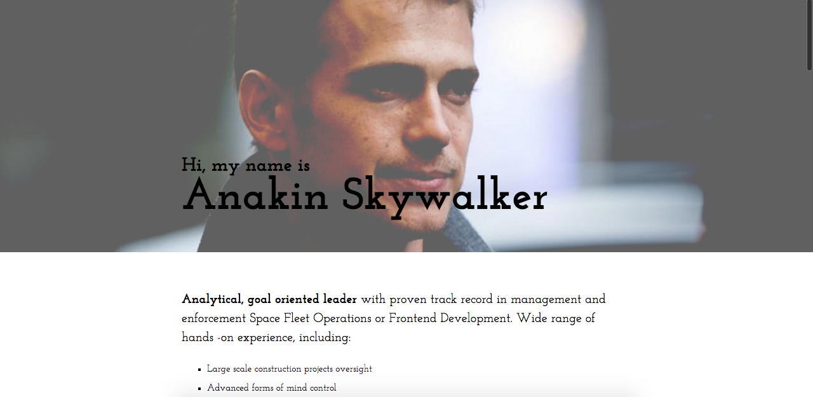
Background of webpage
Insert photo <img>
Problem when resizeing the image
Background in CSS
The good solution

Slide 8
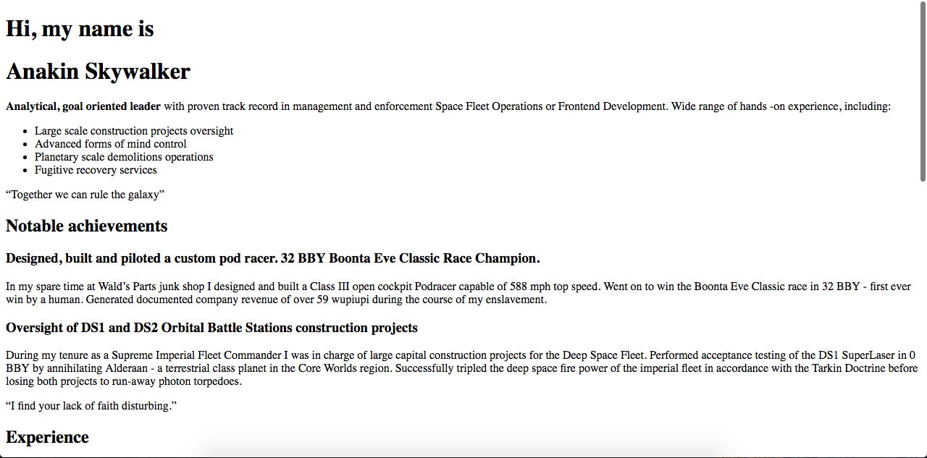

HTML CSS

Slide 9
End

