Slide 1
Week 04
Cathy Chen
Notes:
make a summary what i have learned in the past two weeks

Slide 2
Front end basis:
React:
CSS, DOM, EVENT, HTTP,
promise&Fetch, async&Generator
State&component, CSS in JS and Routing, Hooks&Component Lifecycle, Project
Notes:
in week 3 ， we learn 。。。
in 4，we。。

Slide 3
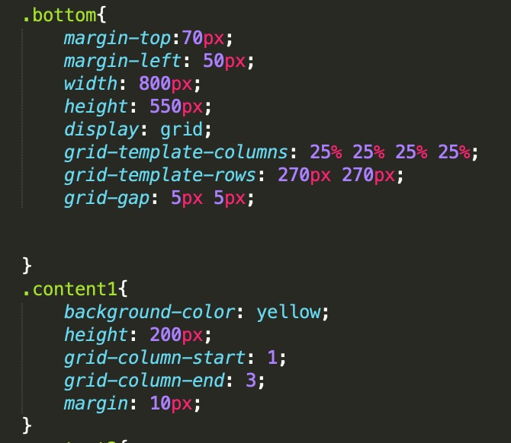
css
The CSS Grid Layout Module offers a grid-based layout system, with rows and columns, making it easier to design web pages without having to use floats and positioning.
Flex box + grid
Notes:
The vertical lines of grid items are called columns.
The horizontal lines of grid items are called rows.
I just divide this container into 4 colunmns and 2 rows. I find that it is flexible to use grid-column-start,end.. why...

Slide 4
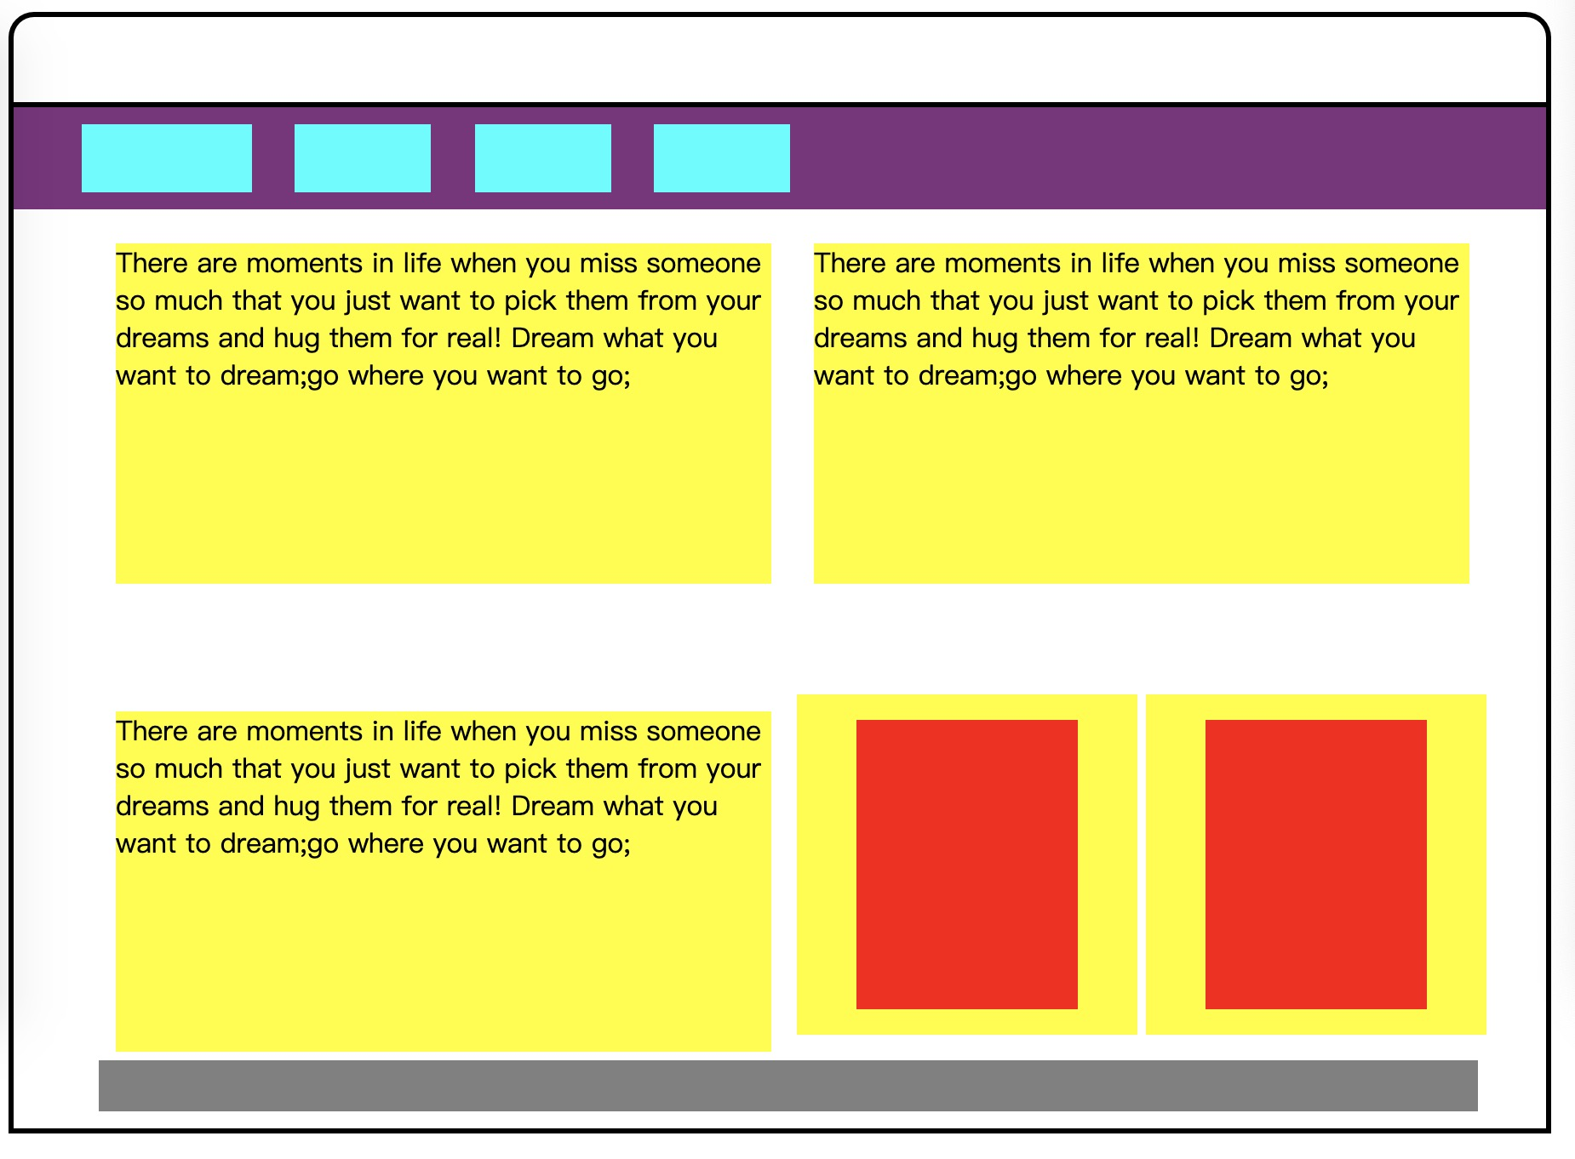
css
The CSS Grid Layout Module offers a grid-based layout system, with rows and columns, making it easier to design web pages without having to use floats and positioning.
Flex box + grid
Notes:
grid-column-gap grid-row-gap grid-gap

Slide 5
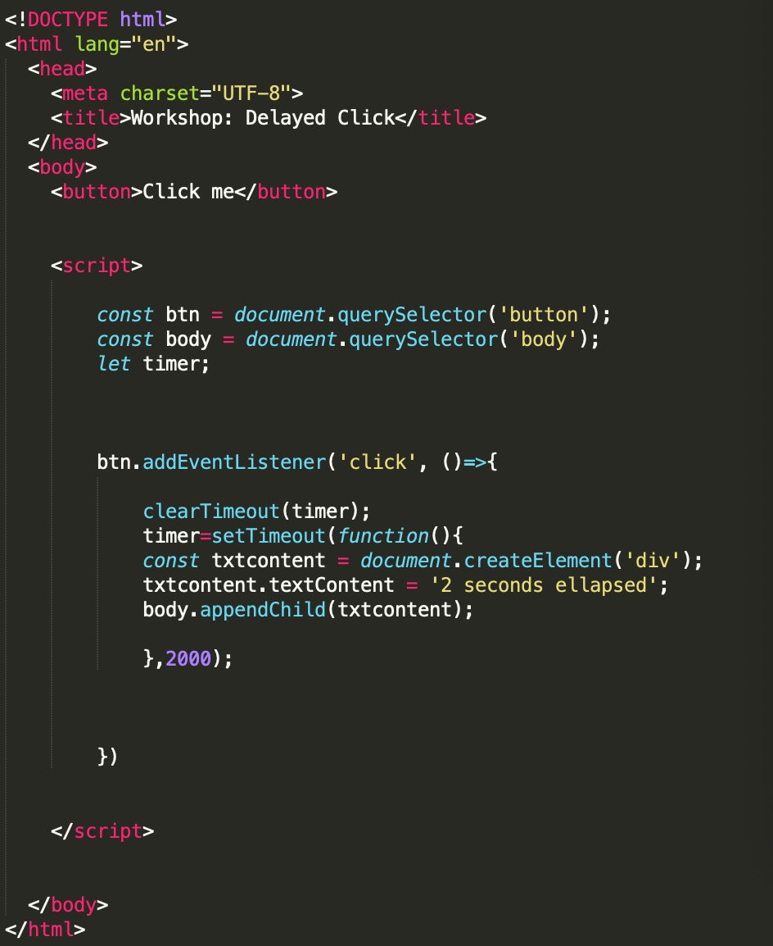
EVENT
onclick
onfocus
onkeydown
onkeypress
onkeyup
onmousedown
onmousemove
Notes:
as for the event method ,we use most is addeventlistener
The addEventListener() method attaches an event handler to the specified element.
Use the removeEventListener() method to remove an event handler that has been attached with the addEventListener() method.

Slide 6
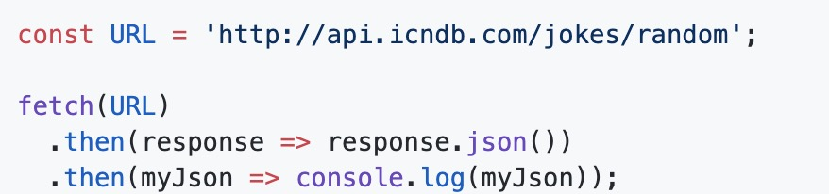
Promise Fetch
Notes:
The fetch method returns a Promise object. I find it useful when I doing exercise, console.log(sth). and I can know what I want to get in the following steps. According to the properties of Promise Api, fetch can be easily used. Promise.resolve() or Promise.reject() will return the Promise result
of course, !! Async/await, you can get the return value directly, you don't have to write .then(callback) , you don't have to write .catch(error), you can use the try catch standard syntax to catch the error.
Await/async solves problem of using Promise completely - sharing data problems between different Promise.

Slide 7
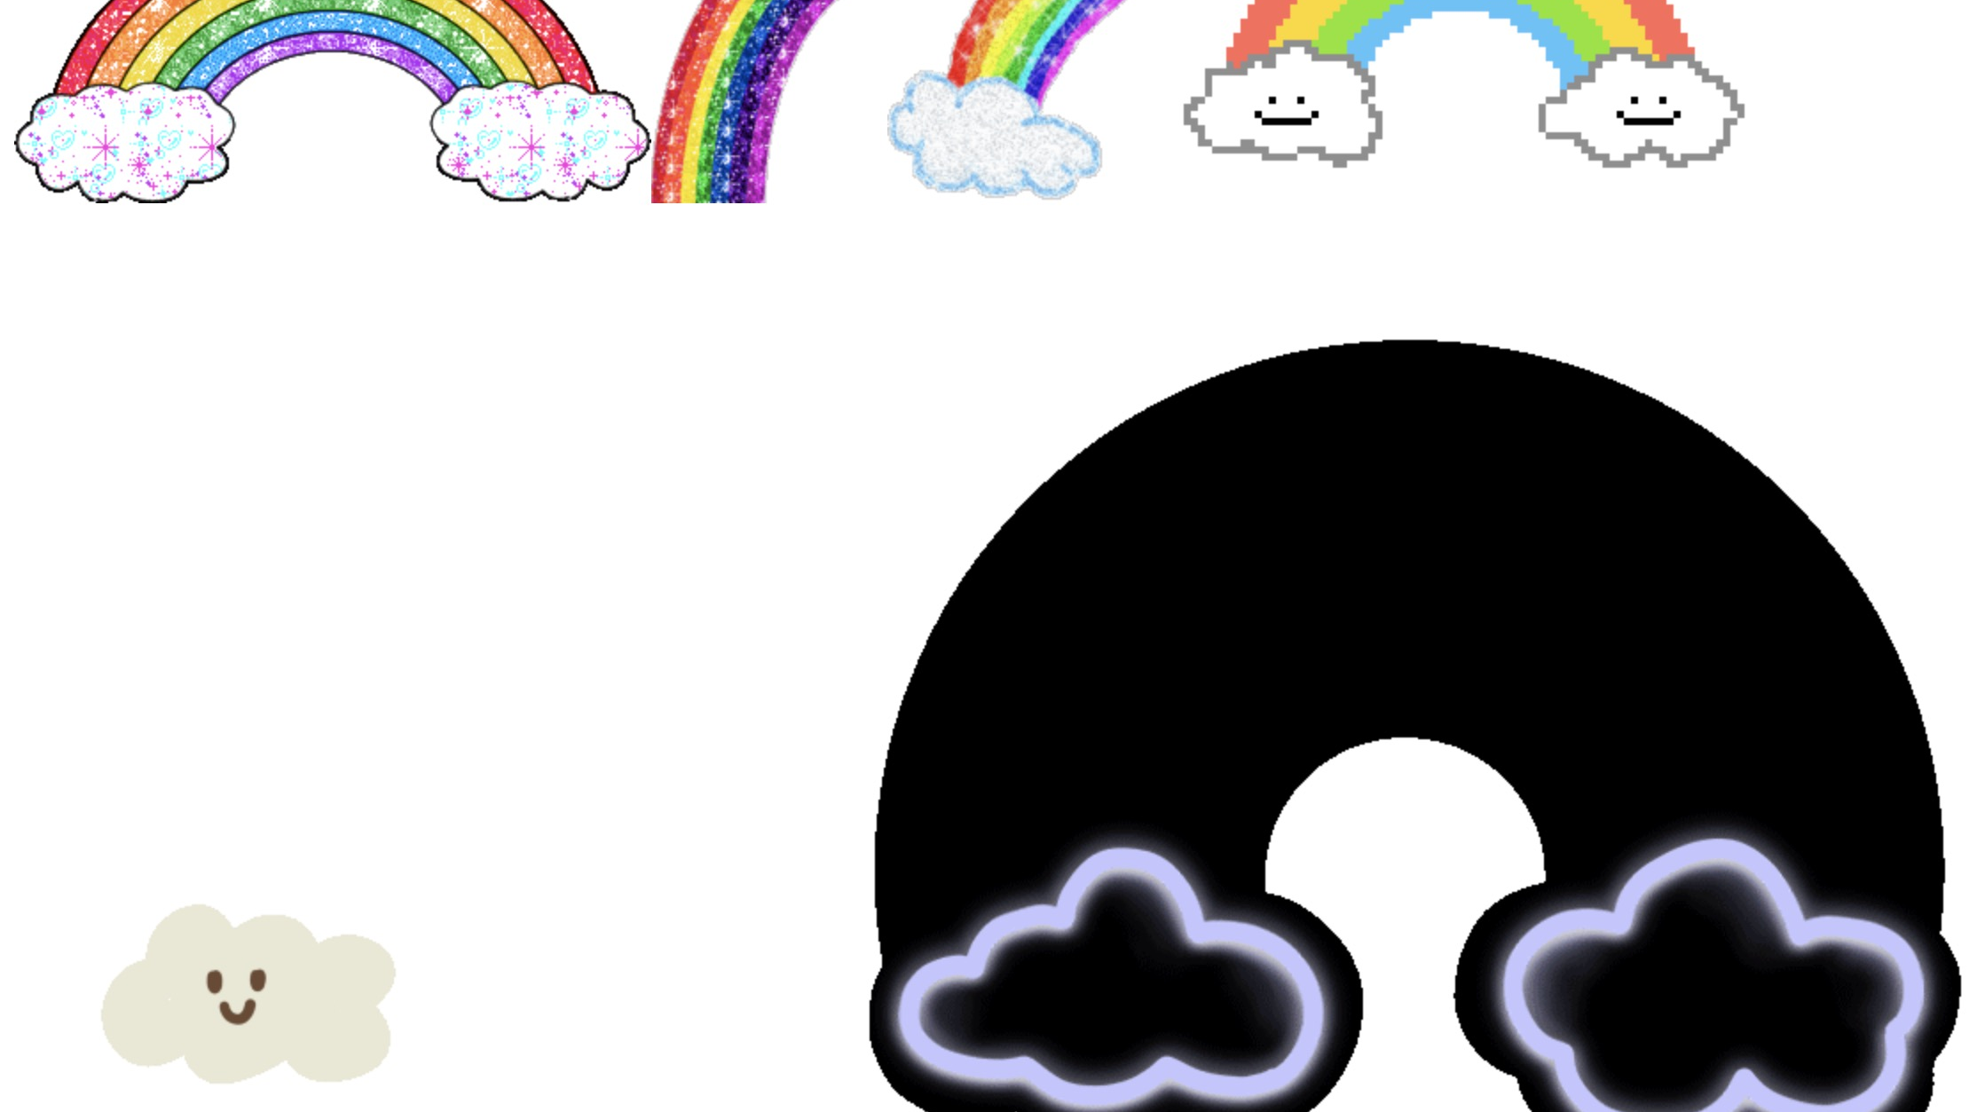
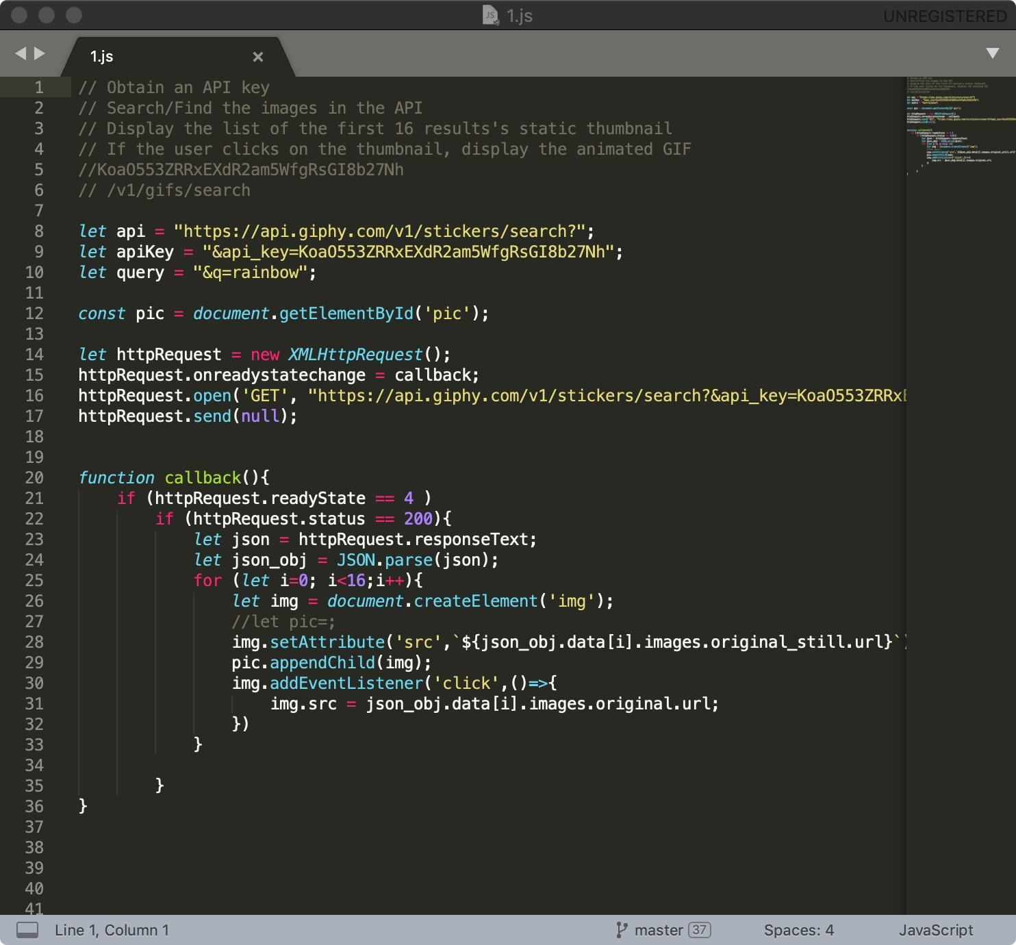
Promise Fetch
Notes:
one example of our workshop.
keyword in api is RAINBOW..click.

Slide 8
Difference
React:
state props
Notes:
react is a very powerful framework. What I want to mention is that when i first learn react, THIS TWO WORDS make me confused. i ask for..thanks to ..
I know that we can Set the state in the parent component, and then use the props on the child component to receive the value of the parent component. The state of the value must be changed by setState to update the data of the component.
Props and state are often used in combination, and the parent component's state can be converted to props to pass values ​​to the child component. In this case, the props received by the subcomponent are replaced. To change the value, only the state of the parent component can be changed.

Slide 9
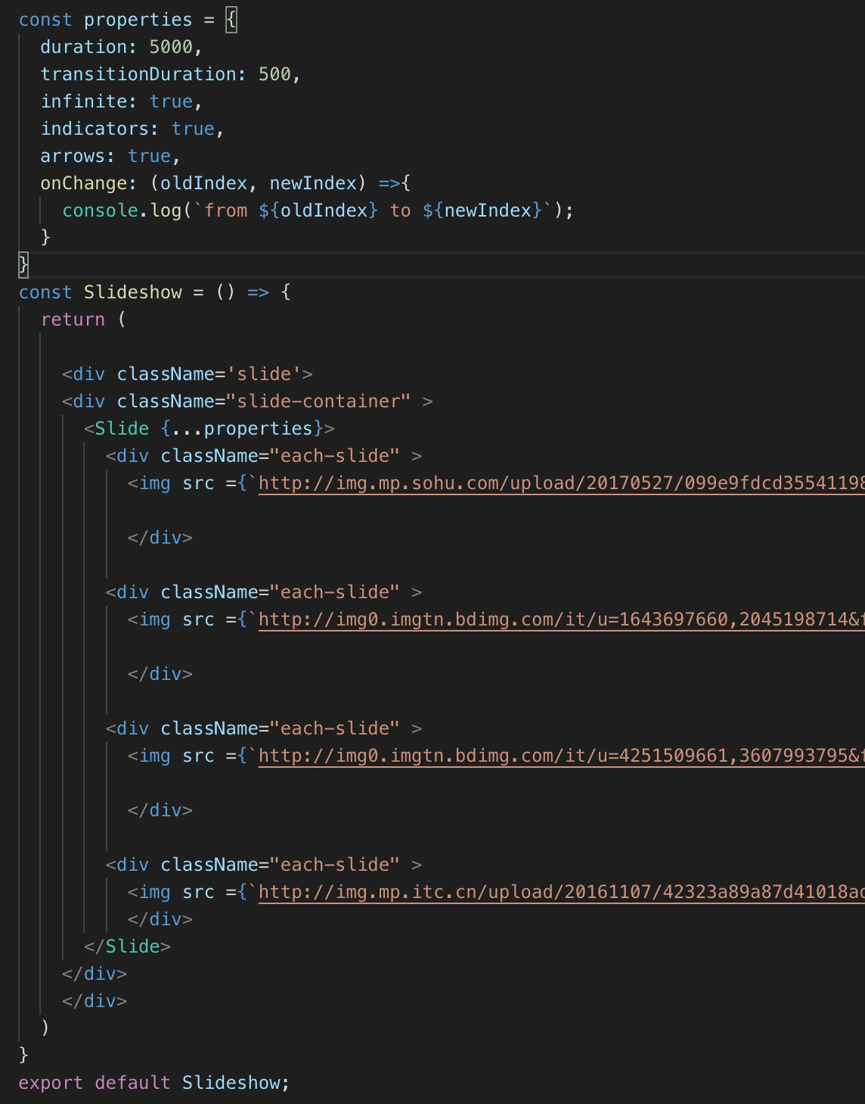
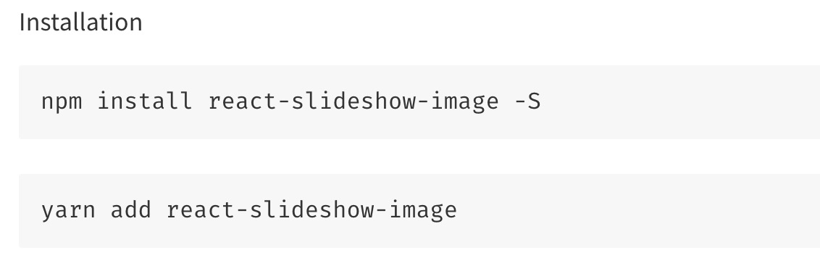
Project

Slide 10
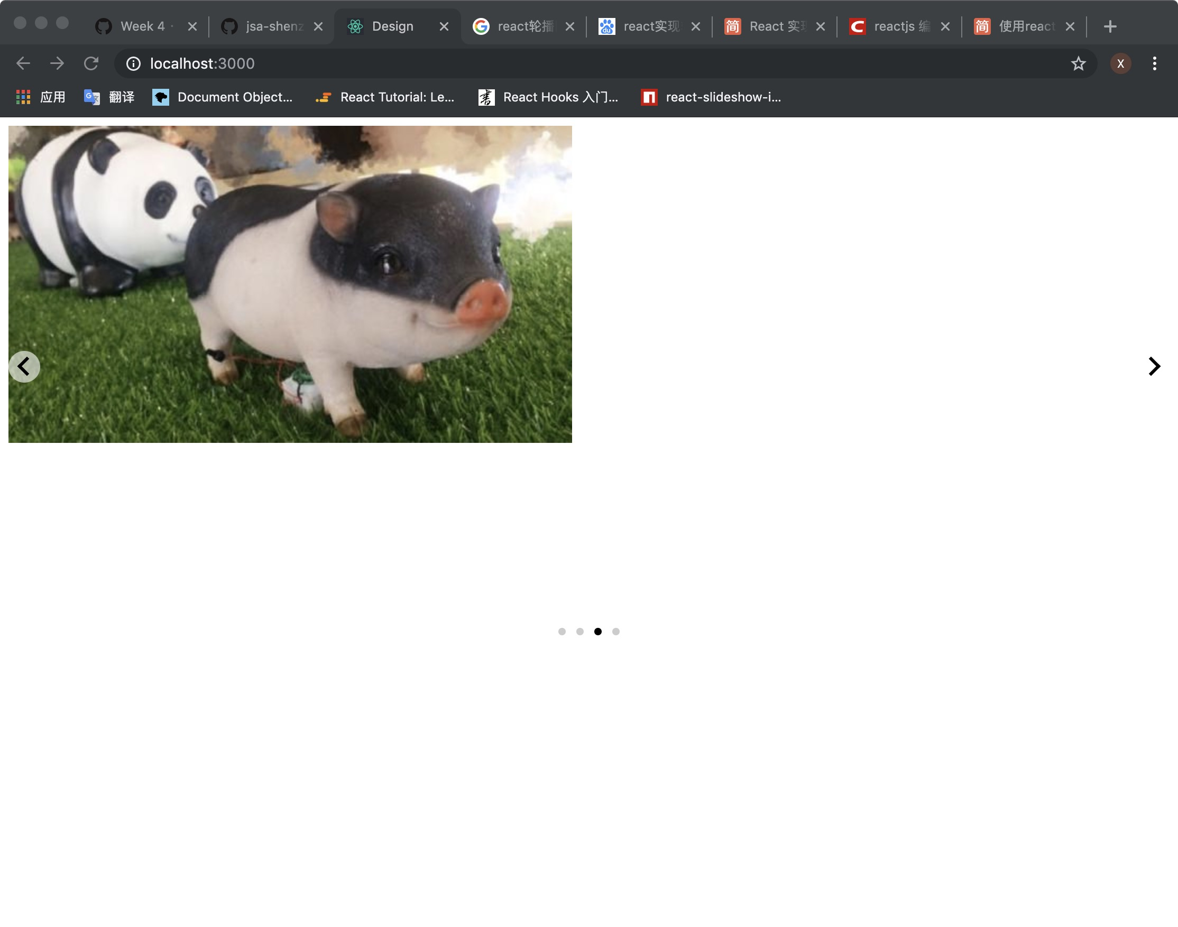

Slide 11
Thank you!

