Slide 1
Git – An Introduction
-Mathan raj

Slide 2
Agenda
What is Git
VCS architecture
Git architecture
Why Git?
Git branching workflow
Generic branching Workflow
Git installation
Git file states
Basic Git commands
Further readings
Q & A?

Slide 3
What is Git?
Distributed version control system.
History: Linux kernel was using BitKeeper - a proprietary DVCS system. 2005 the free of charge status is revoked. So ‘Linus Torvalds’ prompted Linux development community to develop their own tool. Git is created.

Slide 4

VCS Architecture

Slide 5
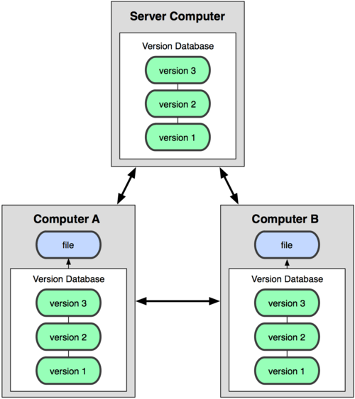
Git architecture (Distributed VCS)
Speed in usage
Simple design
Fully distributed (offline usage)
Easy recovery after server failures

Slide 6
Why Git?
Offline access: Version control is very important – it serves as creating check points in the development code, which allows us to go back to last known good state. Users can commit even when the system is offline.
Local: Almost all the operations in Git are local. Checking history, viewing VCS annotations in IDE and lot more are local. This makes Git much faster than other VCS systems.
Multiple branch (non-linear development): Users can have multiple branches in same directory and it is easy to switch between them. Less time spent on setting up a branch.

Slide 7
Why Git? (..contd)
Integrity: Everything in Git is check-summed before it is stored and the commit is referred by that checksum. Git has no revision numbers, but has a hash (SHA-1)
commit 6bc294653f18ca93ace2b1a9011a9ac94865a55a
Easy recovery after server failures: Each computer has a copy of the entire code, this can be easily replicated to a new server within minutes.
Better merging strategy: Git supports 3 way merge which is more powerful and less conflict prone than SVN

Slide 8
Git “branching” workflow
Branching workflow is a set of rules agreed my the team on how to create branches, merge and maintain the releases. It is flexible from team to team.
Mainline development – everyone pushes to one branch ‘develop’ or ‘master’. Deployments happen from that branch. (suitable for small teams)
Environment branches – each environment has it own branch running (bad practice)
GitHub Workflow – create branch for each feature, pull request, deploy to production and later merge to ‘master’

Slide 9

Generic branching workflow

Slide 10
Git installation
Suggested installation for windows/Mac: https://help.github.com/desktop/guides/getting-started/installing-github-desktop
This will automatically generate a SSH key in your local machine and uploads to GitHub server.
GitHub installation comes with an UI and PowerShell command line tool for windows.
If your code is hosted in other provider, you may have to upload the SSH key to those servers for seamless interaction.
Some Other tools: https://git-scm.com/downloads https://www.sourcetreeapp.com/

Slide 11
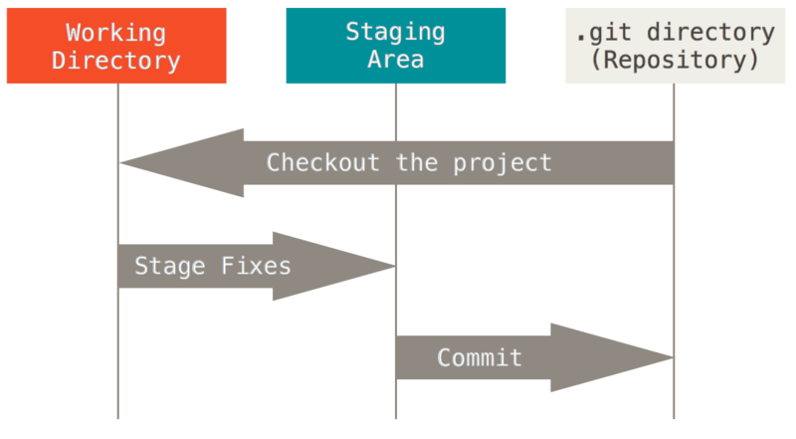
Git file states
Files can be in any one of states
Committed
Modified
Staged

Slide 12
Basic Git Commands
git clone <url> [clones the remote repository to your local directory]
git init [setup up your local directory for git]
git add <files> [ Add the specified files to the ‘stage’ state, modified or untracked files can be added]
git status [shows the list of file in different states, ‘modified’, ‘staged’ etc]
git commit –m “JIRA-1234: This is initial commit” [commits to local repository]
git push [pushes all the local changes to the remote repository]

Slide 13
Basic Git Commands (..contd)
git branch [Lists all branches, the one with * is current branch]
git checkout <branch-name> [if branch is present in local, switches too the specified branch. Else checkouts the branch form the server]
git branch <new-branch-name>[ creates new branch from the current branch]
git merge <other-branch> [merges ‘other-branch’ into this branch]

Slide 14
Basic Git Commands (..contd)
git merge –no-ff <other-branch> [merge with no fast forward, shows the tree structure ]
git fetch [fetches remote version and won’t change your local version]
git pull [does a fetch followed by merge – makes your local change upto date with remote version]
git pull –rebase [ same as pull, but replays your changes on top of remote changes]

Slide 15
Basic Git Commands (..contd)
git stash [stores the local changes to a ‘shelf’]
git reset <file or commit-SHA>[resets the current branch to version in remote repo]
git log [shows commit history]
git rm <filename or Pattern> [removes file from local and index]
git diff [ shows the difference between local and remote repo]

Slide 16
Further learnings..
Advanced Git commands
Git workflows (Integration manager, Dictator and Lieutenants, etc..)
Git merge – in depth ( 3 way merge, Subtree merging)
Git configuration
Git Hooks
Git Tagging
https://try.github.io/levels/1/challenges/1 (UI tool to learn commands)

Slide 17
References
https://git-scm.com/book/en/v2
https://www.amazon.co.uk/Continuous-Delivery-Deployment-Automation-Addison-Wesley/dp/0321601912

Slide 18

Questions?

