Slide 1
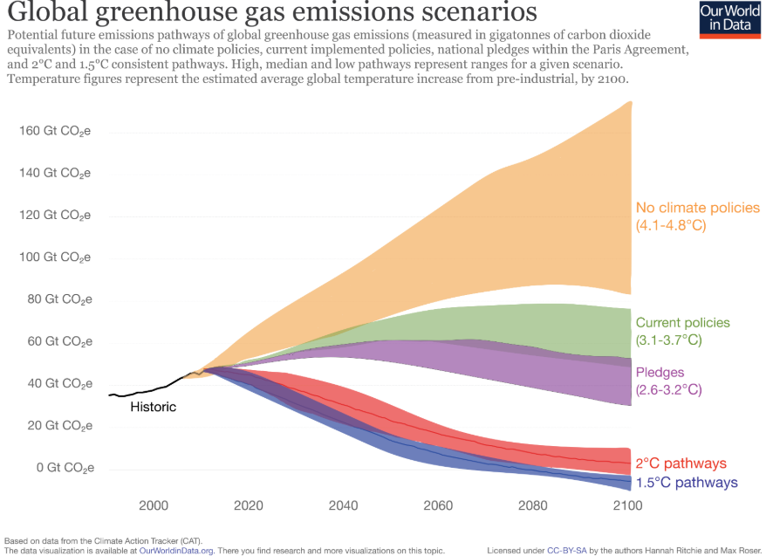
The 1.5 degree scenario
To reach the 1.5 degree temperature rise scenario, not only should we reduce our emissions, but in the future we will have to have no emissions at all and further increase the uptake from the atmosphere.
Several considerations have been taken into the model, such that there is room for developing countries to have economic growth and some time given from changing habits, policies and technologies.
lhttps://ourworldindata.org/co2-and-other-greenhouse-gas-emissions#future-emission-scenarios

Slide 2
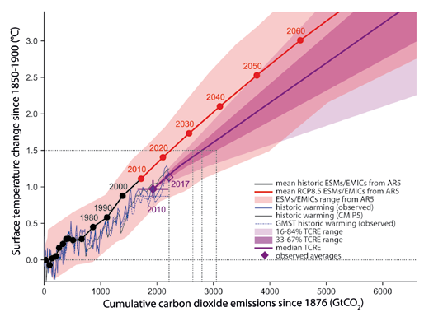
The CO2 budget
CO2 accumulates in the atmosphere. The CO2 uptake by land and ocean is estimated at 3.1Gton/year in 2000-2005[Boeker 2011]. Presently we release around 50Gton/year
The remaining CO2 emission allowed prior reaching a 1.5 degree temperature rise amounts to approx 500Gton. This is our buffer before we have to become CO2 neutral.
Given allmost 8billion people populating the world. This allows for an average emission per person of 3.1/8 ton/year = 0,4ton per person per year for stable cycle.
https://www.ipcc.ch/site/assets/uploads/sites/2/2019/02/SR15_Chapter2_Low_Res.pdf

Slide 3
The 3 ton value
The eco-living way only allows 400kg CO2 per year
But to be realistic we have to decrease our emissions stepwise, both for developing countries to experience growth, but also for developed countries to change habits.
So the steps are such: 2019-2030 3ton/per person. 2031-2040 2ton/person. 2041-2050 1 ton/person. 2051-?-1 ton per person.
Year | Tons CO2/ person year
2019-2030 | 3
2031-2040 | 2
2041-2050 | 1
2051-YEARZERO | -1
YEARZERO-Future | 0,4

