Slide 1


Embedding reaction systems into link-calculus
Linda Brodo (Sassari)
joint work with
Roberto Bruni (Pisa)
Moreno Falaschi (Siena)
SECOND INTERNATIONAL WORKSHOP ON REACTION SYSTEMS
JUNE 5-7, 2019 TORUŃ, POLAND

Slide 2
Roadmap
An open multi-party calculus (joint work with Roberto Bruni and Chiara Bodei -Univ. of Pisa-)
Encoding reactions
Encoding entities
Encoding contexts
Enhancing expressivity for reaction systems
Conclusion and future work

Slide 3
Interaction
An interaction is an action by which
(communicating) processes
can influence each other.

Slide 4
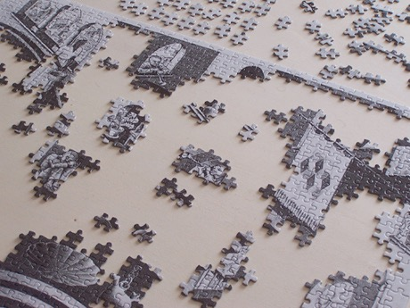
Multiparty interaction
An interaction is multiparty when
it involves two or more processes

Slide 5

Open interaction
An interaction is open when
the number of involved processes is not fixed

Slide 6
Notation
interaction over a
silent interaction
free “slot”, accepting
any interaction (only in labels)

Slide 7
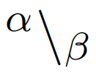
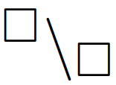

Link
From α to β
Valid:
if it is virtual
if it is solid

Slide 8
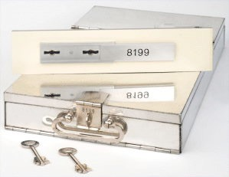
Example: three party
Swiss-bank box

Slide 9




Link chain
is the set of channel names
such that:

Slide 10
Link chain: terminology
Solid:
if all its links are so

Slide 11
Counter-examples
X
X
X

Slide 12
Examples: non solid
Virtual links
can be read as missing pieces of the puzzle

Slide 13
Examples: merge

Slide 14
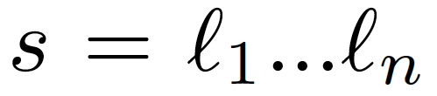
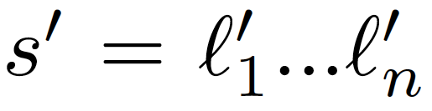

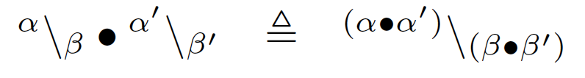
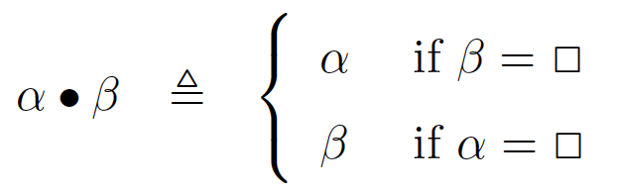
Merge
The result is undefined if the outcome is not valid

Slide 15

Examples: restriction

Slide 16
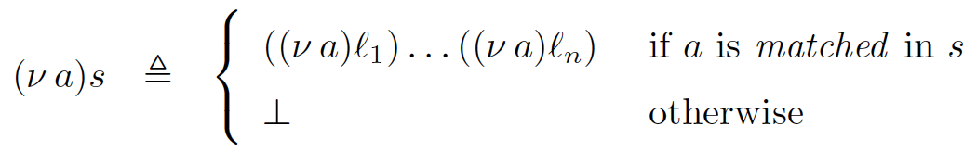
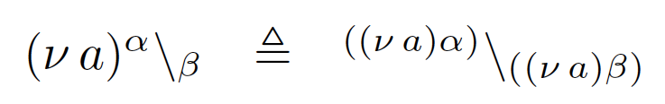
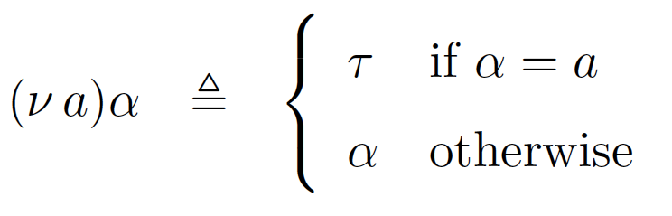
Restriction

Slide 17
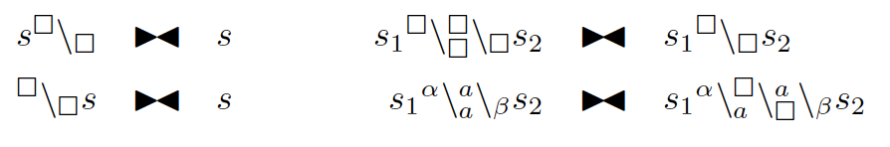
Equivalence relation over link chains
(the black tie)

Slide 18

The accordion lemma
not relevant here, it is for the bisimulation game !

Slide 19
link-calculus syntax
null action
choice
restriction
recursion
prefix
(link prefix)
parallel
relabelling
very closed to the CCS syntax
very closed to the CCS syntax

Slide 20
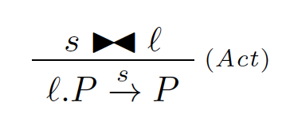
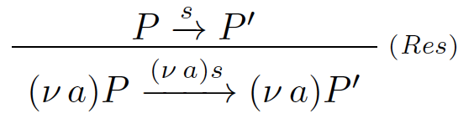
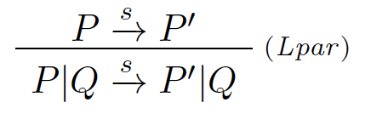
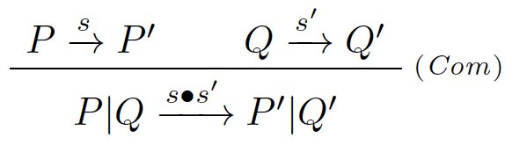
(Relevant) SOS rules
the length of the link chains
(of a transition) is decided
by the semantics

Slide 21
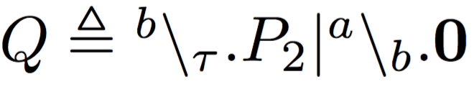
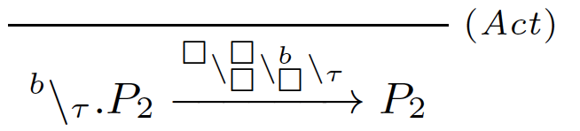
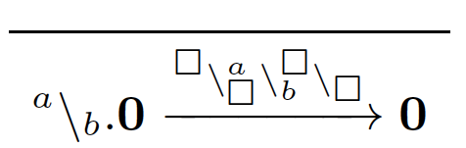


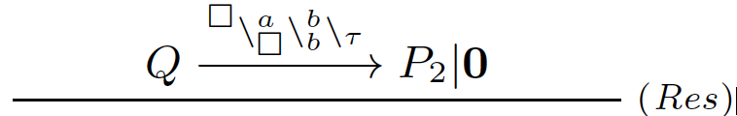
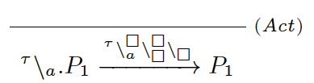


Example
,

Slide 22
Bibliography
Bodei, C., Brodo, L. , Bruni, R.
A Formal Approach to Open Multiparty Interactions
(2019) Theoretical Computer Science,
Volume 763: pp. 38-65
Brodo, L., Olarte, C.
Symbolic semantics for multiparty interactions in the
link-calculus
(2017) Lecture Notes in Computer Science,
volume 10139 LNCS, pp. 62-75
Bodei, C., Brodo, L., Bruni, R., Chiarugi, D.
A flat process calculus for nested membrane interactions
(2014) Scientific Annals of Computer Science
Volume 24, Issue 1, pp. 91-136
Bodei, C., Brodo, L., Bruni, R.
Open multiparty interaction
(2013) Lecture Notes in Computer Science,
volume 7841 LNCS, pp. 1-23
Bodei, C., Brodo, L. , Bruni, R.
The link-calculus for Open Multiparty Interactions
submitted to Information and Computation
Brodo, L., Olarte, C.
Verification techniques for a network algebra
submitted to Fundamenta Informaticae
The link-calculus homepage:
http://linkcalculus.di.unipi.it

Slide 23
Fact
The process algebra of linked interactions
is a straightforward extension of CCS
It includes CCS as a sub-calculus

Slide 24
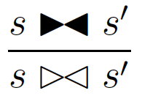

Equivalence relation over link chains
(the white tie)

Slide 25
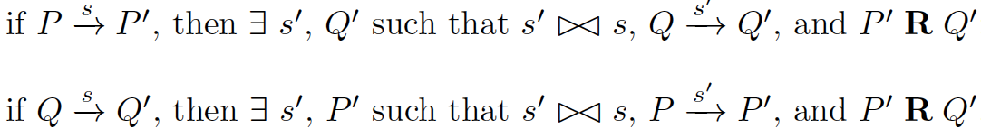
Network bisimulation

Slide 26

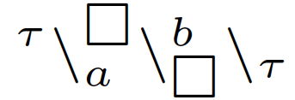

Fact
network bisimulation is a congruence
also with respect to
substitution

Slide 27
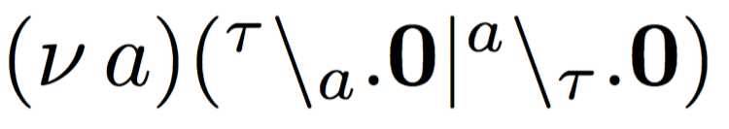
Caveat
there are two kinds of tau:

Slide 28

Separation of concerns
...
This way we separate
the interaction mechanism
from
the name passing mechanism
(We formalize them separately and
then fit them together)

Slide 29




Tuple
variables are instantiated by values
values are used for matching arguments
Assigns n to y
Matches m with m
Assigns k to x
=

Slide 30
(syntactic)Tuple
syntactic tuples, the ones used in the prefixes

Slide 31

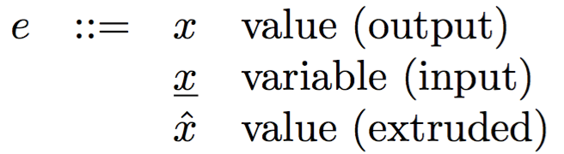
(semantic)Tuple
semantic tuples, the ones used in the labels
Assigns n to y
Matches m with m
Assigns k to x
Assigns n to y
Matches m with m
Assigns extruded k
to x
=
=

Slide 32

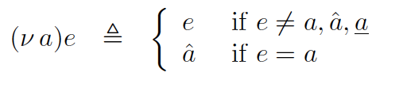
Extrusion
an argument in a tuple can be extruded if it is
not already annotated
extruded arguments have an hat

Slide 33


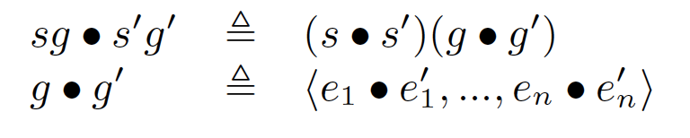
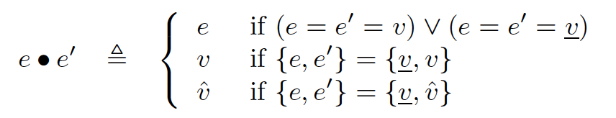
Merge

Slide 34
Some notation
not ground link chain (i.e. contains virtuals);
substitution acting on variables, only;
a ground tuple, not variables are present.

Slide 35
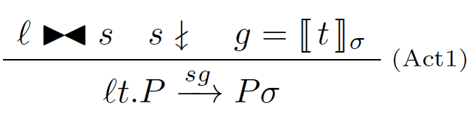
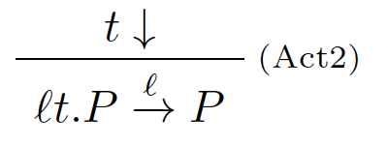
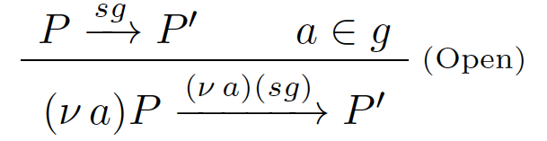
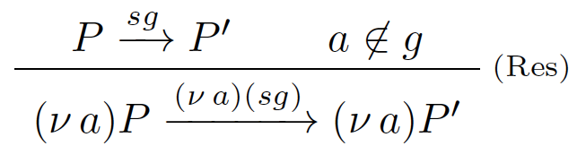
(Relevant) SOS rules 1/2
(analogous to (early) pi rules)

Slide 36
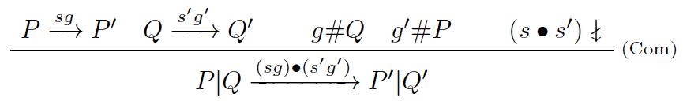
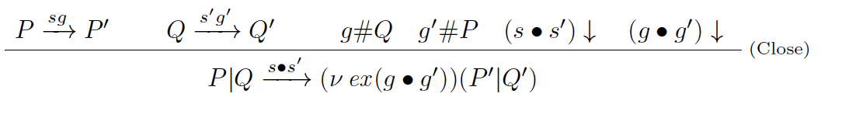
(Relevant) SOS rules 2/2
(analogous to (early) pi rules)

Slide 37
Fact
The process calculus of linked interactions with name
mobility is a straightforward extension of pi-calculus
It includes pi-calculus as a sub-calculus
Finer (bisimilarity over the) LTS pi-calculus
(but it is a congruence)

Slide 38
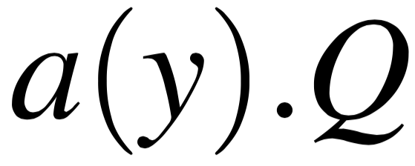
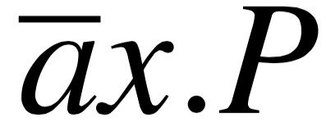

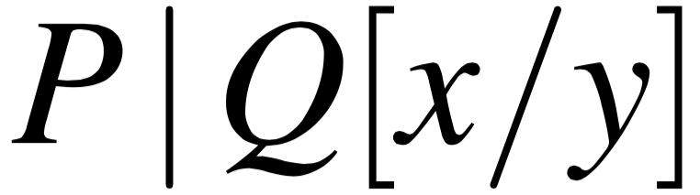
Milner’s pi interaction

Slide 39
Milner’s pi interaction in the link-calculus

Slide 40
Roadmap
An open multi-party calculus
Encoding reaction systems
Encoding entities
Encoding contexts
Enhancing expressivity for reaction systems
Conclusion and future work

Slide 41

Reaction Systems
A reaction system is a set of rules of the type:
Reactants
Inhibitors
Products

Slide 42
Reaction Systems
external
context:
empty
external
context:
empty
external
context:
empty
cya,
cAMP,
CAP
products
after one
step:
cAMP,
cAMP-CAP
products
after two
step:
cAMP-CAP
...
first step
second step
always are applied
(when possible)
all together

Slide 43
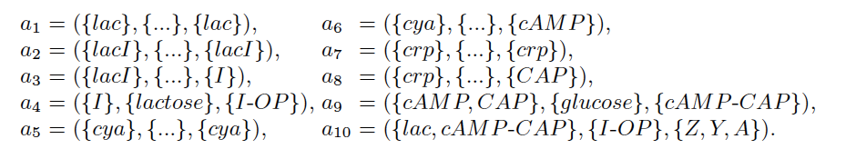
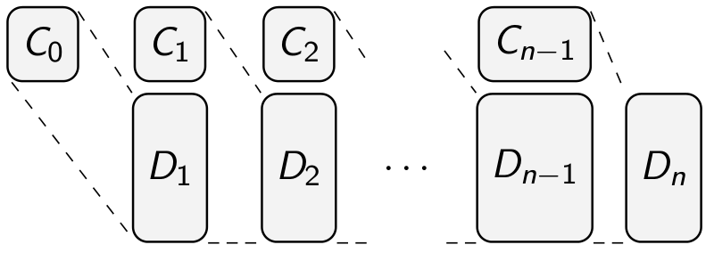
Reaction Systems
C_{i} are the entities provided by the biological external context:

Slide 44

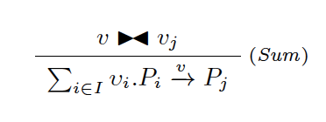
The chained link-calculus
Is a version of the link-calculus where prefixes are
link chains.
syntax
link chain prefix
relevant semantic rule

Slide 45
Encoding reaction systems: usage of the names
entities assume different behaviours:
reaction link-
systems calculus
a present a
a absent a
a products ã
acting as reagent or inhibitor

Slide 46

Encoding reactions
(when applicable)
assuming a rs with only 2 reactions, and 5 entities:
reaction 1
reaction 2
encoding the two reactions as link-calculus processes
reaction 1
reaction 2

Slide 47
Encoding reactions
when the reaction is not applicable, we still execute the process encoding the reaction
reaction 2

Slide 48
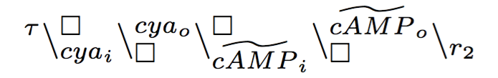
Encoding reactions
the link chain prefixes of the two reactions can be linked

Slide 49
Encoding reactions
the link chain prefixes of the two reactions can be linked

Slide 50
Encoding reactions
the link chain prefixes of the two reactions can be linked
(forming a sort of communication backbone):
what is still missing is the contribution of the single entities (molecules)

Slide 51
Encoding reactions
the link chain prefixes of the two reactions can be linked
(forming a sort of communication backbone):
what is still missing is the contribution of the single entities (molecules)

Slide 52
Roadmap
An open multi-party calculus
Encoding reaction systems
Encoding entities
Encoding contexts
Enhancing expressivity for reaction systems
Conclusion and future work

Slide 53
Enconding entities
When the entity is present or produced

Slide 54
Enconding entities
When the entity is absent or produced

Slide 55
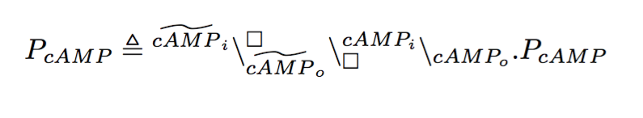
The enconding: reactions + entities
encoding the entities

Slide 56
Roadmap
An open multi-party calculus
Encoding reaction systems
Encoding entities
Encoding contexts
Enhancing expressivity for reaction systems
Conclusion and future work

Slide 57
Enconding reaction systems: (more) usage of the names
entities assume different roles:
reaction link-
systems calculus
...
a provided by the context â
a not provided by the context a
(absence)

Slide 58
Adding contexts
how a context behaves

Slide 59
Make contexts synchronise with entities

Slide 60
Make contexts synchronise with reactions

Slide 61
Roadmap
An open multi-party calculus
Encoding reaction systems
Encoding entities
Encoding contexts
Enhancing expressivity for reaction systems
Conclusion and future work

Slide 62
What we gain:
recursive contexts
modeling mutating entities
communicating reaction systems: for example, the lac operon system (that depends on the presence or absence of the glucose) can be connected with the system producing the glucose.
modeling style: backbone + resources: the processes encoding the reactions and the context form the backbone; processes encoding entities provide the resources.

Slide 63
Future work
We would like to:
model two communicating reaction systems;
model a reaction system with mutating entities;
exploit the nature of process algebra to define properties
of reaction systems;
...

Slide 64

THANKS FOR YOUR ATTENTION! questions ?… any suggestion ?

Slide 65
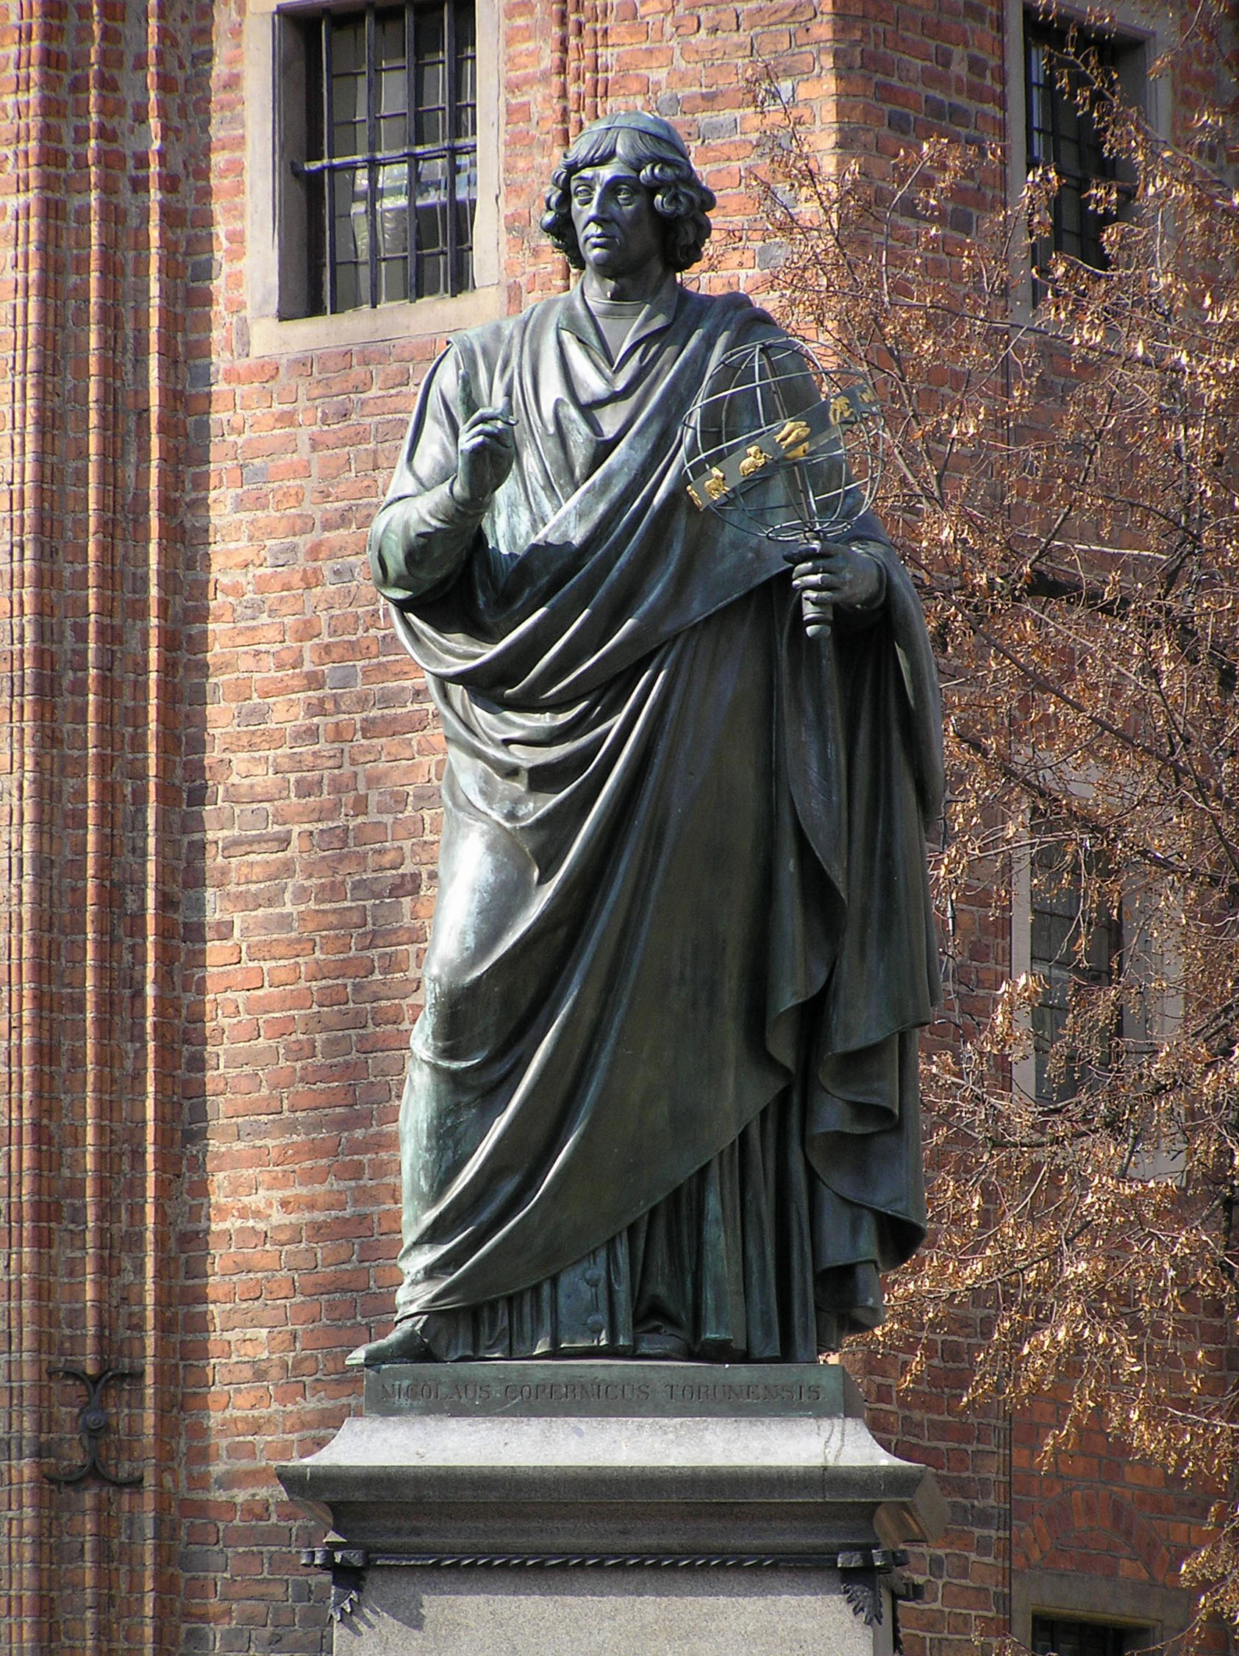
THANKS
FOR YOUR
ATTENTION! questions ?
… any suggestion ?

