Slide 1
Customer Churn Analysis - Telecom Industry
Report

Slide 2
KPI Summary
• Total Customers: 7,032
• Churned Customers: 1,869
• Churn Rate: 26.58%
• Avg Monthly Spend: $64.80

Slide 3
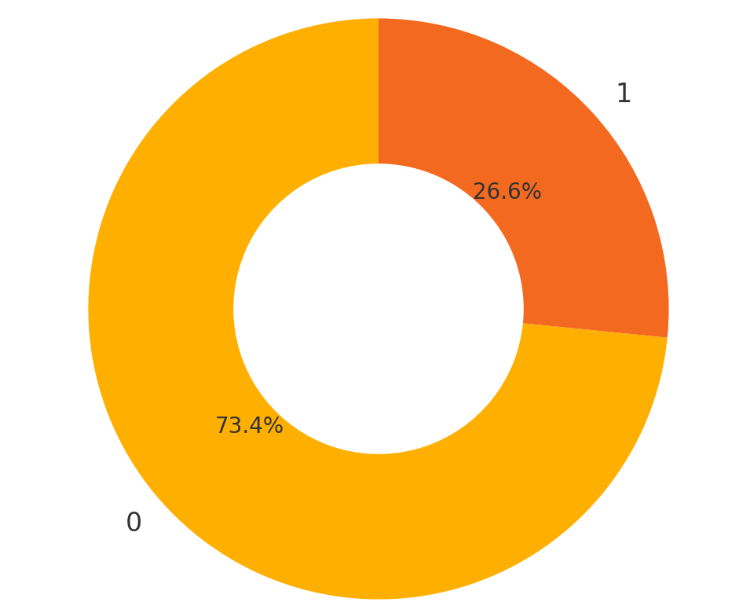
Churn vs Non-Churn

Slide 4
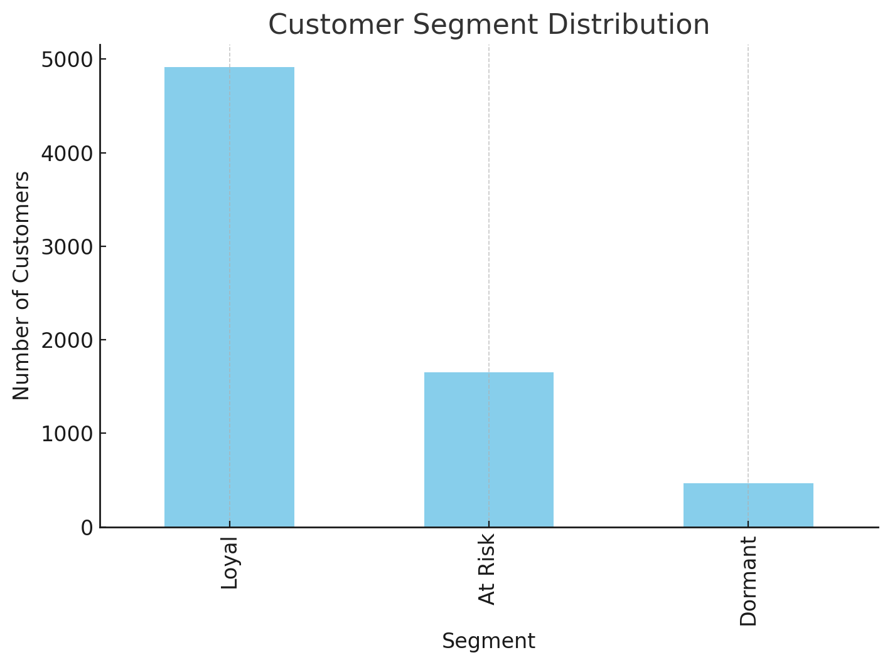
Segment Distribution

Slide 5
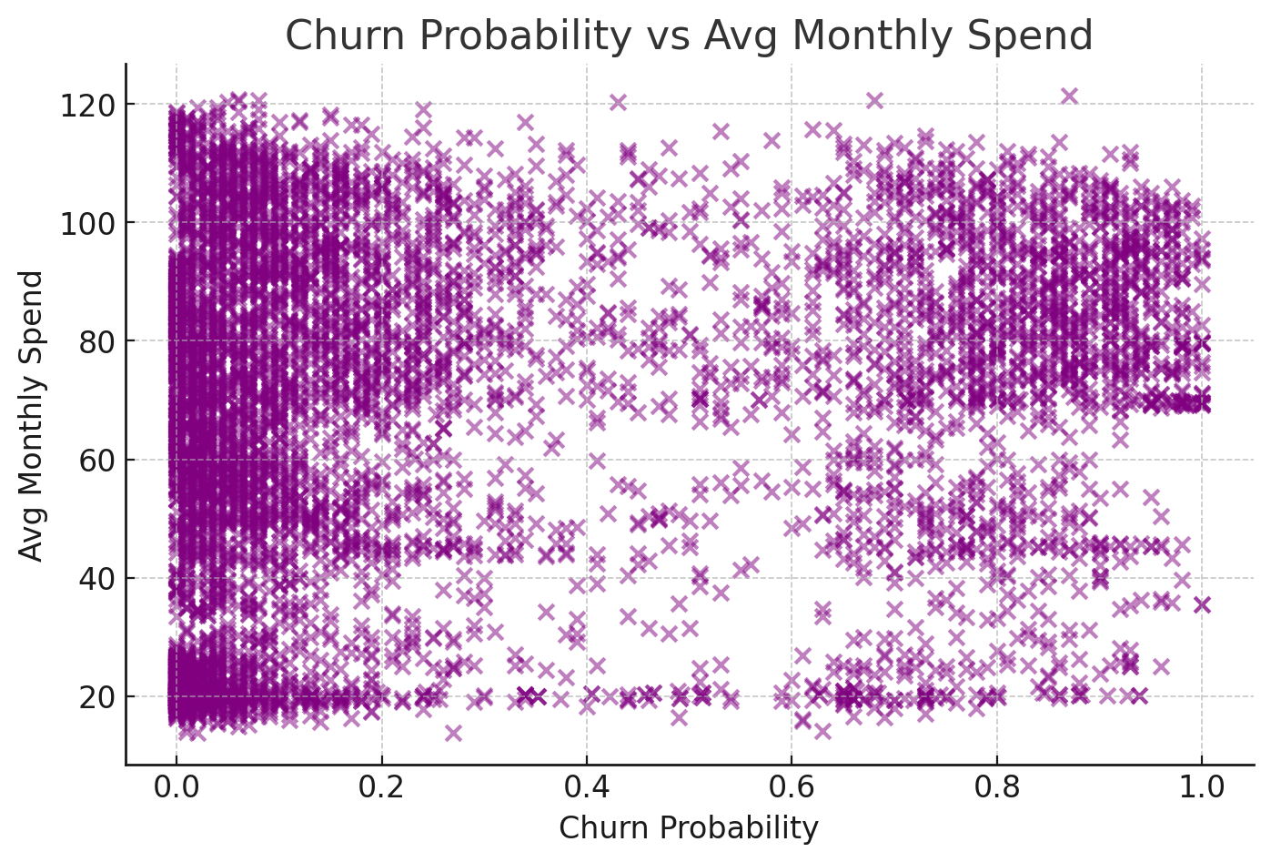
Churn Probability vs Avg Monthly Spend

Slide 6
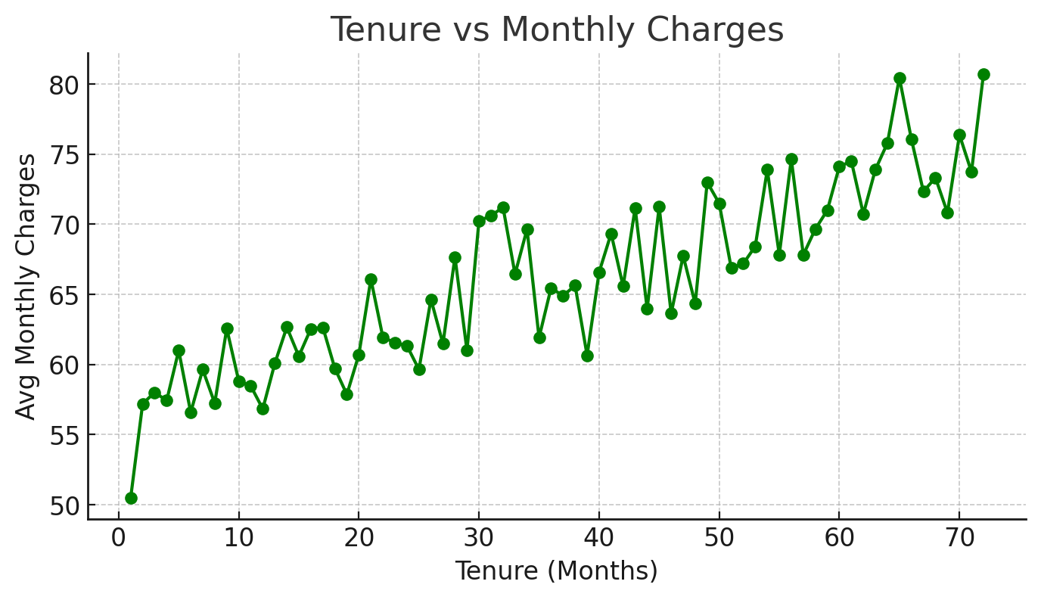
Tenure vs Monthly Charges

