Slide 1



Decision making in ABM
Agents with Agency
Jonathan Gray
Department of Social Statistics and Demography
University of Southampton, UK
Course IDEM 112: Agent-based modeling and simulation (ABM-ABS)
Rostock, 27 October 2014

Slide 2
Outline
Games, decisions, and simulation
Descriptive and normative theories
  Bayesian Risk
  Fast and Frugal Heuristics
  Cumulative Prospect Theory
Practicalities

Slide 3
Games, Decisions, and Simulation
Part 1

Slide 4
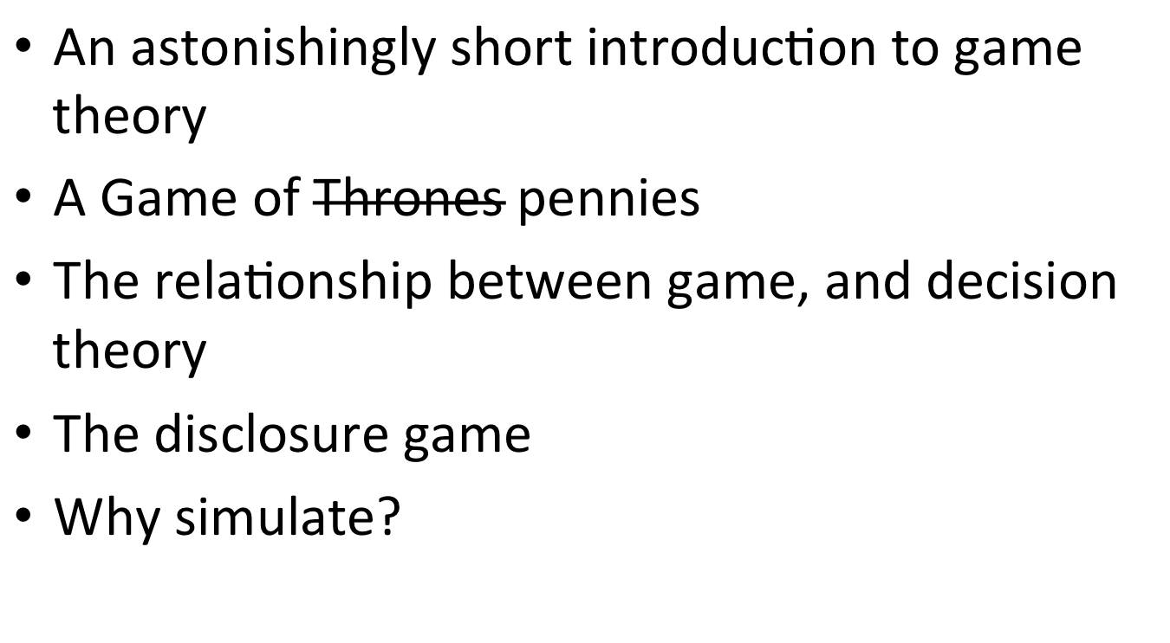
Outline

Slide 5
Game Theory
The study of strategic interactions.
Or, of social situations (psychology perspective)
The basic ingredients of a game are players, rules, and a way of keeping score.
This very abstract definition covers things like poker, ice hockey, the game of thrones, rock-paper-scissors and so on.
But could also include less obviously game like things: job interviews, a group of people deciding which movie to see, or how to split the bill for dinner.

Slide 6
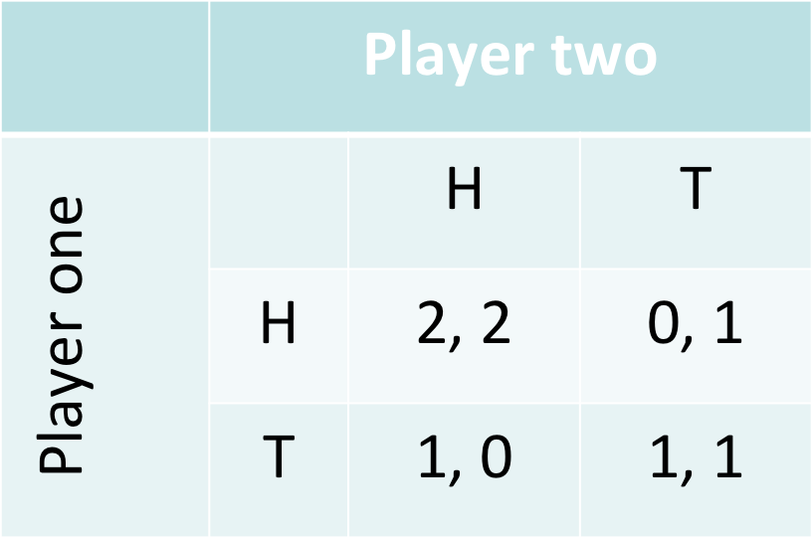
A game of… Pennies*
*Technically, this game is the Stag Hunt.

Slide 7
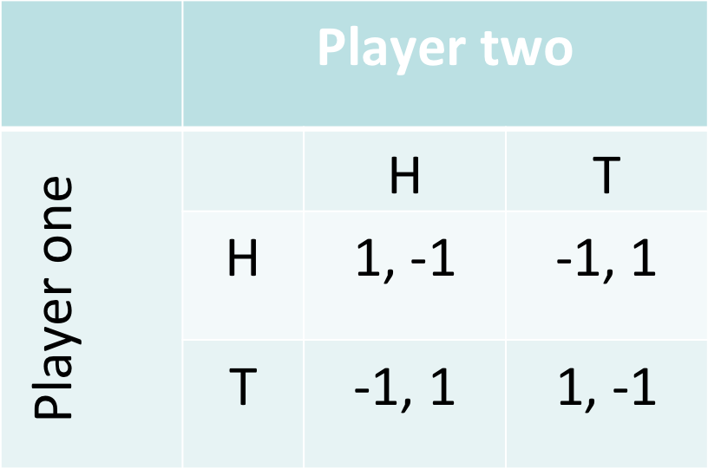
Slightly harder*
*And actually the matching pennies game.

Slide 8
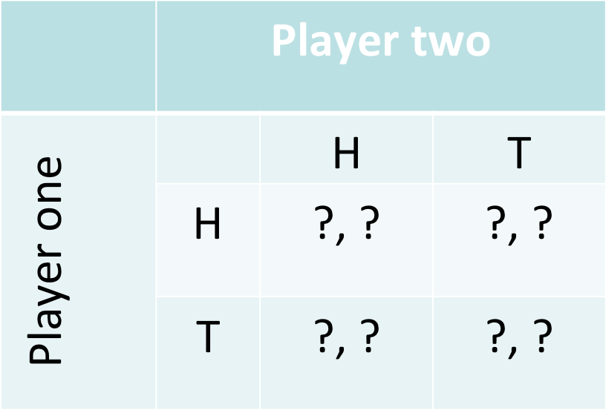
Incomplete information

Slide 9
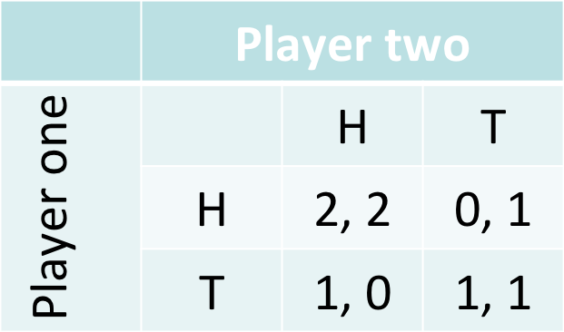
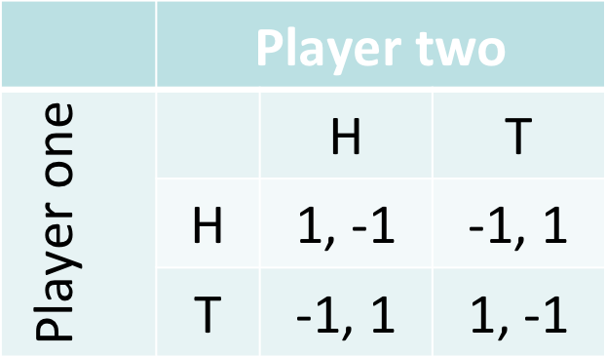
A third player
‘Nature’ chooses
p=0.5
p=0.5

Slide 10
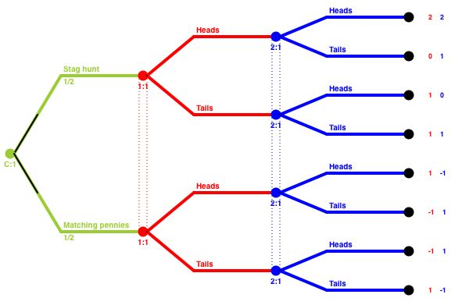
Extensive form

Slide 11
The disclosure game
Players: Women, and midwives.
Scenario
Over several appointments, women decide what to tell the midwife about how much they drink (nothing, a bit, or a lot). The midwife decides if they should be referred to a specialist, and depending on how judgemental they are, might tell them off for drinking.
Women want to avoid getting told off for how much they drink, midwives don’t want to refer unnecessarily.
Both want a healthy pregnancy.

Slide 12
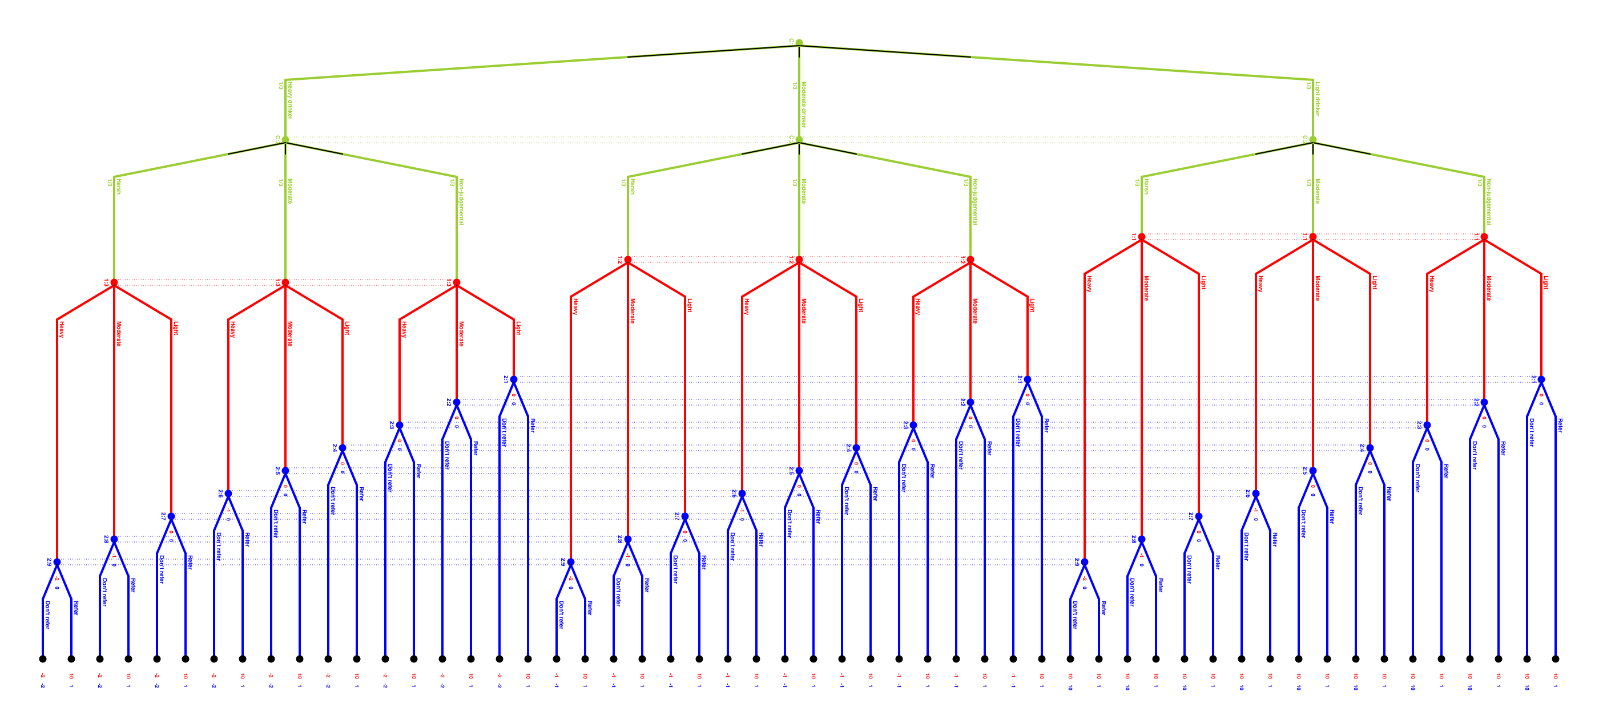
Extensive form disclosure game*
*This is the simplified version.

Slide 13
Normal form?

Slide 14
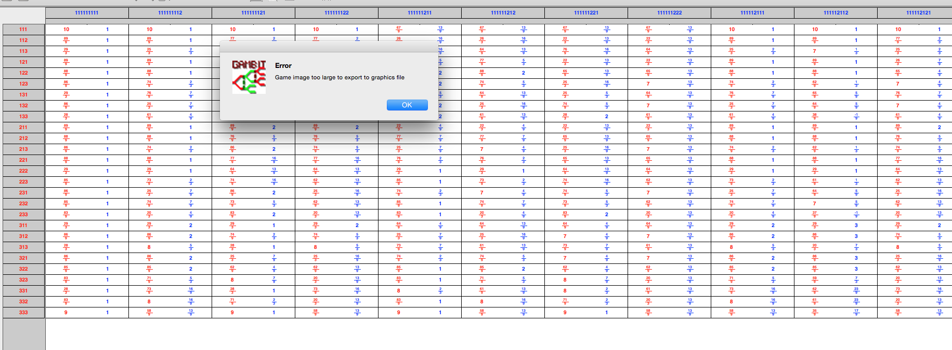

Slide 15
Why simulate?
Pretty simple scenario – but quite a complicated game
Fair to say it is non-obvious what the outcomes will be
Usual Game Theoretic approach of looking for equilibrium not very helpful (there are dozens)
More interested in seeing how play changes as players learn
So, it makes sense to get some (simulated) people, to actually play it

Slide 16
Decision theory and games
Strong relationship between games and decisions
One player games are equivalent to decision problems*
Games against nature are equivalent to decision problems
When a player chooses their move, they are clearly making a decision
Can treat any game as ‘against nature’…
And one game of n players becomes n decision problems.
Other player is a black box, an unknown probability distribution.
Changes the focus from strategy, and information acquisition to how decisions are made.
*But worth noting that decision problems needn’t be individual only!

Slide 17
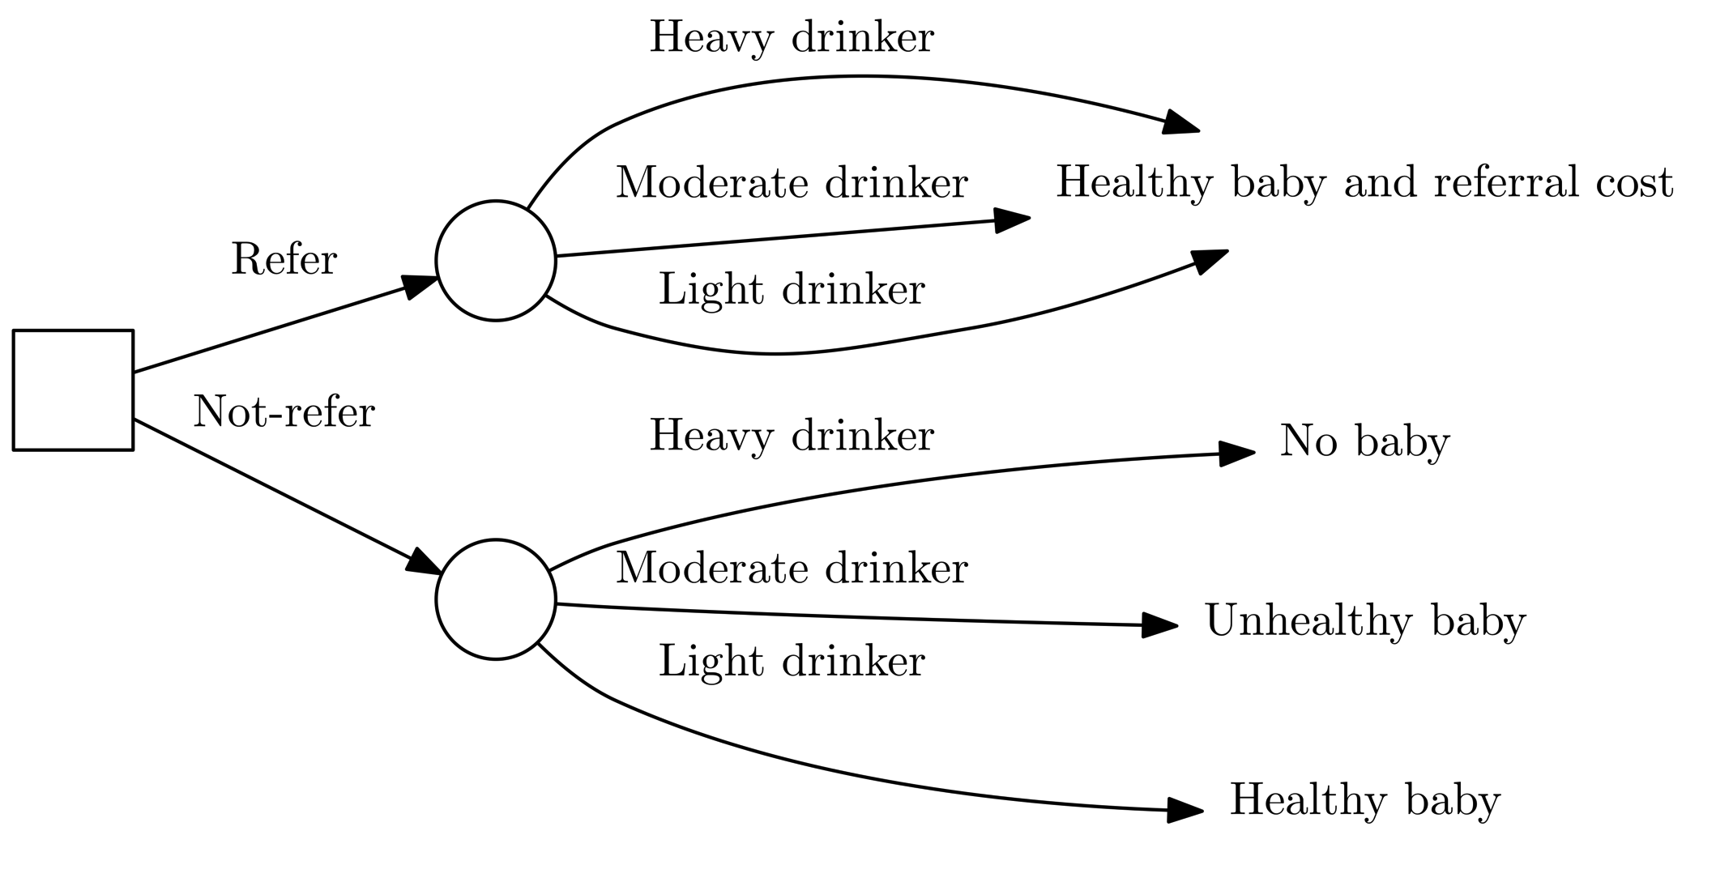
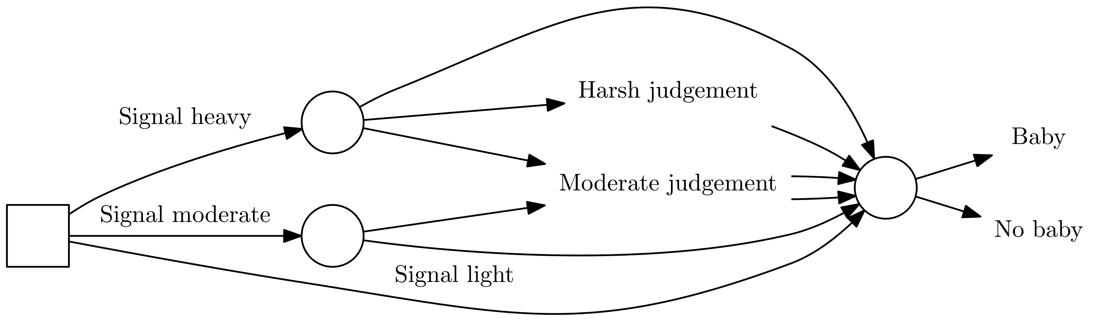
Disclosure decision problems
Midwives
Women

Slide 18
Descriptive and normative Theories
Part 2

Slide 19
Outline
Descriptive and normative: the debate
Rational decision making
  Bayesian Risk
Ecologically rational decision making
  Fast and Frugal Heuristics
City size game
Dealing with frustratingly irrational humans
  Cumulative Prospect Theory

Slide 20
Descriptive and Normative
Descriptive
Normative
How do decide
Prediction
Explanation
How to decide
Decision support
Analytically tractable

Slide 21
A note on utility
Utility is a surprisingly woolly concept
Not as simple as monetary value == utility
Actually a function unique to the individual
Usual assumptions
  Complete
  Transitive
  Convex
  Independent
In practice, 2 & 4 are usually ignored.

Slide 22
Rational decision making
More mature area
Underpinning of economic theory – rational agent model
Consider all possible outcomes, and probabilities
Use the expected utility to make choices
Usual assumptions:
  Perfectly rational
  Perfectly informed
  Perfect communicators
  Unlimited computational power

Slide 23
Bayesian risk example
Knowing the loss incurred by all outcome, and having used Bayesian inference* to produce likelihoods for them, choose the least risky option.
(Loss determined by a loss function, L)
Risk = sum of each L(outcome) * probability of it, for all outcomes
*For substantially more on Bayesian methods, check out Jason’s talk on Thursday.

Slide 24
Lever Pulling
Using a very simple loss function, where L(outcome) = -outcome.
Red Lever
80% chance of €7
20% chance of nothing
R=0.8*-7+0.2*-0=-5.6
Blue Lever
11% chance of €100
89% chance of losing €5
R=0.11*-100+0.89*5=-6.55
Purple Lever
Certain €6
R=1*-6=-6
Conclusion: pull the blue lever

Slide 25
Ecological rationality
Fast and frugal heuristics
Rationality can only be determined in context
Specific heuristics for different kinds of problems
Limited cognitive powers
Satisfice* (choose first acceptable option), not optimise
*Coined by Herbert Simon, who suggests they are usually equivalent anyway.

Slide 26

The cereal aisle: a satisficing example
Why don’t people have nervous breakdowns at the supermarket?
291 cereals, all subtly different
Optimise by evaluating all 291…
Or satisfice by choosing the first ‘good enough’ cereal you see

Slide 27
The city size game
Time for game, borrowed from Goldstein, Daniel G., and Gerd Gigerenzer. "Models of ecological rationality: the recognition heuristic." Psychological review 109.1 (2002): 75.
Which city in each pair is the biggest?

Slide 28
Which is bigger?
City A
City B
Columbus (0.8 million)
Baton Rouge (229K)
Nashville (600K)
Garden Grove (175K)
Albuquerque (556K)
Austin (885K)
New York (8.5 million)
North Las Vegas (227K)
Mesa (500K)
Huntsville (186K)
Forth Worth (793K)
Jacksonville (843K)

Slide 29
A heuristic for lever-pulling
Lexicographic heuristic
Take the most likely outcomes from your choices. If one is obviously better, choose that. If not, look at the second most likely, and so on.
Red Lever
80% chance of €7
20% chance of nothing
Most likely: €7
Blue Lever
11% chance of €100
89% chance of losing €5
Most likely: -€5
Purple Lever
Certain €6
Most likely: €6
Conclusion: pull the red lever

Slide 30
An obvious question about that heuristic
Q: What do you do if you have tie, that looks like this:
A: As far as I know, no canonical answer, so up to you whether to discard, or keep C
Outcome | A | B | C
Most likely | 2 | 2 | -2
2nd most | 5 | 1 | 1000

Slide 31
Systematic deviations from rationality
Purely rational theories are faulty*
People deviate systematically from rational behaviour, e.g.
  Too generous in the ultimatum game
  Loss aversion
  Probability distortion
  Risk aversion/risk seeking
Solution: patch the theory to correspond to real behaviour
*Or, for the economists in the room: humans are faulty.

Slide 32
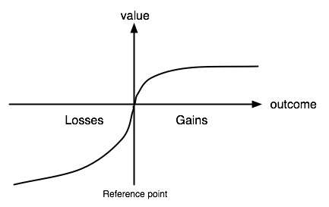
Cumulative Prospect Theory
Based on earlier Prospect Theory, corrects some mathematical issues, allows non-binary choices
Distorts the value of an outcome, based on probability, magnitude, and whether it is a gain or a loss

Slide 33
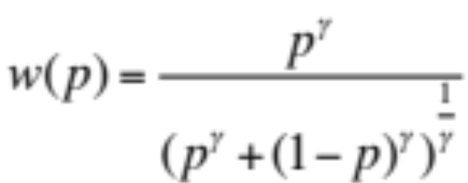
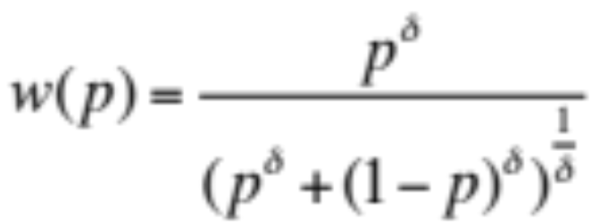
Weighting probabilities
Gains
Losses
Generally set γ < δ.

Slide 34
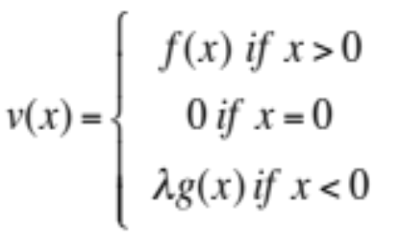
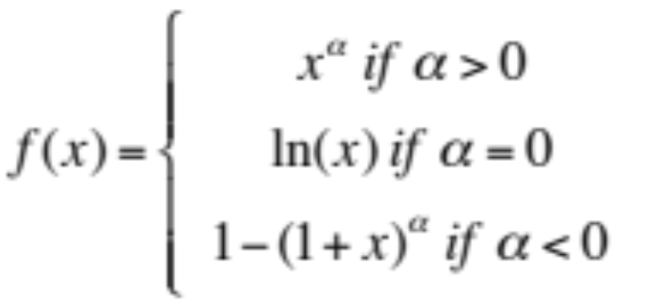
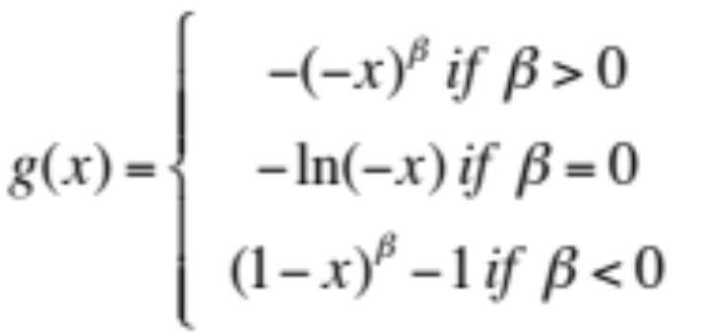
Distorting value
Value distorted such that losses are more painful than gains are enjoyable.

Slide 35
Cumulative prospect levers
Knowing all the outcomes etc. etc.
Outcome and a probability together are a prospect
Calculate CPT value of each prospect*
Choose the alternative with the highest sum of CPT values
Red Lever
80% chance of €7
20% chance of nothing
CPT value=3.4
Blue Lever
11% chance of €100
89% chance of losing €5
CPT value=4.2
Purple Lever
Certain €6
CPT value=4.8
Conclusion: pull the purple lever
*See handout for the working out.

Slide 36
Decisions and the brain
If any of these models are ‘true’, should be able to find an implementation in the brain – neuroeconomics.
Look for neural correlates, neuronal firing rates linked to magnitude and probability of a reward.
Platt, Michael L., and Paul W. Glimcher. "Neural correlates of decision variables in parietal cortex." Nature 400.6741 (1999): 233-238.
Padoa-Schioppa, Camillo, and John A. Assad. "Neurons in the orbitofrontal cortex encode economic value." Nature 441.7090 (2006): 223-226.
Christopoulos, George I., et al. "Neural correlates of value, risk, and risk aversion contributing to decision making under risk." The Journal of Neuroscience 29.40 (2009): 12574-12583.

Slide 37
Learning to decide: bad news
No one true theory of learning ☹

Slide 38
Learning to decide: good news
Lots of options, among them:
Frequency counting
  Fast, cheap, simple to implement
Statistical methods (Bayesian inference – see Jason’s talk for more on this!)
  Handling of bias, better cognitive plausibility?
Error correction models (Rescorla-Wagner, Temporal Difference)
  Better neurological plausibility

Slide 39
Alternative approaches
Lots.
Simpler heuristics: Minimax, maximax, maximin
Classic economics: Expected Utility Maximisation, random utility models.
Explicit handling of time: EU with discounting, Lowenstein-Prelec.
Neural network based: ACT-R
Reinforcement learning style: Q-Learning, TD models
Ad hoc heuristics, neural nets, threshold models

Slide 40
Practicalities
Part 4

Slide 41
Outline
Levers in the disclosure game
Which is best?
Does it actually matter – example from the disclosure game
Gotchas

Slide 42
Levers in the disclosure game
Midwives
Women

Slide 43
Which is best?
It depends

Slide 44
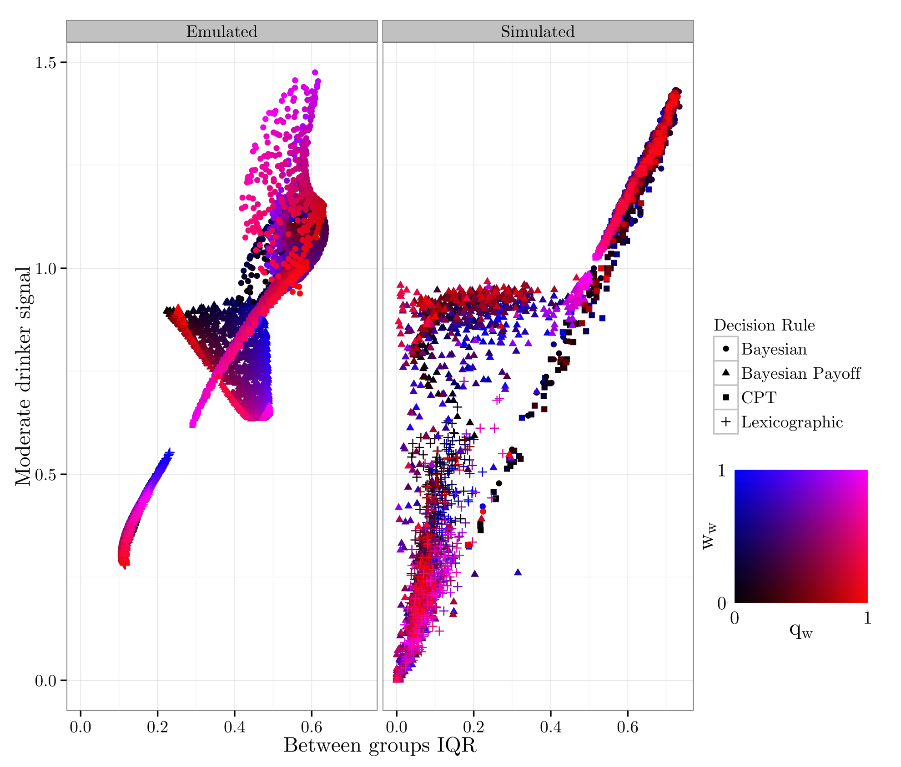
It totally matters
Outcome space of disclosure game simulation.
Shows separation by both decision problem representation, and decision rule.

Slide 45
Gotchas
No one true theory
Tendency to assume that all decisions are
  Binary
  One shot
  From description
  In the moment
Lack of comparability – how would you solve the cities problem with prospect theory?
Choice of model impacts problem representation
Not necessarily necessary!
How do you parameterise?

Slide 46
To be continued…
After a brief coffee break:
Discussion on modelling decision makers in demography (with Frans, Anna, and me)
After a brief lunch break (14⁰⁰):
Computer lab on RNetLogo (with Sebastian, and Francisco)

Slide 47

Thank you!
Jonathan Gray
j.gray@soton.ac.uk
@lime_ape
https://github.com/greenape
Financial support by the Max Planck Institute for Demographic Research
and the EPSRC grant EP/H021698/1 Care Life Cycle is gratefully acknowledged.

