Slide 1



The Risky Business of Asking for help
An ABM of Unmet Need in Older Adults
Jonathan Gray
Department of Social Statistics and Demography
University of Southampton, UK
BSPS 2015
Leeds, 7th of September, 2015

Slide 2
Outline
Motivation
Model
Data
Results

Slide 3
Motivation
~25% of over 65s need help washing or dressing
~47.5% of that 25% actually get help (Vlachantoni et al, 2011)
Notes:
Emphasise the 47.5.
2008 number, but pretty constant based on the ELSA.
Worth noting that based on Eurobarometer, and the ONS OPN, people are overly optimistic about this (75.5%, 2008 EB; ~60% OPN)
Leads us to our overarching question…

Slide 4
Motivation
~25% of over 65s need help washing or dressing
~47.5% of that 25% actually get help (Vlachantoni et al, 2011)
What’s up with that?
Notes:
What *is* up with that? Why don’t 100% of those 25% get help.
What kind of process might lead to that outcome? What kind of decisions are going on, and how are they made?
Because we’re asking questions about process, and decision, the obvious thing to do is take an agent model approach to this, and build a simulation to explore it.

Slide 5
Conjecture
  Not everybody asks for help, because asking feels risky.
Notes:
Simulations are really runnable conjectures about a data generating process – here’s a way the world might work to produce this data that we’ve observed.
Here’s my guess, about what might explain only half of over 65s who need help, getting it.
Asking for help is risky, or at least feels risky to them. And following from that..

Slide 6
Conjecture
  Not everybody asks for help, because asking feels risky.
  People’s decisions are based on risk.

Slide 7
Testing the Conjecture
Need a few things to test that:
  A formal representation of our conjectured process
  A synthetic population to test it in
  Synthetic psychologies for that population
Notes:
We can test the conjecture by building a simulation to embody it, and running that. If you can’t reproduce the data, you can falsify the model; and our conjecture about the data generating process is flawed. (SCIENCE!)
To test it, we need to represent it formally, which I’ll talk about next.
But we also need two other things – we need a synthetic population, and because this conjecture is all about decision making, and perceptions of risk, we also need synthetic psychologies for that population.
Population is very simple, just 25% chance of each member needing support. Not the focus here.

Slide 8
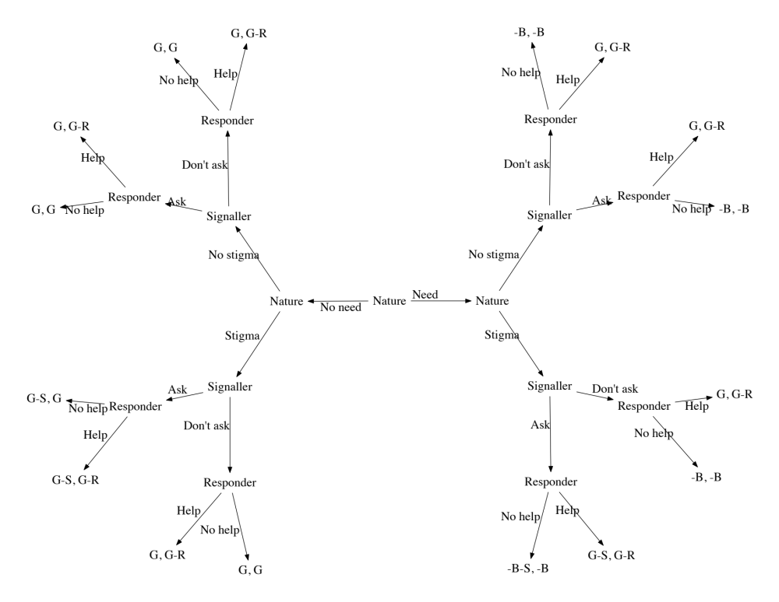
A Process
Notes:
He’s our formal process,
We’ve borrowed from game theory, which is all about creating formal representations of interactions. We define our interaction in terms of moves, costs, and payoffs.
This is a game for two players, one of them is the person who might need help, and the other is somebody deciding whether they get it.
The person who might need help can ask for it, or do nothing. The decider can give help, or do nothing.
There are four kinds of payoff. Two of them are shared by both players, and two are not. Payoffs for good and bad outcomes are shared. Signallers have a possible penalty, which we’ve called ‘stigma’; and deciders have a penalty for giving help.

Slide 9
Synthetic Psychology
Using learning decision rule agents – actions are based on costs/payoffs & beliefs
Two kinds of learning
  Experiential
  Social
Two kinds of belief
  What kind of player is the other guy?
  What will the other player do next?
Use opinion surveys to generate distributions of these beliefs
Notes:
If you have a game, you might as well play it, right?
Our players will be populations of agents, and because we’re interested in decision making we’ll have them use simple decision rules.
Decision rules act on payoffs, and beliefs. In our model there are really only two things you can have beliefs about – what kind of player is the other guy, which is equivalent to where am I in the tree; and what happens next?
So a rule, and a set of beliefs together is what we’ll call the psychology of our agent.
We’ve used opinion surveys, ESS and Eurobarometer, to generate synthetic psychologies for the populations.

Slide 10
Signaller Psychology
Is the decider going to make me feel bad if I ask for help?
  ESS 2008
  Latent trait analysis on 8 likert type items
  Fitted a logistic distribution to the underlying trait
Will I get help?
  EuroBarometer 67.3 asks exactly that
  Multinomial distribution over definitely, yes, etc.
Notes:
Signallers worry about what kind of person the other player is, and to get a belief type representation of that we’ve used latent trait analysis on questions about perception of the elderly in the 2008 European social survey and fitted a distribution to the results of that.
In fact, at least in these simulations they don’t actually need to worry about this at all – all of the deciders are nice!
We’ve also used a Eurobarometer from 2007 to get an idea of beliefs about whether they will actually get help.

Slide 11
Decider Psychology
Should I believe what this guy is saying?
  ESS 2008 again
  Latent trait on 3 likert types
  Fitted a normal distribution
Notes:
The deciders are a bit less complicated, they’re worried about whether to believe what the other guy says. If they say they don’t need help, should you believe that?
To capture this, we’ve again used latent trait analysis on questions from ESS 2008. This time questions on social trust.

Slide 12
Model
Draw populations
Have them play the game
Beliefs based on social surveys
Cost for giving help as the average LA cost of providing care for 1 year, in 2008
Quite a few free parameters..
  Payoffs, magnitude of beliefs, decision models
Build a statistical emulator of the simulation
  Look at sensitivity
  Use to fit the model

Slide 13
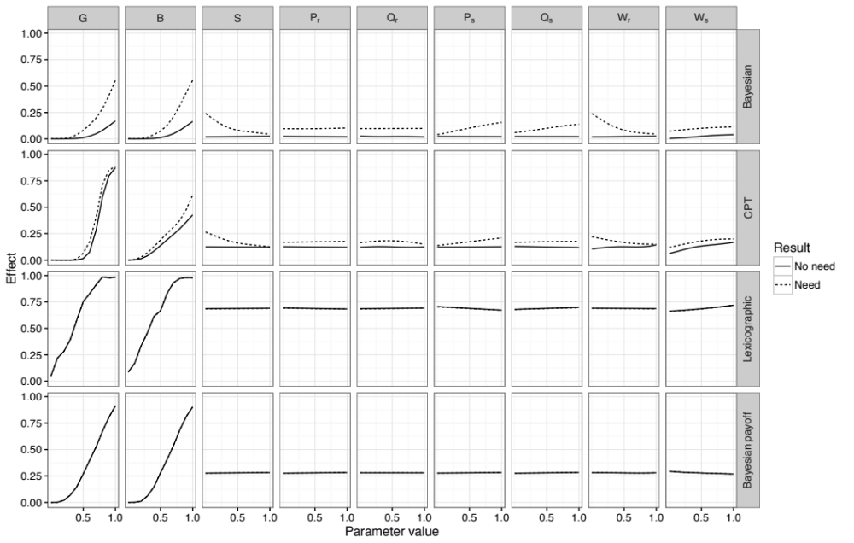
Sensitivity
Notes:
Can look at sensitivity. Most obvious point first – the most significant parameters are the good and bad payoffs.
Also, easy to see that there are two models that don’t work at all – the simple, heuristic models.
Don’t show any capability to distinguish between those who need, and don’t need help. We can discard them.
More complex models are interesting – normative model suggests that the effect of payoffs differentiates, but the descriptive model suggests they don’t.
Can look in more detail at the two.

Slide 14
Fitting
Can’t fit the heuristics!
  Need more than cardinality.
  Need a mental model.
Notes:
Important to emphasize, there’s actually a lot of possible fits for these parameters.

Slide 15
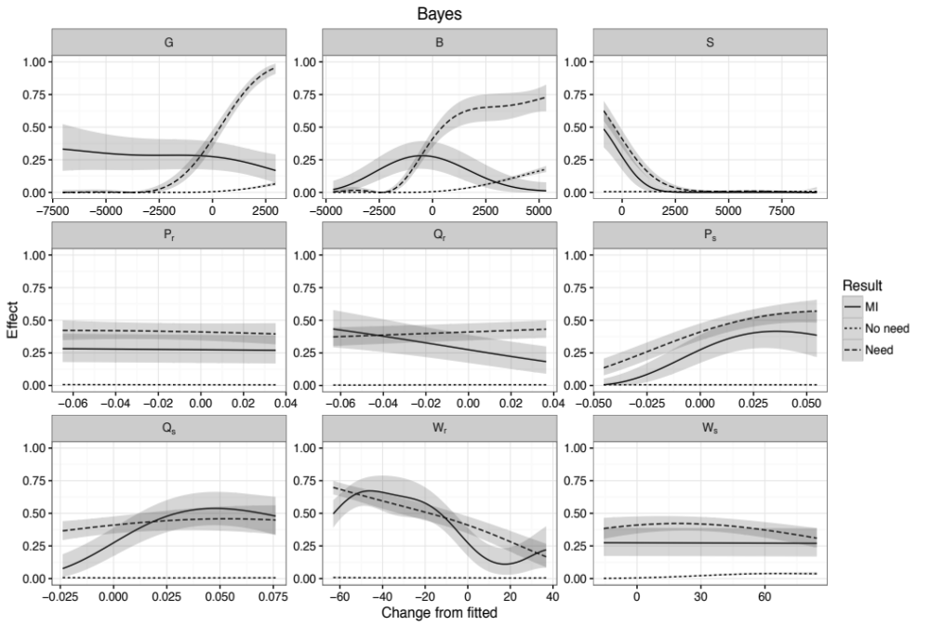
Interventions
Notes:
Having fitted some parameters, we can also look at what happens if we change them.
Going to add a new measure here – Mutual information. Gives an indication of how good the quality of communication is. Higher is better!

Slide 16
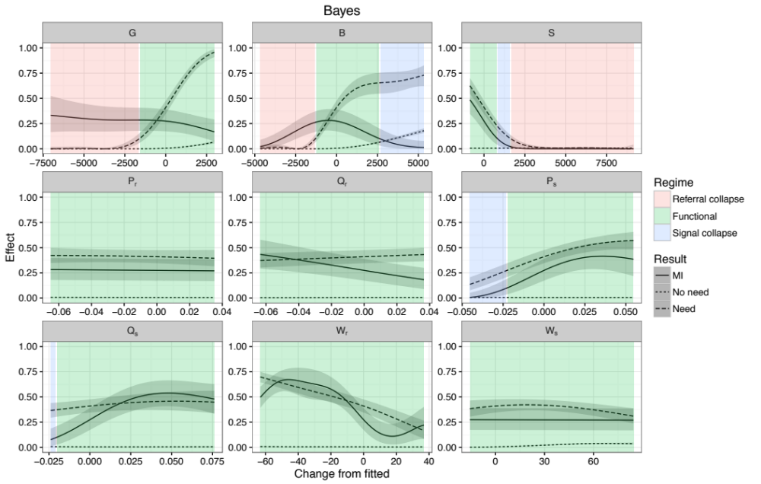
Interventions

Slide 17
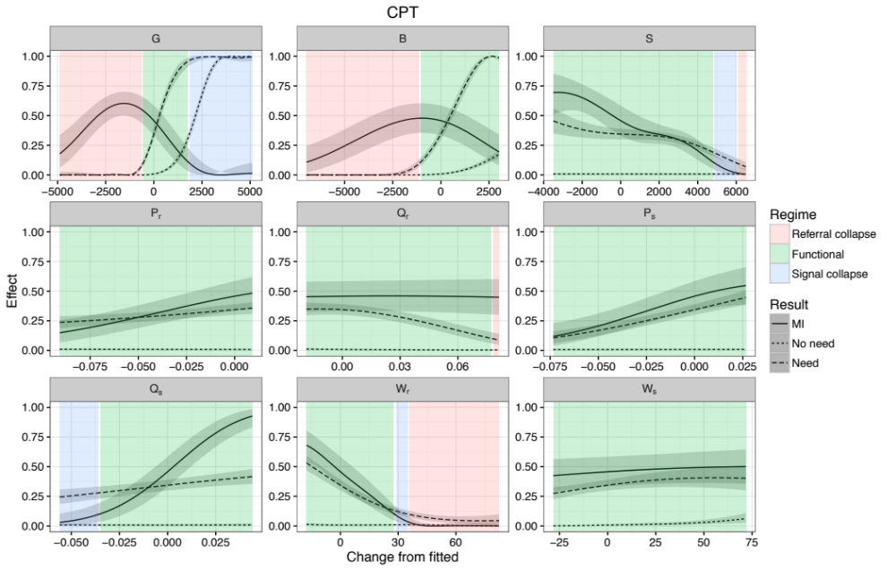
Interventions

Slide 18
Take Away
Not the complete data generating process, but can’t reject outright
Simple heuristics are insufficient
Biggest impact on referrals is from payoffs…
But! Better to target
  Information sharing
  Prior beliefs
Notes:
A few thoughts to take away, aside from the ones on the slide – first, the combination of simulation and statistical emulation is very powerful. Second, psychology really matters in ABM. How we do decision making makes a huge difference to the model.

Slide 19
References
Vlachantoni, A., Shaw, R., Willis, R., Evandrou, M., Falkingham, J., & Luff, R. (2011). Measuring unmet need for social care amongst older people. Population Trends, (145), 56–72.
European Social Survey Round 4 Data (2008). Data file edition 4.3. Norwegian Social Science Data Services, Norway – Data Archive and distributor of ESS data.
European Commission (2012): Eurobarometer 67.3 (May-Jun 2007). TNS OPINION & SOCIAL, Brussels [Producer]. GESIS Data Archive, Cologne. ZA4561 Data file Version 2.1.0
Marmot, M. et al. , English Longitudinal Study of Ageing: Wave 0 (1998, 1999 and 2001) and Waves 1-5 (2002-2011) [computer file]. 17th Edition. Colchester, Essex: UK Data Archive [distributor], December 2012. SN: 5050.
Personal Social Services Expenditure and Unit Costs England, 2008-09, HSCIC (2010)

Slide 20

Thank you!
Jonathan Gray
j.gray@soton.ac.uk
@lime_ape
https://github.com/greenape/risky-aging-model
EPSRC grant EP/H021698/1 Care Life Cycle is gratefully acknowledged.

