Slide 1
Predicting Customer Churn
at Telecom
A Data-Driven Retention Strategy
GCI World Final Assignment | April 2026 | Telecom Churn Analysis
Notes:
Opening framing: this is a business proposal backed by a machine learning analysis of roughly 100,000 customers. The goal is a concrete, costed recommendation, not just a model result.

Slide 2
Agenda
01
Market Context
02
Data & EDA
Why churn is the clearest lever for growth
What 100,000 customers reveal about churn
03
Model Development
04
Results
Testing three approaches; selecting the best
LightGBM test AUC-ROC 0.703
05
Business Impact
06
Recommendation
Profitable only when sharply targeted; offer cost is the key lever
Two-track campaign; phased rollout plan
Notes:
Each section builds toward the recommendation. The proposal itself is on Slide 13; everything before it is evidence.

Slide 3


Retention Costs a Fraction of Acquisition: Telecom's Clearest Lever for Growth
Market context
5-25x
Telecom markets are saturated
Worldwide there are 112 mobile subscriptions per 100 people (ITU, 2024). With the market saturated, growth depends on keeping existing customers.
more expensive to acquire
a new customer than to
retain an existing one
Industry churn runs 20-40% annually
Nguyen et al. (2022) put average annual telecom churn at 20-40%, so every year a large share of the base must be replaced just to stand still.
Sources: Gallo (2014), Harvard Business Review; ITU Facts and Figures (2024); Nguyen et al. (2022), PLOS ONE.
Notes:
Telecom markets are largely saturated. Growth increasingly comes from keeping existing customers rather than chasing new ones, and industry data consistently shows retention is far cheaper than acquisition. That is the lever this proposal targets.

Slide 4


100,000 Customers, Two Linked Data Sources, One Clear Target
Data foundation
~100,000
~100
1
customers
behavioral &
account features
target variable
(churn)
Merged
Dataset
Client.csv
Record.csv
Demographics
Account & plan type
Tenure & device info
joined on
Customer ID
Usage & billing metrics
Call quality indicators
Churn target variable
~100K rows
~100 features
1 target
Notes:
Telecom provided two linked tables: who customers are, and how they use the service. We joined them into a single dataset of 100,000 customers and set out to predict one thing: who is about to leave.

Slide 5
Half the Sample Churned: a Balanced Dataset for Learning Who Leaves
Target variable analysis
49.6%
Definition
Churn = customer left within 31-60 days of the observation date. Classes are nearly balanced (49.6% / 50.4%).
Why AUC-ROC?
AUC-ROC is the primary metric: the campaign ranks customers by risk, and AUC measures ranking quality across all decision thresholds.
churn rate
within the 31-60 day window
Read with care
50.4% stayed
~50% churn in two months is far above real-world rates (20-40% a year), so this is likely a balanced sample. Impact figures are flagged accordingly.
Notes:
The target is almost perfectly balanced. That is ideal for learning what separates churners from stayers, but it is not Telecom's real churn rate, since a real operator does not lose half its customers in two months. We use AUC-ROC because the campaign ranks customers by risk, and we flag the base-rate caveat wherever we size the business impact.

Slide 6
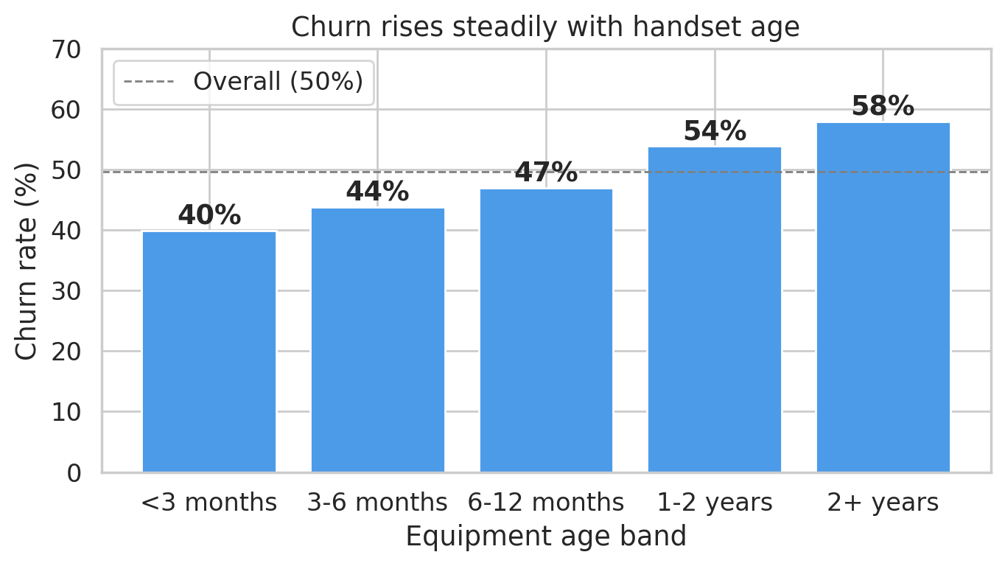
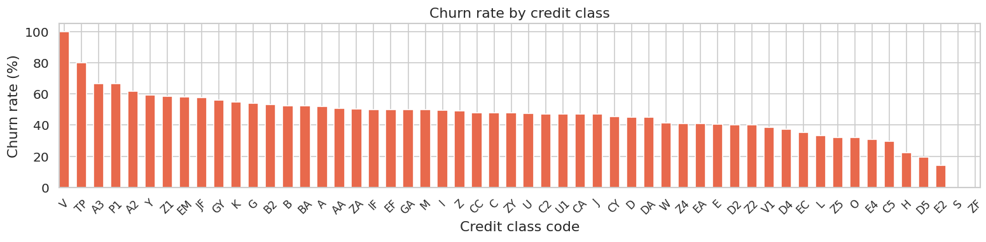
Churn Rises Steadily With Handset Age: 40% to 58%
EDA: churn rate by equipment age band
The older the handset, the higher the churn rate: a clear, monotonic effect and a direct lever: an upgrade offer.
Notes:
Churn rises every step up in handset age, from 40% for phones under three months old to 58% for phones over two years old. Churners' handsets are about two months older on average. This is the model's strongest driver and the basis for the first campaign track: a proactive upgrade offer.

Slide 7
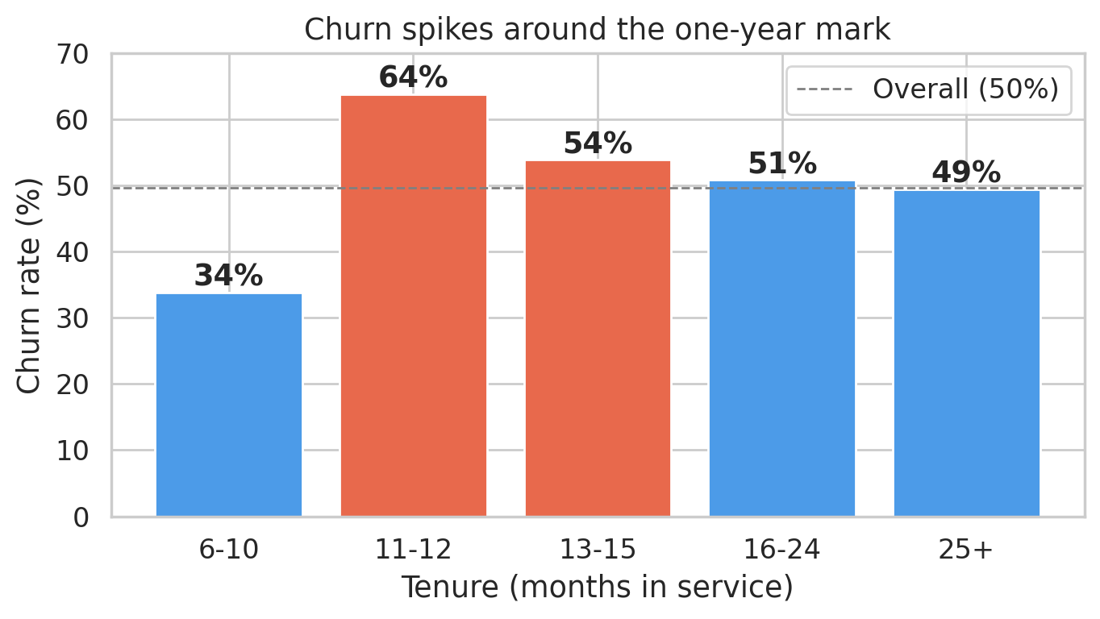
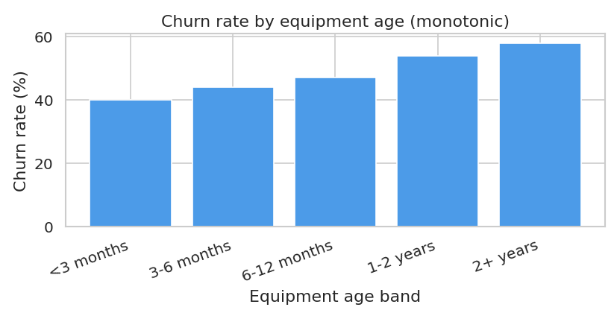
Churn Nearly Doubles at the One-Year Mark: 34% to 64%
EDA: churn rate by tenure (months in service)
Consistent with 12-month contracts expiring: customers become free to leave. Contact them before month 11.
Notes:
Newer customers are not the problem: churn is lowest in the first ten months. It nearly doubles at 11-12 months and stays elevated to month 15, which is consistent with customers coming off a one-year contract. The data dictionary does not state contract terms, so this is an inference, but it gives a clear trigger for the second campaign track: a pre-renewal loyalty offer.

Slide 8
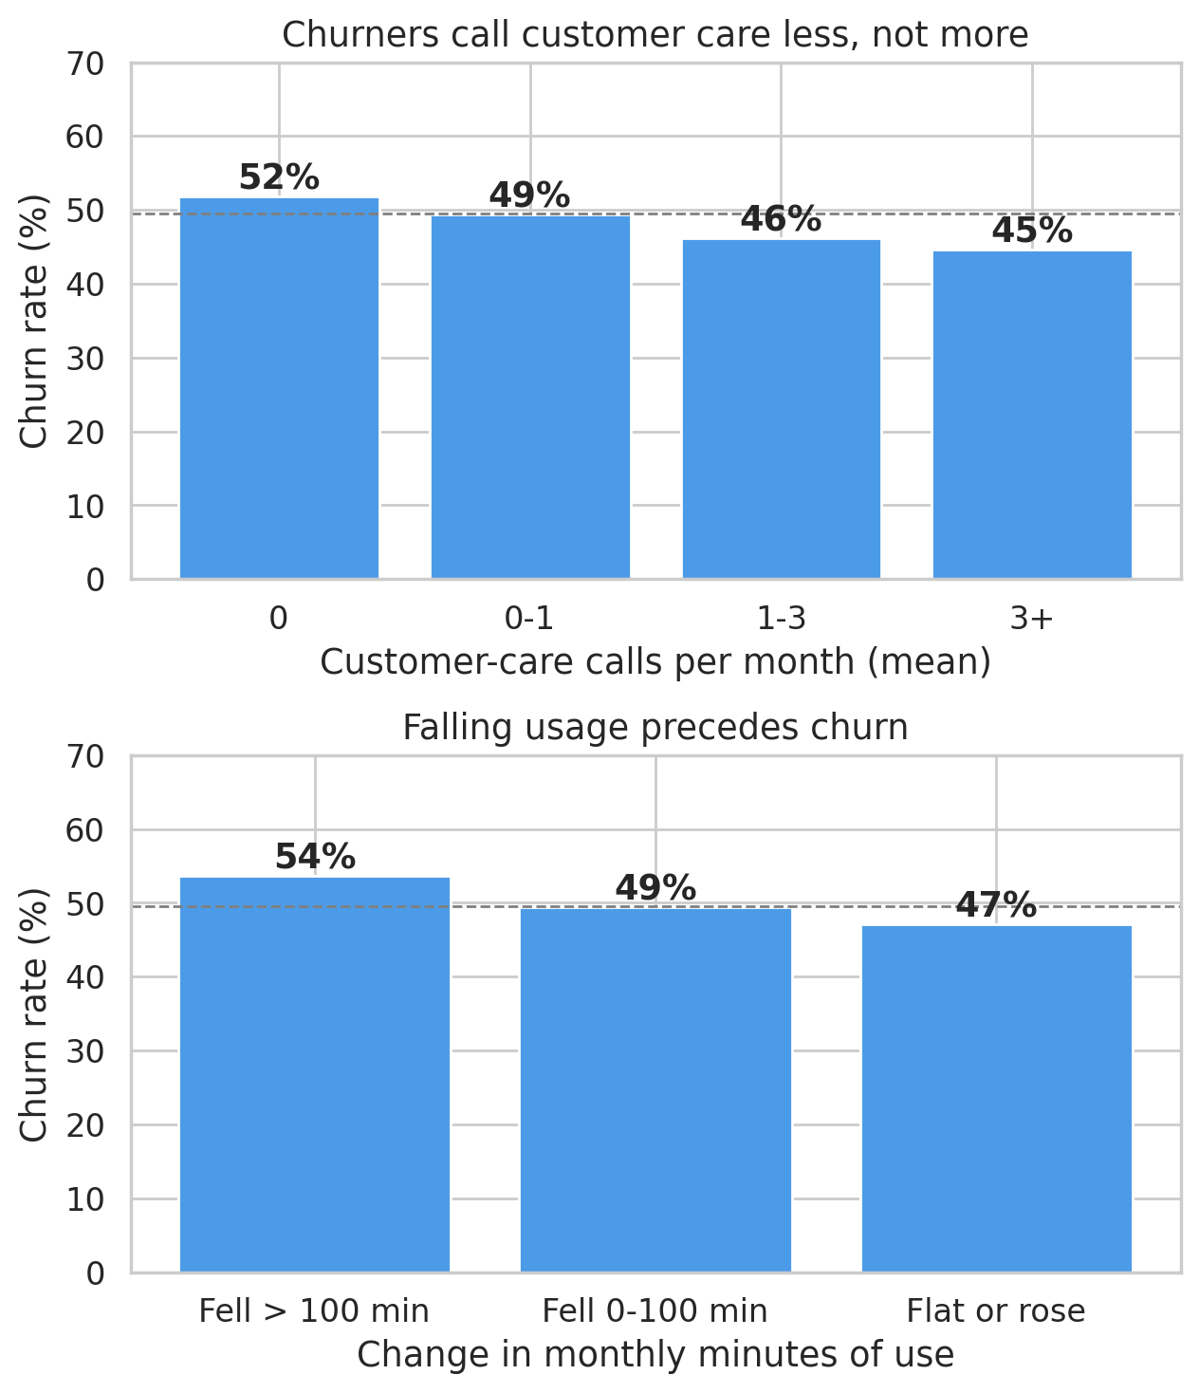



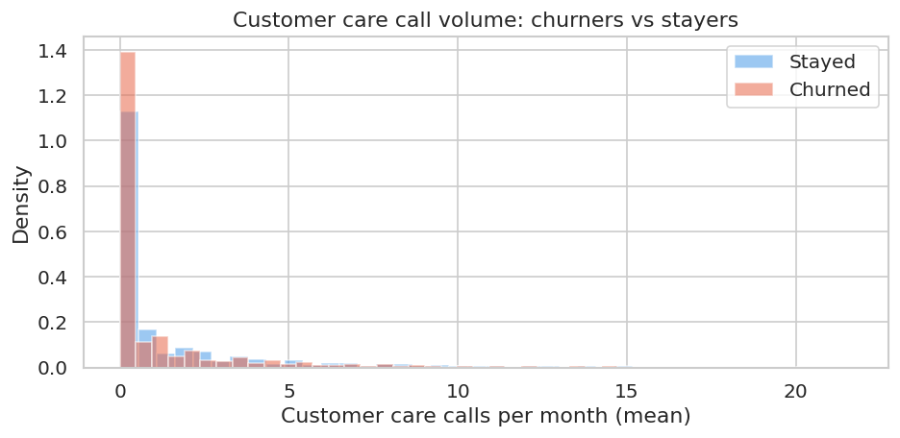
No Single Factor Predicts Churn, and Churners Rarely Complain First
EDA to model bridge
Churners leave quietly
Customers who never call customer care churn more (52%) than frequent callers (45%), so waiting for complaints misses them.
Falling usage is a warning sign
Minutes down 100+ vs the prior 3 months: 54% churn, vs 47% for stable users. Real, but modest.
Combination is the answer
Combining ~100 weak signals through gradient boosting produces a ranking no simple business rule could replicate.
Notes:
Two things stand out. First, churners do not complain before they leave; they call customer care less than loyal customers, so a complaint-driven retention process would miss them. Second, falling usage is a genuine warning sign, but a modest one. No single variable separates churners from stayers, which is exactly why we need a model that combines many weak signals.

Slide 9



Predicting Churn 31-60 Days Out Gives the Business a Real Window to Act
Business Question
ML Formulation
Which customers are likely to leave in the next 31-60 days, and how early can we know?
Binary classification. For each customer, the model outputs a probability score. Customers are ranked by risk and prioritised for outreach.
Why Churn?
Evaluation Metric
Churn is directly board-relevant and ties to the acquisition-cost case in Slide 3. A 31-60 day prediction window gives enough lead time for retention teams to act before customers are lost.
AUC-ROC (primary) measures ranking quality across all decision thresholds. F1-score (secondary) captures precision-recall balance at the chosen campaign threshold.
Notes:
We framed this as binary classification: for each customer, predict the probability they will churn in the next 31 to 60 days. That window matters because it gives a retention team enough lead time to act before the customer is actually gone.

Slide 10
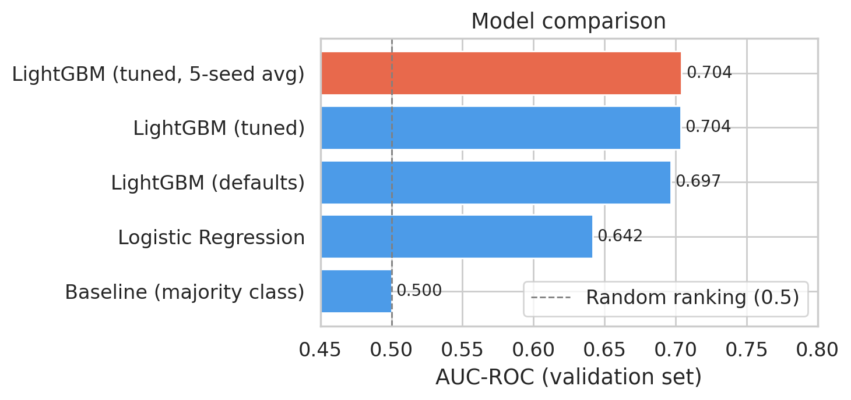
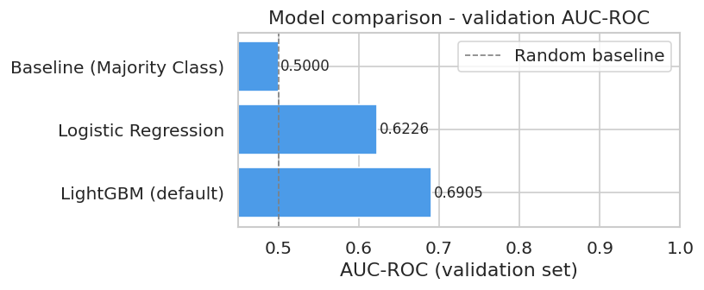
We Tested Three Approaches, Then Tuned the Strongest One
Model selection
Baseline
Always predicts the majority class. AUC-ROC = 0.50 by definition. Confirms real signal exists; any useful model must exceed this.
Logistic Regression
Linear model with log-scaled, one-hot inputs; interpretable but limited. Validation AUC 0.642; it cannot capture non-linear effects like the one-year churn spike.
LightGBM (selected)
Gradient boosting; captures non-linear patterns across ~100 correlated features. Tuned with Optuna (5-fold CV, early stopping), 5-seed average: validation AUC 0.704.
Methods: LightGBM (Ke et al., 2017); tuning with Optuna (Akiba et al., 2019); scikit-learn (Pedregosa et al., 2011).
Notes:
We did not default to the most complex model. We started with a baseline to confirm real signal exists, tried logistic regression as an interpretable benchmark, then moved to LightGBM, which suits this kind of mixed customer data. LightGBM clearly outperformed the simpler approaches, and tuning plus averaging five seeds added a little more.

Slide 11
Our LightGBM Model Achieves an AUC-ROC of 0.703: A Real, Moderate Signal Worth Acting On
Test-set results (held-out, never seen during training)
0.703
~64%
~64%
AUC-ROC
Recall
Precision
ranking accuracy across
all thresholds
of churners correctly
identified
of flagged customers are
genuine churners
What does 0.703 AUC-ROC mean?
Per 100 actual churners:
AUC-ROC ranges 0 to 1: 0.5 is random guessing, 0.7-0.8 is a moderately effective signal, and our 0.703 (95% CI 0.696-0.709) sits at the bottom of that band. The riskiest 10% churn at 3x the average rate, 81.5% in this balanced sample, about 9% at a realistic 3% monthly churn rate.
~64 correctly flagged
~36 missed (leave with no intervention)
Real-churn-rate figure uses a prior-shift correction (Saerens et al., 2002).
Notes:
Our tuned LightGBM model, an average of five seeds, scores 0.703 AUC-ROC on customers it has never seen, with a 95% confidence interval of 0.696 to 0.709. That is a moderate, honest result, not an inflated one. At the default cut-off it catches about 64 of every 100 churners. More importantly for the campaign, the top 10% of customers by predicted risk churn at about three times the average rate. In this balanced sample that is 81.5%; corrected to a realistic 3% monthly churn rate it is about 9%.

Slide 12
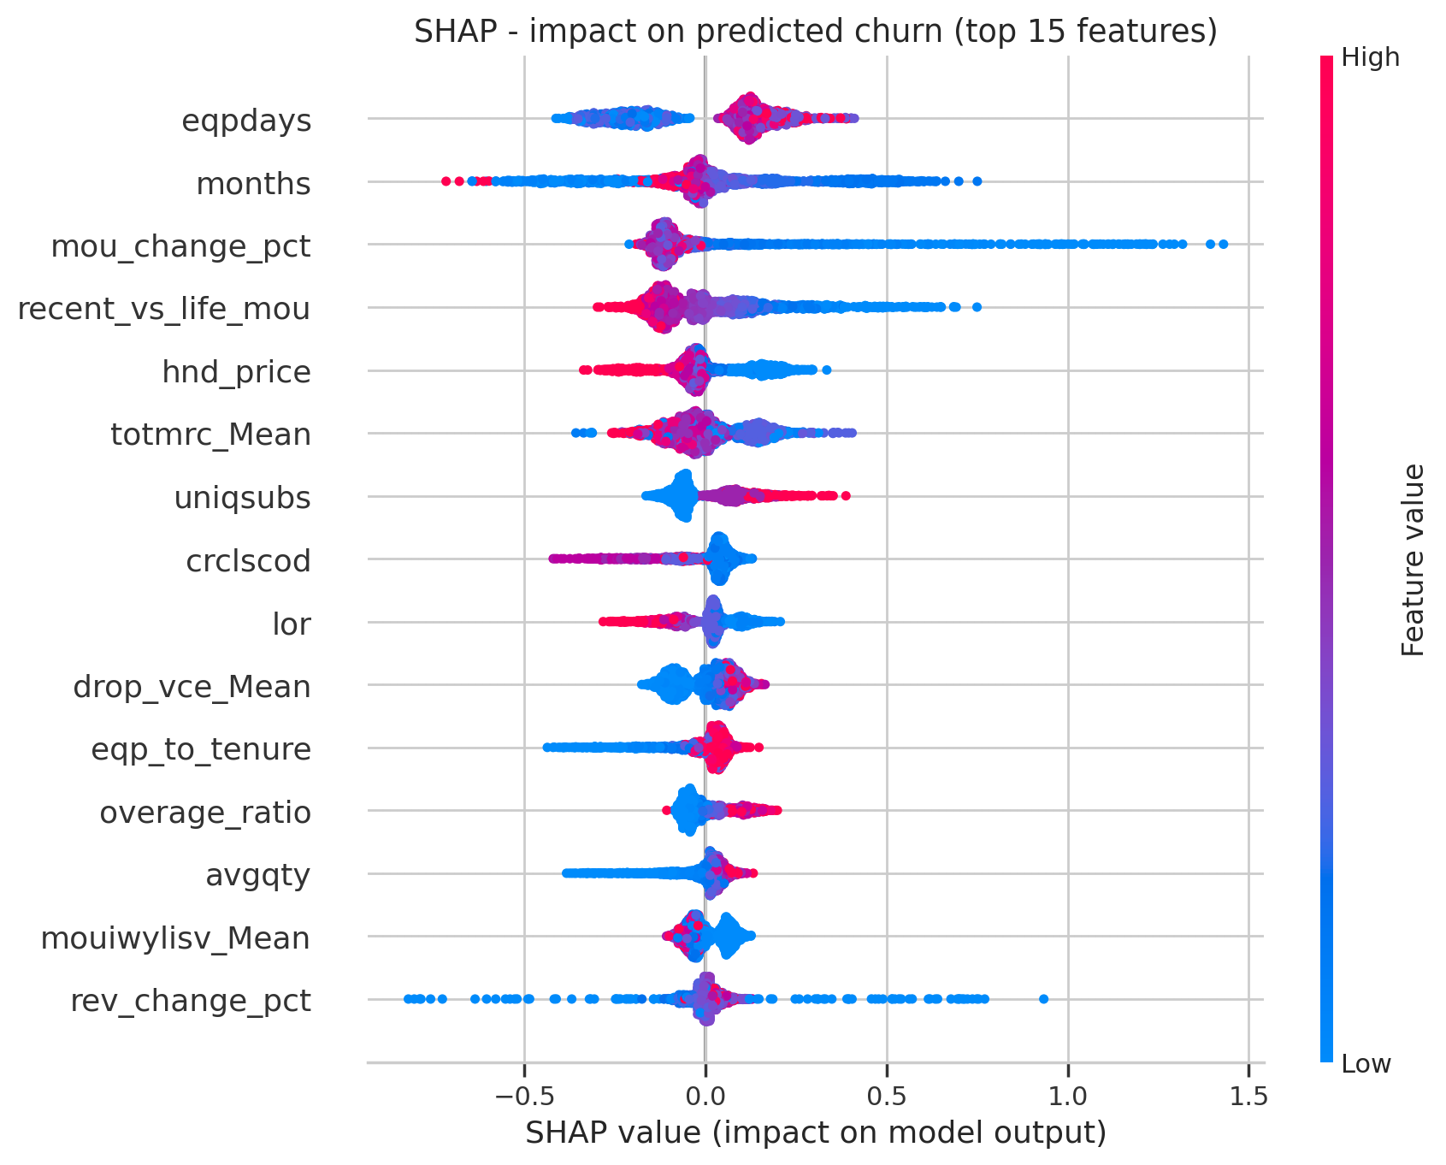
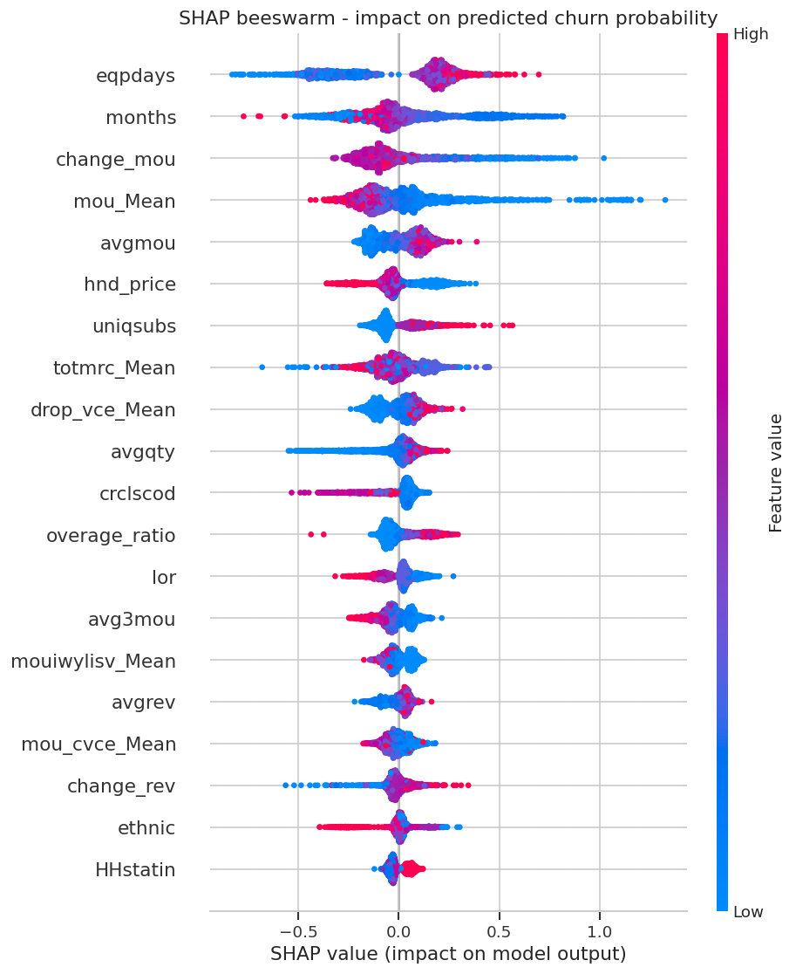
Equipment Age, Tenure, and Usage Trends Drive the Model's Predictions
SHAP beeswarm: impact on predicted churn (top 15 features)
Can act on
Equipment age (eqpdays): upgrade offer
Tenure (months): pre-renewal offer
Usage trend (mou_change_pct): check-in
Plan fit (totmrc_Mean, overage_ratio)
Informative only
Household subscribers (uniqsubs)
Handset price paid (hnd_price)
Credit class (crclscod)
Length of residence (lor)
Handset age and tenure lead, with usage change relative to the customer's own history close behind, matching the EDA. Old handsets (red) push toward churn.
SHAP: Lundberg & Lee (2017).
Notes:
Looking inside the model confirms the EDA. Handset age is the strongest driver, followed closely by tenure and by how much a customer's usage has changed relative to their own history. All three are things the business can act on, which is why they define the campaign. Features such as credit class or handset price help the model rank customers but are not used as campaign triggers. Ethnicity was removed from the model on fairness grounds, with no loss of accuracy.

Slide 13



A Sharply Targeted Campaign Pays Off: Offer Cost Sets the Scale
$23k-$270k
Assumptions and what they imply
Real churn rate: 3%/month (assumed; sample is 50/50)
Top-10% precision: ~9% real (81.5% as sampled)
Retention success / horizon: 30% / 24 months
Break-even at 1-month offer: churn prob. > 13.9%
Top-10% campaign at 1-month offer: -$0.2M
Contact if value > 0: 0.7% of base, +$23k
net per 100k customers over 24 months, as offer cost falls from 1 to 1/4 month's revenue
Equipment Upgrade Offer
Target: positive-value customers with handsets 1+ year old
Action: early upgrade, device discount, or bundle upgrade
Rationale: #1 model driver; churn rises from 40% to 58%
How it works:
Model flags
at-risk customer
Retention team
notified
Targeted
offer sent
Outcome
tracked
→
→
→
Pre-Renewal Loyalty Offer
Score monthly and contact only customers whose expected value is positive. Cheaper offers widen that group: at 1/4 month's revenue, ~29% of the base qualifies.
Target: positive-value customers at 10-15 months tenure
Action: loyalty discount, renewal perk, or plan review
Rationale: churn jumps from 34% to 64% at one year
Sources: prior-shift correction (Saerens et al., 2002); expected-value targeting (Elkan, 2001; Verbeke et al., 2012).
Notes:
In the balanced sample, contacting the riskiest 10% looks very profitable. But the sample is 50/50 churn, and real churn is closer to 3% a month. Corrected for that, only about 9% of the top decile really churn. That is three times the average, but below the 13.9% break-even for an offer costing a month's revenue, so a fixed top-10% campaign would lose about $0.2 million per 100,000 customers. The profitable design is to contact only customers whose expected value is positive: at today's assumptions that is under 1% of the base, netting about $23,000 per 100,000 customers. The lever is offer cost: at a quarter of a month's revenue, about 29% of the base is worth contacting and the net rises to about $270,000. Each contacted customer still gets the offer matching their driver.

Slide 14

This Is a Proof of Concept: Here Is What Strengthens It Before Production
Limitations and recommended next steps
AUC-ROC of 0.703 is moderate
Key assumptions need validation
More data (support-ticket text, network-quality logs, competitor pricing) could lift performance. But the business case moves far more with offer cost and retention success than with accuracy.
Real churn rate (3%/month assumed), retention success (30%) and offer cost decide the case. Replace them with Telecom's figures and pilot results before budgeting.
Run a pilot before full rollout
Phased deployment path
Randomised pilot: ~490 customers per arm (offer vs. no offer) detects a 30% cut in churn. It measures the real retention rate and cost per save, and gives the data for uplift modelling.
Phase 1 (months 1-2): connect the model to live customer records; monthly scoring.
Phase 2 (months 2-4): randomised pilot; measure retention rate and cost per save.
Phase 3 (months 4-6): reset the contact threshold from pilot results; build an uplift model; retrain quarterly.
Uplift modelling: Kunzel et al. (2019).
Notes:
To be direct about where this stands: 0.703 AUC-ROC is a real, usable signal, trained on a balanced sample. The business case depends mostly on three numbers we had to assume: the real churn rate, the retention success rate and the offer cost. The pilot is designed to measure the last two, with a randomised control group of about 490 customers per arm, and the same data lets us move from targeting likely leavers to targeting customers an offer can actually change.

Slide 15
References
Company A ("Telecom") dataset: Client.csv, Record.csv. GCI World 2026 Final Assignment.
Neslin, S. A., Gupta, S., Kamakura, W., Lu, J., & Mason, C. H. (2006). Defection detection: Measuring and understanding the predictive accuracy of customer churn models. Journal of Marketing Research, 43(2). https://doi.org/10.1509/jmkr.43.2.204
Gallo, A. (2014). The value of keeping the right customers. Harvard Business Review. https://hbr.org/2014/10/the-value-of-keeping-the-right-customers
ITU (2024). Facts and Figures 2024: Mobile-cellular subscriptions. https://www.itu.int/itu-d/reports/statistics/2024/11/10/ff24-subscriptions/
Nguyen, N. Y., Tran, V. L., & Dao, V. T. S. (2022). Churn prediction in telecommunication industry using kernel Support Vector Machines. PLOS ONE, 17(5). https://doi.org/10.1371/journal.pone.0267935
Ke, G. et al. (2017). LightGBM: A highly efficient gradient boosting decision tree. NeurIPS. https://lightgbm.readthedocs.io/
Akiba, T. et al. (2019). Optuna: A next-generation hyperparameter optimization framework. KDD. https://doi.org/10.1145/3292500.3330701
Lundberg, S. M., & Lee, S.-I. (2017). A unified approach to interpreting model predictions. NeurIPS. https://shap.readthedocs.io/
Pedregosa, F. et al. (2011). Scikit-learn: Machine learning in Python. JMLR, 12, 2825-2830. https://jmlr.org/papers/v12/pedregosa11a.html
Saerens, M., Latinne, P., & Decaestecker, C. (2002). Adjusting the outputs of a classifier to new a priori probabilities: A simple procedure. Neural Computation, 14(1), 21-41. https://doi.org/10.1162/089976602753284446
Elkan, C. (2001). The foundations of cost-sensitive learning. Proceedings of IJCAI 2001.
Verbeke, W., Dejaeger, K., Martens, D., Hur, J., & Baesens, B. (2012). New insights into churn prediction in the telecommunication sector: A profit driven data mining approach. European Journal of Operational Research, 218(1), 211-229.
Kunzel, S. R., Sekhon, J. S., Bickel, P. J., & Yu, B. (2019). Metalearners for estimating heterogeneous treatment effects using machine learning. PNAS, 116(10), 4156-4165. https://doi.org/10.1073/pnas.1804597116
Notes:
All external sources cited on the slides are listed here.

