Slide 1
The Economics of the Electric Transition: A 5-Year TCO Analysis for Delhi (2026)
Honda Activa 6G vs. Ather 450X (2.9 kWh) · Scenarios: 10 · 30 · 50 km/day · Delhi, April 2026
Submitted by: Purnendu Kumar (24/BBA/43) · Rahul Roushan (24/BBA/44) · Shresth Saran (24/BBA/52) · Mayank Aggarwal (24/BBA/37)
Notes:
1

Slide 2
KEY FINDING
The Ather 450X Saves Up to ₹1,41,248 Over 5 Years — But Only If You Ride Enough
Financial advantage scales directly with daily usage. The EV becomes cheaper from Year 2 for average commuters and Year 1.5 for heavy users.
₹72,212
₹1,41,248
Average Commuter
Heavy Commuter
30 km/day · Break-even ~Year 2
50 km/day · Break-even ~Year 1.5
₹3,177
₹38,341
Light Commuter
EV Upfront Premium
10 km/day · Break-even ~Year 5
After ₹32,848 in combined subsidies
Notes:
2

Slide 3

CONTEXT
Delhi's 2028 ICE Mandate and ₹10,900 Crore PM E-DRIVE Scheme Are Accelerating the EV Transition
Policy Drivers
100% electric two-wheeler registrations mandated in Delhi from April 2028
PM E-DRIVE: ₹10,900 Cr central outlay; ₹5,000 subsidy per eligible two-wheeler (extended to July 2026)
Delhi EV Policy 2024–30: 100% road tax waiver + ₹20,000 state purchase subsidy (Year 1)
19.19 lakh electric two-wheelers sold under PM E-DRIVE by January 2026
Combined subsidies total ₹32,848 — reducing the Ather's effective on-road cost to ₹1,27,866.
Notes:
3

Slide 4

METHODOLOGY
TCO Model Captures Net Upfront Cost, Running Expenses, and Service Over a Full 5-Year Ownership Cycle
Running Cost
Daily km × cost/km × 365 × 5 years.
Net Upfront Cost
Recurring OpEx
Ex-showroom + RTO + Yr1 insurance − subsidies.
Annual service + insurance renewals Yr2–Yr5.
TCO = Net Upfront Cost + (Daily km × Cost per km × 365 × 5) + (Service + Insurance renewals). All inputs sourced from publicly available, authoritative data as of April 2026. Year 1 insurance is included in capital outlay; Years 2–5 renewals treated as operating expenses.
Notes:
4

Slide 5
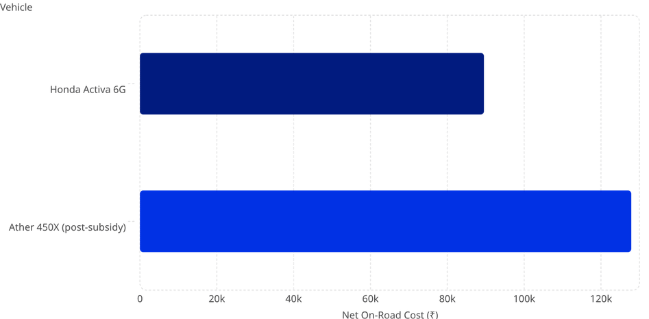
UPFRONT COSTS
Subsidies Reduce the Ather's On-Road Premium to ₹38,341 Over the Activa
Cost Breakdown
Component
Activa 6G
Ather 450X
Ex-Showroom
₹75,433
₹1,47,999
RTO / Registration
₹7,848
₹0 (waived)
Year 1 Insurance
₹6,244
₹4,867
PM E-DRIVE Subsidy
—
− ₹5,000
Delhi State Subsidy
—
− ₹20,000
Net On-Road
₹89,525
₹1,27,866
Upfront premium of ₹38,341 must be recovered through lower running costs.
Notes:
5

Slide 6
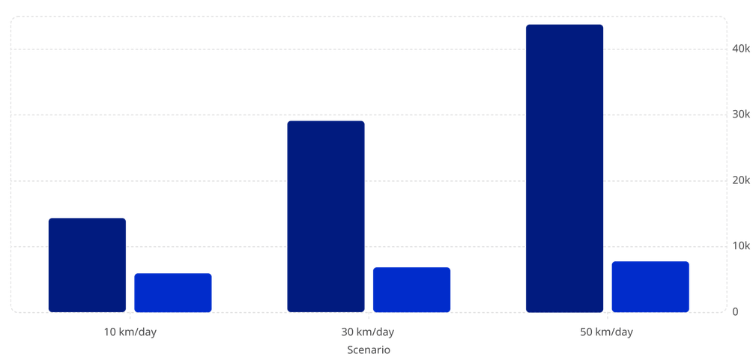
RUNNING COSTS
EV Running Costs Are 78–94% Lower Than Petrol Across All Usage Scenarios
Activa Annual OpEx (₹)
Ather Annual OpEx (₹)
Annual OpEx Components
Item
Activa
Ather
Petrol (₹94.77/L, 47 kmpl)
₹7,360–₹36,799
—
Electricity (₹4.50/kWh, ~36 km/kWh)
—
₹456–₹2,281
Annual Service
₹3,500
₹2,500
Insurance Renewal (Yr 2–5)
₹3,500
₹3,000
Fuel saving at 30 km/day: ₹20,710/year. At 50 km/day: ₹34,518/year.
Notes:
6

Slide 7
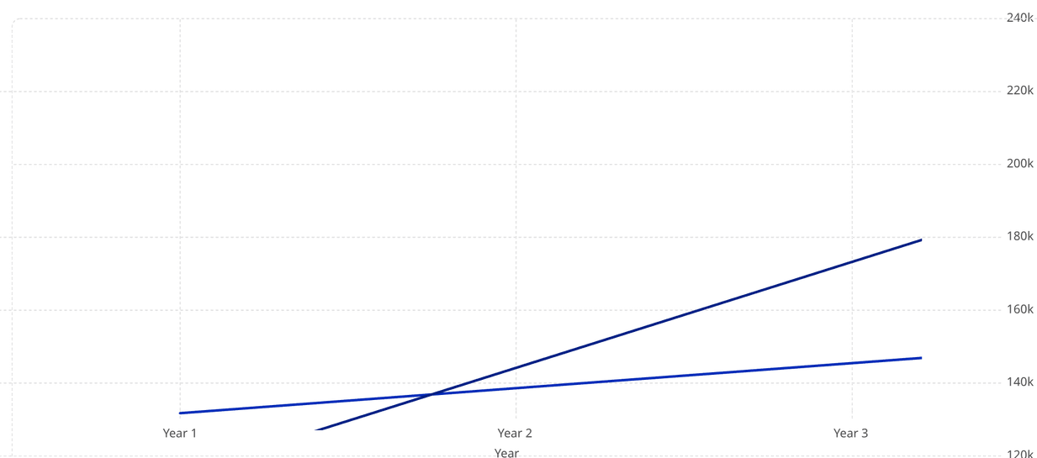
TCO ANALYSIS
At 30 km/day, the Ather 450X Saves ₹72,212 Over 5 Years — Becoming Cheaper From Year 2 Onward
Ather 450X (₹)
Honda Activa 6G (₹)
Crossing point: ~Year 2 (≈21,900 km). Annual fuel saving of ₹20,710 recovers the ₹38,341 premium in under 2 years. 5-year net EV saving: ₹72,212.
Notes:
7

Slide 8

VERDICT
EV Financial Advantage Scales Directly With Daily Usage — Heavy Commuters Save ₹1,41,248
Profile
5-Yr Activa TCO
5-Yr Ather TCO
EV Net Saving
Break-Even
Verdict
Light (10 km/day)
₹1,57,824
₹1,54,647
+₹3,177
~Year 5
Marginal Win
Average (30 km/day)
₹2,31,422
₹1,59,210
+₹72,212
~Year 2
EV Wins
Heavy (50 km/day)
₹3,05,020
₹1,63,772
+₹1,41,248
~Year 1.5
Clearly Wins
Tipping Point: ~30 km/day (≈10,950 km/year). Below ~15 km/day, break-even stretches beyond 5 years and the financial case weakens.
Notes:
8

Slide 9
STRATEGIC OUTLOOK
Key Risks and Policy Implications That Could Shift the TCO Equation
EV Risks Not Modelled
ICE Depreciation Risk
Battery replacement: ₹49,000–₹84,500 post-warranty (3 yr / 30,000 km); heavy commuters may exceed this within 5 years
Home charger: ₹4,500–₹6,000 not included in model
Petrol price volatility: +10% price rise shortens 30 km/day break-even by 3–4 months, adding ~₹11,000 to EV savings
Delhi's 2028 ICE ban creates structural resale value risk for petrol scooters purchased in 2026
Combined ₹32,848 subsidy insufficient to flip economics for light commuters — further subsidy enhancement or price reduction needed for mass adoption
Financing / EMI cost differentials not modelled; would affect year-by-year cash outflows
Notes:
9

Slide 10
CONCLUSION
For Any Delhi Commuter Riding 30 km or More Daily, the Ather 450X Is Already the Financially Superior Choice in 2026
TCO Over Sticker Price
Usage Is the Deciding Variable
Policy Accelerates the Timeline
EV transition economics depend on total cost of ownership, not upfront price. The ₹38,341 premium is fully recoverable.
30 km/day is the tipping point. Every additional kilometre strengthens the EV case further.
Delhi's 2028 mandate eliminates the ICE option entirely — petrol scooters carry accelerating residual-value risk.
The EV transition for Delhi's two-wheeler market is not a matter of if, but of when each individual commuter crosses their personal break-even threshold.
Notes:
10

