Slide 1
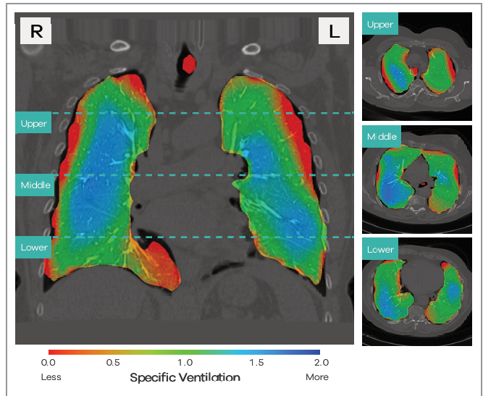

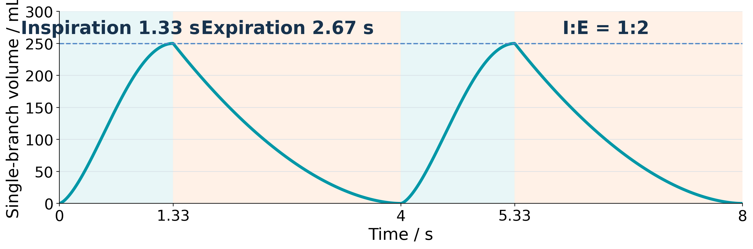



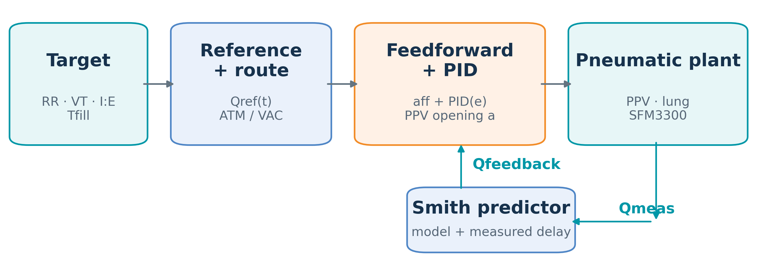
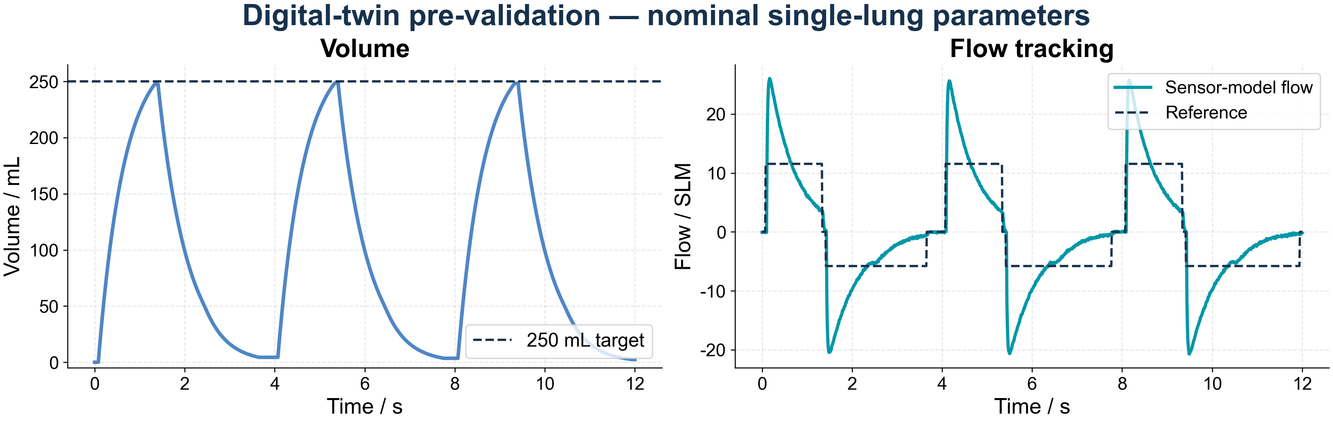
LungLogic: Intelligent Airflow Control
for Realistic Breathing Simulation
ME-12-TYIN-007 | Yuqiao Li, Chun Yin Ku (John), Jiaquan Zhong | Supervisors: Jonathan Eden, Ying Tan | Mechatronics Engineering
1. Introduction
2. Pneumatic System & Hardware
1.1 Project need
2.1 Objective
Dynamic lung phantoms provide repeatable breathing inputs for imaging and ventilation research.
Control one lung branch and measure airflow for closed-loop regulation and calibration.
1.2 Project objective
2.2 Pneumatic system prototype
LungLogic controls airflow in a biomimetic lung model. This stage validates one 250 mL branch before bilateral integration.
Regional ventilation imaging.
Application context.
Prototype photograph
(to be added)
1.3 Nominal breathing reference
Fig. 1. Single-lung route; prototype photograph pending.
Breathing-cycle illustration at 15 bpm and I:E = 1:2.
2.3 Embedded control architecture
RR · respiratory rate | 12–16 bpm; nominal 15 bpm
I:E · inhale:exhale time | 1:2; 1.33 s / 2.67 s at 15 bpm
VT · tidal volume | 250 mL per branch
Repeatability | VT error within ±5%
PC / Python UI
→
Controller
→
24 V bridge PCB
→
Valves + sensor
The controller runs the 100 Hz breathing and flow loop. The bridge connects logic to the routing valves, PPV and SFM3300 sensor.
Nominal design values, not measured performance. Target: 250 mL per branch and VT error within ±5%.
Fig. 2. Control architecture and bridge PCB.
Sources: 4DMedical project scope (19 March 2026), pp. 5, 13. Ventilation image: supplied reference.
3. Integrated Control System & Software
3.1 Objective
Track flow and tidal volume with a visible, repeatable closed-loop system. Feedforward supplies the nominal valve command; sensor feedback corrects error.
3.2 Operator and developer interface
3.3 Model-assisted flow feedback
User Mode
Developer Mode
Fig. 3. User and Developer modes.
Fig. 4. Feedback control with optional Smith prediction.
3.4 Optional Auto PID and measured-delay compensation
Auto PID scores bounded Kp/Ki over full runs by flow, volume and saturation; optional Smith prediction uses the model and measured delay.
4. Results & Future Work
4.1 Experimental results
4.2 Future work
1
Integrate the 250 mL branch
2
Re-identify model and delay
3
Validate branch repeatability
Fig. 5. Digital-twin simulation at 15 bpm (not measured hardware).
Connect the single branch to the biomimetic lung model and test the required breathing range.
Industry collaborator: 4DMedical | Background: project scope deck, 19 March 2026 | Control: current single-lung system | Experimental results: pending | Bench research prototype.

