Slide 1

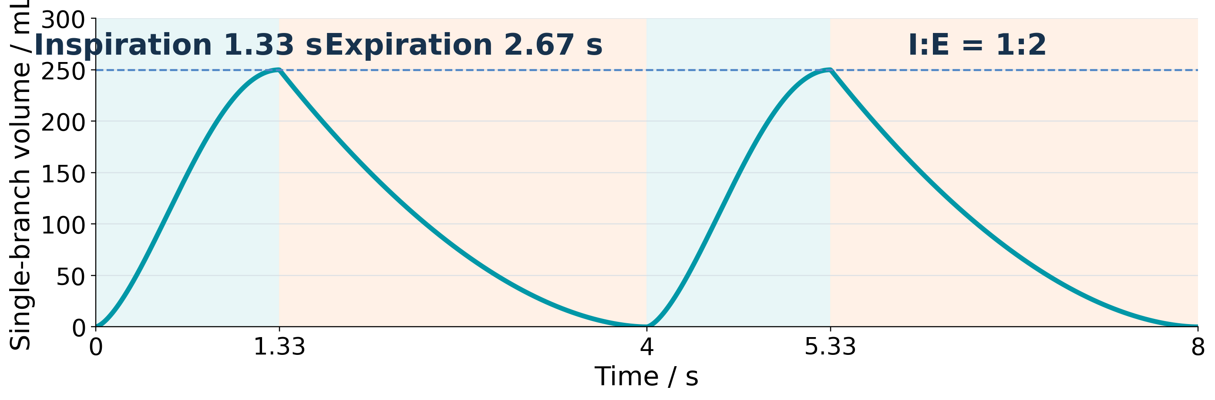



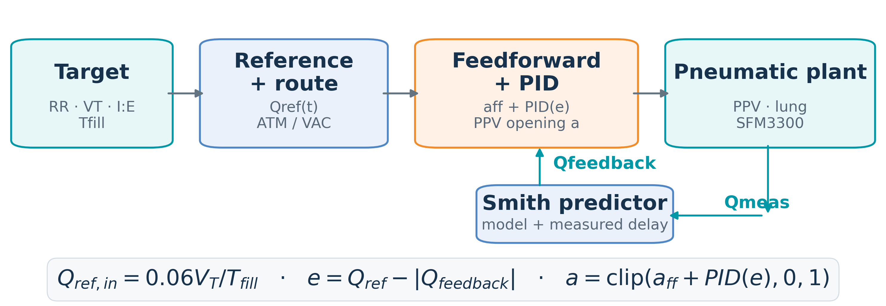
LungLogic: Model-Based Airflow Control
with Measured-Delay Compensation and Auto PID
ME-12-TYIN-007 | Yuqiao Li, Chun Yin Ku (John), Jiaquan Zhong | Supervisors: Jonathan Eden, Ying Tan | Mechatronics Engineering
1. Introduction
2. Pneumatic System & Hardware
1.1 Project need
2.1 Objective
Dynamic lung phantoms support imaging and ventilation research. Existing products and laboratory systems do not combine programmable timing, repeatable volume and independent left/right actuation.
Control one lung branch and measure airflow for closed-loop regulation and calibration.
1.2 Project objective
2.2 Pneumatic system prototype
LungLogic develops a pneumatic and software platform to control a medical biomimetic lung model. This stage validates one 250 mL branch before bilateral integration.
1.3 Nominal breathing reference
Prototype photograph
(to be added)
Breathing-cycle illustration at 15 bpm and I:E = 1:2.
Fig. 1. Single-lung route; prototype photograph pending.
RR · respiratory rate | 12–16 bpm; nominal 15 bpm
I:E · inhale:exhale time | 1:2; 1.33 s / 2.67 s at 15 bpm
VT · tidal volume | 250 mL per branch
Repeatability | VT error within ±5%
2.3 Embedded control architecture
PC / Python UI
→
Controller
→
24 V bridge PCB
→
Valves + sensor
The controller runs the 100 Hz breathing and flow loop. The bridge connects logic to the routing valves, PPV and SFM3300 sensor.
Nominal design values, not measured performance. The 250 mL branch target is half of the ~500 mL adult tidal-volume example.
Source: 4DMedical project scope, 19 March 2026, pp. 5 and 13. The ±5% repeatability value is a design target.
Fig. 2. Control architecture and bridge PCB.
3. Integrated Control System & Software
3.1 Objective
Track flow and tidal volume with a visible, repeatable closed-loop system. Feedforward supplies the nominal valve command; sensor feedback corrects error.
3.2 Operator and developer interface
3.3 Model-assisted flow feedback
User Mode
Developer Mode
Fig. 3. User and Developer modes.
Fig. 4. Feedback control with optional Smith prediction.
3.4 Auto PID and measured-delay compensation
Auto PID scores bounded Kp/Ki trials. Smith prediction uses the identified model and measured delay; hardware adds no artificial delay.
4. Results & Future Work
4.1 Experimental results
4.2 Future work
1
Integrate the biomimetic lung model
EXPERIMENTAL RESULTS TO BE ADDED
2
Re-identify the model and delay
Insert measured flow and volume plots
Report: VT error · flow RMSE · repeatability
3
Validate bilateral repeatability
Fig. 5. Reserved for measured hardware results.
Extend the verified branch to independent left/right control across the required breathing range.
Industry collaborator: 4DMedical | Background: project scope deck, 19 March 2026 | Control: current single-lung system | Experimental results: pending | Bench research prototype.

