Slide 1

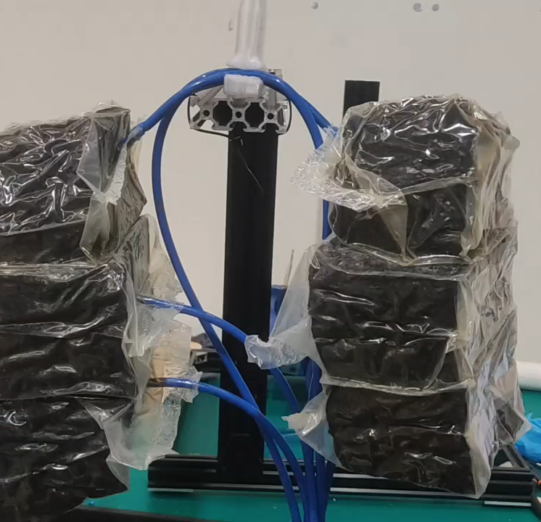

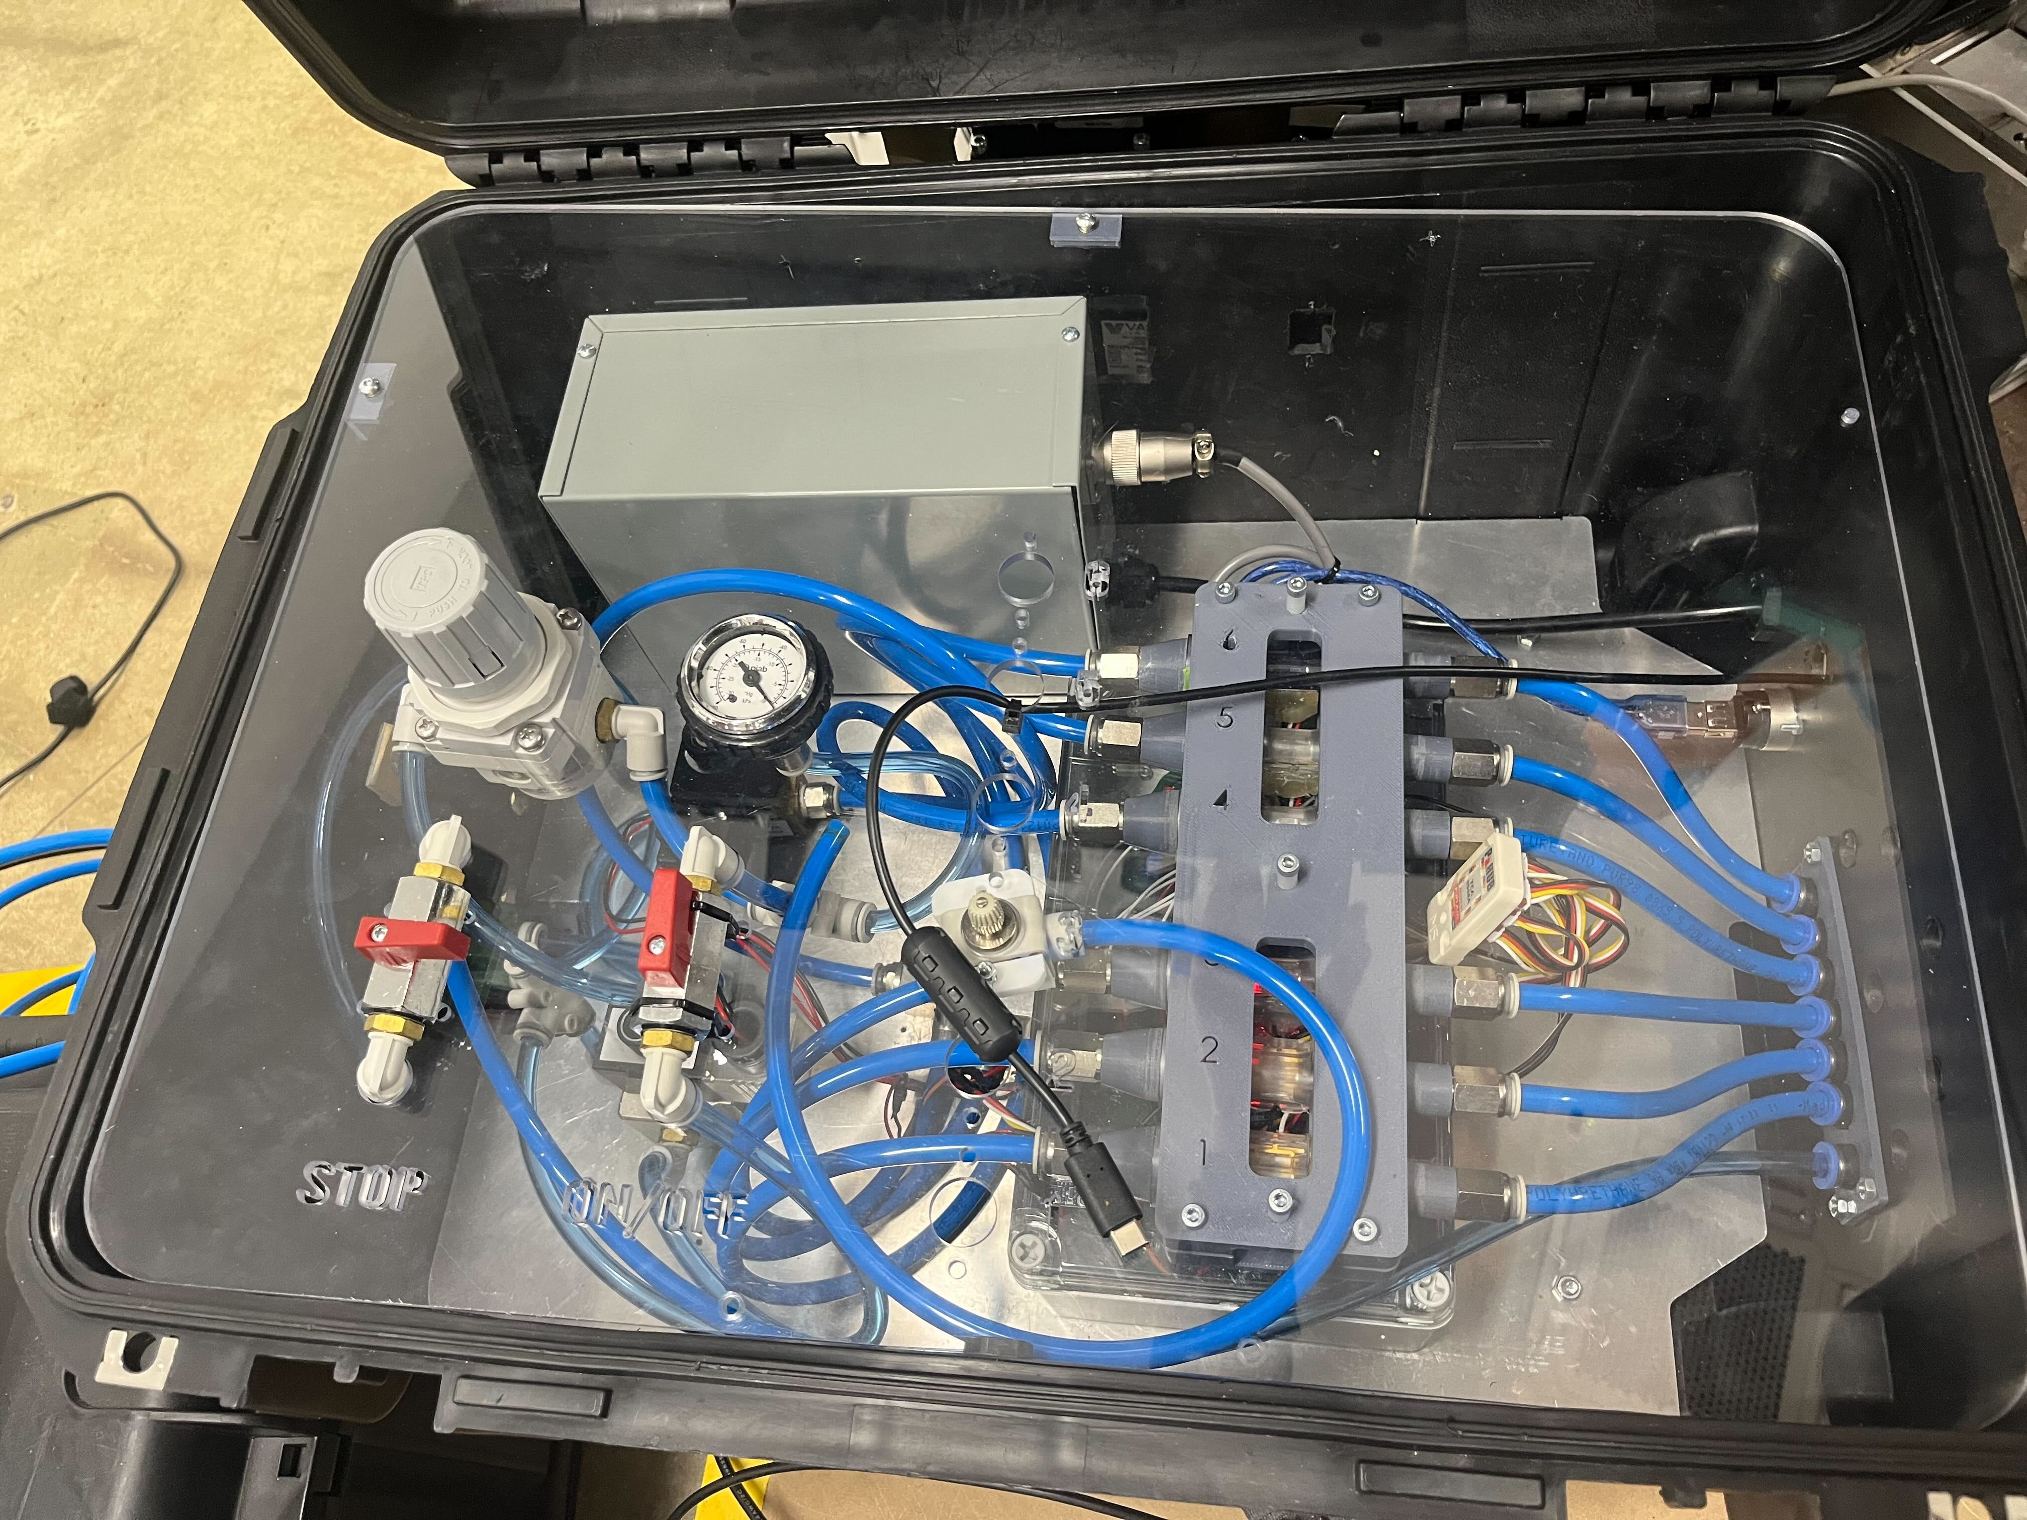


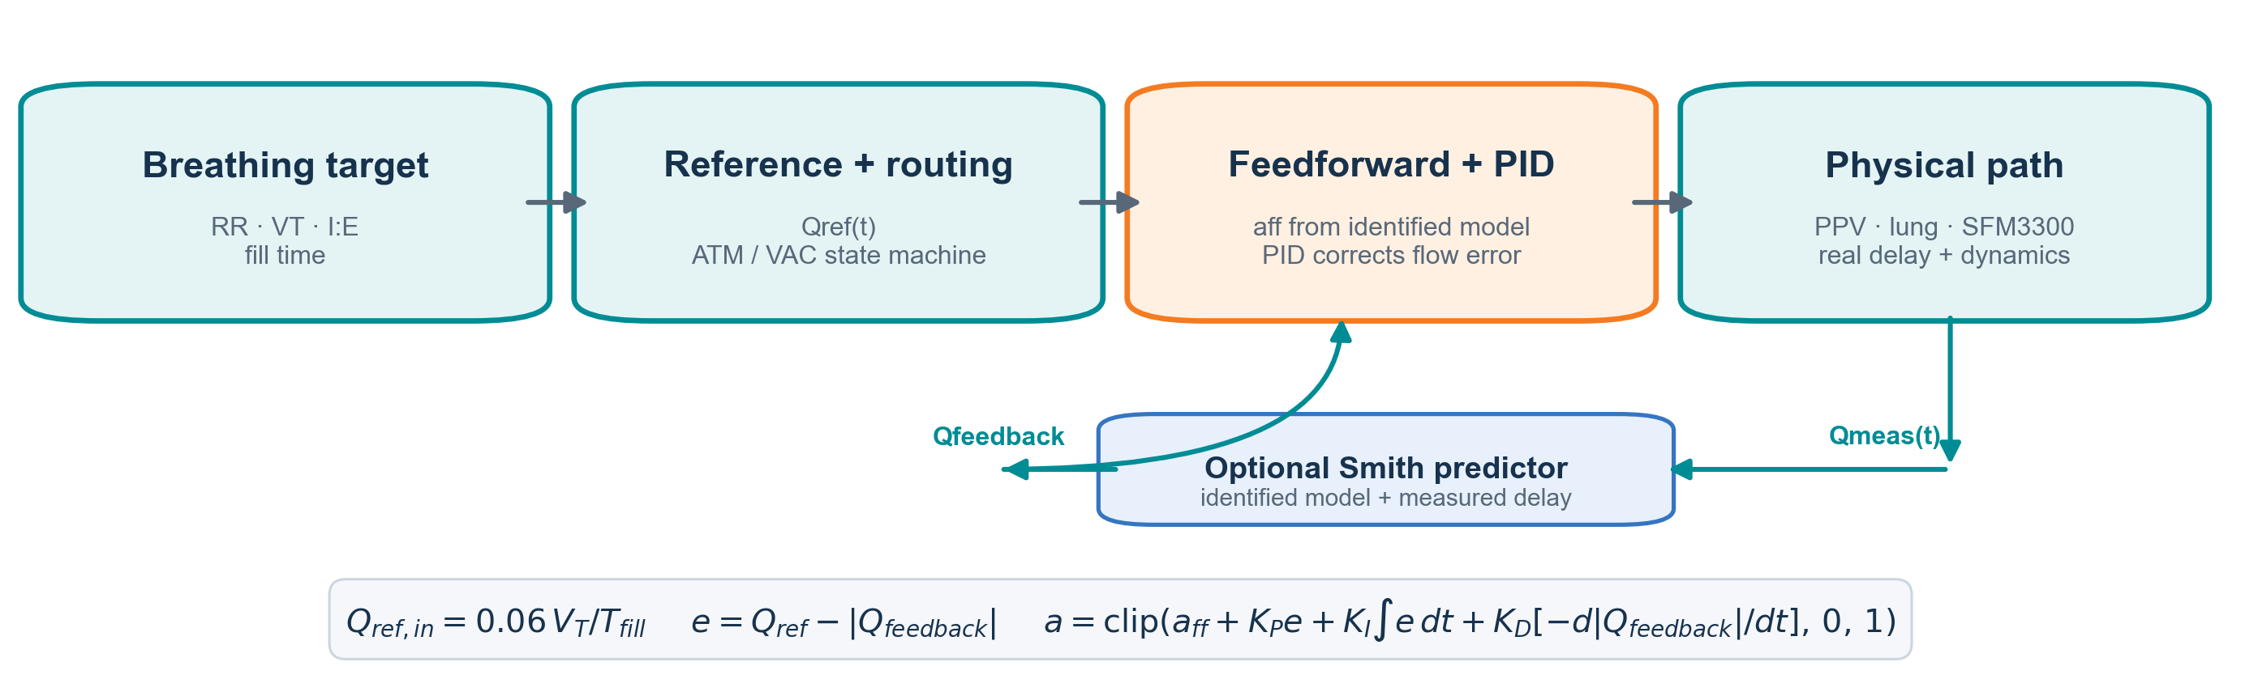
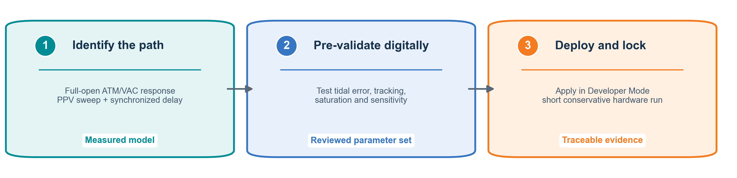
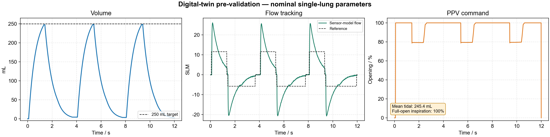
LungLogic: Model-Based Airflow Control
with Measured-Delay Compensation and Auto PID
ME-12-TYIN-007 | Yuqiao Li, Chun Yin Ku (John), Jiaquan Zhong | Supervisors: Jonathan Eden, Ying Tan | Mechatronics Engineering
1. Pneumatic System & Requirements
2. Embedded Hardware Architecture
OBJECTIVE | Reproduce a physiologic breathing pattern in one 250 mL lung branch.
Design targets combine respiratory timing, tidal volume and repeatability despite valve nonlinearity, sensor dynamics and real pneumatic delay.
OBJECTIVE | Connect software commands to safe, deterministic pneumatic actuation.
The host configures and logs experiments; the embedded controller executes the 100 Hz state machine and flow loop through a protected 24 V bridge.
Respiratory rate | 12–16 bpm
Tidal volume | 250 mL / lung
I:E ratio | 1:2
Repeatability target | < ±5%
PC / Python GUI
Setpoints, telemetry, Auto PID
Configuration / telemetry
Embedded controller
State machine and flow feedback
24 V bridge PCB
Power and protected interfaces
Valves
Sensors
ATM, vacuum and PPV
Flow feedback and volume estimate
Fig. 1. Single-lung pneumatic route and six-lobe breathing phantom.
Fig. 2. Host–controller–PCB architecture and pneumatic control case.
3. Control Software & Workflow
4. Control Method & Validation
OBJECTIVE | Provide a visible, adjustable tool for operation, tuning and traceable experiments.
User Mode simplifies routine runs; Developer Mode exposes PID, model, measured-delay and calibration controls.
OBJECTIVE | Track target flow and tidal volume despite nonlinear PPV response and measured delay.
Feedforward supplies nominal valve opening; measured-flow PID removes residual error; Smith prediction is optional.
User Mode
Developer Mode
Fig. 3. Telemetry-driven dynamic model and protected developer controls.
Auto PID: bounded run-to-run PI search
Optional tuning evaluates a stable baseline and bounded Kp/Ki candidates over complete hardware runs. Flow error, tidal error and PPV saturation form the score. Kd and identified model/delay parameters remain fixed; the user reviews the best tested gains.
Breathing setpoints | Routine experiment setup
Dynamic Model | Live telemetry visualisation
PID / Smith / Auto PID | Controller development
Measured parameters | Locked after identification
CSV logging | Traceable experiment review
Measured-delay compensation
Hardware adds no artificial delay. Optional Smith prediction uses the identified first-order model and measured command-to-feedback latency. Re-identify after changing tubing, valves, sensor filtering or sampling.
Workflow: identify → simulate → lock/deploy. Measured model and delay values are protected by default; current scope is one 250 mL branch.
Fig. 4. Digital-twin pre-validation at 15 bpm. Model-based result; measured hardware validation remains required.
Industry collaborator: 4DMedical | Prototype images: project scope deck (19 March 2026) | Simulation result: current single-lung model | Bench prototype—not for clinical use.
Notes:
Sources: revised 23-09-Presentation_Integrated_Control_UI_Numbered (1)(1).pptx; project scope; supplied pneumatic schematic. STM32 replaces Arduino at the team's latest instruction. Original UI screenshots and PCB assembly photo are embedded. Prototype photo and PC-STM32-PCB connection photo await final images. No measured or simulated performance numbers have been invented.
CONTROL MODEL: the displayed phase-dependent first-order volume equation is a working approximation, not a claimed identified model. V_eq maps valve opening to equilibrium lung volume. The flow conversion assumes the model's equivalent volume basis and time in seconds. Calibrate inflation/deflation time constants, valve mapping and delays using actual measurements.
SIMULATION WORDING (editable): Simulation compares target and measured-model flow/volume across repeated breaths, with and without Smith prediction. Report tidal-volume error, breath-to-breath variation, tracking error and valve saturation. Insert only verified values and specify respiratory settings, gains and delay assumptions.
HARDWARE WORDING (replace after tests): Hardware tests compared SFM3300 flow and integrated tidal volume with their targets over [N] breaths at [RR] bpm and I:E [ratio]. Tidal-volume error was [value], cycle variation [value], and tracking error [value]. State pneumatic load, sensor calibration and any observed saturation. Replace Fig. 4 with measured traces and label it Experiment.
CAPTION ALTERNATIVES: Fig. 4. Simulated flow and tidal-volume tracking at [settings], comparing baseline PI and delay-compensated PI. OR Fig. 4. Experimental flow and tidal-volume tracking over [N] respiratory cycles at [settings].
IMAGE RESOLUTION: supplied schematic and UI screenshots are review assets and do not reach 300 dpi at their current poster sizes. Replace with vector schematic and higher-resolution screenshots before printing. The board image reaches approximately 300 dpi at the selected width. Photo placeholders should use original high-resolution camera files.

