Slide 1
LungLogic UI
From breathing requirements to testable control
Capstone update for 4DMedical / Medical Group
Focus: what the interface does, what the simulation shows,
and which system requirements still need agreement
22 September 2026
Notes:
Today I will focus on the interface: how it turns breathing requirements into a repeatable simulation, what has been implemented, and where the physical system currently limits the result. I will finish with the decisions and measurements needed from the next stage.

Slide 2
1 — OBJECTIVE & REQUIREMENTS
Objective first: make breathing performance visible and testable
OBJECTIVE
Let a user configure a breathing target, see the pneumatic response, and judge whether repeated breaths meet the target before hardware deployment.
01
02
03
04
250 mL per branch
12–18 bpm
30 repeatable cycles
Independent branches
500 mL total system target
15 bpm nominal; I:E = 1:2
tidal volume within ±5%
safe ATM / VAC switching
Prototype scope: one 250 mL branch; dual-branch performance is not yet demonstrated.
Requirements source: project brief and PROTOTYPE_REQUIREMENTS.md
2
Notes:
The objective is not simply to display a moving lung. The interface converts a requested breath into timing, flow and valve behaviour that can be checked. The system-level targets are 500 millilitres across two branches, 12 to 18 breaths per minute with 15 nominal, a one-to-two I:E ratio, and repeatability over 30 breaths. This prototype represents only one 250 millilitre branch, so it cannot yet claim the two-branch requirement.

Slide 3
02
UI walkthrough
One simple mode for setting and reviewing a breath; one technical mode for understanding the controller and assumptions.
3
Notes:
I will now show the two interface layers. User Mode is designed around the requested breath and its outcome. Developer Mode opens the controller and model details needed for diagnosis and calibration.

Slide 4
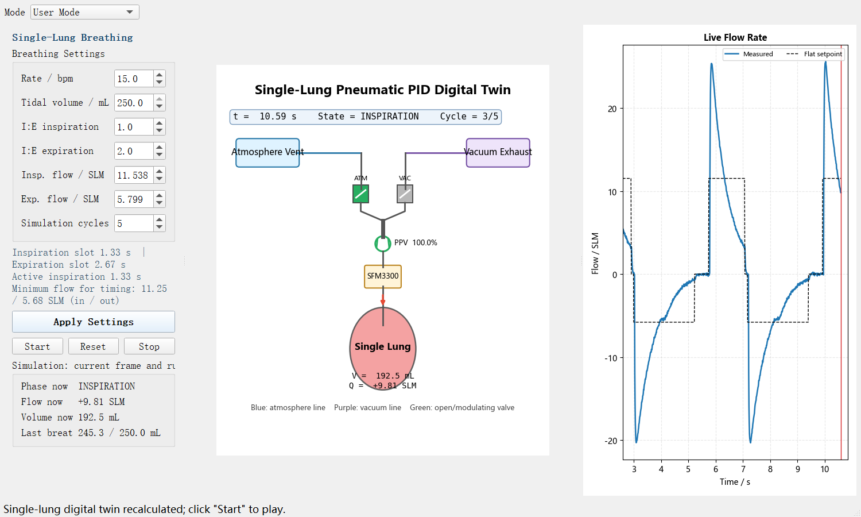
2 — UI WALKTHROUGH
User Mode: set a breath, play it back, assess the result
1
Breathing inputs
1
Rate, tidal volume, I:E, flow and cycle count.
2
Apply & playback
4
Recalculate, then start, pause, reset or stop.
3
3
Pneumatic state
ATM/VAC route, PPV opening, phase, flow and volume.
2
4
Live flow
Measured model output against the flat setpoint.
5
5
Outcome
Current frame plus last-breath volume versus target.
The interface exposes clinical-style settings while keeping model assumptions out of the main workflow.
Figure: current single_lung_pid_gui.py User Mode; displayed values are simulated
4
Notes:
User Mode is the main demonstration view. First, the user enters the breathing target. Applying the settings recalculates the full simulation. Playback then shows the current phase, routing valves, pinch-valve opening, sensor location, lung volume and flow. The panel on the left reports the current frame and the most recent tidal volume. The flow chart compares simulated measured flow with the requested flat setpoint. This is precomputed playback, not live hardware data.

Slide 5
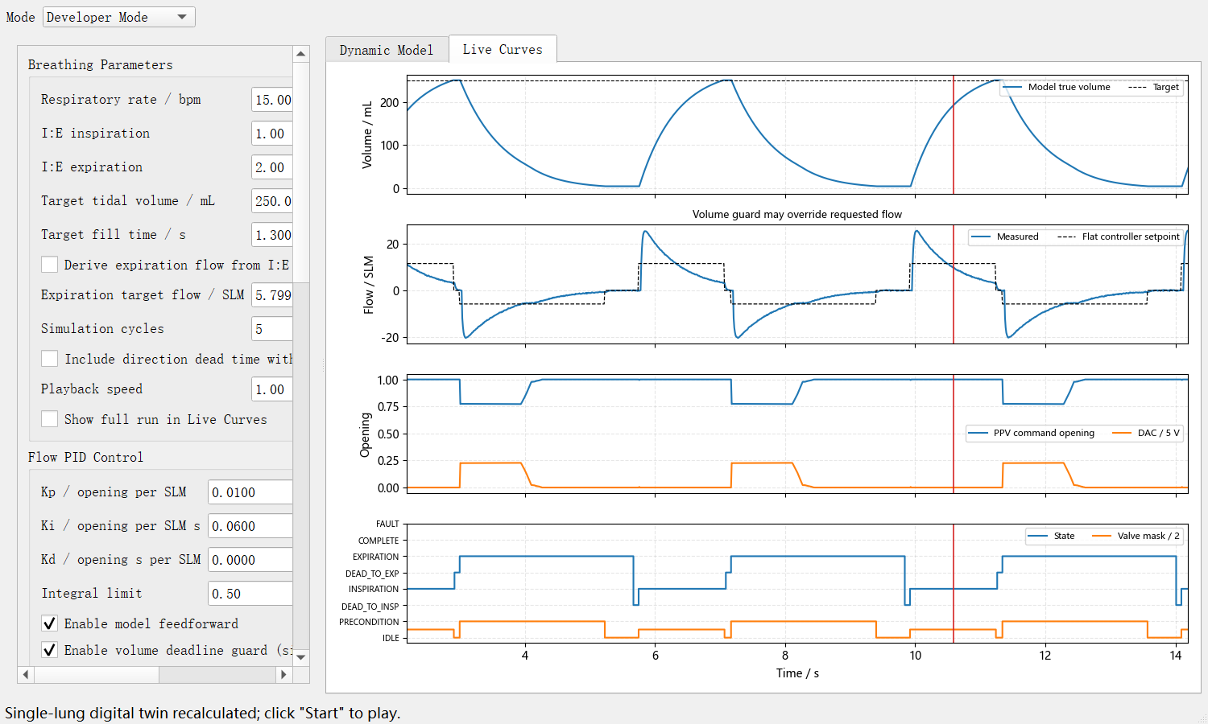
2 — UI WALKTHROUGH
Developer Mode: expose assumptions and diagnose why a case passes
3
1
Test definition
1
Breathing timing, target volume and run length.
2
Controller options
PID, feedforward, Smith prediction and volume guard.
4
3
Volume evidence
True model volume and target over repeated breaths.
4
Flow evidence
2
Sensor-model flow reveals overshoot and missed setpoints.
5
5
Actuation & state
PPV opening, DAC command, route and phase timing.
A passing volume is interpreted together with flow tracking, saturation, timing and valve state.
Figure: current single_lung_pid_gui.py Developer Mode; displayed values are simulated
5
Notes:
Developer Mode answers a different question: why did the result pass or fail? It exposes timing, controller gains, model feedforward, Smith prediction, input delay, sensor assumptions and the optional volume deadline guard. The plots align volume, flow, PPV command and the state machine on the same time axis. This matters because a tidal-volume pass may still rely on valve saturation or a large flow pulse.

Slide 6
03
Current status
What is implemented, what the 30-cycle study shows, and why the nominal 15 bpm case still needs a requirements decision.
6
Notes:
The next section separates completed software capability from physical-system evidence, then examines the nominal fifteen-breath-per-minute case.

Slide 7
3 — CURRENT STATUS
The UI is implemented; the physical closed loop is not yet verified
AVAILABLE NOW
NOT YET DEMONSTRATED
✓
User and Developer workflows
–
Physical PPV actuation from this controller
✓
Input checks and timing warnings
–
SFM3300 feedback used by the PID
✓
Flow, volume, command and state plots
–
Synchronized pressure acquisition
✓
Repeatable 30-cycle simulation studies
–
30-cycle hardware repeatability
✓
Saved configuration and playback
–
Independent two-branch operation
Use the UI today for simulation, requirement discussion and experiment planning—not hardware acceptance.
Evidence: source code, STM32 demo scope, PROTOTYPE_REQUIREMENTS.md
7
Notes:
The interface itself is implemented and supports two levels of use, parameter validation, plots, repeatable simulations and saved settings. However, the physical controller is not complete. The STM32 demo can read the SFM3300, but that reading is not yet used by this PID model; the pinch valve is not driven by this loop; pressure is not synchronized; and neither 30 physical breaths nor independent dual-branch control has been verified.

Slide 8
3 — CURRENT STATUS
At 15 bpm, thirty simulated breaths pass with almost no margin
±5% lower limit
15 bpm
12 bpm
245.3–250.0 mL
✓
242.6–246.3 mL
Passes the ±5% simulation band
15 bpm
242.6–246.3 mL
✓
16 bpm
237.3–240.8 mL
×
Critical caveat
18 bpm
227.2–231.1 mL
×
PPV is fully open for ~100% of inspiration.
No meaningful throttling margin remains.
220
230
237.5
240
250
Tidal volume across 30 cycles / mL
This is a model result under stated assumptions, not evidence of installed-path performance.
Data: output/requirement_benchmark/single_lung_30_cycle_benchmark.md; guard on, assumed plant
8
Notes:
The 30-cycle model result is useful, but it must be described precisely. Twelve and fifteen breaths per minute are within the 237.5 to 262.5 millilitre acceptance band. Sixteen misses by 0.2 millilitres in its weakest breath, and eighteen fails clearly. At fifteen, however, the volume deadline guard drives the pinch valve fully open for almost every inspiration sample. Therefore fifteen is a marginal simulated pass with no useful control margin, not a robust hardware result.

Slide 9
3 — CURRENT STATUS
15 bpm is a requirement trade-off, not just a PID tuning problem
Available inspiration time at 15 bpm, I:E = 1:2
1.333 s inspiration slot
DECISION NEEDED FROM 4DMEDICAL
≈1.23 s remaining for pneumatic response
1
Must 15 bpm, 250 mL and I:E 1:2 all be fixed simultaneously?
80 ms
switch
~25 ms
delay
2
Is ±5% required for every breath, and is a high early-flow pulse acceptable?
Assumed full-open reach: 1.30 s
Result: the controller is saturated before it can create comfortable margin.
3
If the path saturates, should we change timing, target volume or hardware capacity?
18 bpm under the current assumed plant: 227–231 mL; PID gain changes cannot overcome full-open saturation.
When the PPV is already fully open, software cannot create additional pneumatic flow.
Timing and saturation evidence: benchmark and 18 bpm trade-off studies; installed path remains unmeasured
9
Notes:
At fifteen breaths per minute, the full cycle is four seconds and the one-to-two ratio gives 1.333 seconds for inspiration. Direction switching and the assumed input delay leave about 1.23 seconds of pneumatic response, while the model assumes 1.30 seconds to reach full volume from empty. That explains why the volume guard saturates the valve. We need 4DMedical to tell us which constraints are clinically or experimentally non-negotiable: cadence, tidal volume, I:E ratio, per-breath tolerance and flow shape. At eighteen, this assumed plant cannot reach the tolerance band even when fully open, so changing PID gains alone is not a solution.

Slide 10
04
Future
Calibrate the installed pneumatic path, close the hardware loop, and validate against the agreed acceptance test.
10
Notes:
The final section turns the current uncertainty into a short measurement and validation plan.

Slide 11
4 — FUTURE
Future work: replace assumptions with measurements, then validate
1
Calibrate the path
2
Close the real loop
3
Validate performance
Full-open ATM/VAC response
Fixed-opening PPV sweep
Synchronize Q(t), V(t), P(t), commands
Drive PPV and routing valves
Feed SFM3300 data to controller
Verify timing and safety interlocks
30 cycles at agreed nominal/boundary
Report volume, flow and saturation
Then test independent dual branches
→
→
Measured model
Hardware closed loop
Requirement evidence
Success is a measured 30-cycle result against an agreed requirement—not a favourable simulation trace.
Proposed experiments: experiment_design_speaker_notes.md and PROTOTYPE_REQUIREMENTS.md
11
Notes:
The next stage has three gates. First, calibrate the assembled path using a fully open inspiration and expiration test plus a fixed-opening pinch-valve sweep, with synchronized flow, independent volume, pressure and command signals. Second, implement the real closed loop so the microcontroller drives the valves and uses measured flow. Third, run 30-cycle tests at the agreed nominal and boundary conditions, then extend to two independently controlled branches. Each gate produces evidence for the next one.

