Slide 1
PPV40V Bench Experiments
PWM–voltage calibration and fake-lung inspiration modelling
Two experiments
2026-10-06
1. PCB/Arduino PWM → voltage
2. PPV voltage → inspiratory flow
Preliminary parameter identification and test-quality review

Slide 2
Introduction
Electrical command conversion and pneumatic system response
Experiment 1: PWM–voltage sweep
Experiment 2: fake-lung inspiration
PWM
PCB+STM32
Multimeter
PPV voltage
Open ATM
SFM3300
0%-100%
bias from nominal value
0–5 V
0–4.2 V
Inspiration step
flow rate
• Linearity, steady-state error
• Time constant, control range, closure voltage and γ
• PPV was preset; its actuation delay cannot be isolated
The electrical calibration supports interpreting the flow plateau as a pneumatic-system effect.
2

Slide 3
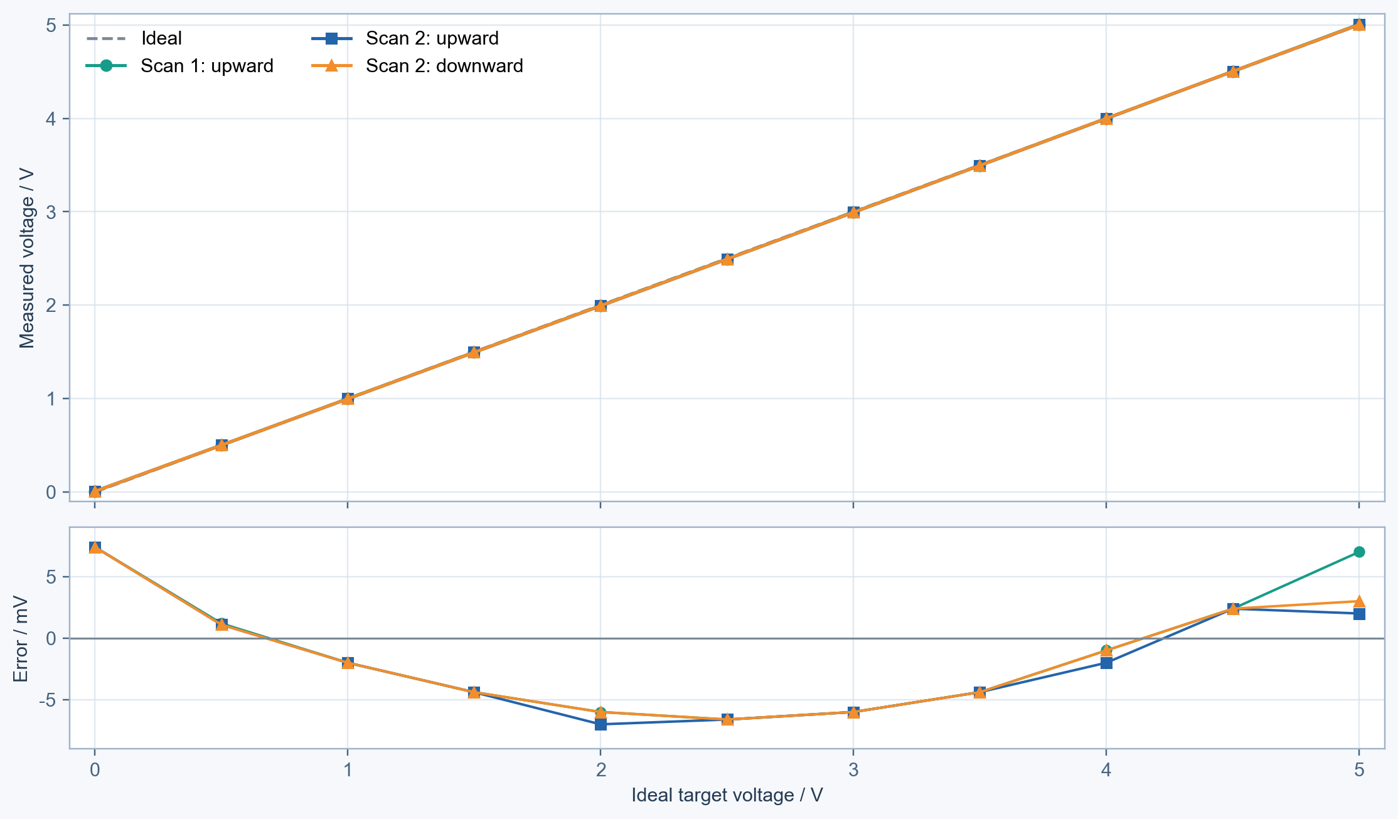
Experiment 1: output voltage closely follows the PWM command
Method
Sweep 0–100%, then 100–0%
Measured results
• Maximum error: 7.4 mV
• Max. up/down difference: 1.0 mV
Conclusion
Passing through the PCB and bridge board does not affect the ideal voltage output (i.e., the boards do not interfere with the pinch valve control).
3

Slide 4
Experiment 2: inspiration at a fixed PPV voltage
Manually compress the fake lung, then open ATM to initiate inspiration
1
Compress lung
2
Close ATM/VAC
3
Set PPV
4
Open ATM
5
Record flow
Manual initial state
Isolate the circuit
0–4.2 V
Inspiration
SFM3300, 50 Hz
- Inspiratory flow curve ------ first order system
- inspired volume------tidal volumn
- Fully open time constant τin (τeff in fully open)
- Effective time constant τeff at different voltages
- PPV control range and closure voltage
- Nonlinearity parameter γ ----modeling parameter value about the PPV
4

Slide 5
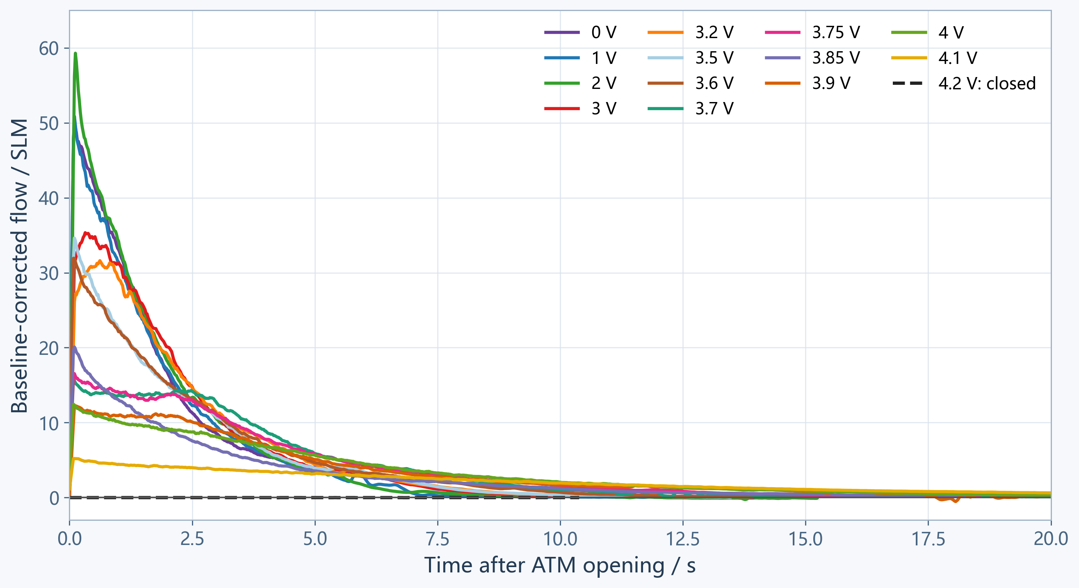
flow traces
• 0–3.2 V: The curves decay at similar rates, indicating little valve restriction.
• 3.5–3.9 V: The flow peaks decrease, and inspiration takes longer.
• 4.1 V: The flow is much lower, and the response is significantly slower.
• 4.2 V: The flow is close to the baseline, indicating that the valve is fully closed.
• Peak flow depends on the initial compression of the fake lung
6

Slide 6
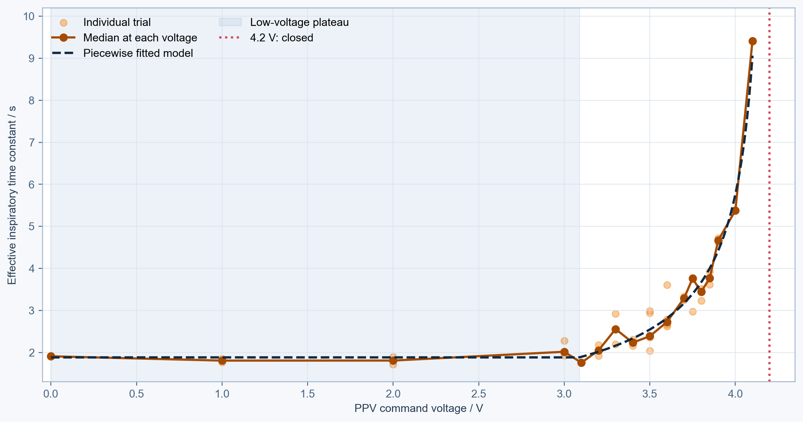

First-order time-constant identification
Initial results
The following initial modelling parameters were obtained:
• Fully open inspiratory time constant: τin ≈ 1.9 s
• Effective control onset voltage: Ud ≈ 3.1 V
• Full closure voltage: Uc ≈ 4.2 V
• Nonlinearity parameter: γ ≈ 0.65
• Effective time constant τeff
Use τin ≈ 1.9 s as the fully open baseline; the time constant rises rapidly above 3.9 V.
7

Slide 7
Limitations: only inspiration was identified
Identified
Still unknown
Control implications
•basic modeling parameter:
Fully open τin and restricted-opening τeff
• PPV control range, closure voltage and γ
• Expiratory / vacuum-collapse time constant τout
• Isolated PPV command-to-flow delay
• Vacuum is adjustable; τout is less urgent for the current inspiration model
• τout is still needed to assess breathing rate, I:E ratio and cycle consistency
• Identify τout at several vacuum settings
Adjustable vacuum can tune expiration speed; a complete model still needs both inspiratory and expiratory parameters.
10

Slide 8
Preliminary results: usable initial model parameters
Use these estimates for initial modelling and sensitivity analysis, rather than final calibration
τin ≈ 1.9 s
Ud ≈ 3.1 V
Uc = 4.2 V
γ ≈ 0.65
R² = 0.986
Fully open; 1.8–2.1 s
Control onset
Confirmed closure
Sensitivity: 0.60–0.70
τ–voltage fit
Suggested initial inspiration model
Applications
τeff = τin / aeff(U)^γ
• Initial feedforward model parameters
• Controller parameter sensitivity tests
• Baseline for subsequent breathing-cycle tests
aeff=1 for U≤3.1 V; decreases linearly to 0 at 4.2 V; closed for U≥4.2 V.
Apply γ≈0.65 together with the piecewise effective opening aeff(U).
11

Slide 9
Future work
1.
Vacuum / expiration tests
2.
PPV step response and delay
Record flow at several vacuum settings; estimate τout and collapse volume.
With ATM open and pressure drop stable, step PPV and record command and flow together.
3.
Complete breathing cycles
Run consecutive inspiration / expiration cycles; check phase switching and repeatability.
12

Slide 10
Appendix: time constants by voltage
Ranges show the minimum and maximum individual fitted values at each voltage
Voltage / V | n | Median τ / s | τ range / s | Peak flow / SLM | Median volume / mL
0 | 1 | 1.91 | 1.91–1.91 | 51.7 | 1602
1 | 2 | 1.81 | 1.76–1.85 | 47.9 | 1569
2 | 2 | 1.81 | 1.72–1.90 | 61.7 | 1674
3 | 3 | 2.02 | 1.93–2.28 | 48.5 | 1569
3.1 | 1 | 1.76 | 1.76–1.76 | 53.0 | 1571
3.2 | 2 | 2.05 | 1.92–2.18 | 41.2 | 1528
3.3 | 2 | 2.56 | 2.19–2.92 | 39.7 | 1539
3.4 | 2 | 2.23 | 2.16–2.31 | 37.7 | 1513
3.5 | 5 | 2.39 | 2.04–2.99 | 35.5 | 1375
3.6 | 4 | 2.72 | 2.62–3.61 | 23.0 | 1396
3.7 | 2 | 3.29 | 3.25–3.33 | 16.3 | 1291
3.75 | 3 | 3.76 | 2.97–3.77 | 17.9 | 1342
3.8 | 3 | 3.44 | 3.23–3.51 | 16.5 | 1323
3.85 | 2 | 3.77 | 3.62–3.92 | 18.4 | 1078
3.9 | 2 | 4.67 | 4.62–4.72 | 12.4 | 1245
4 | 1 | 5.38 | 5.38–5.38 | 13.1 | 1193
4.1 | 1 | 9.41 | 9.41–9.41 | 5.6 | 837
4.2 | 1 | Closed | — | ≈0 | —
13

