Slide 1
R 프로그래밍 #9
2019. 05. 08
한국생명공학연구원
김하성

Slide 2
In the previous lecture
Exercised how to manipulate and to visualize a dataset
ggplot2
geom_bar, geom_line
geom_errorbar
dplyr
%>%, group_by, summarize
mutate, select, join
reshape2

Slide 3
In today’s lecture
Exercised how to manipulate and to visualize a dataset
ggplot2
geom_bar, geom_line
geom_errorbar, scale, theme
96well dataset
dplyr
%>%, group_by, summarize
mutate, select, join
reshape2
https://tutorials.iq.harvard.edu/R/Rgraphics/Rgraphics.html

Slide 4
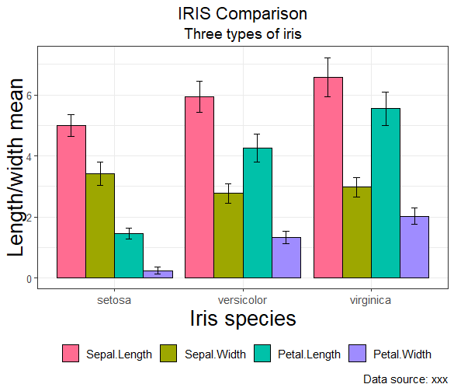
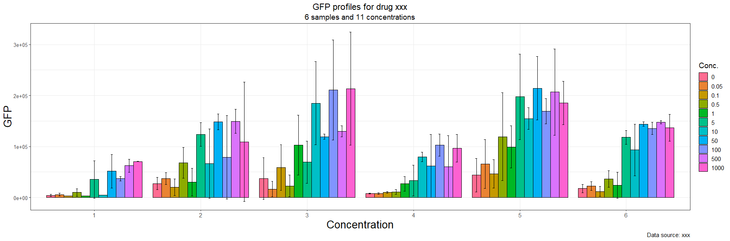
Start at the end

Slide 5


Data analysis in R
Data
Manipulated
data
Visualization
split
subset
apply
merge
join
…
ggplot2
Analysis
https://www.tidyverse.org/

Slide 6
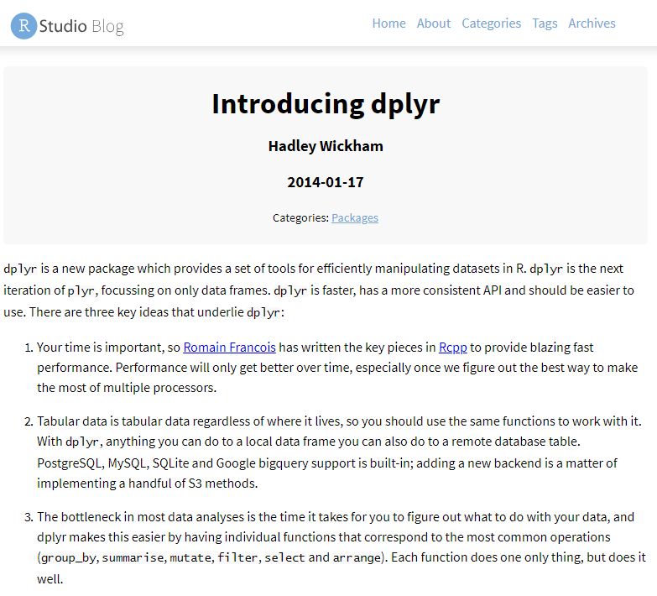

Slide 7
dplyr functions
dplyr Function | Description
select() | Selecting columns (variables)
filter() | Filter (subset) rows.
group_by() | Group the data
summarise() | Summarise (or aggregate) data
arrange() | Sort the data
join() | Joining data frames (tables)
mutate() | Creating New Variables
str(iris)
tmp <- select(iris, Sepal.Length)
head(tmp)
# to select variables
iris_sepal <- select(iris, Sepal.Length, Sepal.Width)
head(iris_sepal)
# to select a variable and divide into groups
iris_sepal <- select(iris, Sepal.Length, Sepal.Width, Species)
iris_group <- group_by(tmp, Species)
iris_group
# to get means
iris_mean <- summarize(iris_group,
mean(Sepal.Length),
mean(Sepal.Width))
iris_mean
# to get means for all columns
iris_mean <- summarize_all(iris_group, mean)
iris_mean
# to get standard deviations for all columns
iris_sd <- summarize_all(iris_group, sd)
iris_sd
# join iris_mean and iris_sd with the same species
iris_join <- inner_join(iris_mean, iris_sd, by="Species")
iris_join
mutate(iris_join, Sepal.Length.x+2)
colnames(iris_join) <- c("Specis",
"Sepal.Length.mean",
"Sepal.Width.mean",
"Sepal.Length.sd",
"Sepal.Width.sd")
# use pipe operator
iris_mean <- iris %>%
select(Sepal.Length, Sepal.Width, Species) %>%
group_by(Species) %>%
summarize_all(mean)

Slide 8
The Pipe Operator: %>% (dplyr package)
=
apply
combine
plot
analysis
mean
%>% takes the output of its lhs statement and makes it the input of the rhs (next) statement
f(x) == x %>% f
Short cut in Rstudio: Shift + Ctl + m (Alt+_ for <-)
Placeholder . operator

Slide 9
example 9-1) ggplot and dplyr
Draw a bar graph of the iris_join$Sepal.length.mean
using plot function
using ggplot function
Draw a bar graph of the all the mean variables in iris_join
using plot function
using ggplot function
Dataset of mean and sd for all variables of iris

Slide 10
Transform data structure for ggplot
x y
1 1
2 6
5 7
7 8
variable value
x 1
x 2
x 5
x 7
y 1
y 6
y 7
y 8
=
x y z
1 1 3
2 6 4
5 7 5
7 8 6
variable value
x 1
x 2
x 5
x 7
y 1
y 6
y 7
y 8
z 3
z 4
z 5
z 6
=

Slide 11
Melt iris data
library(reshape2)
iris_melt <- melt(iris_mean)
iris_mean <- iris %>% group_by(Species) %>% summarize_all(mean) %>% melt
iris_sd <- iris %>% group_by(Species) %>% summarize_all(sd) %>% melt
iris_join <- inner_join(iris_mean, iris_sd, by=c("Species", "variable"))
colnames(iris_join)[c(3,4)] <- c("mean", "sd")
## change column name value → mean or sd
iris_mean <- iris %>% group_by(Species) %>% summarize_all(mean) %>% melt(value.name=c("mean"))
iris_sd <- iris %>% group_by(Species) %>% summarize_all(sd) %>% melt(value.name=c("sd"))
iris_join <- inner_join(iris_mean, iris_sd, by=c("Species", "variable"))
iris_join

Slide 12
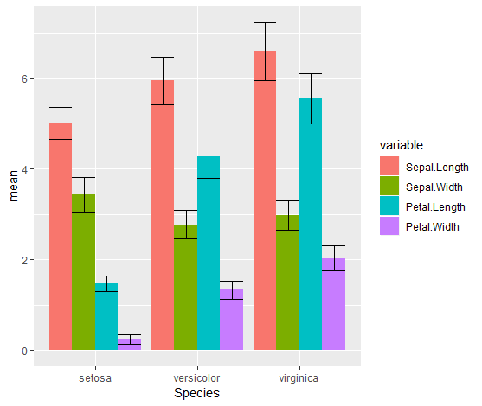
iris data bar graph
ggplot(iris_join, aes(x=Species, y=mean, fill=variable)) +
geom_bar(stat="identity", position="dodge")
ggplot(iris_join, aes(x=Species, y=mean, fill=variable)) +
geom_bar(stat="identity", position="dodge") +
geom_errorbar(aes(min=mean-sd, max=mean+sd), position="dodge")

Slide 13
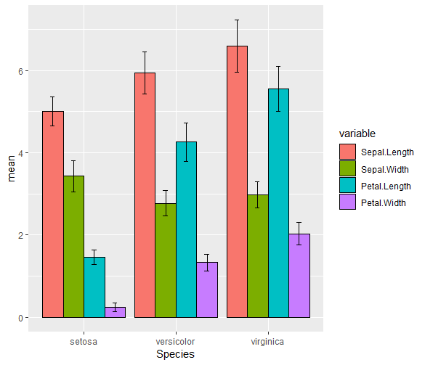
Draw error bars
p1 <- ggplot(iris_join, aes(x=Species, y=mean, fill=variable)) +
geom_bar(stat="identity", position="dodge", color="black") +
geom_errorbar(aes(ymin=mean-sd, ymax=mean+sd), width=.2, position=position_dodge(0.9))
p1

Slide 14
Scale
aes mapping data to variable. Scale sets detail indications (axis, label, legend, …)
position
color and fill
size
shape
line type
Scales are modified with a series of functions using a scale_<aesthetic>_<type> naming scheme. Try typing scale_<tab> to see a list of scale modification functions.
Common scale arguments
name: the first argument gives the axis or legend title
limits: the minimum and maximum of the scale
breaks: the points along the scale where labels should appear
labels: the labels that appear at each break

Slide 15
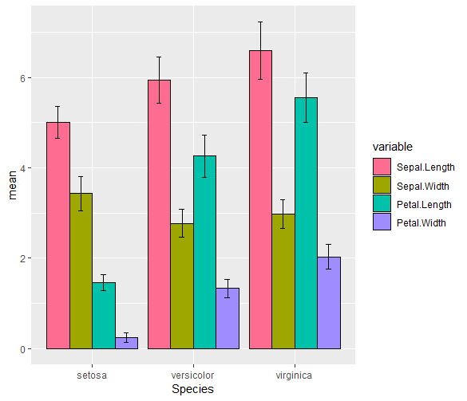
Scale
p1 + scale_fill_brewer(palette = "Greens")
p1 + scale_fill_hue(h = c(0, 360))
p2 <- p1 + scale_fill_hue(h = c(0, 360)) +
scale_y_continuous(name="Length/width Mean") +
scale_x_discrete(name="Iris species")
p2
p2 <- p1 + scale_fill_hue(h = c(0, 360)) +
ylab("Length/width Mean2") +
xlab("Iris species2") +
labs(title = "IRIS Comparison", subtitle="Three types of iris", caption="Data source: xxx", fill="Types")
p2
?scale_fill_hue

Slide 16
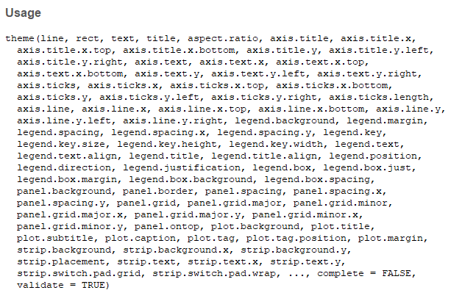
Theme
Axis label
Plot background
Facet label backround
Legend appearance

Slide 17
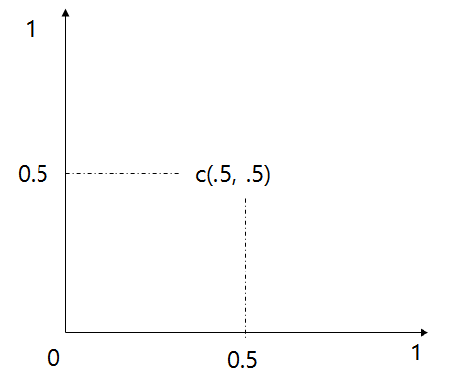
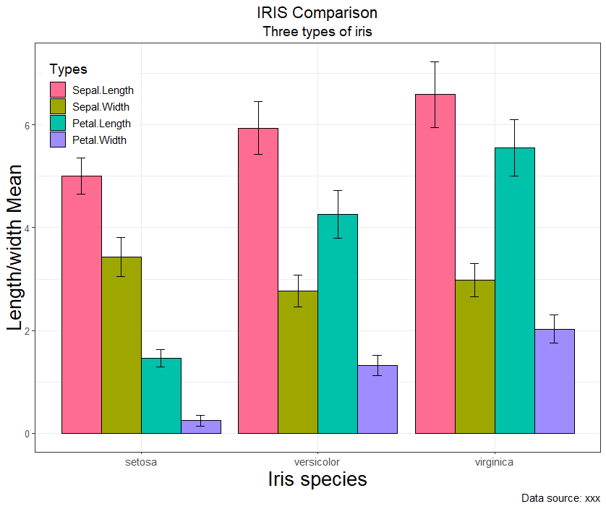
Theme overriding
p2 + theme_bw() +
theme(
text=element_text(size=14),
axis.text.y = element_text(size=10),
axis.title.y = element_text(size=20),
axis.title.x = element_text(size=20),
#legend.position = "bottom",
legend.position = c(0.1,0.9),
plot.title=element_text(hjust=0.5),
plot.subtitle=element_text(hjust=0.5)
)

Slide 18
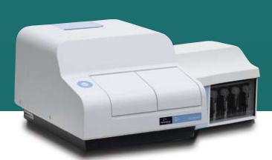
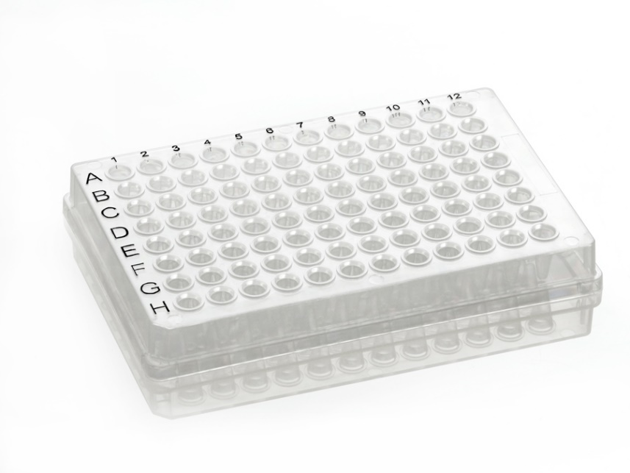
Dataset for exercise Experiment conditions Cell types: 1~4 Drug type: 1 (phenol) Drug concentrations: 11 points Replications: 4 times

Slide 19
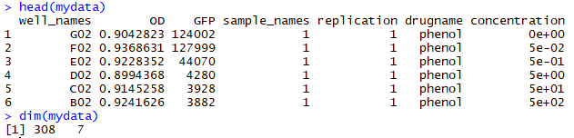
Dataset
setwd("C:\\Rprog\\07")
source("read_plate.R")
design_file_name <- "exp_design2.xlsx"
data_file_names <- c("20171012-phenol-1.xls",
"20171012-phenol-2.xls",
"20171227-phenol-1.xls",
"20171227-phenol-2.xls")
mydata1 <- multiple_plate_excel_reader2(design_file_name, data_file_names[1], sheet4design=1)
mydata2 <- multiple_plate_excel_reader2(design_file_name, data_file_names[2], sheet4design=2)
mydata3 <- multiple_plate_excel_reader2(design_file_name, data_file_names[3], sheet4design=3)
mydata4 <- multiple_plate_excel_reader2(design_file_name, data_file_names[4], sheet4design=4)
mydata <- rbind(mydata1, mydata2, mydata3, mydata4)
mydata2 <- mydata
mydata2$concentration <- as.factor(mydata2$concentration)
str(mydata2)
head(mydata2)

Slide 20
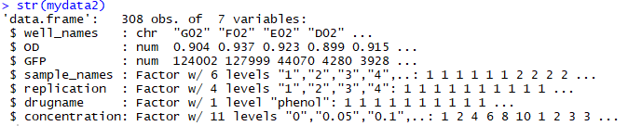
Dataset
Experiment conditions Cell types: 1~6 Drug type: 1 (phenol) Drug concentrations: 11 points Replications: 4 times

Slide 21
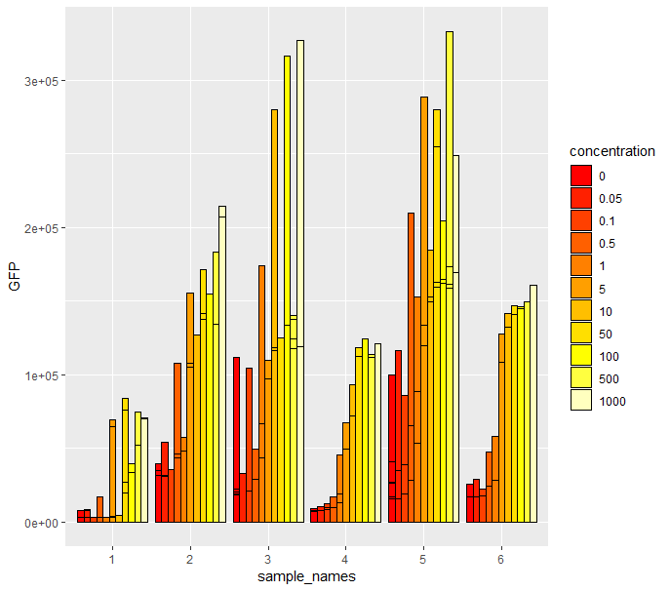
barplot - ggplot
ggplot(data=mydata2, aes(x=sample_names, y=GFP, fill=concentration)) +
geom_bar(stat="identity", position="dodge", color="black") +
scale_fill_manual(values = heat.colors(11))

Slide 22
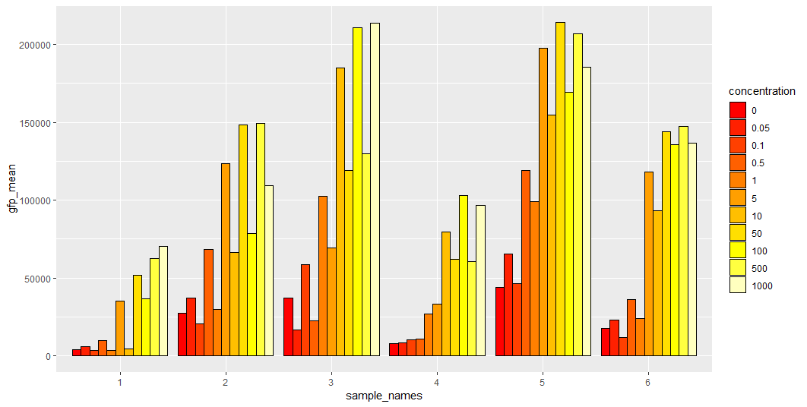
Plot gfp mean values
grouped_data <- group_by(mydata2, sample_names, drugname, concentration)
data_mean <- summarize(grouped_data, gfp_mean=mean(GFP))
ggplot(data_mean, aes(x=sample_names, y=gfp_mean, fill=concentration)) +
geom_bar(stat="identity", position="dodge", color="black") +
scale_fill_manual(values = heat.colors(11))
save(mydata2, file="mydata2.Rdata")
load(mydata2)

Slide 23
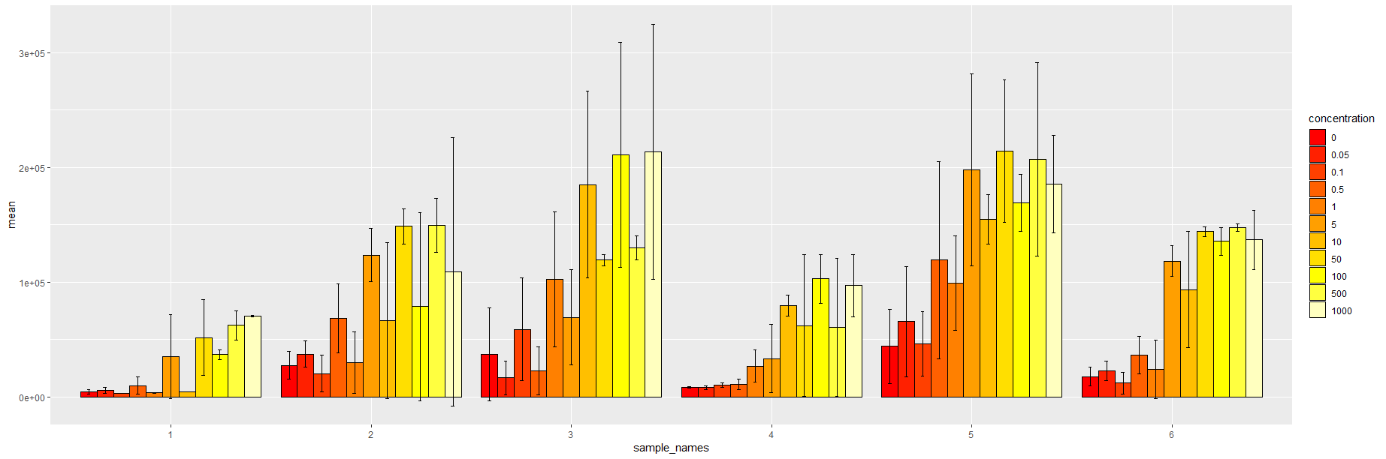
bar graph with error bars
grouped_data <- group_by(mydata2, sample_names, drugname, concentration)
data_mean <- summarize(grouped_data, mean=mean(GFP))
data_sd <- summarize(grouped_data, sd=sd(GFP))
data_join <- inner_join(data_mean, data_sd, by=c("sample_names", "drugname", "concentration"))
ggplot(data_join, aes(x=sample_names, y=mean, fill=concentration)) +
geom_bar(stat="identity", position="dodge", color="black") +
scale_fill_hue(h = c(0, 360)) +
geom_errorbar(aes(min=mean-sd, max=mean+sd), width=.2, position=position_dodge(0.9))

Slide 24
bar graph with error bars
p1 <- ggplot(data_join, aes(x=sample_names, y=mean, fill=concentration)) +
geom_bar(stat="identity", position="dodge", color="black") +
geom_errorbar(aes(min=mean-sd, max=mean+sd), width=.2, position=position_dodge(0.9))
p1 + scale_fill_hue(h = c(0, 360)) +
ylab("GFP") +
xlab("Concentration") +
labs(title = "GFP profiles for drug xxx",
subtitle="6 samples and 11 concentrations",
caption="Data source: xxx", fill="Conc.") +
theme_bw() +
theme(
text=element_text(size=14),
axis.text.y = element_text(size=10),
axis.title.y = element_text(size=20),
axis.title.x = element_text(size=20),
plot.title=element_text(hjust=0.5),
plot.subtitle=element_text(hjust=0.5)
)

Slide 25
Next
Sequence analysis in R
Install packages
shiny
Biostrings
rentrez

