Slide 1
igem_team
id (character)
team_name (character)
project (character)
year (character)
wiki (character)
igem_part
id (character)
BBid (character)
type (character)
link (character)
backbone (character)
device_id (character)
team_name (character)
user (character)
igem_obs
id (character)
strain (character)
indc (character)
conc (numeric)
concunit (character)
value (numeric)
valunit (character)
incubhr (numeric)
incubtemps (character)
device_id (character)
link (character)

Slide 2
igem_team
id (character)
team_name (character)
project (character)
year (character)
wiki (character)
Unique
igem_device
id (character)
device_name (character)
Unique
igem_obs
id (character)
strain (character)
indc (character)
conc (numeric)
concunit (character)
value (numeric)
valunit (character)
incubhr (numeric)
incubtemps (character)
device_name (character)
link (character)
igem_part
id (character)
BBid (character)
type (character)
link (character)
backbone (character)
device_name (character)
team_name (character)
user (character)

Slide 3
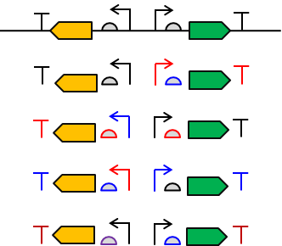
igem_team
id (character)
team_name (character)
project (character)
year (character)
wiki (character)
1
Unique
igem_obs
id (character)
strain (character)
indc (character)
conc (numeric)
concunit (character)
value (numeric)
valunit (character)
incubhr (numeric)
incubtemps (character)
device_name (character)
link (character)
igem_part
id (character)
BBid (character)
type (character)
link (character)
backbone (character)
device_name (character)
team_name (character)
user (character)
igem_device
id (character)
device_name (character)
1
(M)
M
?
M
M
M

Slide 4
igem_part

Slide 5
igem_team
id (character)
team_name (character)
project (character)
year (character)
wiki (character)
1
igem_obs
id (character)
strain (character)
indc (character)
conc (numeric)
concunit (character)
value (numeric)
valunit (character)
incubhr (numeric)
incubtemps (character)
device_id (character)
link (character)
igem_device
id (character)
device_name (character)
part_combination (character)
M
M
igem_part
id (character)
BBid (character)
type (character)
link (character)
backbone (character)
device_id (character)
team_id (character)
user (character)
프로모터 A,
RBS B
CDS C
Terminator D
조합의 경우
A, B, C, D가 igem_part 테이블의
1, 3, 5, 6 id를 가지고 있으면
M
M
“1,3,5,6” 이라고 입력

