Slide 1
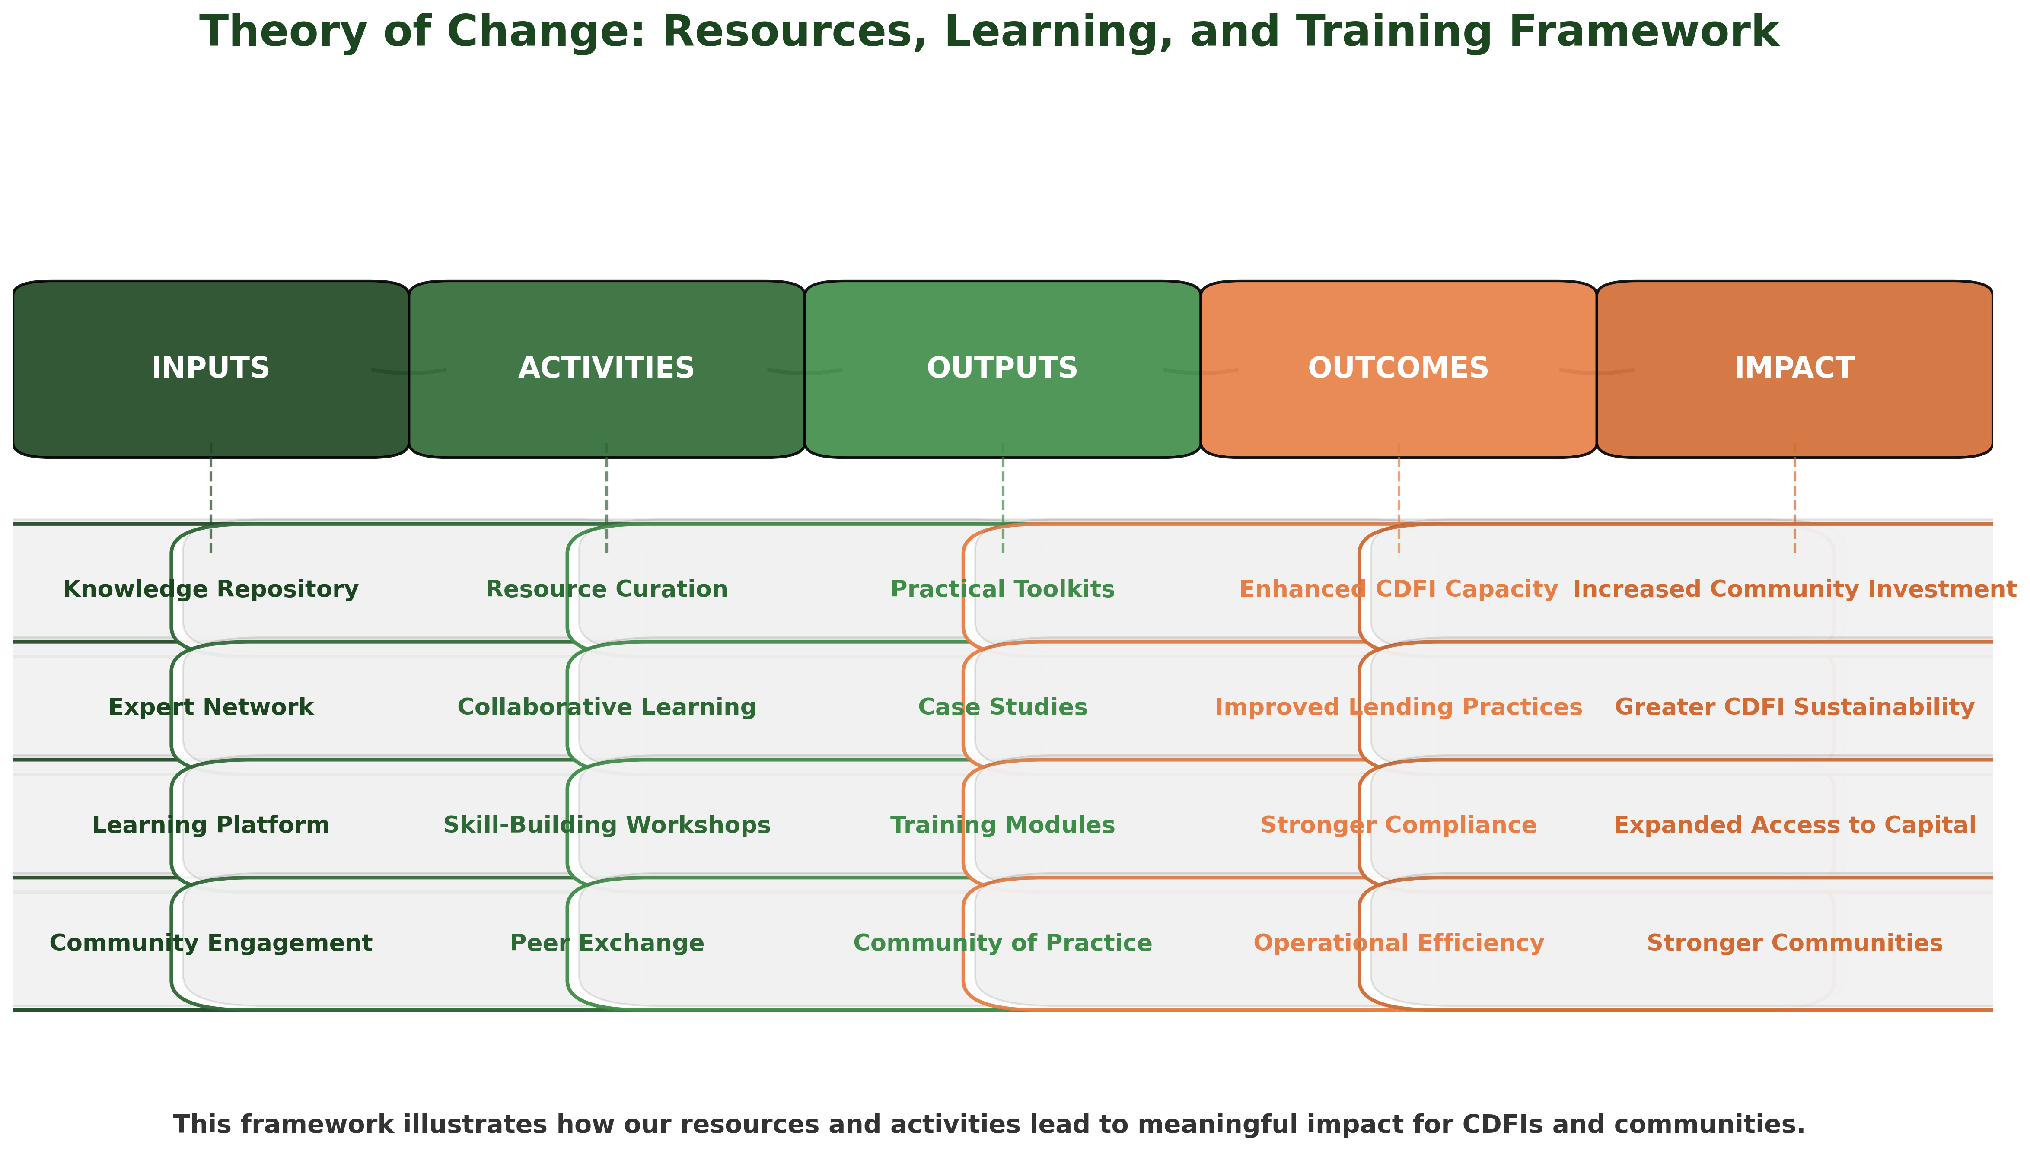

Slide 2
Inputs
Activities
Outputs
Outcomes
Impact
Theory of Change: Resources, Learning, and Training Framework
Knowledge Repository
Resource Curation
Practical Toolkits
Enhanced CDFI Capacity
Increased Community Investment
Expert Network
Collaborative Learning
Case Studies
Improved Lending Practices
Greater CDFI Sustainability
Learning Platform
Skill-Building Workshops
Training Modules
Stronger Compliance
Expanded Access to Capital
Community Engagement
Peer Exchange
Community of Practice
Operational Efficiency
Stronger Communities

