Slide 1
Replication of Acemoglu’s Colonial Origins of Comparative Development Paper
  Based on RPubs analysis (Agniva Ganguly, 2024)
  20‑Minute Presentation
  Emily Green, Dylan Landon, and Christian Amelia

Slide 2
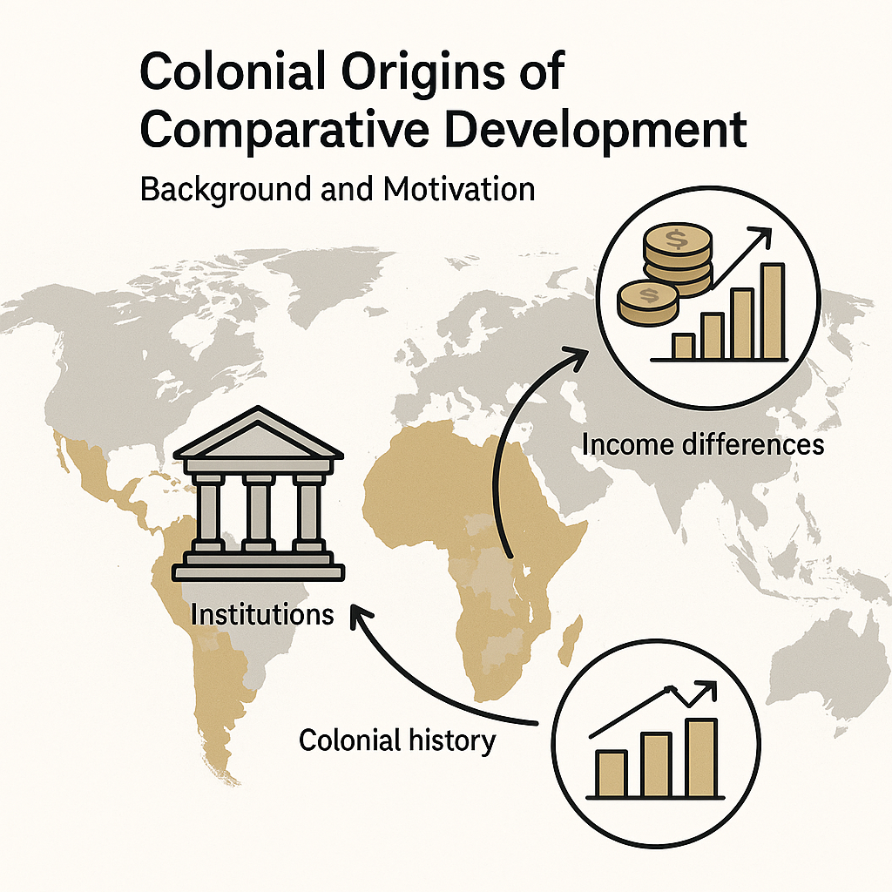
Background & Motivation
Large cross‑country income differences
Hypothesis: institutions explain persistent inequality
Institutions are endogenous; need an instrument
Settler mortality → institutional type
High mortality → extractive institutions
Low mortality → inclusive institutions

Slide 3
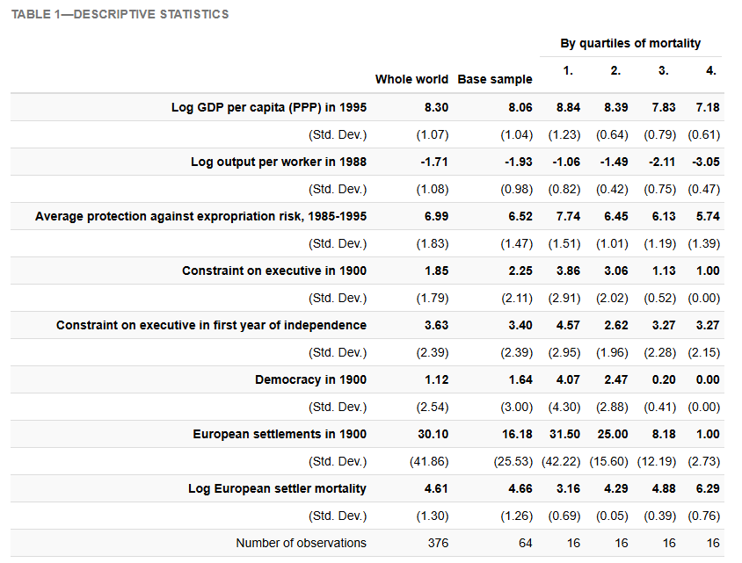
Data & Variables
Outcome:
  log GDP per capita
Institution measure:
  expropriation risk
Instrument:
settler mortality

Slide 4
Data & Variables II
Sample: ~75 former colonies
Controls:
  geography
  legal origin
  continent
  religion

Slide 5
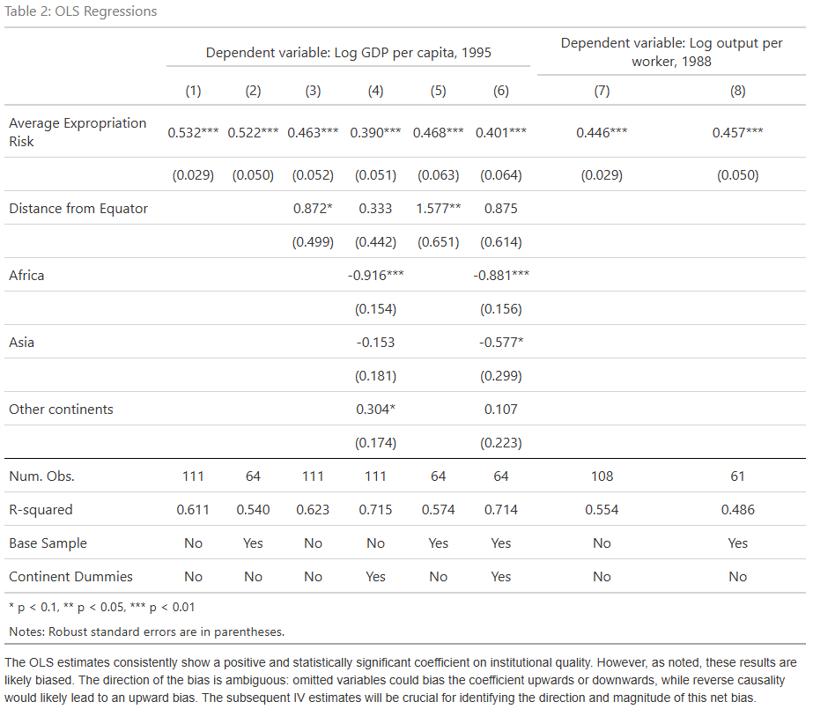
Econometric Model I (OLS)
log(y) = α + β*Institutions + controls
Shows correlation, not causation

Slide 6
Econometric Model II (2SLS)
First stage: mortality → institutions
Second stage: predicted institutions → income
Identification: exclusion restriction

Slide 7
Replication Approach
Uses public replication data
Add scatterplots to check IV relevance
Checks consistency with original results
Robustness and overidentification checks

Slide 8
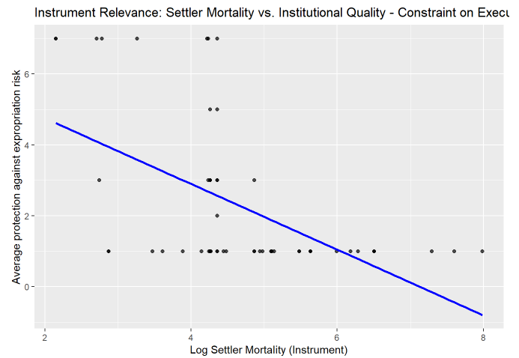
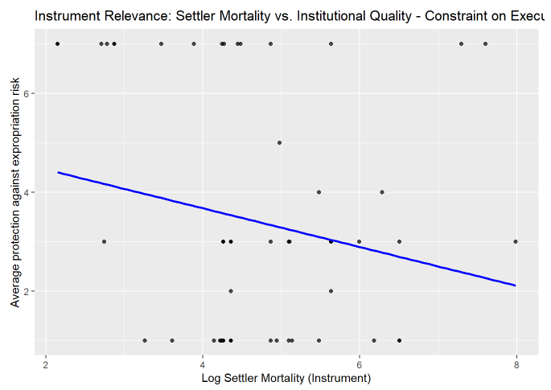
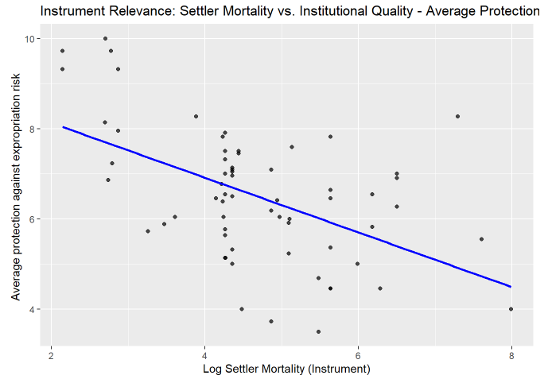
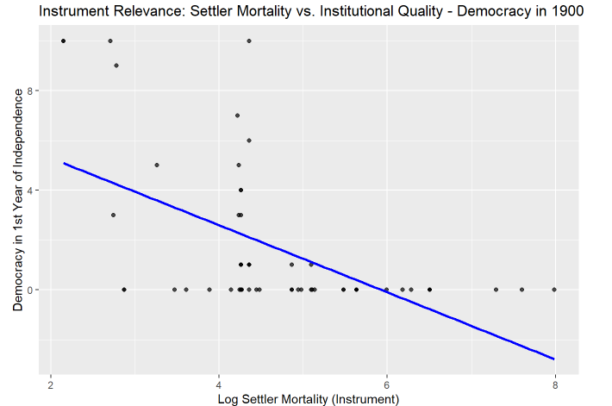
Replication: First Stage
Strong negative relationship
Higher mortality → weaker institutions

Slide 9
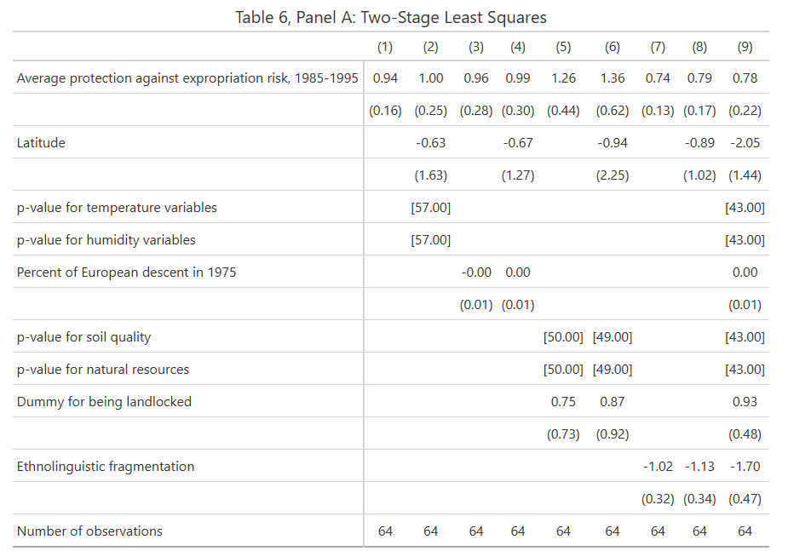
Replication — Second Stage
Instrumented institutions → strongly predict income
Magnitude similar to original findings

Slide 10
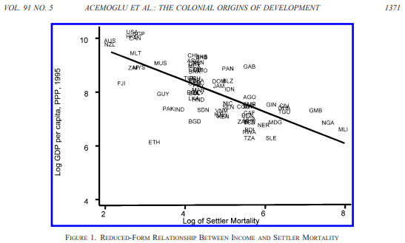
Replication Plot
Reduced form: mortality negatively linked with income

Slide 11
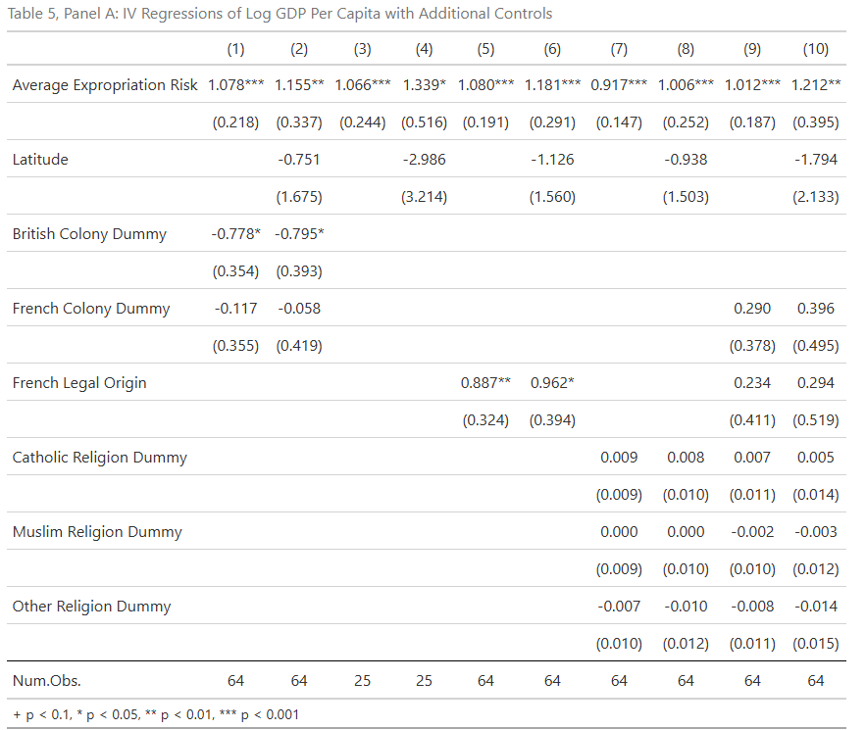
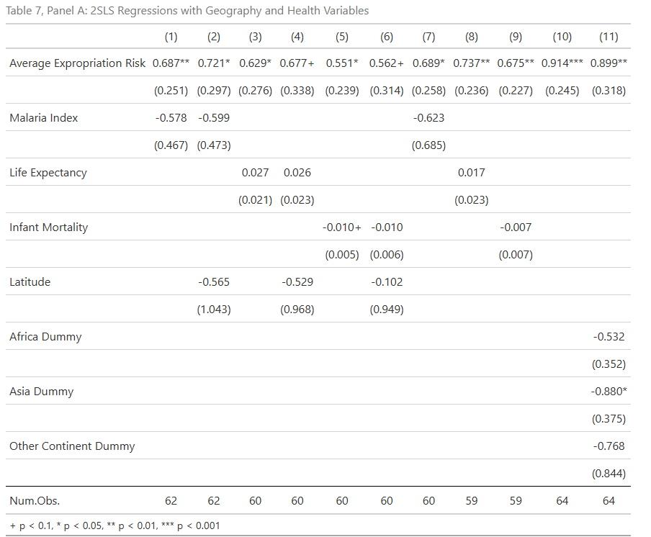
Robustness Tests
Exclude outliers: results stable
Add controls: geography, disease, colonizer identity

Slide 12
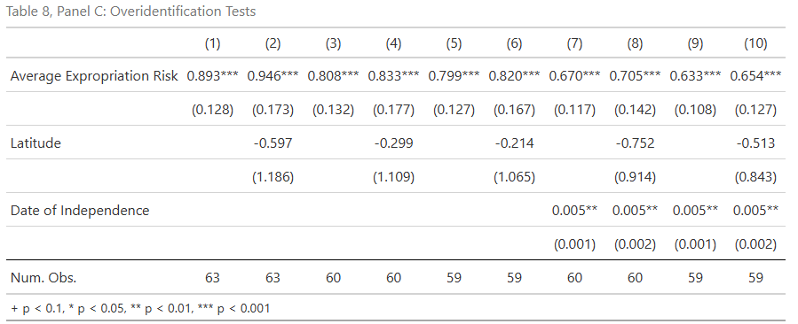
Critiques & Debates
  Instrument validity questioned (Albouy 2012)
  Mortality data quality issues
  Checked alternative instruments – Sargan test

Slide 13
Replication Value
Confirms general findings, importance of institutions driving income differences
Strengthens credibility of IV
Highlights transparency & limitations
Supports policy relevance

Slide 14
Policy Implications
Strengthening institutions may raise incomes
Institutional reform is long‑run and difficult
  Must account for historical legacies
Pushes back on “geography is destiny”
Spurs policy/research focusing on:
  Anti-corruption
  Judicial independence
  Tax administration and state capacity
  Developing inclusive political institutions

Slide 15
Open Science Lessons
Key paper for the value of transparency
  Shapes development policy, and institutions research
Value of shared data and reproducibility
  verify claims,
  identify limitations/challenge weak assumptions,
  And improve future empirical strategies
Replications increase credibility, field progresses

Slide 16
Conclusion
Replication supports main conclusions
  The core empirical relationships are robust
But debates about instrument remain
Open science improves research quality
Overall Takeaway:
Institutions matter hugely — but why they differ, how they persist, and how to change them remains central challenges.

