Slide 1
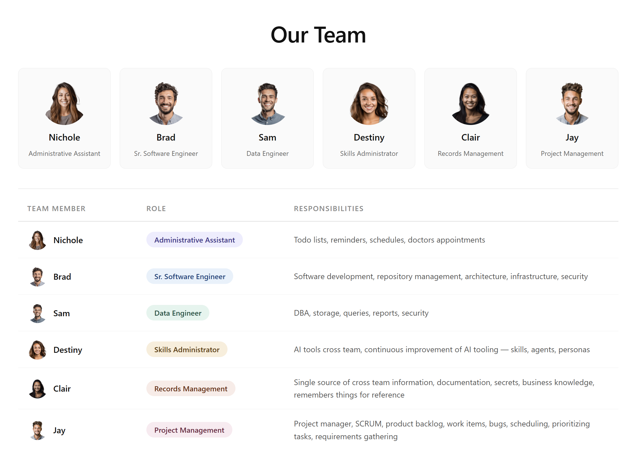
Hire a Team with AI Assistant Personas

Slide 2
No Magic. Just Text Files.
INPUT
OUTPUT
persona.txt
Role, tone, behavior
Focused Responses
Stays in role & scope
skills.txt
What the AI can do
AI
Assistant
Consistent Voice
Predictable behavior
context.txt
Background & goals
Reusable Systems
Same files, any AI tool
How you organize your text files is how you succeed with AI systems.

Slide 3
Context vs. Persona in AI
What the model knows about the situation vs. how the model behaves
CONTEXT
PERSONA
What the model is given (The work)
How the model acts (Who does the work)
Information fed to the model (documents, history, data)
Situational — changes per request or conversation
Answers “what does the model need to know?”
Examples: RAG results, prior messages, attached files
Identity & style the model adopts (tone, role, voice)
Behavioral — consistent across requests
Answers “how should the model respond?”
Examples: system prompt defining a coach, lawyer, tutor
Put simply: context is the material on the desk.
The persona is the colleague you handed it to.

Slide 4
Working with Context
Working with a Persona
How you work with context
Upload an Excel Spreadsheet
Ask agent to get a list of products
Ask agent to query the database to get the total sales volume and put into the spreadsheet.
Agent uses MCP tool or CLI to work with database
Ask agent to get the top 10 grossing products
Ask agent to notify team members by email
How you work with a persona
Dana, can you send the top 10 grossing products that were included in last month’s sales spreadsheet and send it to the marketing team. Add a column for the sales volume for each product.

Slide 5
Context sees everything · Persona gets what it needs
CONTEXT — Full Access
PERSONA — Assigned Skills
Can draw on any skill at any time
Only specific skills assigned to this role
Summarise
Translate
Classify
★ Sales Assistant Persona
Extract
Compare
Write Code
Summarise
Draft Email
Debug
Reformat
Search
SKILL INVENTORY
All skills available to the system
Brainstorm
Classify
Explain
Draft Email
Brainstorm
→
→
Critique
Synthesise
Plan
Synthesise
Plan
Not assigned to this persona:
Write Code
Debug
Translate
Search
Reformat
Extract
Context pulls from the full inventory each turn · Persona is pre-configured with a fixed skill set · Unassigned skills are unavailable to the persona

Slide 6
Persona Handoff · AI Agents Collaborating
C
S
N
Clair
Steve
Nichole
IT Support
Clair → Steve
Sysadmin
Onboarding
Can you set up my login?
Steve → Clair
Sure
Steve → Clair
Done
Clair → Nichole
Ok I am set up — send the onboarded notification
Each name is a persona (AI agent) · Handoffs occur when a task is outside a persona’s assigned skills

