Slide 1
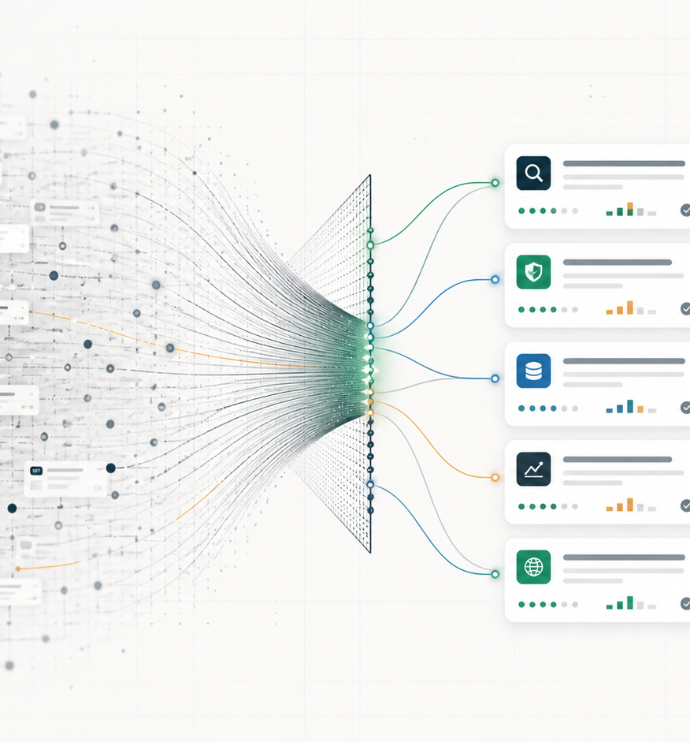
HACKATHON PITCH
RouteSignal
A field guide to the long tail of paid API routes for agents.
If agents can buy one API call at a time, the hard problem becomes routing: what exists, what has signal, what should be probed, and what can be composed.
13,517
1,753
4
route rows in local corpus
providers mapped
derived verdict states
RouteSignal hackathon pitch
01

Slide 2
THE PROBLEM
A route explosion turns API discovery into procurement.
The future is not a better directory. It is agents deciding which tiny paid capability deserves the next dollar.
What has actual buyer or activity signal?
Which route is cheap enough for a first-dollar probe?
What routes compose into a workflow instead of a SaaS subscription?
What should an agent warn on or block before spending?
SIGNAL FILTER
10B FUTURE ROUTES
PAY / PROBE / WARN / BLOCK
RouteSignal hackathon pitch
02

Slide 3
WHAT EXISTS TODAY
The public route surface is already large enough to need analysis.
The first corpus is not complete market truth. It is enough to show the shape of the routing problem.
13,517
12,857
1,753
6
route rows
distinct routes
providers
networks
Network concentration
Cost calibration
Base mainnet
12,043
0.01 USDC
3,448
Solana canonical
615
0.001 USDC
994
Solana mainnet
599
0.005 USDC
817
Base dominates the listed surface; the product has to separate ecosystem activity from catalog inflation.
The useful primitive is the cheap probe: spend pennies, collect a receipt, stop early.
Source: site/public/data/routesdb.json, generated 2026-05-21 from x402scan public route records plus local RouteSignal derived fields.
RouteSignal hackathon pitch
03

Slide 4
MARKET SHAPE
The interesting story is not the average route. It is the long tail plus the distortions.
A good agent procurement layer has to show clusters, route farms, niche utilities, and where activity actually appears.
Derived route clusters
HIDDEN TENSION
Counts reward catalog inflation. Agents need evidence, cost, and stop rules.
Long-tail utilities
5,243
Onchain market data and wallets
3,696
Route farms and catalog inflation
2,042
USEFUL SURPRISE
External action channels
866
The weird long tail is the opportunity: tiny paid capabilities become ingredients.
Sensitive verification and legal risk
861
This is why a flat table feels bad: the reader sees URLs, not the market. The product has to compress routes into procurement-relevant mental models.
Source: RouteSignal derived cluster fields in site/public/data/routesdb.json.
RouteSignal hackathon pitch
04

Slide 5
THE PRODUCT STATE
RouteSignal converts listings into procurement decisions.
Every route should answer a next-action question: pay, probe, warn, or block.
Verdict split
Evidence ladder
PAY
6,259
11,728
279
88
PROBE
5,749
metadata complete
probe candidates
activity observed
WARN
815
BLOCK
694
Caveat: 13,150 routes had no observed activity in the local scrape. That is not failure; it is exactly why signal matters.
Source: summary.verdicts, summary.evidence_stages, and summary.activity_signals in routesdb.json.
RouteSignal hackathon pitch
05

Slide 6
THE WEDGE
Composition is where paid routes become interesting.
When every API call can be bought separately, agents can assemble strange workflows from cheap ingredients and stop as soon as the receipt trail is decisive.
Supplier screener
registry
|
sanctions
|
shipment
|
owner graph
|
receipt
First-dollar rule
Start with the cheapest call that can kill the task.
Viral claim trace
claim search
|
reverse image
|
fact check
|
source age
|
proof
Neighborhood check
reviews
|
crime
|
transit
|
broadband
|
attestation
Stop rule
Stop on contradiction, sanctions, reused media, or weak evidence.
Wallet diligence
wallet risk
|
token history
|
social graph
|
domain
|
memo
Recipe costs are illustrative; corpus costs cluster around micro and cheap probe calls, with premium calls reserved for later evidence.
RouteSignal hackathon pitch
06

Slide 7
THE DEMO
Three pages make the thesis inspectable.
The goal is not to simulate payments. It is to show the field guide, the compression layer, and the composition layer.
RoutesDB
Analyzer
Wizard
A processable corpus of routes with provider, cost, network, risk, evidence, activity, cluster, and verdict metadata.
Visual compression: network mix, cost bands, clusters, route farms, active anchors, and evidence gaps.
A recipe lab that turns capabilities into long-tail workflows, first-dollar probes, stop rules, and missing route ideas.
data -> signal -> composition
RouteSignal hackathon pitch
07

Slide 8
CLOSING THESIS
When APIs become per-call ingredients, the product is route intelligence.
RouteSignal is the starting field guide: what exists, what has signal, what deserves a probe, and what weird workflows become possible.
What we mapped
13,517 listed route rows, provider shape, cost bands, networks, clusters, risk flags, verdicts.
What we explain
Why flat route directories are hard to read and why counts alone can mislead agents.
What we demonstrate
A three-page demo that turns the corpus into route analysis and long-tail recipe generation.
What comes next
Live probes, receipt trails, provider benchmarks, and a real procurement policy for agent wallets.
Talk track: We mapped the route surface, found the noise, then built the compression and composition layers agents will need when paid APIs become abundant.
RouteSignal hackathon pitch
08

