Slide 1

Greenfox Velox - Presentation
Week-01
06-05-2016
Created by Attila Krüpl

Slide 2
I am going to talk about…
What did we do all week?
What did we learn? Let me introduce you Anakin Skywalker!
The hardest bits
Moments of success
Recap

Slide 3
What did we do all week?
Monday – introduction, a bit of HTML/CSS at the end of the day
Tuesday – team building, lots of fun
Wednesday – The first day of work, git, bash commands
Thursday – HTML, CSS basics, first web projects
Friday – CSS in details, CV building

Slide 4
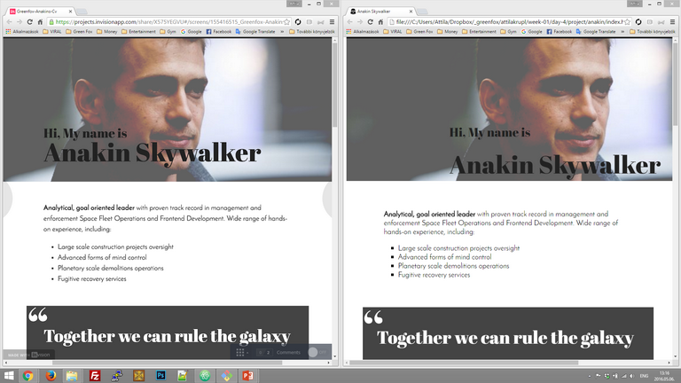
What did we learn? Let me introduce you Anakin Skywalker!
Anakin Skywalker’s CV
The template
My version

Slide 5
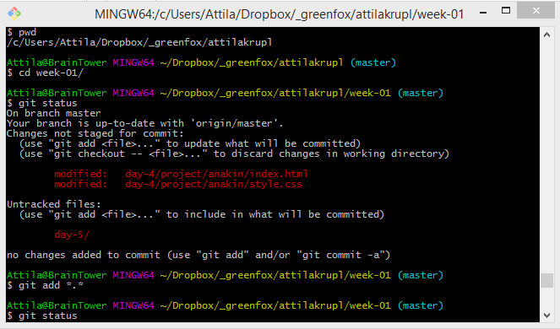
The hardest bits

Slide 6
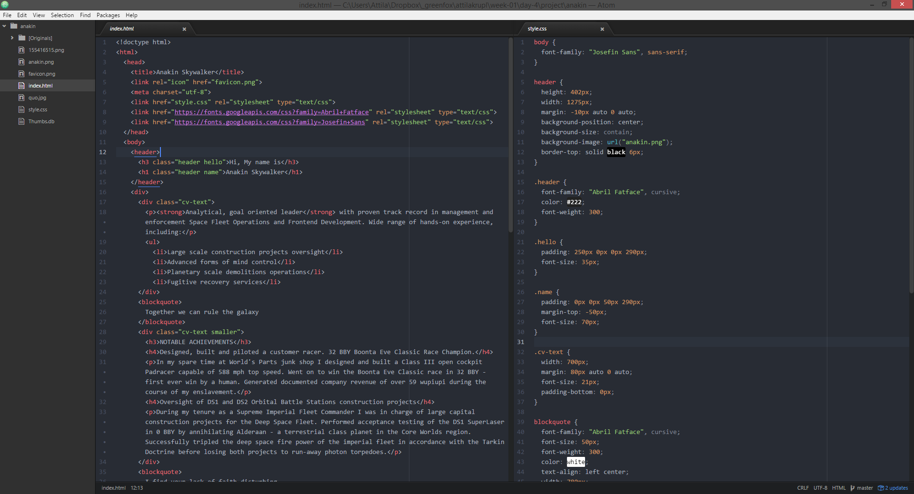
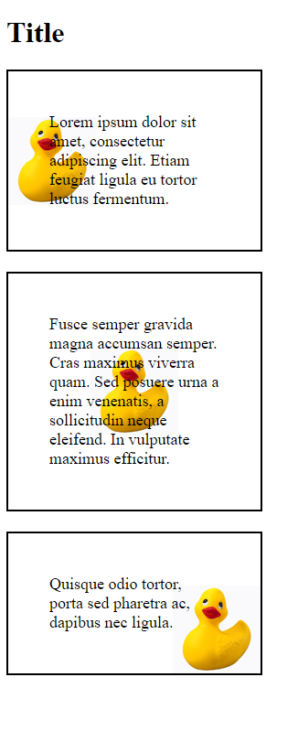
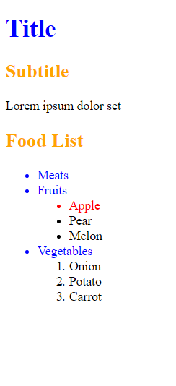
Moments of success

Slide 7
Recap
Re-learned a lot of information, and met some new stuff
GIVE ME MORE!!!
Thank you for watching!
May the fox be with you!

