Slide 1


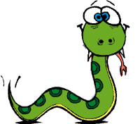
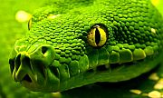
WEEK 3
PYTHON

Slide 2
Performance

Slide 3
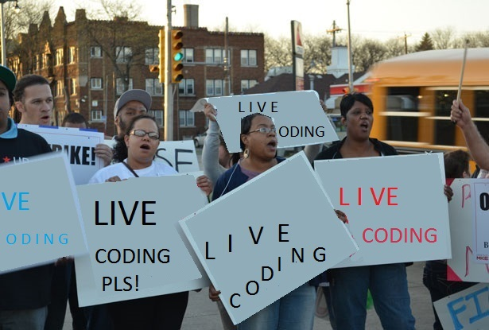
? ? ?

Slide 4
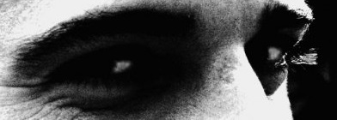

Slide 5


?
Thank you for your attention

