Slide 1



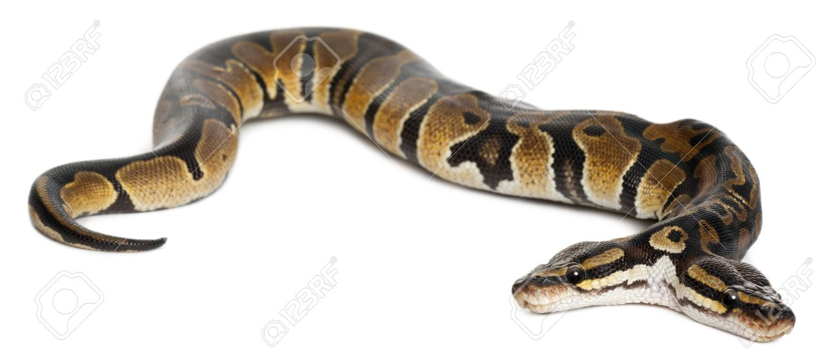
WEEK 4 – STILL PYTHON
GRAPHICS
RECURSION
FRACTALS

Slide 2
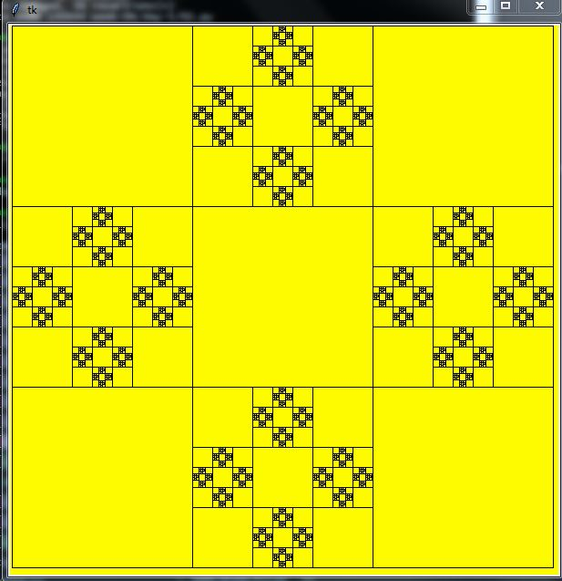

Slide 3
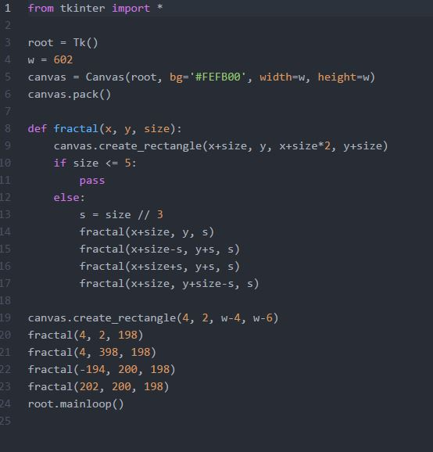

Slide 4
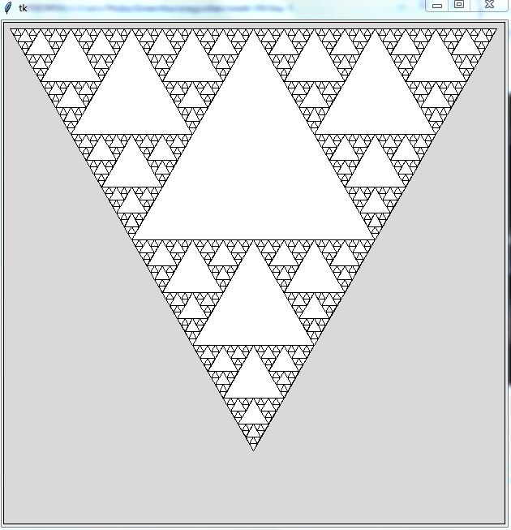

Slide 5
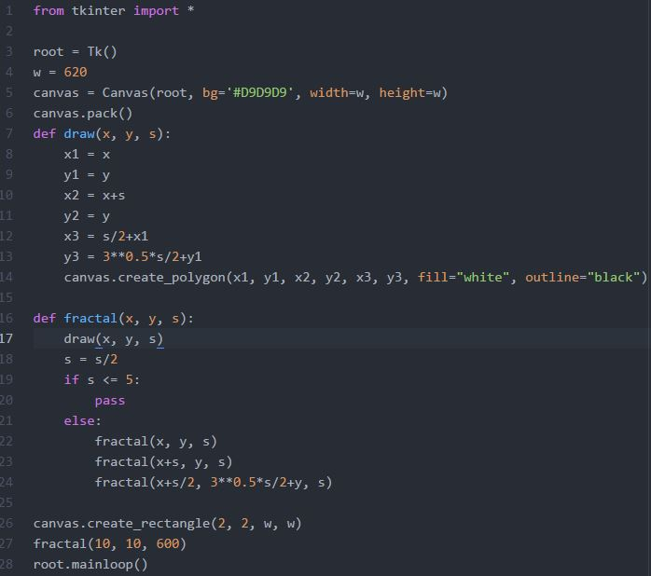

Slide 6
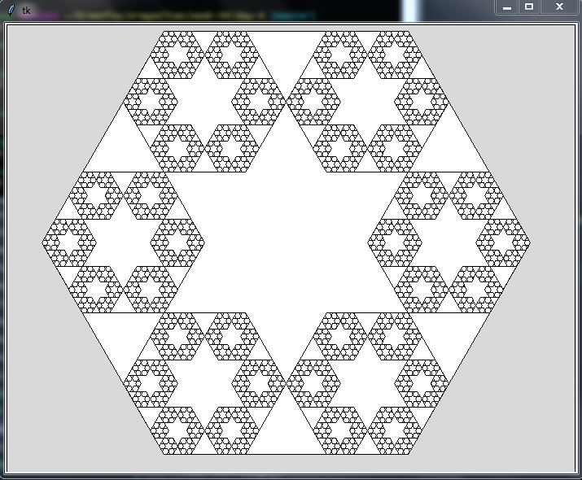

Slide 7
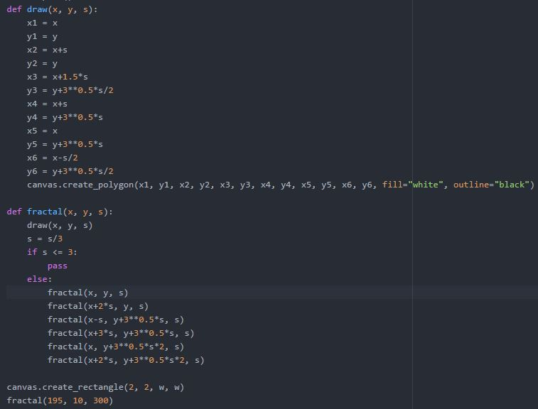

Slide 8
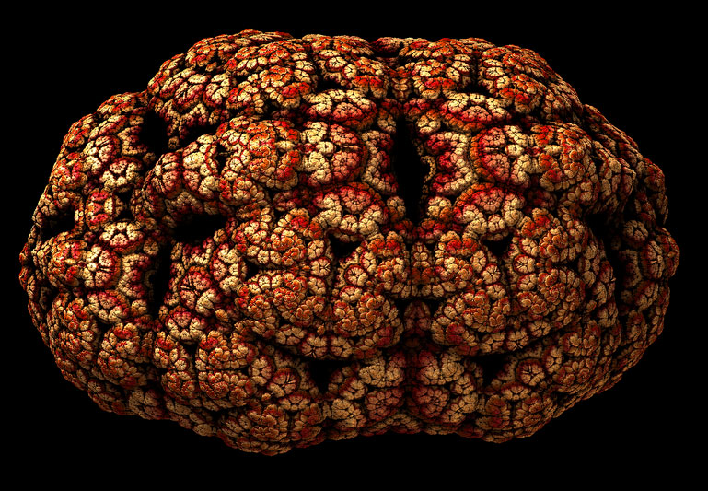

Slide 9
THANK YOU FOR YOUR ATTENTION!
LET’S GO FOR A BEER!

