Slide 1
GREEN FOX ACADEMY
Week No. 1

Slide 2

Monday Internet
Bit, Byte, MegaBit, MegaByte, KiloByte
Internet
Protocol
ISP
IP (IPv4, IPv6, bits, layout)
IP address
DNS
Packet
Router
Fault tolerant, Redundancy
TCP
URL
HTTP

Slide 3
Monday Internet
HTTP methods
HTML
HTTPS
Public Key
Private Key
SSL
Virus
Backdoor
Bot Net
DDos
Phising

Slide 4
Tuesday Teambuilding
Getting to know each other
Community tasks

Slide 5
Wednesday Command line and Git
cd
. and ..
pwd
ls
touch
mkdir
cp
mv
rm

Slide 6
Wednesday Command line and Git
command options
< and > and >> and |
sort
uniq
grep
sed
git init, clone, add, rm, commit, push, pull, remote

Slide 7
Thursday HTML & CSS
Purpose of: <html>, <head>, <link>, <script>,<body>, <meta>, <title>, <h1> - <h6>, <p>, <a>, <img>,<article>, <aside>, <strong>, <em>, <span>, <div>, <header>, <main>, <footer>, <section>, <ul>, <ol>, <li>,<dd>, <dt>, <pre>

Slide 8
Thursday HTML & CSS
class
id
Descendant selector
Conflict
Inheritance
Specificity
Box model
Shorthand
Default browser styles

Slide 9
Friday HTML & CSS 2 + CV
Multiple elements selector
Combine selectors
Universal selector
Attribute selector
Child selector
Adjacent selector
Pseudo selector
first-child, last-child, nth-child, nth-type
important

Slide 10
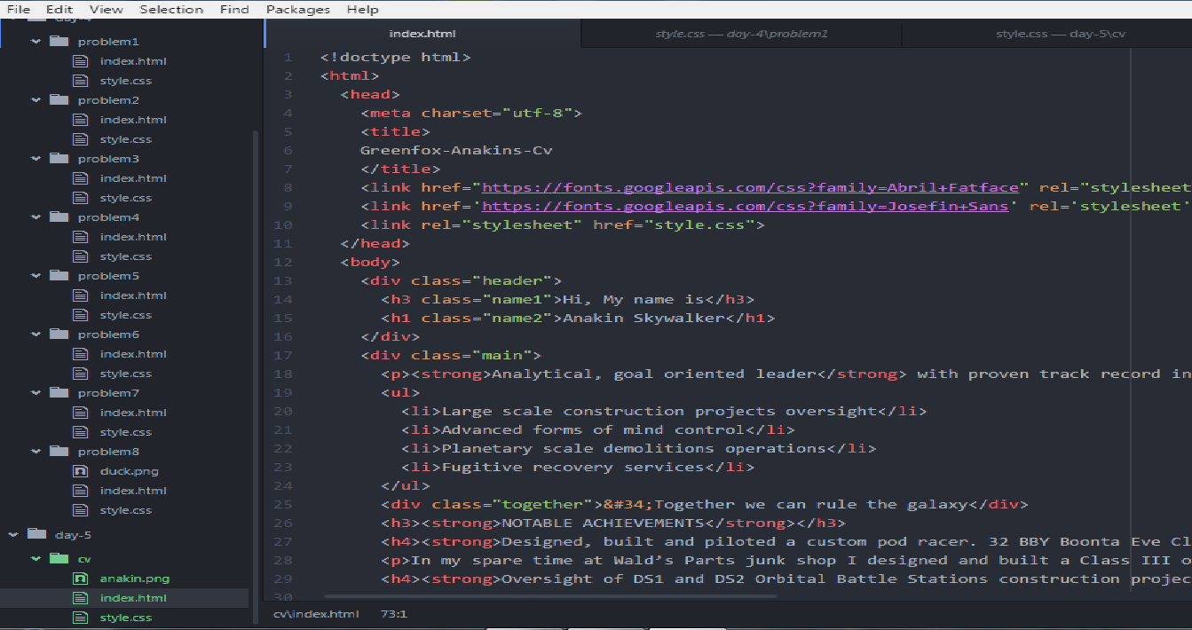
Friday HTML & CSS 2 + CV

Slide 11
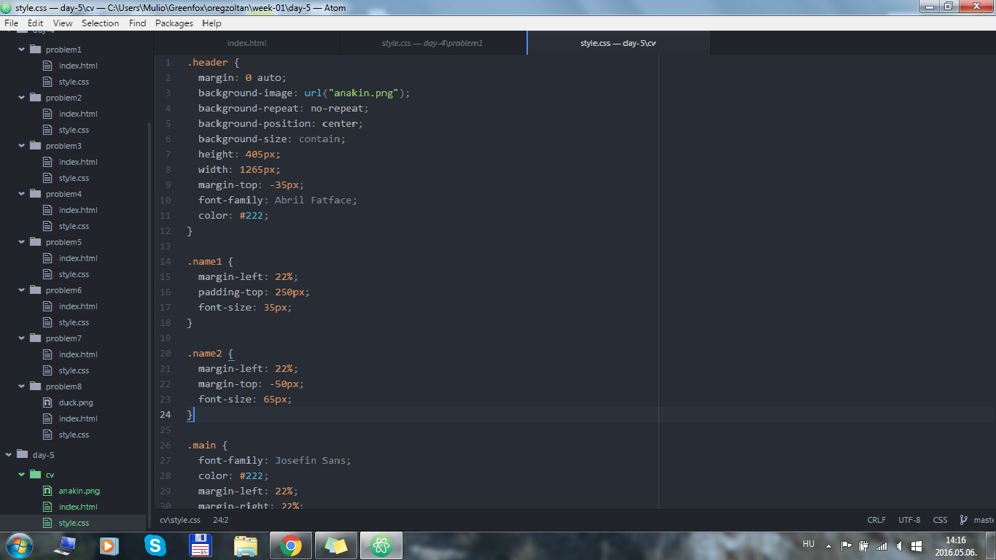
Friday HTML & CSS 2 + CV

Slide 12

http://oregzoltan.github.io/

