Slide 1
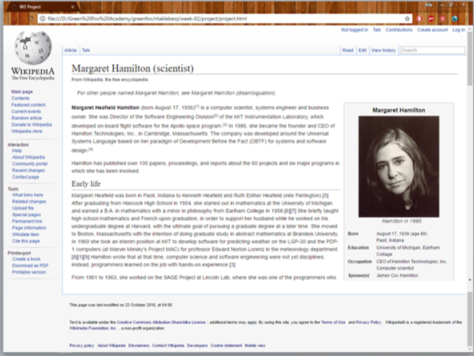

From newbie to
advanced in two weeks
<!doctype html>
<html>
<head>
</head>
<body>
</body>
</html>
Semantically correct usage of elements
Selectors
Declarations
Resolve CSS conflicts
Layouts
Klébesz Rita – 10/28/2016, Demo Presentation
https://github.com/greenfox-zerda-raptors/ritaklebesz

Slide 2
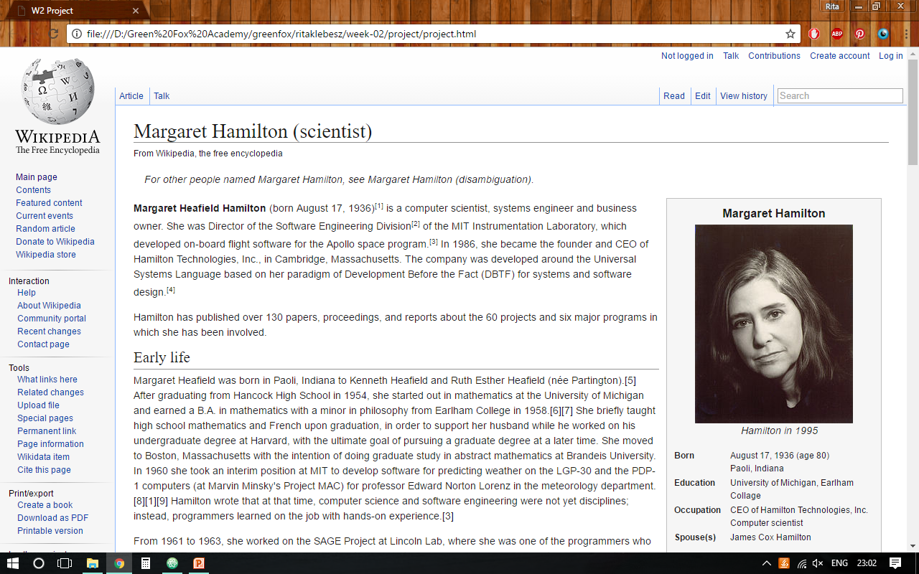
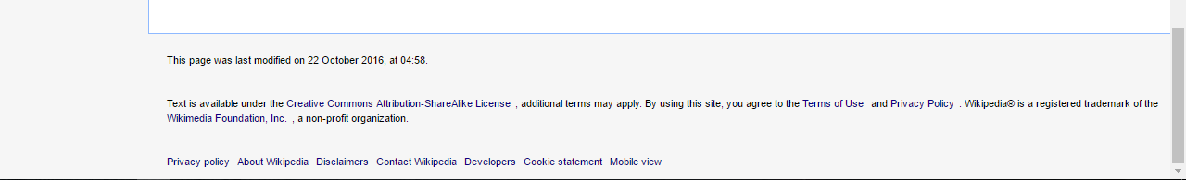

Slide 3
<header>
<main>
<nav>
<footer>

Slide 4
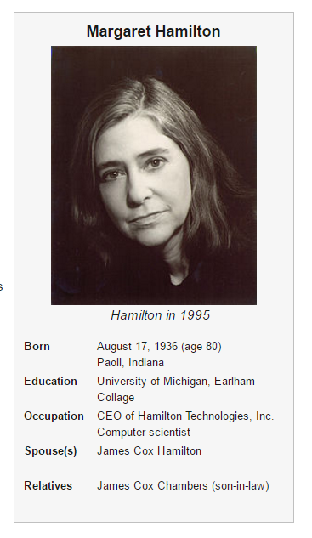
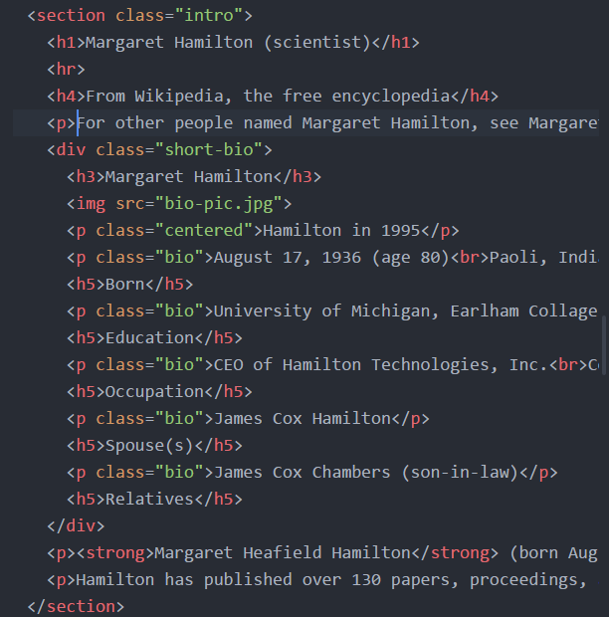

Slide 5
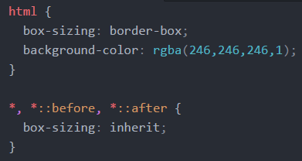
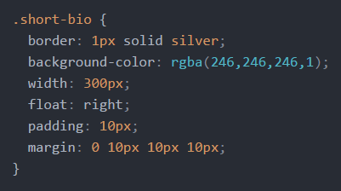
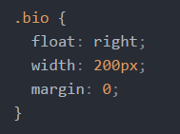
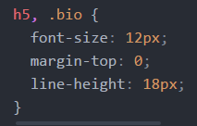

Slide 6
<header>
<main>
<nav>
<footer>

Slide 7
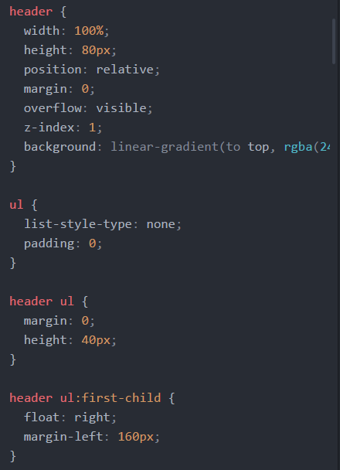
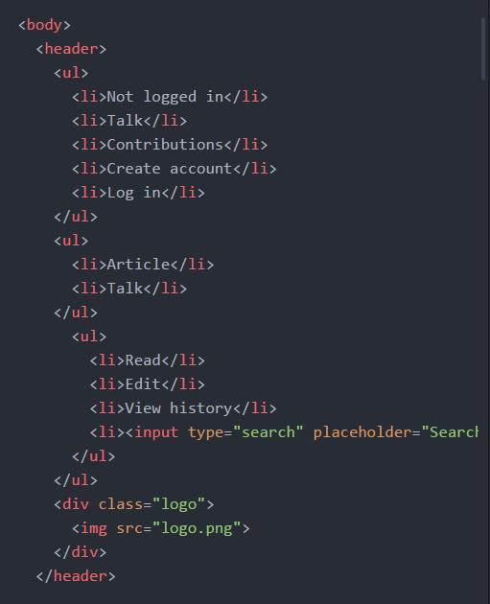

Slide 8
