Slide 1
Jávorszky Mazsi
MULTIPLAYER GOMOKU
Green Fox Academy

Slide 2
Evolution
Gomoku for one player
Basic chat program
Multiplayer gomoku

Slide 3
Multiplayer gomoku - challenges
Initialization of SDL_net in my game
Players overwriting each other's tiles
Players can step as much as they want
Only one board refreshes after victory

Slide 4
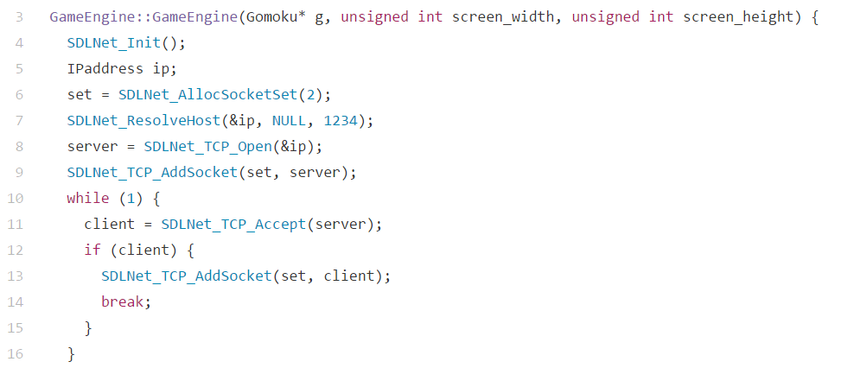
Initialization of SDL_net - SOLVED

Slide 5
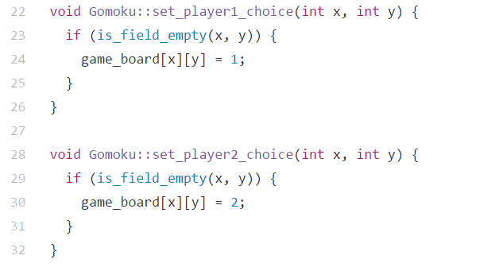
Owerwriting - SOLVED

Slide 6
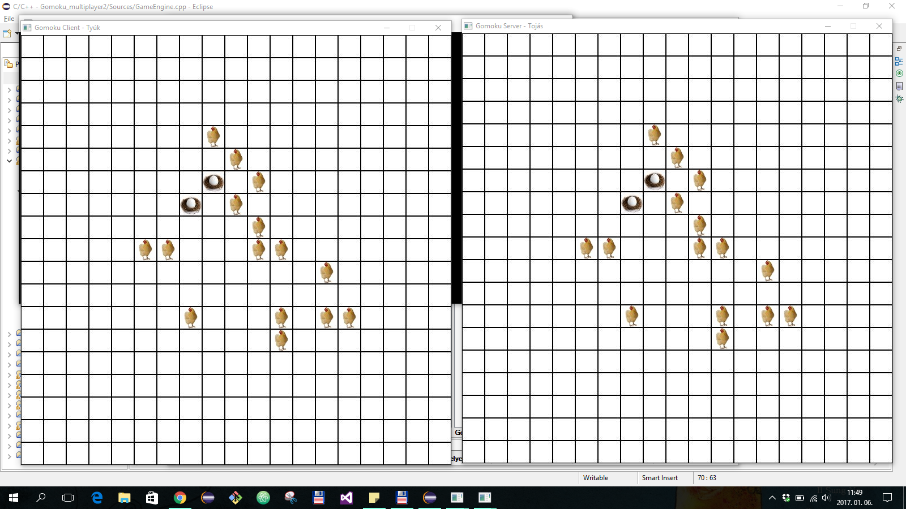
One step at a time - SOLVED

Slide 7
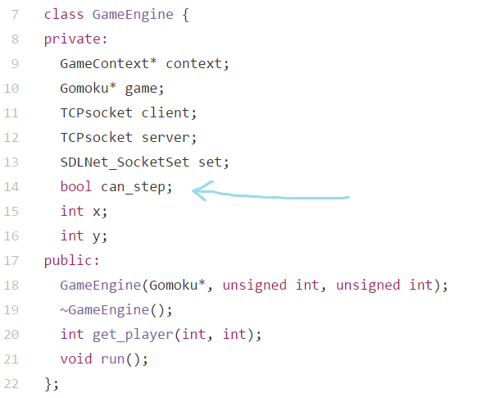
One step at a time - SOLVED

Slide 8
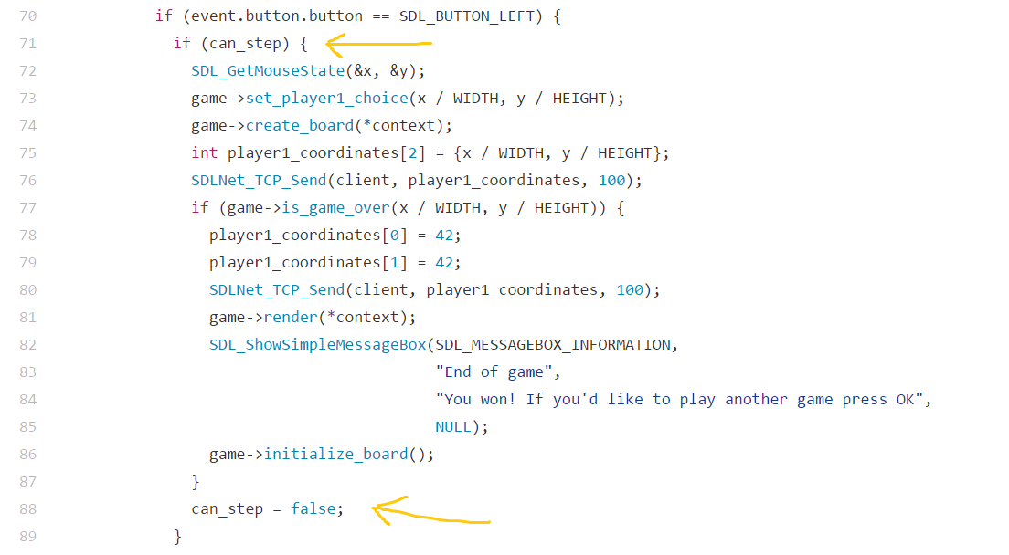
One step at a time - SOLVED

Slide 9
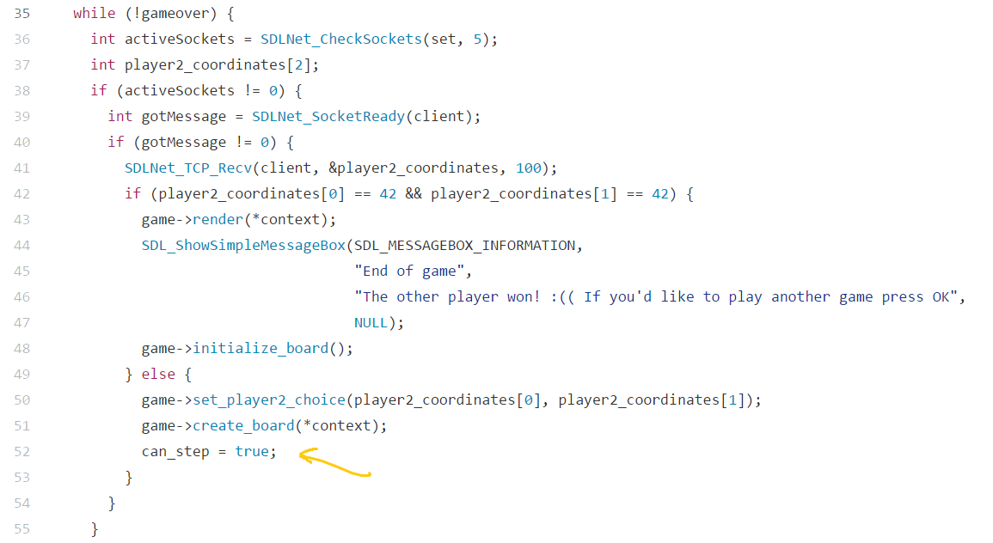
One step at a time - SOLVED

Slide 10
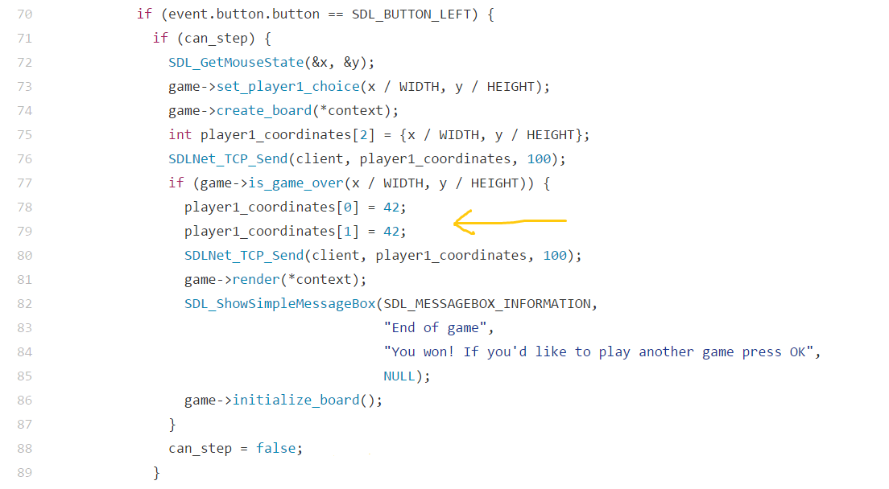
Initialize board for new game - SOLVED

Slide 11
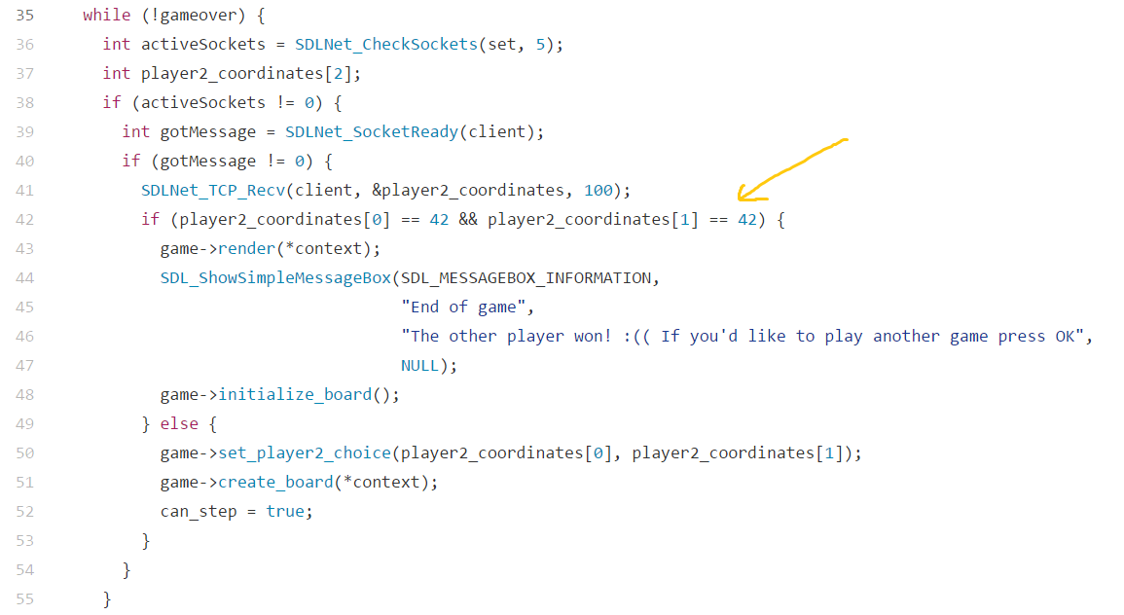
Initialize board for new game - SOLVED

Slide 12
Problems left to fix
Crashes upon exit
Counts as a click if you click on the header
Sometimes has initial steps
Refactoring

Slide 13
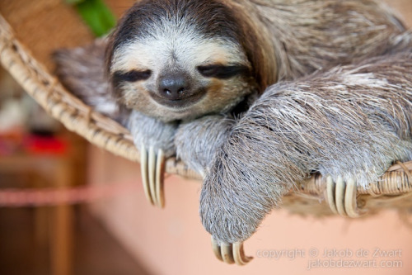
THANK YOU FOR YOUR ATTENTION
AND
HAVE A RELAXING WEEKEND! :)

