Slide 1


Slide 2

Soft skills

Slide 3
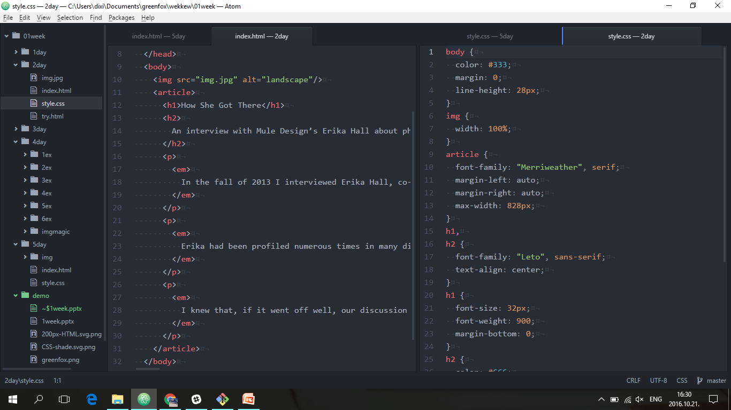
Web developing 1
CSS
HTML

Slide 4
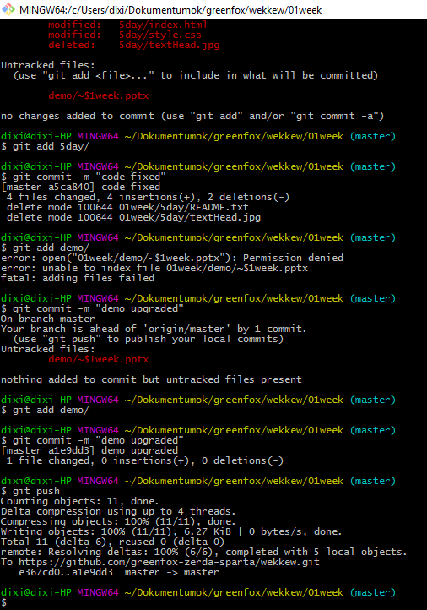
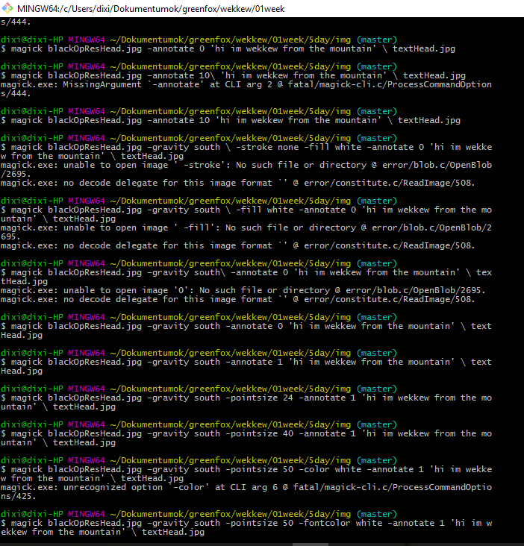
Command line
git
imagemagick

Slide 5
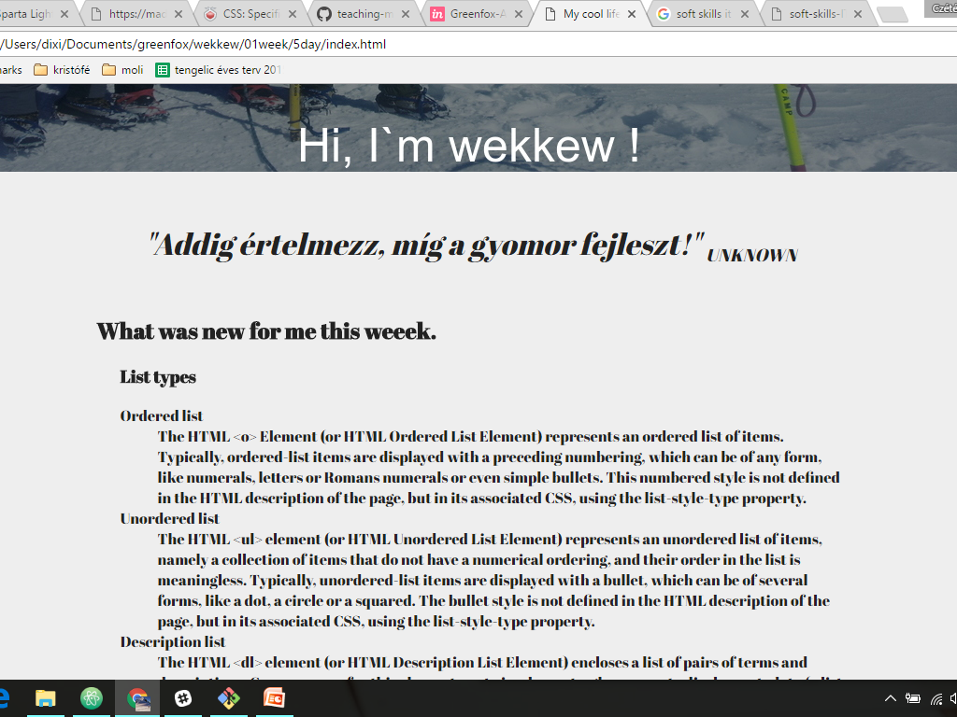

Slide 6


