Slide 1


Slide 2

Soft skills

Slide 3
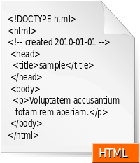
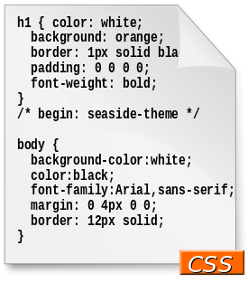
Web developing 1
HTML
CSS

Slide 4
Computer for dummies
PC structure
Command line

Slide 5
Web developing 2
atom
imagemagick

Slide 6
