Slide 1
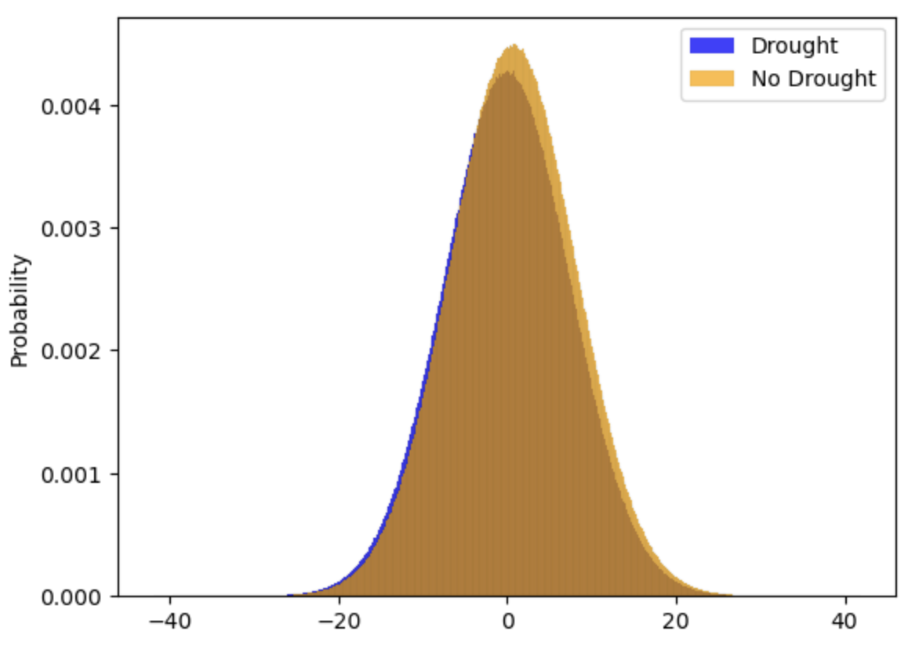
53% chance of TFP increase
(no drought)
50% chance of TFP increase
(drought)

Slide 2
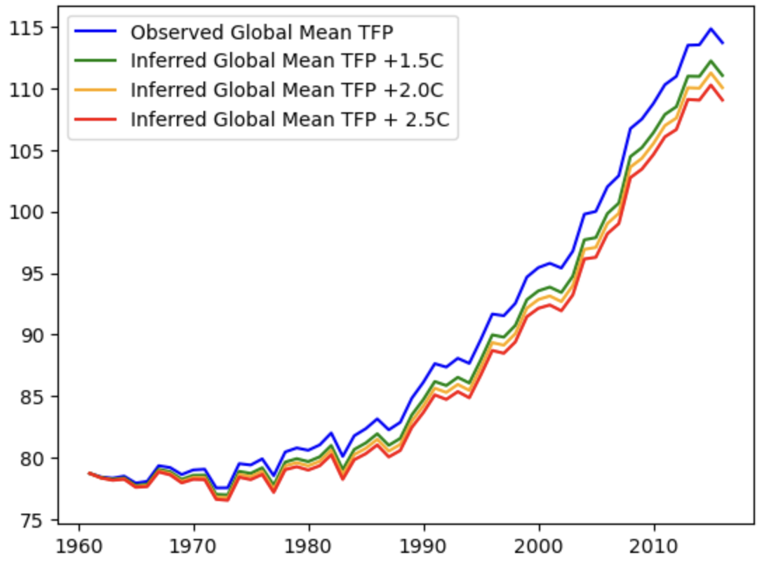
114
111
110
109

