Slide 1

COVID-19
Limiting the spread of coronavirus disease 2019 while minimizing the number of days of social distancing practices
By Jordyn Watkins
Notes:
Hello and good morning. My name is Jordyn Watkins. For the class project, I decided to research something quite relevant for us today — COVID-19.
I will be showing you several different disease progression cases:
no social distancing whatsoever
Progression of the spread hardcoded with Washington State’s actual actions
3) minimizing the number of days for each shelter in place phase given start date of March 23.

Slide 2

Introduction
System Characterization
Optimization Algorithm Selection
Validation of Analysis Tool
Optimization Results
Conclusions
Questions
Notes:
Before I go into the actual optimization problem set up, I'd like to give you a little background on the topic and why this project is significant.
I chose to analyze Washington state because it was the first US state to diagnose a COVID19 patient, and thus has a slightly larger database than other US states and serves an an easy analysis since ”patient zero” can be defined as a single person and a specified date.
Now, the primary consideration when dealing with a pandemic is to minimize the number of deaths. But a secondary consideration is minimizing the negative impacts it may have on the economy.

Slide 3

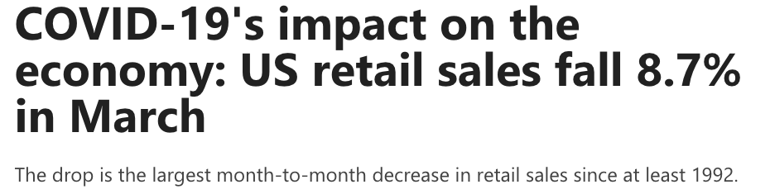
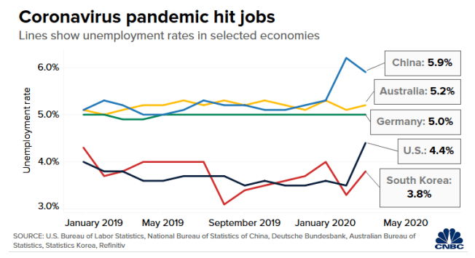
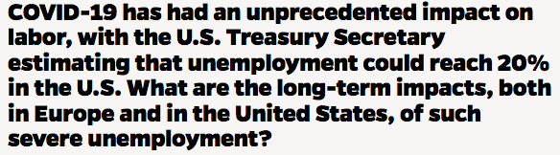
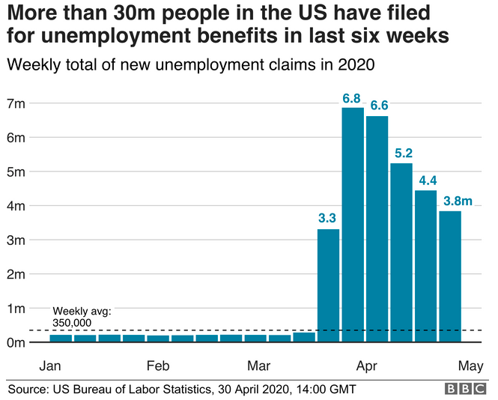
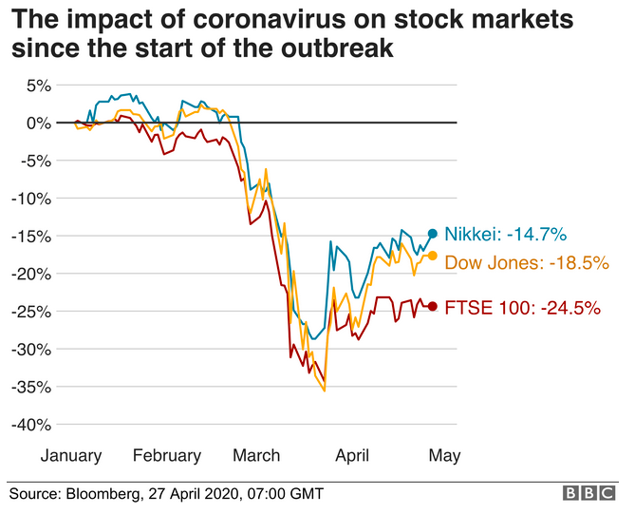
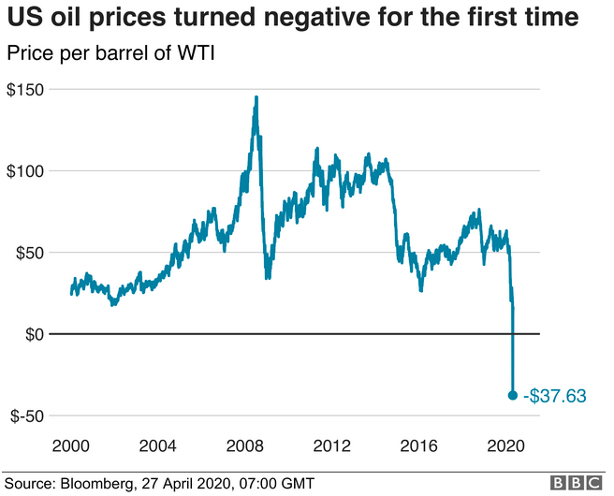
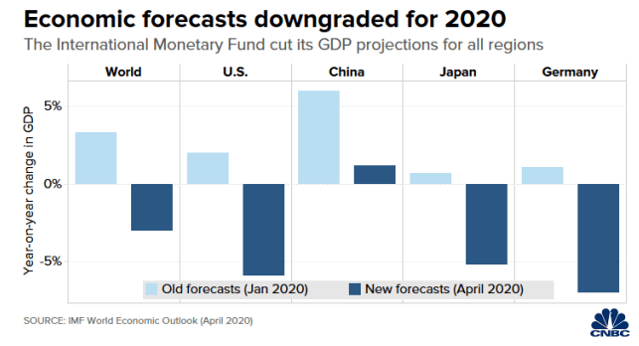


Impact on the Economy
Notes:
The economy has been a big topic in the news. The stock market plummeted. Oil prices were in the negatives unemployment skyrockets. So being able to minimize the number of shelter in place order days would be of interest to anyone concerned with getting the economy up and running again as soon as possible.
Resources:
1) https://usafacts.org/articles/covid-19-impact-economy-us-retail-sales-fall-87-march/?utm_source=google&utm_medium=cpc&utm_campaign=ND-COVID&gclid=EAIaIQobChMIyODn96nf6QIV2CCtBh20dwLfEAAYASAAEgInD_D_BwE
2) https://www.bbc.com/news/business-51706225
3) https://hub.jhu.edu/2020/04/16/coronavirus-impact-on-european-american-economies/
4) https://www.cnbc.com/2020/04/24/coronavirus-pandemics-impact-on-the-global-economy-in-7-charts.html

Slide 4
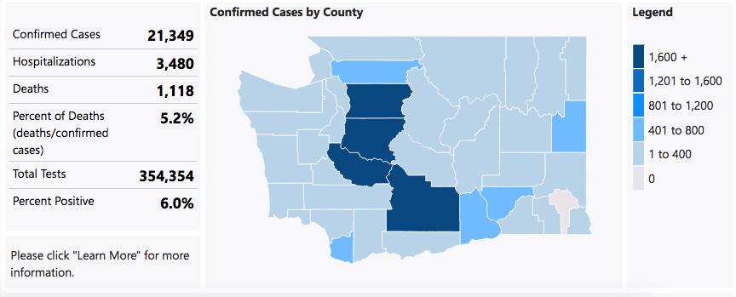
Notes:
Here we have the statistics according to the washington state department of health as of May 31, 2020. Note that the number of confirmed cases actually only represents about 1/3 of the actual number of positve cases for COVID19 if we follow the trend that was studied in New York. Thus, the number of infectives is actually 64,047 instead of 21,349.
https://www.doh.wa.gov/Emergencies/Coronavirus
If the number of confirmed cases only represents 1/3 of the actual number of positive cases for Covid19, then the actual number for infectives is 64047. Thus, the percent requiring hospitalizations is actually only 5.43% of the number of infected. And the death rate, while 5.2% when compared to confirmed cases is actually only 1.75% if we consider that only 1/3 of the cases are confirmed.

Slide 5
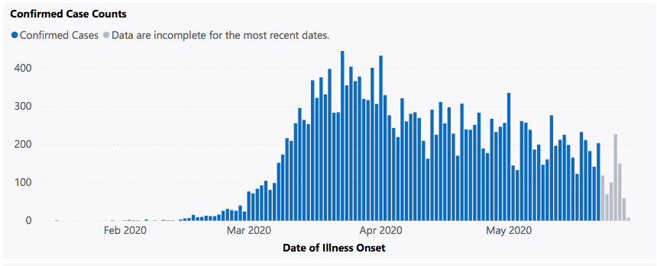
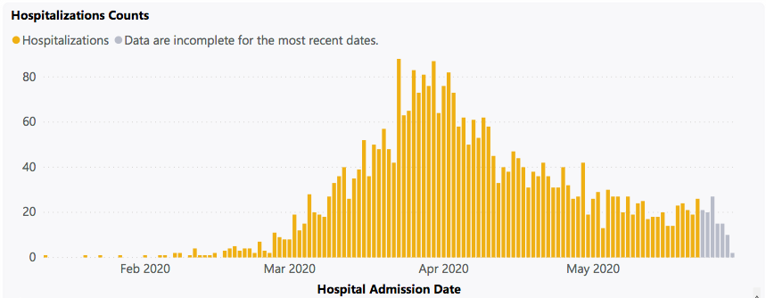
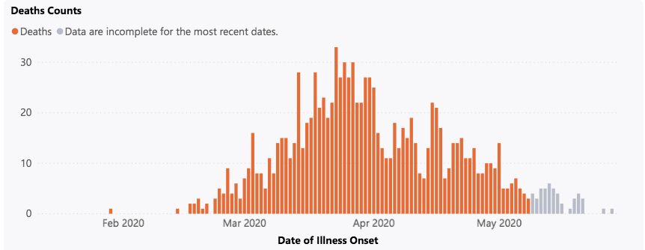
Notes:
These curves are what they refer to when people talk about “flattening the curve”. Note that the number of cases start decreasing at the end of March, correlating to when the Shelter in Place Order was announced to take effect March 23. Now, I drew these red curves to illustrate the general trend. Since the confirmed cases, hospitalizations, and deaths count all relatively follow the same trend, I will be considering the deaths count and hospitalizations as percentages of the the number of confirmed cases for simplicity in my analysis.
https://www.doh.wa.gov/Emergencies/Coronavirus
Public health experts agree that the true number of people who have been infected with COVID-19 in Washington greatly exceeds the number of COVID-19 infections that have been laboratory-confirmed. It is very difficult to know exactly how many people in Washington have been infected to date since most people with COVID-19 experience mild illness and the ability to get tested is still not widely available.
But from research conducted on New York, we know that for every 1 patient diagnosed, there are at least 2 others that have not been tested but are contagious.

Slide 6
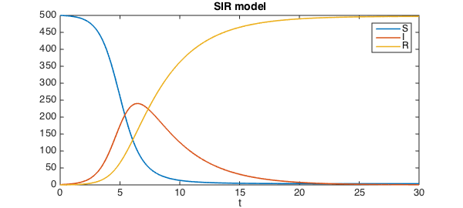

Introduction
System Characterization
Optimization Algorithm Selection
Validation of Analysis Tool
Optimization Results
Conclusions
Questions
System Characterization
Susceptible-Infective-Removed (SIR) Model
S: $S_{t+1}−S_{t}=−rS_{t}I_{t}$
I: $I_{t+1}−I_{t}=rS_{t}I_{t}−aI_{t}$
R: $R_{t+1}−R_{t}=aI_{t}$
Notes:
I will be basing my model primarily off of the SIR Model. It’s a time variant set of equations that update as shown on the slide. If we plot a generic SIR model, we get something that looks like this. Again, this red line for the infectives is what people talk about when they talk about ”flattening the curve”.

Slide 7

Introduction
System Characterization
Optimization Algorithm Selection
Validation of Analysis Tool
Optimization Results
Conclusions
Questions
System Characterization
Susceptible-Infective-Removed (SIR) Model
S: $S_{t+1}−S_{t}=−rS_{t}I_{t}$
I: $I_{t+1}−I_{t}=rS_{t}I_{t}−aI_{t}$
R: $R_{t+1}−R_{t}=aI_{t}$
The key variables in determining the rate of spread of the disease based on this model are a and r.
a is determined by the duration of infectiousness.
r is determined by the rate of spread of the disease.
Social distancing decreases the rate of spread, and therefore decreases the value of r.
Notes:
The key variables in the SIR model are ”a” and small “r”. Where a is the duration of the infective period, and r is the rate of spread of the disease. The smaller the value of little r, the better – and social distancing decreases the rate of spread and therefore decreases the value of r.

Slide 8
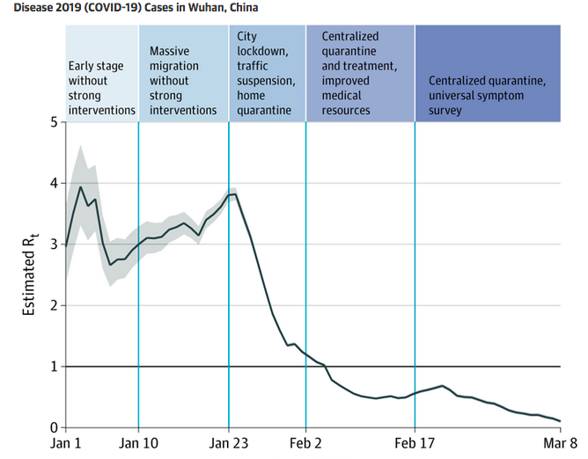
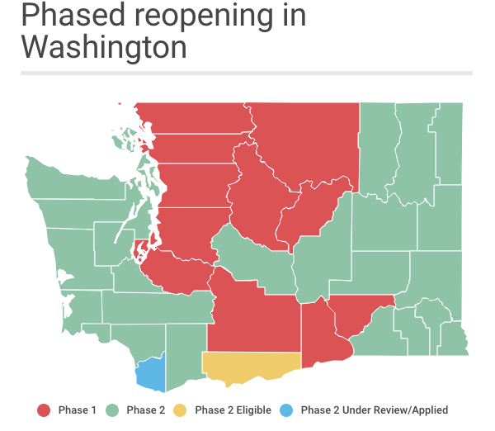
Notes:
One way of determining the value of little r is by determing R naught – the reproductive number. The blue graph here shows how the estimated value of R-naught changes with implementation of social distancing stages in Wuhan, China. The map of washington shows the phased reopening of the state - which should work to slowly open the state back up with minimal increase in the R naught value.

Slide 9
Introduction
System Characterization
Optimization Algorithm Selection
Validation of Analysis Tool
Optimization Results
Conclusions
Questions
System Characterization
Without Social Distancing, the r value is: 0.14583 (R0 = 3.5)
Phase I Shelter-In-Place Order, the r value is: 0.029167 (80% decrease) (R0 = 0.7)
Phase II, the r value is: .07~ ( 50% decrease) (R0 = 1.68)
Notes:
Here are my assumption here for the corresponding r and R-naught values. So we essentially see a trend from 3.5 -> 0.7 -> 1.68
https://jamanetwork.com/journals/jama/fullarticle/2765665

Slide 10

Introduction
System Characterization
Optimization Algorithm Selection
Validation of Analysis Tool
Optimization Results
Conclusions
Questions
Optimization Problem, Standard Form
$\min{f\left(x_{1},x_{2}\right)} = x_{2}−x_{1}$
$w.r.t. x = \{x_{1},x_{2}$}
$$s.t. g_{1} = −x_{1},−x_{2} ≤0$$
$g_{2} = \max\left(I\right)∙\frac{1}{3}∙0.20 ≤5070$
$g_{3} = \max\left(R\right)∙0.0175 ≤1500$
$g_{4} = x_{1}−x_{2} ≤0$
Notes:
Using the assumptions built upon in the last few slides, we build our optimization problem as shown here. Where x1 is the start date of the stay at home order, and x2 is the end date of the stay at home order. Looking at our constraints, the significant ones are g2 and g3. Where g2 ensures that the hospital capacity is not exceeded, and g3 ensures we constrain the number of deaths to 1500.

Slide 11
Introduction
System Characterization
Optimization Algorithm Selection
Validation of Analysis Tool
Optimization Results
Conclusions
Questions
Algorithm Selection
The designed problem is characterized by:
A linear objective function
Linear and nonlinear constraints
Modeled as a continuous function
Constraints that are dependent on non-design variables where it is difficult to supply gradient information
I chose to utilize the Sequential Quadratic Programming Method (SQP) – Matlab’s fmincon built in function.
Notes:
I used Matlab’s built in SQP optimizer, fmincon. The reasons are listed as bullet points here. For the sake of time, I wont discuss each one, I'll just mention that Fmincon allows the user to use non-design variables in the constraints, and it also gives the user the option to supply or not supply gradient information – both of which were very useful for my anaylsis.

Slide 12
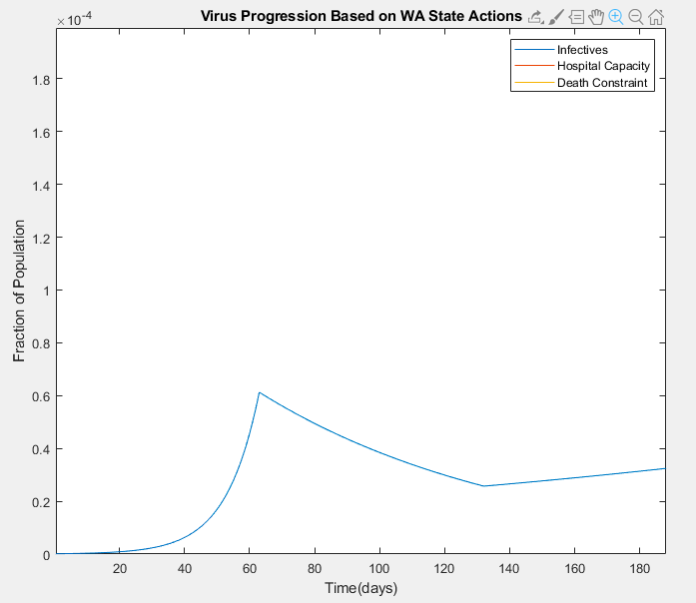
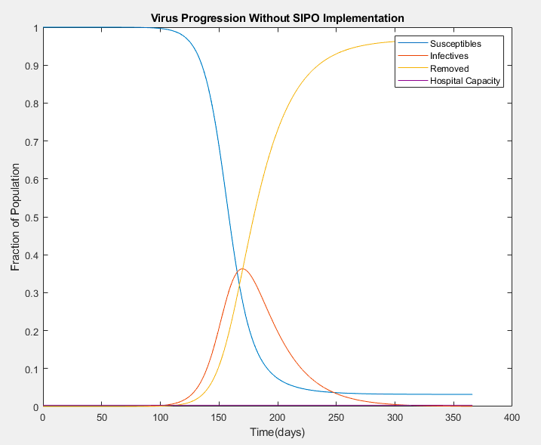
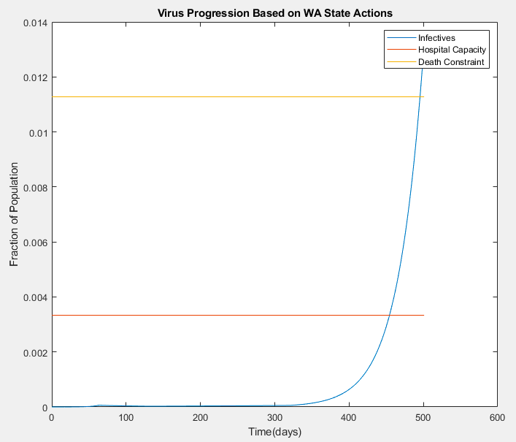
Introduction
System Characterization
Optimization Algorithm Selection
Validation of Analysis Tool
Optimization Results
Conclusions
Questions
Notes:
This next picture is a plot of the SIR curves for coronavirus provided there is no social distancing involved. Note that the peak of the infectives curve is waayy above the hospital capacity line.
This plot is hardcoded with the dates Washington state implemented the stay at home order, and assumptions based on its reopening. If we zoom in to the bottom corner here, we see sharp changes in the number of infectives. Look familiar? The numbers here correlate to the same dates and general trend we way earlier from the Washington state department of health’s website.

Slide 13
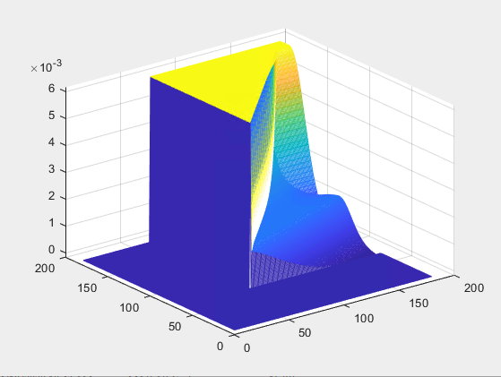
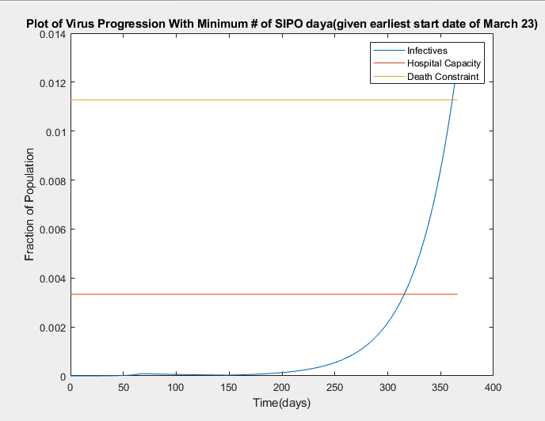
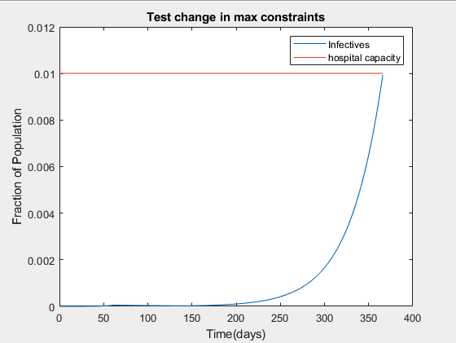
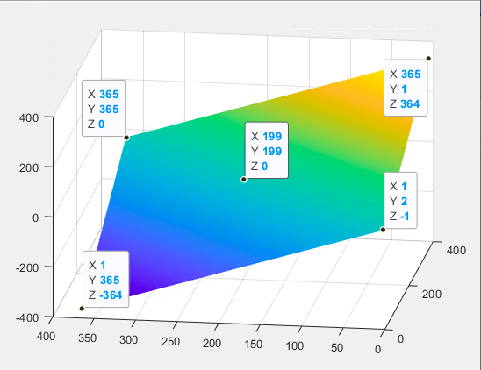
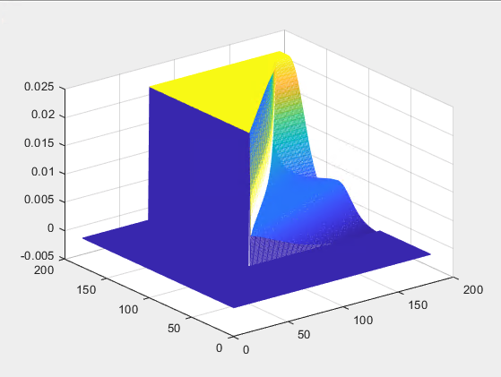
Introduction
System Characterization
Optimization Algorithm Selection
Validation of Analysis Tool
Optimization Results
Conclusions
Questions
Notes:
Ultimately, I wasn’t able to get fmincon to optimize the problem. Here, we see the 3D plot of the objective function on the left. Note, that because of it’s shape, we can have a line for our solution, so that there are many possible solutions.
This next pictures on the right are 3D plot of the constraints. The top is of the hospital capacity and the bottom is of the death constraint. Interestingly, the region where the constraints should be active is the flat yellow triangle – but they’re all the same value, which should theoretically not be the case.
Since, if I do a 2D plot of the curve that should be changing the constraint – we see that itself changes. Now, this picture here is where I forced the algorithms to satisfy the constraints and minimize the function. So I could guess that a theoretical solution to this problem is about 80 days, given a start date of March 23.
The best solution I could get the algorithm to arrive at was 82 days – which was actually an infeasible solution, as shown in this picture here. We can see that it crosses the hospital capacity limit.

Slide 14
Introduction
System Characterization
Optimization Algorithm Selection
Validation of Analysis Tool
Optimization Results
Conclusions
Questions
Notes:
In conclusion here, we can clearly see that social distancing and the shelter in place orders have played a huge role in keeping the number of cases at a manageable level. Fmincon was having a difficult time solving this problem due to the abrupt nature of the constraints and the possibility of multiple solutions with the objective function. Together, I believe it had a difficult time finding an adequate search direction which also made it very sensitive to initial guesses. For further work, I would look into possibly scaling the constraints, investigate the performance of other possible algorithms, and refine the R0 values so that they are more realistic and therefore provide a greater chance of a feasible solution.

Slide 15

Questions
Notes:
Any questions?

