Slide 1
Next Gen. Sequencing Files and pysam
BCHB524
Lecture 13
BCHB524 - Edwards

Slide 2
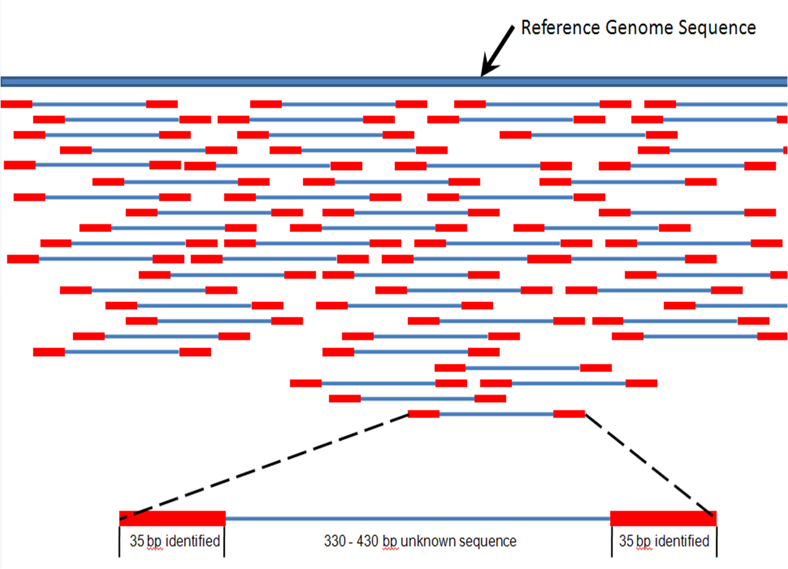
Next Gen. Sequencing
BCHB524 - Edwards
Wiki: Genomics

Slide 3
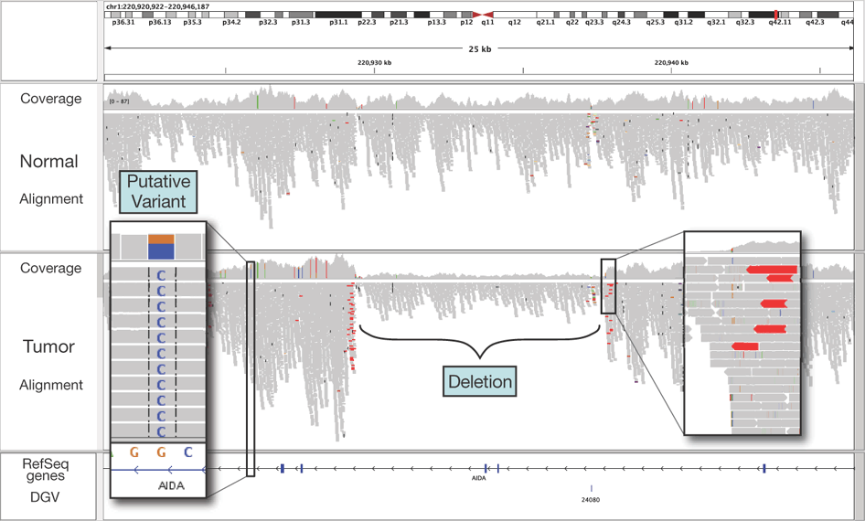
Next Gen. Sequencing
Nature Biotechnology 29, 24–26 (2011)
BCHB524 - Edwards

Slide 4
Python for NGS
NGS data is big!
  Special purpose tools (tophat, cufflinks, samtools) for aligning
Use Python for:
  Clean up / filter reads
  Post-process tool output
  Visualization
BCHB524 - Edwards

Slide 5
Count reads from FASTQ file
# Import BioPython's SeqIO module
import Bio.SeqIO
# Import the sys module
import sys
# Get first command-line argument
inputfile = sys.argv[1]
# Initialize counter
count = 0
# Loop through all reads in inputfile
for read in Bio.SeqIO.parse(inputfile, "fastq"):
# Increment count
count += 1
# Output result
print(count,"reads")
BCHB524 - Edwards

Slide 6
Filter reads in FASTQ file
import Bio.SeqIO
import sys
# Get command-line arguments
inputfile = sys.argv[1]
minlength = int(sys.argv[2])
# Loop through all reads in inputfile
for read in Bio.SeqIO.parse(inputfile, "fastq"):
# Check the length
if len(read.seq) > minlength:
# Output to standard-out
print(read.format("fastq"),end="")
BCHB524 - Edwards

Slide 7
Filter reads in FASTQ file
import Bio.SeqIO
import sys
# Get command-line arguments
inputfile = sys.argv[1]
thr = int(sys.argv[2])
# Loop through all reads in inputfile
for read in Bio.SeqIO.parse(inputfile, "fastq"):
# Check the minimum phred score
if min(read.letter_annotations["phred_quality"]) >= thr:
# Output to standard-out
print(read.format("fastq"),end="")
BCHB524 - Edwards

Slide 8
Remove primer sequence
import Bio.SeqIO
import sys
# Get command-line arguments
inputfile = sys.argv[1]
# Loop through all reads in inputfile
for read in Bio.SeqIO.parse(inputfile, "fastq"):
# if the primer sequence is present
if read.seq.startswith('GATGACGGTGT'):
# remove it and output as FASTA
read = read[11:]
print(read.format("fastq"),end="")
BCHB524 - Edwards

Slide 9
Dump space-separated-values
import Bio.SeqIO
import sys
# Get command-line arguments
inputfile = sys.argv[1]
# Loop through all reads in inputfile
for read in Bio.SeqIO.parse(inputfile, "fastq"):
# Output description, and read length
print(read.description,len(read.seq))
BCHB524 - Edwards

Slide 10
Plot read lengths
import Bio.SeqIO
import sys
from matplotlib.pyplot import *
# Get command-line arguments
inputfile = sys.argv[1]
lengths = []
# Loop through all reads in inputfile
for read in Bio.SeqIO.parse(inputfile, "fastq"):
# Store read length
lengths.append(len(read.seq))
# lengths.sort()
plot(lengths,'.')
show()
# Save and use "shotwell readlengths.png" to view
# savefig('readlengths.png')
BCHB524 - Edwards

Slide 11
Histogram of read lengths
import Bio.SeqIO
import sys
from matplotlib.pyplot import *
# Get command-line arguments
inputfile = sys.argv[1]
lengths = []
# Loop through all reads in inputfile
for read in Bio.SeqIO.parse(inputfile, "fastq"):
# Store read length
lengths.append(len(read.seq))
hist(lengths)
show()
# savefig('readlengthhist.png')
BCHB524 - Edwards

Slide 12
Plot read lengths and quality
import Bio.SeqIO
import sys
from matplotlib.pyplot import *
# Get command-line arguments
inputfile = sys.argv[1]
lengths1 = []
lengths2 = []
# Loop through all reads in inputfile
for read in Bio.SeqIO.parse(inputfile, "fastq"):
phred_scores = read.letter_annotations["phred_quality"]
l = 0
for phsc in phred_scores:
if phsc < 30:
break
l += 1
lengths1.append(l)
lengths2.append(len(read.seq))
plot(lengths2,lengths1,'.')
show()
# savefig('readlengths.png')
BCHB524 - Edwards

Slide 13
Plot read lengths and quality
import Bio.SeqIO
import sys
from matplotlib.pyplot import *
# Get command-line arguments
inputfile = sys.argv[1]
lengths1 = []
lengths2 = []
# Loop through all reads in inputfile
for read in Bio.SeqIO.parse(inputfile, "fastq"):
phred_scores = read.letter_annotations["phred_quality"]
l = 0
for phsc in phred_scores:
if phsc < 30:
break
l += 1
lengths1.append(l)
lengths2.append(len(read.seq))
plot(sorted(lengths1),'.',sorted(lengths2),'.')
show()
# savefig('readlengths.png')
BCHB524 - Edwards

Slide 14
Samtools using pysam
Popular format for alignment records
pysam is a lightweight wrapper around the samtools code
  Need to understand samtools alignment data-structures
  BAM indexes permit random access by locus
  Direct access to mate-pairs
BCHB524 - Edwards

Slide 15
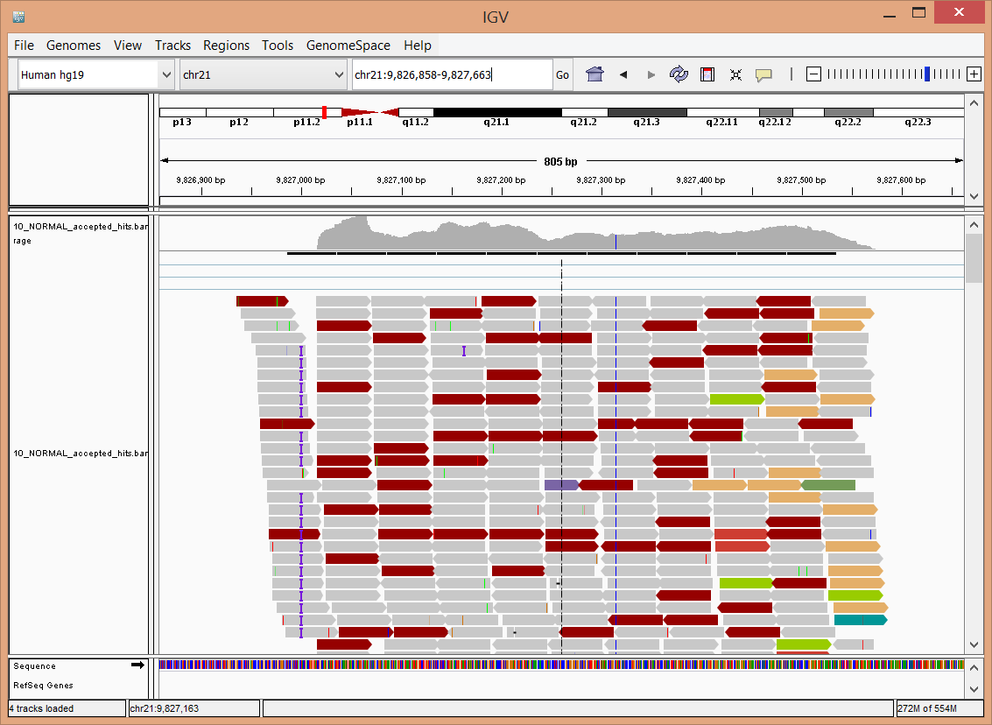
Integrated Genome Viewer
BCHB524 - Edwards
Notes:
chr21:9,826,858-9,827,663

Slide 16
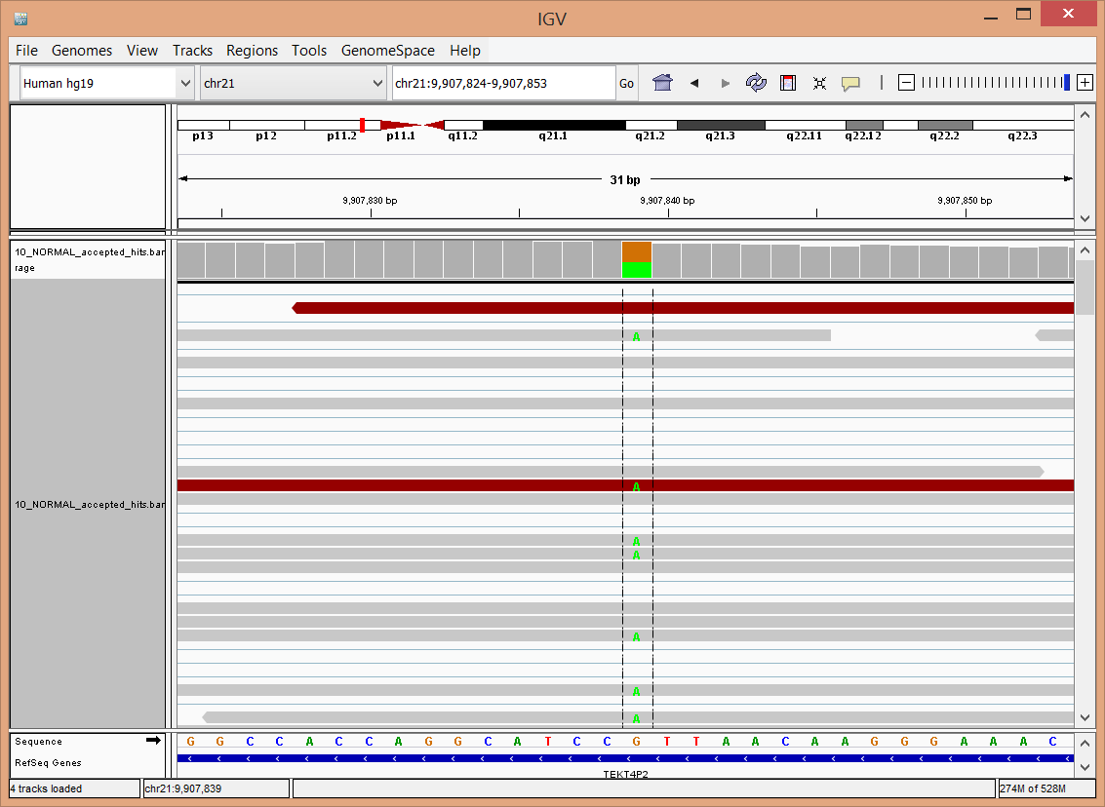
Integrated Genome Viewer
BCHB524 - Edwards
Notes:
chr21:9,907,824-9,907,853

Slide 17
Reads overlapping a region
# Import the PySam module
import pysam
# Open the BAM file
bf = pysam.Samfile('10_Normal_Chr21.bam')
# Access the reads overlapping 21:9000000-10000000
for aligned_read in bf.fetch('21',9000000,10000000):
# Dump the information about each read
print(aligned_read.qname,\
aligned_read.seq,\
bf.getrname(aligned_read.tid),\
aligned_read.pos,\
aligned_read.qend)
BCHB524 - Edwards

Slide 18
Determine coverage by locus
import pysam
# Open the BAM file
bf = pysam.Samfile('10_Normal_Chr21.bam')
# Access the reads overlapping 21:9000000-10000000
for pileup in bf.pileup('21',9000000,10000000):
# Dump the position and number of reads
print(pileup.pos, pileup.n)
# Plot?
BCHB524 - Edwards

Slide 19
Look for SNPs
import pysam
bf = pysam.Samfile('10_Normal_Chr21.bam')
# For every position in the reference
for pileup in bf.pileup('21'):
counts = {}
# ...examine every aligned read
for pileupread in pileup.pileups:
# ...and get the read-base
if not pileupread.query_position:
continue
readbase = pileupread.alignment.seq[pileupread.query_position]
# Count the number of each base
if readbase not in counts:
counts[readbase] = 0
counts[readbase] += 1
# If there is no variation, move on
if len(counts) < 2:
continue
# Otherwise, output the position, coverage and base counts
print(pileup.pos, pileup.n, end=" ")
for base in sorted(counts):
print(base,counts[base], end=" ")
print()
BCHB524 - Edwards

Slide 20
Filter out bad/poor alignments
# ...check the read and alignment
if pileupread.indel:
continue
if pileupread.is_del:
continue
al = pileupread.alignment
if al.is_unmapped:
continue
if al.is_secondary:
continue
if int(al.opt('NM')) > 1:
continue
if int(al.opt('NH')) > 1:
continue
# ...and get the read-base
if not pileupread.query_position:
continue
readbase = al.seq[pileupread.query_position]
# if not enough observations of minor allele, move on
if sorted(counts.values())[-2] < 10:
continue
BCHB524 - Edwards
Notes:
import pysam
bf = pysam.Samfile('10_Normal_Chr21.bam')
# For every position in the reference
for pileup in bf.pileup('21'):
counts = {}
# ...examine every aligned read
for pileupread in pileup.pileups:
# ...check the read and alignment
if pileupread.indel:
continue
if pileupread.is_del:
continue
al = pileupread.alignment
if al.is_unmapped:
continue
if al.is_secondary:
continue
if int(al.opt('NM')) > 1:
continue
if int(al.opt('NH')) > 1:
continue
# ...and get the read-base
if not pileupread.query_position:
continue
readbase = pileupread.alignment.seq[pileupread.query_position]
# Count the number of each base
if readbase not in counts:
counts[readbase] = 0
counts[readbase] += 1
# If there is no variation, move on
if len(counts) < 2:
continue
if sorted(counts.values())[-2] < 10:
continue
# Otherwise, output the position, coverage and base counts
print(pileup.pos, pileup.n,end=" ")
for base in sorted(counts):
print(base,counts[base],end=" ")
print()

