Slide 1
XML Files and ElementTree
BCHB524
Lecture 15
BCHB524 - Edwards

Slide 2
Outline
XML
  eXtensible Markup Language
Python module ElementTree
Exercises
BCHB524 - Edwards

Slide 3
XML: eXtensible Markup Language
Ubiquitous in bioinformatics, internet, everywhere
Most in-house data formats being replaced with XML
Information is structured and named
Can be checked for correct syntax and correct semantics (to a point)
BCHB524 - Edwards

Slide 4
XML: Advantages
Structured - records, lists, trees
Self-documenting, to a point
Hierarchical
Can be changed incrementally
Good generic parsers exist.
Platform independent
BCHB524 - Edwards

Slide 5
XML: Disadvantages
Verbose!
Less good for binary data
  numbers, sequence
All data are strings
Hierarchy isn't always a good fit to the data
Many ways to represent the same data
Problems of data semantics remain
BCHB524 - Edwards

Slide 6
XML: Examples
<?xml version="1.0"?>
<!-- Bread recipie description -->
<recipe name="bread" prep_time="5 mins" cook_time="3 hours">
<title>Basic bread</title>
<ingredient amount="8" unit="dL">Flour</ingredient>
<ingredient amount="10" unit="grams">Yeast</ingredient>
<ingredient amount="4" unit="dL" state="warm">Water</ingredient>
<ingredient amount="1" unit="teaspoon">Salt</ingredient>
<instructions>
<step>Mix all ingredients together.</step>
<step>Knead thoroughly.</step>
<step>Cover with a cloth, and leave for one hour in warm room.</step>
<step>Knead again.</step>
<step>Place in a bread baking tin.</step>
<step>Cover with a cloth, and leave for one hour in warm room.</step>
<step>Bake in the oven at 180(degrees)C for 30 minutes.</step>
</instructions>
</recipe>
BCHB524 - Edwards

Slide 7
XML: Examples
recipe
title
Basic bread
ingredient
Flour
ingredient
Salt
instructions
step
Mix all ingredients together.
step
Bake in the oven at 180(degrees)C for 30 minutes.
BCHB524 - Edwards

Slide 8
XML: Well-formed XML
All XML elements must have a closing tag
XML tags are case sensitive
All XML elements must be properly nested
All XML documents must have a root tag
Attribute values must always be quoted
BCHB524 - Edwards

Slide 9
XML: Bioinformatics
All major bioinformatics sites provide some form of XML data
Lets look at SwissProt.
http://www.uniprot.org/uniprot/Q9H400
BCHB524 - Edwards

Slide 10
XML: UniProt Entry
<?xml version='1.0' encoding='UTF-8'?>
<uniprot xmlns="http://uniprot.org/uniprot" xmlns:xsi="http://www.w3.org/2001/XMLSchema-instance" xsi:schemaLocation="http://uniprot.org/uniprot http://www.uniprot.org/support/docs/uniprot.xsd">
<entry dataset="Swiss-Prot" created="2005-12-20" modified="2011-09-21" version="77">
<accession>Q9H400</accession>
<accession>E1P5K5</accession>
<accession>E1P5K6</accession>
<accession>Q5JWJ2</accession>
<accession>Q6XYB3</accession>
<accession>Q9NX69</accession>
<name>LIME1_HUMAN</name>
<protein>
<recommendedName>
<fullName>Lck-interacting transmembrane adapter 1</fullName>
<shortName>Lck-interacting membrane protein</shortName>
</recommendedName>
<alternativeName>
<fullName>Lck-interacting molecule</fullName>
</alternativeName>
</protein>
<gene>
<name type="primary">LIME1</name>
<name type="synonym">LIME</name>
<name type="ORF">LP8067</name>
</gene>
...
</entry>
</uniprot>
BCHB524 - Edwards

Slide 11
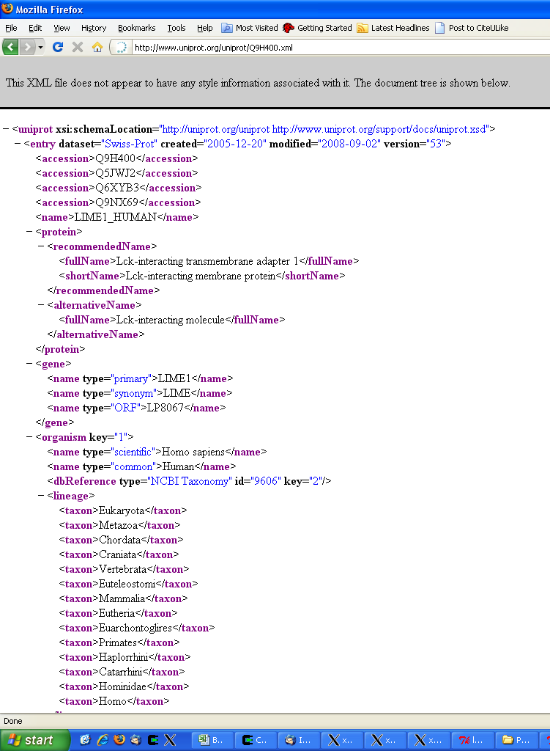
XML: UniProt Entry
Web-browsers can sometimes "layout" the XML document structure
Elements can be collapsed interactively.
BCHB524 - Edwards

Slide 12
ElementTree
Access the contents of an XML file in a "pythonic" way.
  Use iteration to access nested structure
  Use dictionaries to access attributes
  Each element/node is an "Element"
Google "ElementTree python" for docs
BCHB524 - Edwards

Slide 13
Basic ElementTree Usage
import xml.etree.ElementTree as ET
# Parse the XML file and get the recipe element
document = ET.parse("recipe.xml")
root = document.getroot()
# What is the root?
print(root.tag)
# Get the (single) title element contained in the recipe element
ele = root.find('title')
print(ele.tag, ele.attrib, ele.text)
# All elements contained in the recipe element
for ele in root:
print(ele.tag, ele.attrib, ele.text)
# Finds all ingredients contained in the recipe element
for ele in root.findall('ingredient'):
print(ele.tag, ele.attrib, ele.text)
# Continued...
BCHB524 - Edwards

Slide 14
Basic ElementTree Usage
# Continued...
# Finds all steps contained in the root element
# There are none!
for ele in root.findall('step'):
print("!", ele.tag, ele.attrib, ele.text)
# Gets the instructions element
inst = root.find('instructions')
# Finds all steps contained in the instructions element
for ele in inst.findall('step'):
print(ele.tag, ele.attrib, ele.text)
# Finds all steps contained at any depth in the recipe element
for ele in root.getiterator('step'):
print(ele.tag, ele.attrib, ele.text)
BCHB524 - Edwards

Slide 15
Basic ElementTree Usage
import xml.etree.ElementTree as ET
# Parse the XML file and get the recipe element
document = ET.parse("recipe.xml")
root = document.getroot()
ele = root.find('title')
print(ele.text)
for ele in root.findall('ingredient'):
print(ele.attrib['amount'], ele.attrib['unit'], end=" ")
print(ele.attrib.get('state',''), ele.text)
print("Instructions:")
ele = root.find('instructions')
for i,step in enumerate(ele.findall('step')):
print(i+1, step.text)
BCHB524 - Edwards

Slide 16
Basic ElementTree Usage
import xml.etree.ElementTree as ET
# Parse the XML file and get the recipe element
document = ET.parse("recipe.xml")
root = document.getroot()
ele = root.find('title')
title = ele.text
ingredients = []
for ele in root.findall('ingredient'):
ingredients.append([ele.text, ele.attrib['amount'], ele.attrib['unit']])
if ele.attrib.get('state'):
ingredients[-1].append(ele.attrib['state'])
ele = root.find('instructions')
steps = []
for step in ele.findall('step'):
steps.append(step.text)
# Continued...
BCHB524 - Edwards

Slide 17
Basic ElementTree Usage
# Continued...
print("====", title, "====")
print("Instructions:")
for i,inst in enumerate(steps):
print(" ", i+1, inst)
print("Ingredients:")
for indg in sorted(ingredients):
print(" ", " ".join(indg[1:]+indg[:1]))
BCHB524 - Edwards

Slide 18
Advanced ElementTree Usage
Use iterparse when the file is mostly a long list of specific items (single tag) and you need to examine each one in turn…
Call clear()
when done
with each
item.
import xml.etree.ElementTree as ET
for event,ele in ET.iterparse("recipe.xml"):
print(event, ele.tag, ele.attrib, ele.text)
for event,ele in ET.iterparse("recipe.xml"):
if ele.tag == 'step':
print(ele.text)
ele.clear()
BCHB524 - Edwards

Slide 19
XML Namespaces
<?xml version='1.0' encoding='UTF-8'?>
<uniprot xmlns="http://uniprot.org/uniprot" xmlns:xsi="http://www.w3.org/2001/XMLSchema-instance" xsi:schemaLocation="http://uniprot.org/uniprot http://www.uniprot.org/support/docs/uniprot.xsd">
<entry dataset="Swiss-Prot" created="2005-12-20" modified="2011-09-21" version="77">
<accession>Q9H400</accession>
<accession>E1P5K5</accession>
<accession>E1P5K6</accession>
<accession>Q5JWJ2</accession>
<accession>Q6XYB3</accession>
<accession>Q9NX69</accession>
<name>LIME1_HUMAN</name>
<protein>
<recommendedName>
<fullName>Lck-interacting transmembrane adapter 1</fullName>
<shortName>Lck-interacting membrane protein</shortName>
</recommendedName>
<alternativeName>
<fullName>Lck-interacting molecule</fullName>
</alternativeName>
</protein>
<gene>
<name type="primary">LIME1</name>
<name type="synonym">LIME</name>
<name type="ORF">LP8067</name>
</gene>
...
</entry>
</uniprot>
BCHB524 - Edwards

Slide 20
Advanced ElementTree Usage
import xml.etree.ElementTree as ET
import urllib.request
thefile = urllib.request.urlopen(
'http://www.uniprot.org/uniprot/Q9H400.xml')
document = ET.parse(thefile)
root = document.getroot()
print(root.tag, root.attrib, root.text)
for ele in root:
print(ele.tag,ele.attrib,ele.text)
entry = root.find('entry')
print(entry)
ns = '{http://uniprot.org/uniprot}'
entry = root.find(ns+'entry')
print(entry)
print(entry.tag, entry.attrib, entry.text)
BCHB524 - Edwards
Notes:
import xml.etree.ElementTree as ET
import urllib
thefile = urllib.urlopen('http://www.uniprot.org/uniprot/Q9H400.xml')
document = ET.parse(thefile)
root = document.getroot()
print root.tag,root.attrib,root.text
for ele in root:
print ele.tag,ele.attrib,ele.text
entry = root.find('entry')
print entry
ns = '{http://uniprot.org/uniprot}'
entry = root.find(ns+'entry')
print entry
print entry.tag,entry.attrib,entry.text

Slide 21
Exercise
Read through the ElementTree tutorials
Write a program to pick out, and print, the references of a XML format UniProt entry, in a nicely formatted way.
BCHB524 - Edwards

Slide 22
Exercise (Bonus)
Write a program to count the number of spectra in the file "Data1.mzXML.gz" using ElementTree’s iterparse function.
  How many MS (attribute "msLevel" is 1) spectra
  (tag "scan") are there?
  How many MS/MS (attribute "msLevel" is 2) spectra
  (tag "scan") are there?
  How many MS/MS spectra have precursor m/z value between 750 and 1000 Da?
BCHB524 - Edwards

