Slide 1
Python Data Structures: Lists
BCHB524
Lecture 7
BCHB524 - Edwards

Slide 2
Outline
Homework 3 Solutions
Review
Lists
Documentation
BCHB524 - Edwards

Slide 3
Python Review
Printing and execution
Variables and basic data-types:
  integers, floats, strings
  Arithmetic with, conversion between
  String characters and chunks, string methods
Functions, using/calling and defining:
  Use in any expression
  Parameters as input, return for output
Control Flow:
  if statements – conditional execution
  for statements – iterative execution
Command-line, sys.argv, standard input and output
BCHB524 - Edwards

Slide 4
Python Data-structures: Lists
Compound data-structure, stores any number of arbitrary data-items.
  Data-items can be different types
  Can have no items (empty)
  Items can be accessed by index or iteration
  Items can be changed
  Items can be added (inserted, appended)
  Items can be deleted
BCHB524 - Edwards

Slide 5
Lists: Syntax and item access
# Simple list of integers
l = [1,2,3,4,5]
print("List of ints:",l)
# Simple list of mixed types
l = ['a',1,'b',1.5]
print("Mixed list:",l)
# First item of the list
print("First item:",l[0])
# Last item of the list
print("Last item:",l[-1])
# Assign a (new) value to the first item...
l[0] = True
print("New first item:",l)
# Test the value of the last item...
if l[-1] == 'b':
print("Last item is 'b'!")
BCHB524 - Edwards
Notes:
[]
[1,2,3,4,5]
l = ['a',1,'b',1.5]
l
l[0]
l[-1]
l[0] = True
print(l
l[-1] == 'b'

Slide 6
Lists: Adding items and iteration
# Initialize
l = [True, 1, 'b', 1.5]
print("List:",l)
# Insert a new value at position 1
l.insert(1,'fdjasklfjal')
print("List:",l)
# Append a new value (to the end)
l.append('100.0')
print("List:",l)
# How many items on the list?
print("Numbers of items:",len(l))
# Iterate through the list, one at a time...
for item in l:
print("Item:",item)
BCHB524 - Edwards
Notes:
[]
[1,2,3,4,5]
l = ['a',1,'b',1.5]
l
l[0]
l[-1]
l[0] = True
print(l
l[-1] == 'b'

Slide 7
Lists: Slices and out-of-range access
# Initialize
l = [True, 'fdjasklfjal', 1, 'b', 1.5, '100.0']
print("Here is the list:",l)
# Select sub-lists
first_three = l[0:3]
print("List with first three items:",first_three)
last_two = l[-2:]
print("List with last two items:",last_two)
# Assign to sub-lists
l[0:3] = [1,2]
print("First three items replaced with two items:",l)
# Out of range access
print("The tenth item of the list is:",l[10])
BCHB524 - Edwards
Notes:
[]
[1,2,3,4,5]
l = ['a',1,'b',1.5]
l
l[0]
l[-1]
l[0] = True
print(l
l[-1] == 'b'

Slide 8
Strings to Lists
# Demonstrating split: string -> list
s='a,b,c,d,e'
print(s.split(','))
# Leave arguement empty for whitespace split
s = 'The quick brown fox jumped over'
print(s.split())
# One-or-more spaces count as one
s = 'The quick brown fox'
print(s.split())
# Convert a string to a list
print(list('abcdef'))
BCHB524 - Edwards
Notes:
[]
[1,2,3,4,5]
l = ['a',1,'b',1.5]
l
l[0]
l[-1]
l[0] = True
print(l
l[-1] == 'b'

Slide 9
Convert range to a list
# Numbers starting from zero and less than 10
print(list(range(0,10)))
# Numbers starting at 0 less than 10, by twos
print(list(range(0,10,2)))
# Numbers starting at 1 less than 5
print(list(range(1,5)))
# Ten numbers starting at zero less than 10
print(list(range(10)))
# Ten numbers staring from 10 downwards, greater than 0
print(list(range(10,0,-1)))
# Empty list - can't omit bound
print(list(range(10,-1)))
# Empty list - can't omit start
print(list(range(0,-1)))
BCHB524 - Edwards
Notes:
[]
[1,2,3,4,5]
l = ['a',1,'b',1.5]
l
l[0]
l[-1]
l[0] = True
print(l
l[-1] == 'b'

Slide 10
Lists to Strings
# Initialize
s='a,b,c,d,e'
# String to list
l = s.split(',')
print(l)
# Join with "."
print('.'.join(l))
# Join with a space
print(' '.join(l))
# Join with nothing!
print(''.join(l))
BCHB524 - Edwards
Notes:
[]
[1,2,3,4,5]
l = ['a',1,'b',1.5]
l
l[0]
l[-1]
l[0] = True
print(l
l[-1] == 'b'

Slide 11
List iteration
# Initialize and print
s = 'a b c d e'
l = s.split()
print(l)
# Simple and compact
print('Directly:')
for c in l:
print(c)
print()
# Ugh! Don't do this!
print('By index:')
for i in range(0,len(l)):
print(l[i])
print()
# Sometimes this is most clear
print('No list variable!')
for c in s.split():
print(c)
print()
BCHB524 - Edwards
Notes:
[]
[1,2,3,4,5]
l = ['a',1,'b',1.5]
l
l[0]
l[-1]
l[0] = True
print(l
l[-1] == 'b'

Slide 12
Handy list functions
# Initialize
s = 'The quick brown fox jumped over'
l = s.split()
# Let's print out the phrase:
for word in l:
print(word)
print()
# Words sorted!
for word in sorted(l):
print(word)
print()
# Words reversed!
for word in reversed(l):
print(word)
print()
BCHB524 - Edwards
Notes:
[]
[1,2,3,4,5]
l = ['a',1,'b',1.5]
l
l[0]
l[-1]
l[0] = True
print(l
l[-1] == 'b'

Slide 13
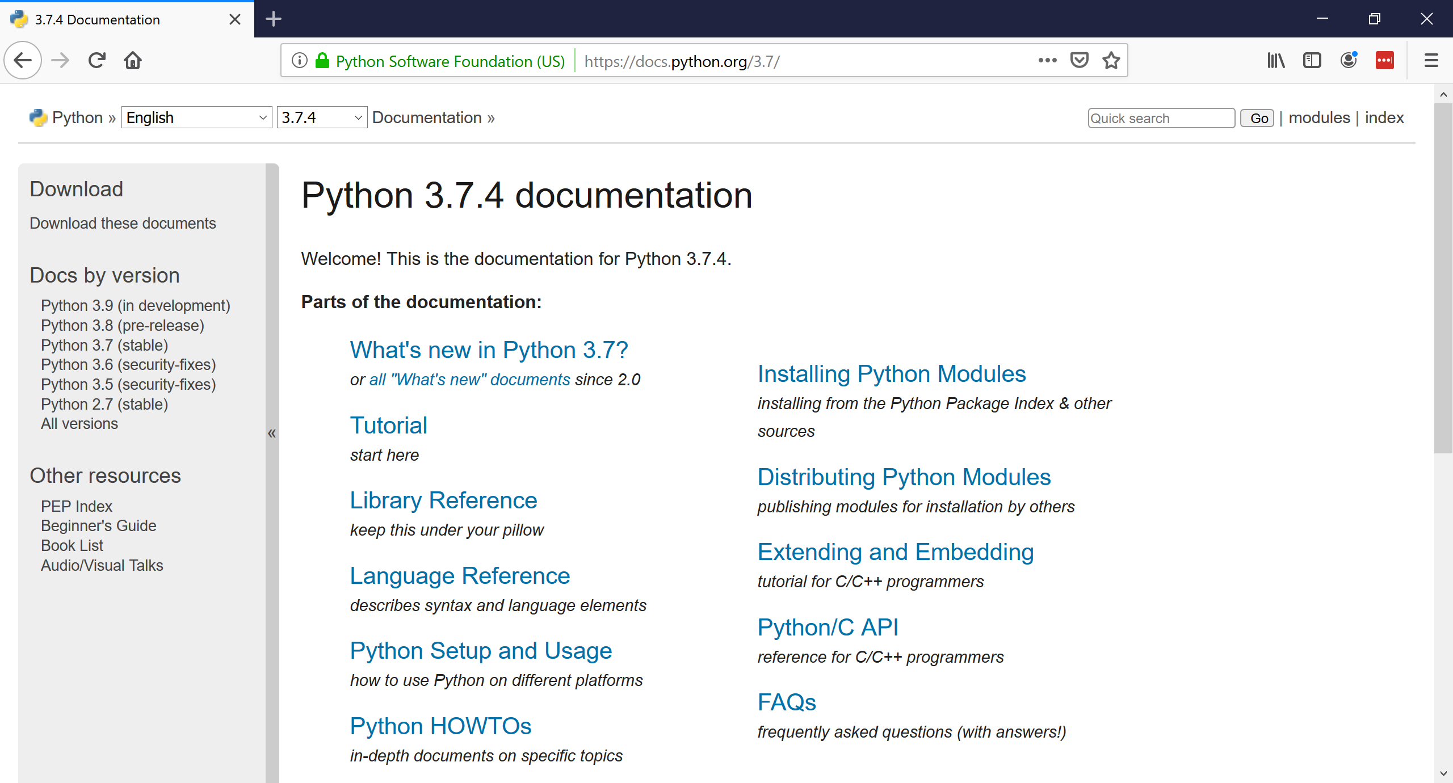
Python Documentation
BCHB524 - Edwards

Slide 14
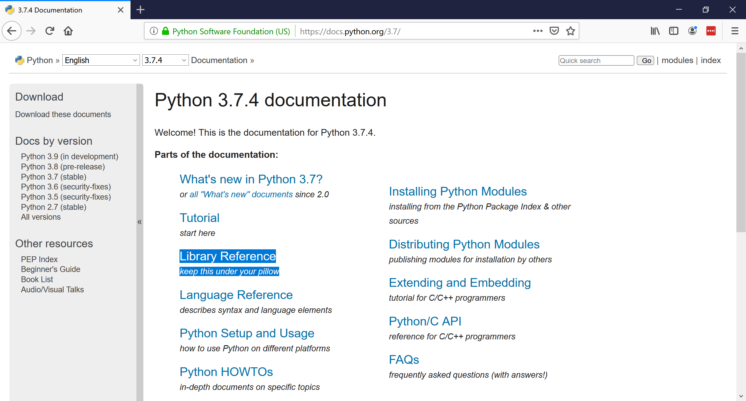
Library Reference
BCHB524 - Edwards

Slide 15
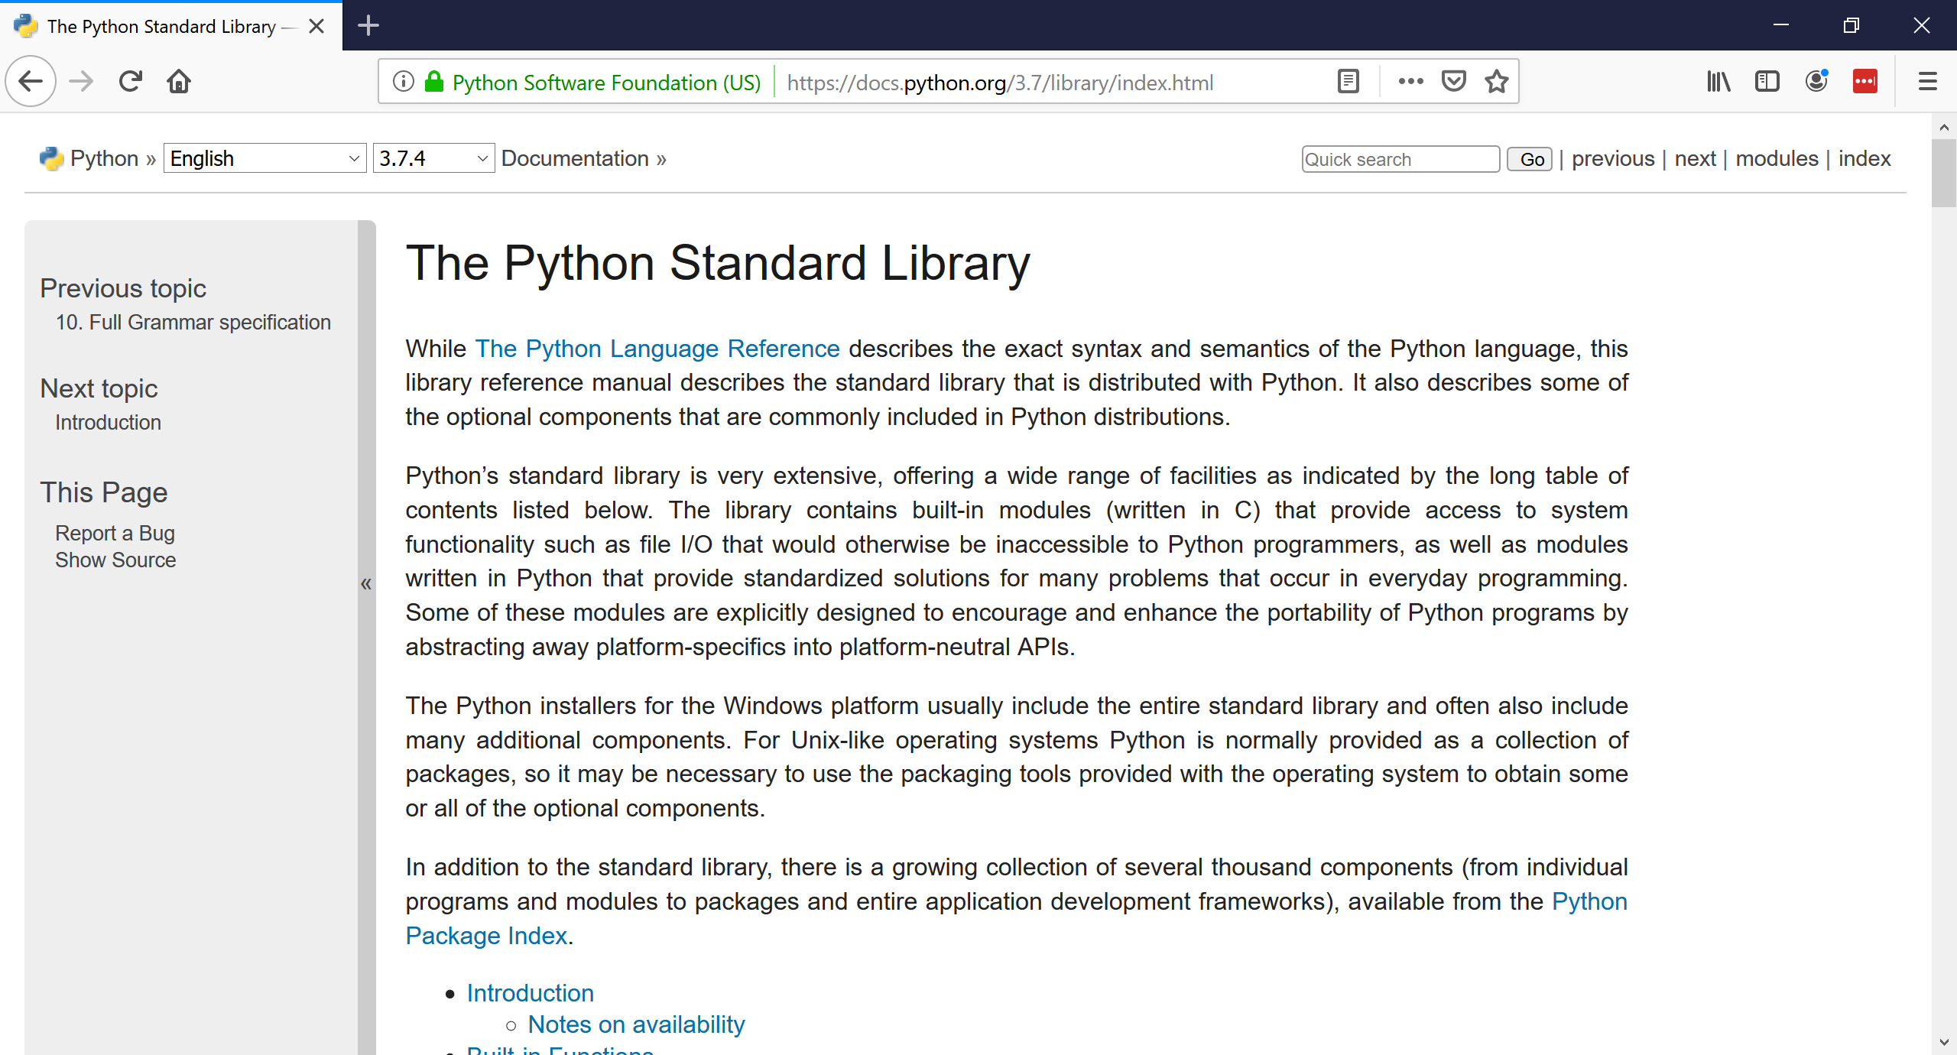
Library Reference
BCHB524 - Edwards

Slide 16
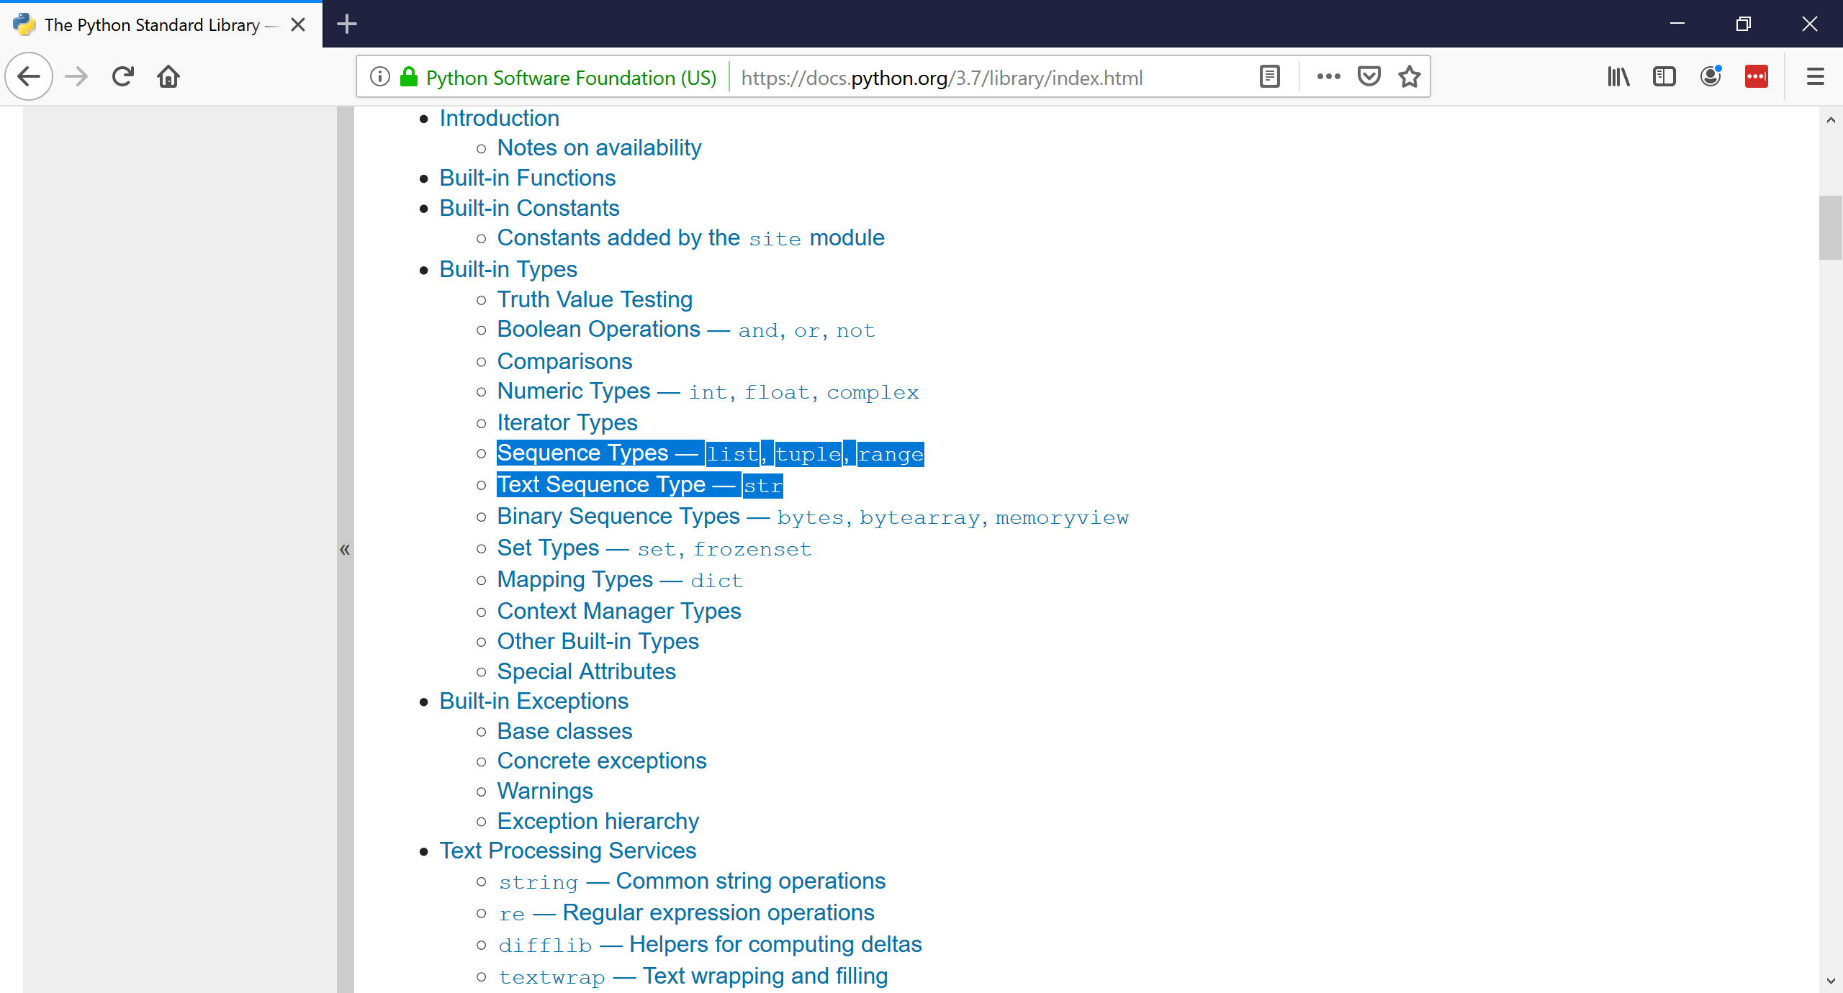
String & List Methods
BCHB524 - Edwards

Slide 17
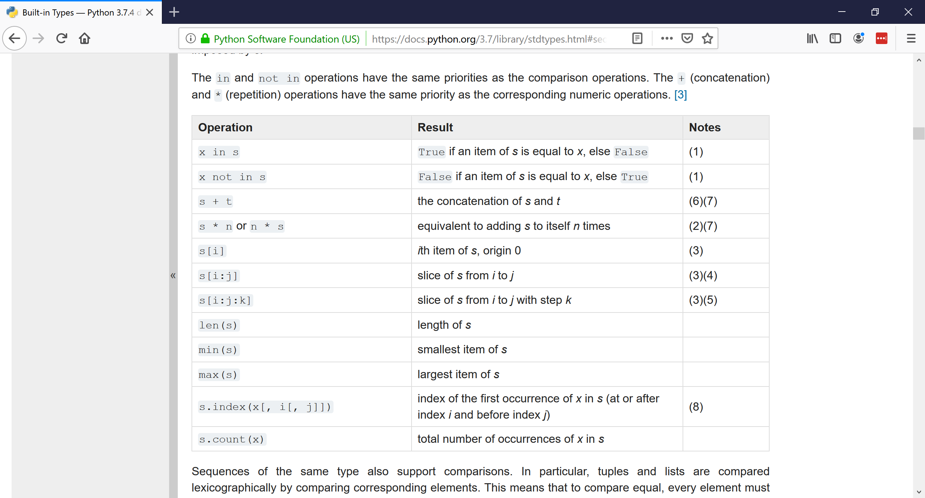
String & List Methods
BCHB524 - Edwards

Slide 18
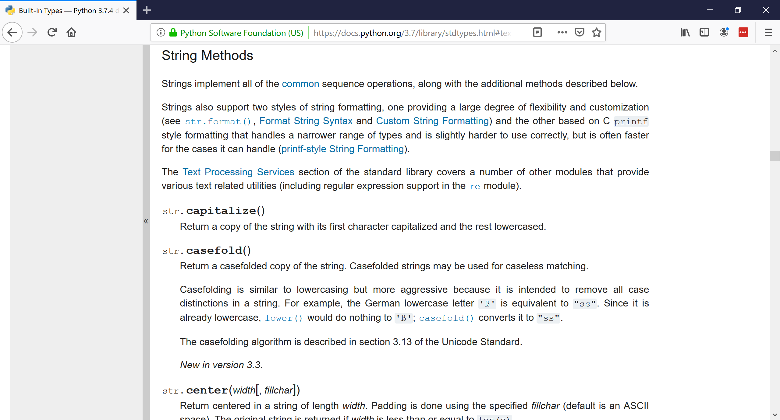
String & List Methods
BCHB524 - Edwards

Slide 19
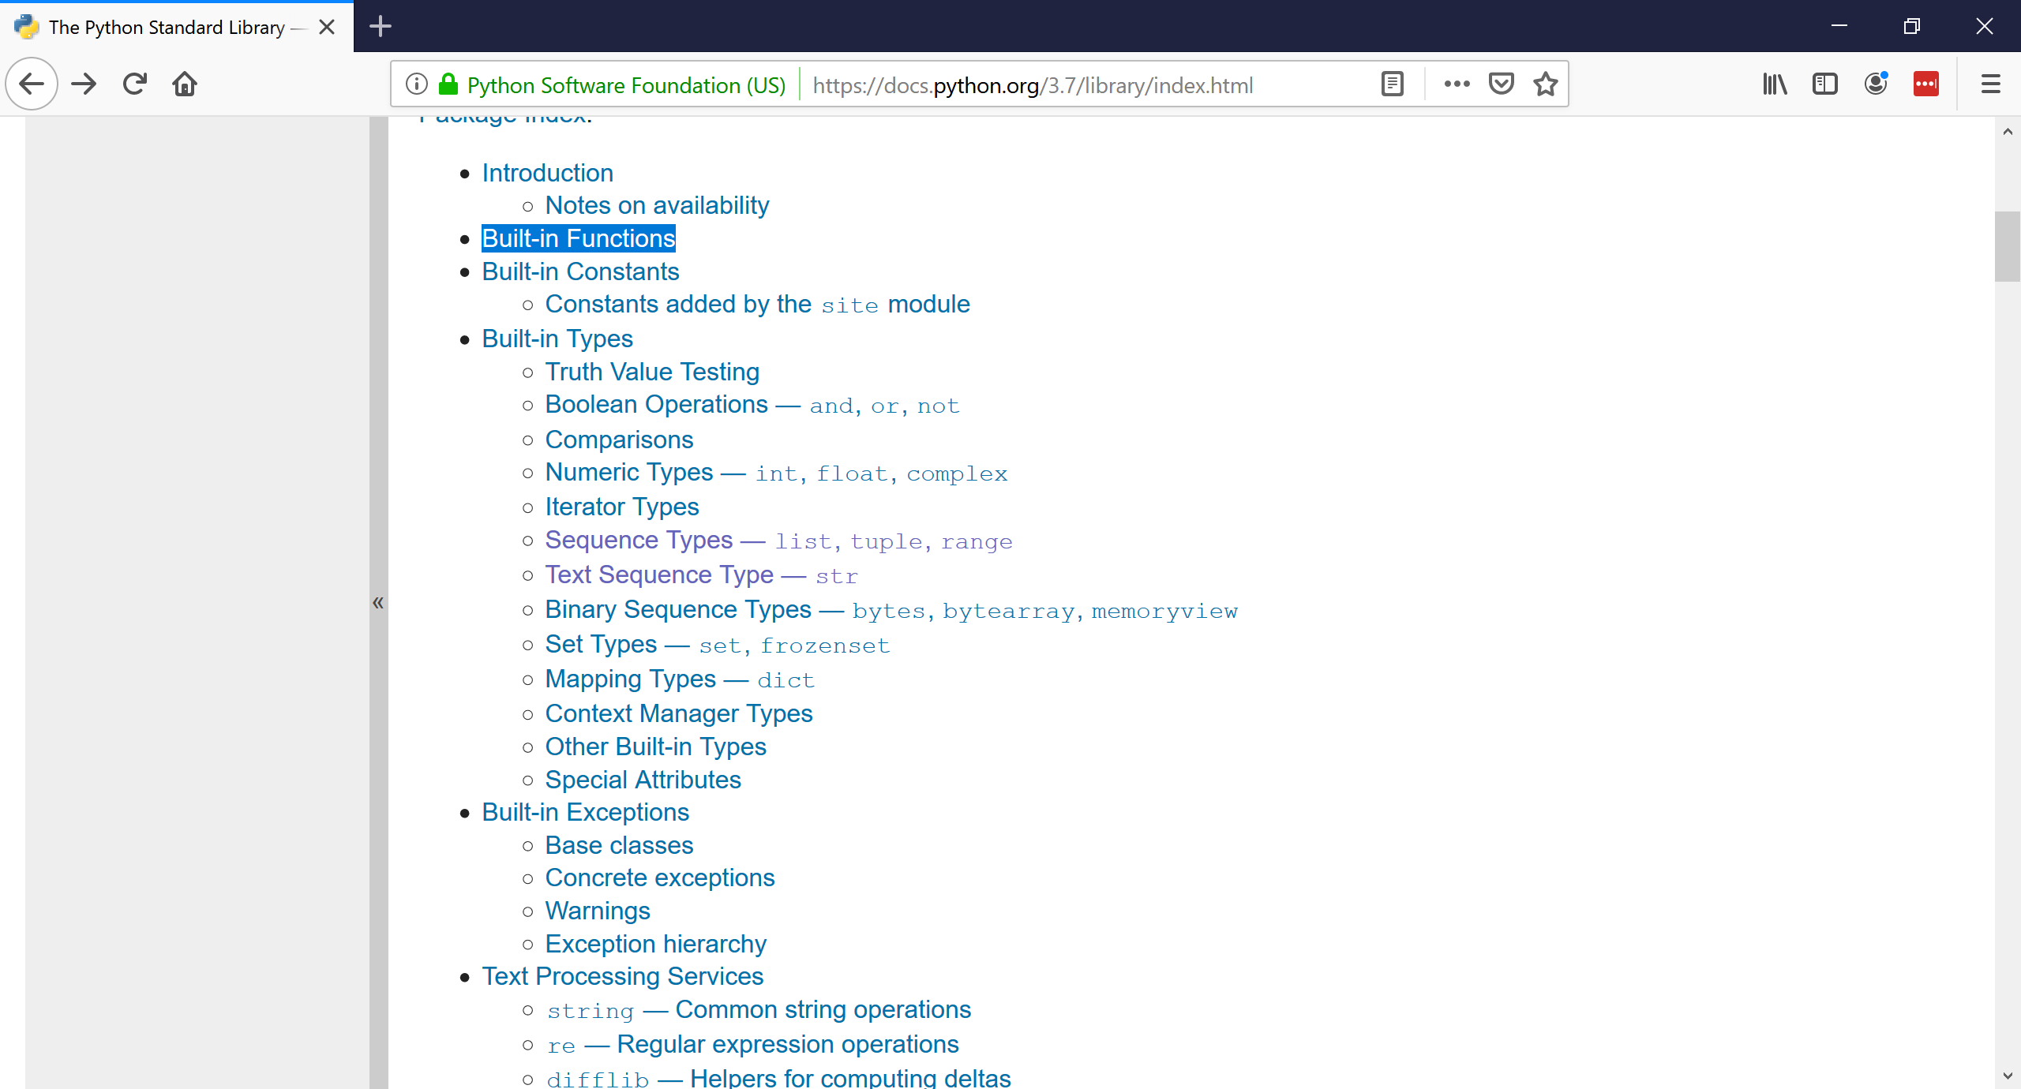
Built-in Functions
BCHB524 - Edwards

Slide 20
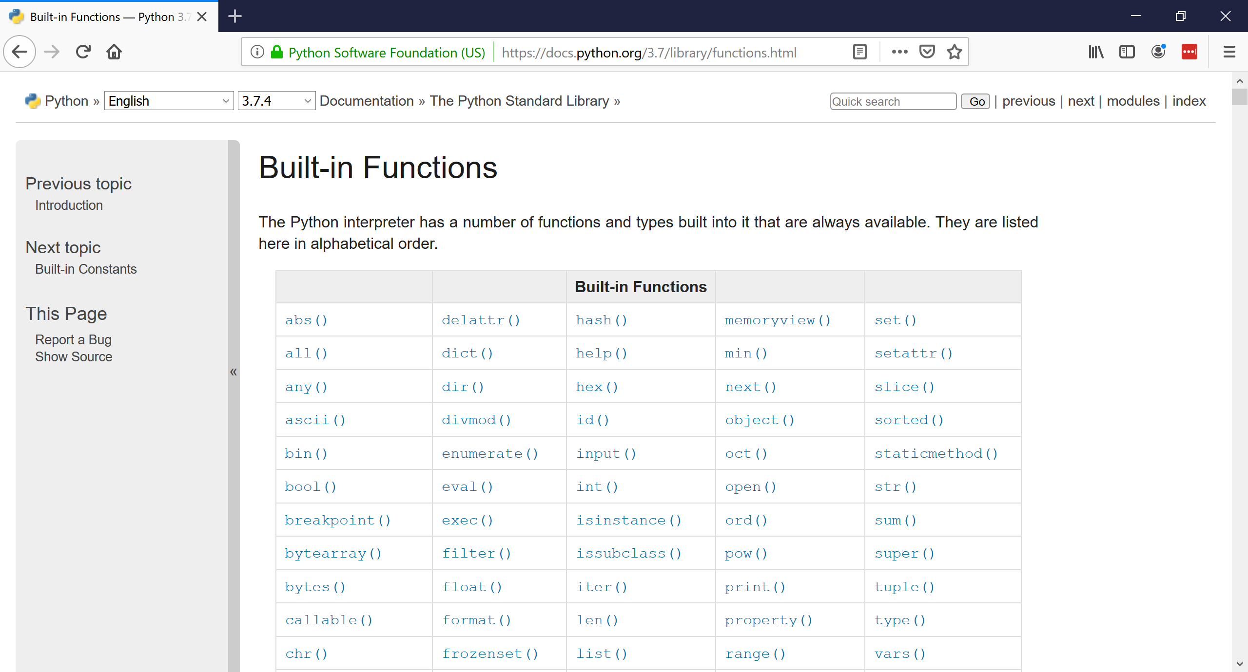
Built-in Functions
BCHB524 - Edwards

