Slide 1
Protein Structure
Informatics using Bio.PDB
BCHB524
Lecture 13
BCHB524 - Edwards

Slide 2
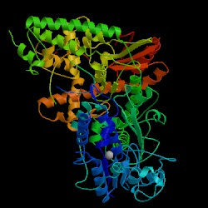
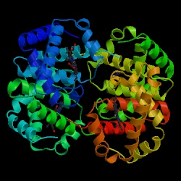
Proteins are…
…3-D molecules that interact with other (biological) molecules to carry out biological functions…
DNA Polymerase Hemoglobin
BCHB524 - Edwards

Slide 3
Protein Data Bank (PDB)
Repository of the 3-D conformation(s) / structure of proteins.
The result of laborious and expensive experiments using X-ray crystallography and/or nuclear magnetic resonance (NMR).
  (x,y,z) position of every atom of every amino-acid
Some entries contain multi-protein complexes, small-molecule ligands, docked epitopes and antibody-antigen complexes…
BCHB524 - Edwards

Slide 4
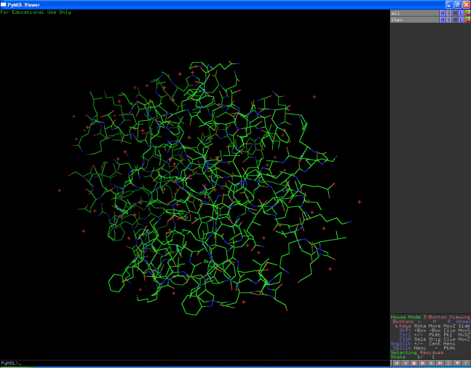
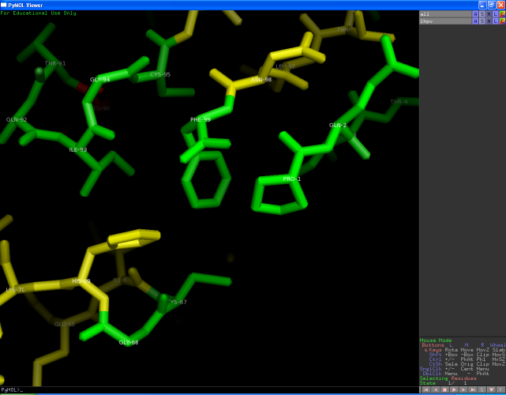
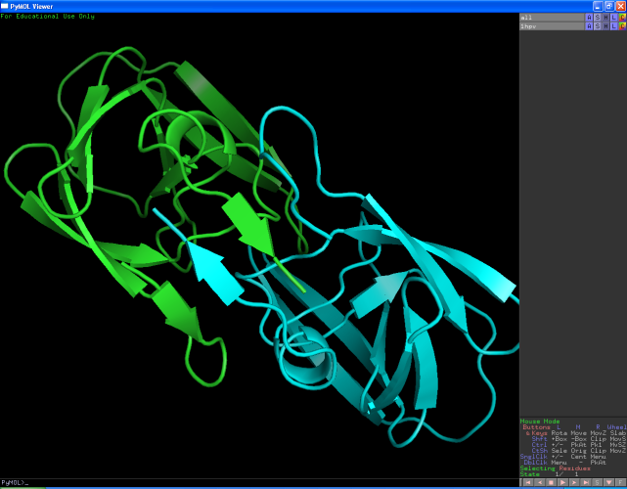
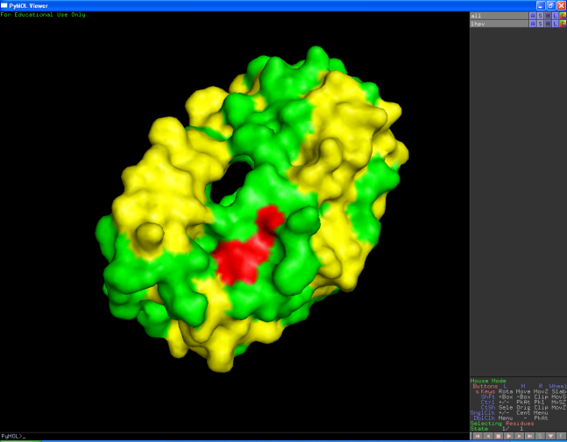
Visualization (PyMOL)
BCHB524 - Edwards

Slide 5
Biopython Bio.PDB
Parser for PDB format files
Navigate structure and answer atom-atom distance/angle questions.
Structure (PDB File) >> Model >> Chain >> Residue >> Atom >> (x,y,z) coordinates
  SMCRA representation mirrors PDB format
BCHB524 - Edwards

Slide 6
SMCRA Data-Model
Each PDB file represents one “structure”
Each structure may contain many models
  In most cases there is only one model, index 0.
Each polypeptide (amino-acid sequence) is a “chain”.
  A single-protein structure has one chain, “A”
  1HPV is a dimer and has chains “A” and “B”.
BCHB524 - Edwards

Slide 7
SMCRA Data-Model
import Bio.PDB.PDBParser
import sys
# Use QUIET=True to avoid lots of warnings...
parser = Bio.PDB.PDBParser(QUIET=True)
structure = parser.get_structure("1HPV", "1HPV.pdb")
model = structure[0]
# This structure is a dimer with two chains
achain = model['A']
bchain = model['B']
BCHB524 - Edwards

Slide 8
SMCRA
Chains are composed of amino-acid residues
  Access by iteration, or by index
  Residue “index” may not be sequence position
Residues are composed of atoms:
  Access by iteration or by atom name
  …except for H!
Water molecules are also represented as atoms – HOH residue name, het=“W”
BCHB524 - Edwards

Slide 9
SMCRA Data-Model
import Bio.PDB.PDBParser
import sys
# Use QUIET=True to avoid lots of warnings...
parser = Bio.PDB.PDBParser(QUIET=True)
structure = parser.get_structure("1HPV", "1HPV.pdb")
model = structure[0]
for chain in model:
for residue in chain:
for atom in residue:
print(chain, residue, atom, atom.get_coord())
BCHB524 - Edwards

Slide 10
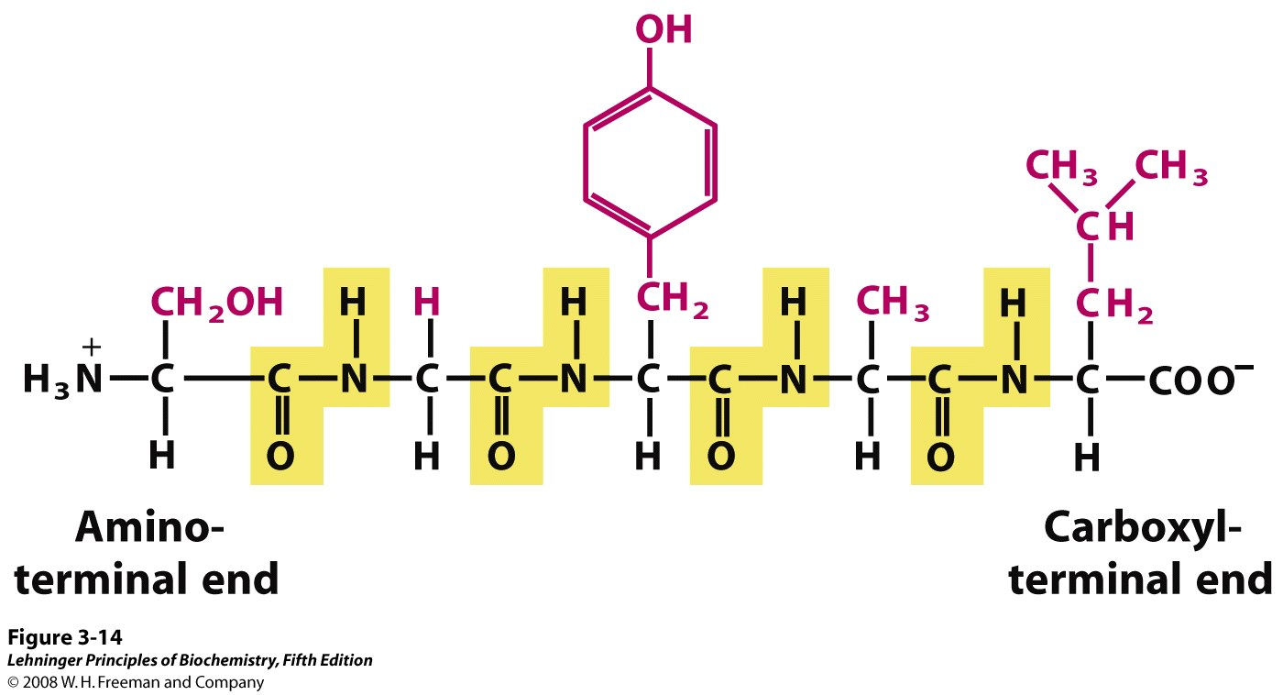
Polypeptide molecules
S-G-Y-A-L
BCHB524 - Edwards

Slide 11
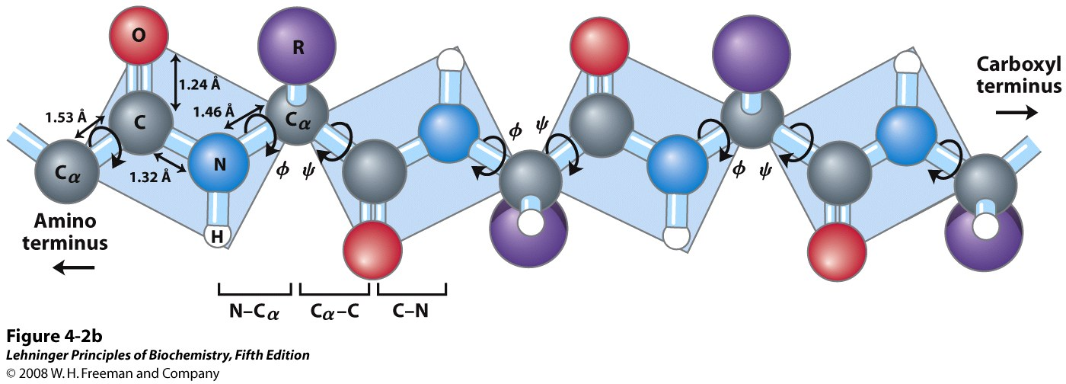
SMCRA Atom names
BCHB524 - Edwards

Slide 12
Check polypeptide backbone
import Bio.PDB.PDBParser
import sys
# Use QUIET=True to avoid lots of warnings...
parser = Bio.PDB.PDBParser(QUIET=True)
structure = parser.get_structure("1HPV", "1HPV.pdb")
model = structure[0]
achain = model['A']
for residue in achain:
index = residue.get_id()[1]
calpha = residue['CA']
carbon = residue['C']
nitrogen = residue['N']
oxygen = residue['O']
print("Residue:",residue.get_resname(),index)
print("N - Ca",(nitrogen - calpha))
print("Ca - C ",(calpha - carbon))
print("C - O ",(carbon - oxygen))
print()
BCHB524 - Edwards

Slide 13
Check polypeptide backbone
# As before...
for residue in achain:
index = residue.get_id()[1]
calpha = residue['CA']
carbon = residue['C']
nitrogen = residue['N']
oxygen = residue['O']
print("Residue:",residue.get_resname(),index)
print("N - Ca",(nitrogen - calpha))
print("Ca - C ",(calpha - carbon))
print("C - O ",(carbon - oxygen))
if achain.has_id(index+1):
nextresidue = achain[index+1]
nextnitrogen = nextresidue['N']
print("C - N ",(carbon - nextnitrogen))
print()
BCHB524 - Edwards

Slide 14
Find potential disulfide bonds
The sulfur atoms of Cys amino-acids often form “di-sulfide” bonds if they are close enough – less than 8 Å.
Compare with PDB file contents: SSBOND
Bio.PDB does not provide an easy way to access the SSBOND annotations
BCHB524 - Edwards

Slide 15
Find potential disulfide bonds
import Bio.PDB.PDBParser
import sys
# Use QUIET=True to avoid lots of warnings...
parser = Bio.PDB.PDBParser(QUIET=True)
structure = parser.get_structure("1KCW", "1KCW.pdb")
model = structure[0]
achain = model['A']
cysresidues = []
for residue in achain:
if residue.get_resname() == 'CYS':
cysresidues.append(residue)
for c1 in cysresidues:
c1index = c1.get_id()[1]
for c2 in cysresidues:
c2index = c2.get_id()[1]
if (c1['SG'] - c2['SG']) < 8.0:
print("possible di-sulfide bond:", end=" ")
print("Cys",c1index,"-", end=" ")
print("Cys",c2index, end=" ")
print(round(c1['SG'] - c2['SG'],2))
BCHB524 - Edwards

Slide 16
Find contact residues in a dimer
import Bio.PDB.PDBParser
import sys
# Use QUIET=True to avoid lots of warnings...
parser = Bio.PDB.PDBParser(QUIET=True)
structure = parser.get_structure("1HPV","1HPV.pdb")
achain = structure[0]['A']
bchain = structure[0]['B']
for res1 in achain:
r1ca = res1['CA']
r1ind = res1.get_id()[1]
r1sym = res1.get_resname()
for res2 in bchain:
r2ca = res2['CA']
r2ind = res2.get_id()[1]
r2sym = res2.get_resname()
if (r1ca - r2ca) < 6.0:
print("Residues",r1sym,r1ind,"in chain A", end=" ")
print("and",r2sym,r2ind,"in chain B", end=" ")
print("are close to each other:",round(r1ca-r2ca,2))
BCHB524 - Edwards

Slide 17
Find contact residues in a dimer – better version
import Bio.PDB.PDBParser
import sys
# Use QUIET=True to avoid lots of warnings...
parser = Bio.PDB.PDBParser(QUIET=True)
structure = parser.get_structure("1HPV","1HPV.pdb")
achain = structure[0]['A']
bchain = structure[0]['B']
bchainca = [ r['CA'] for r in bchain ]
neighbors = Bio.PDB.NeighborSearch(bchainca)
for res1 in achain:
r1ca = res1['CA']
r1ind = res1.get_id()[1]
r1sym = res1.get_resname()
for r2ca in neighbors.search(r1ca.get_coord(), 6.0):
res2 = r2ca.get_parent()
r2ind = res2.get_id()[1]
r2sym = res2.get_resname()
print("Residues",r1sym,r1ind,"in chain A", end=" ")
print("and",r2sym,r2ind,"in chain B", end=" ")
print("are close to each other:",round(r1ca-r2ca,2))
BCHB524 - Edwards

Slide 18
Superimpose two structures
import Bio.PDB
import Bio.PDB.PDBParser
import sys
# Use QUIET=True to avoid lots of warnings...
parser = Bio.PDB.PDBParser(QUIET=True)
structure1 = parser.get_structure("2WFJ","2WFJ.pdb")
structure2 = parser.get_structure("2GW2","2GW2a.pdb")
ppb=Bio.PDB.PPBuilder()
# Manually figure out how the query and subject peptides correspond...
# query has an extra residue at the front
# subject has two extra residues at the back
query = ppb.build_peptides(structure1)[0][1:]
target = ppb.build_peptides(structure2)[0][:-2]
query_atoms = [ r['CA'] for r in query ]
target_atoms = [ r['CA'] for r in target ]
superimposer = Bio.PDB.Superimposer()
superimposer.set_atoms(query_atoms, target_atoms)
print("Query and subject superimposed, RMS:", superimposer.rms)
superimposer.apply(structure2.get_atoms())
# Write modified structures to one file
outfile=open("2GW2-modified.pdb", "w")
io=Bio.PDB.PDBIO()
io.set_structure(structure2)
io.save(outfile)
outfile.close()
BCHB524 - Edwards

Slide 19
Superimpose two chains
import Bio.PDB
parser = Bio.PDB.PDBParser(QUIET=1)
structure = parser.get_structure("1HPV","1HPV.pdb")
model = structure[0]
ppb=Bio.PDB.PPBuilder()
# Get the polypeptide chains
achain,bchain = ppb.build_peptides(model)
aatoms = [ r['CA'] for r in achain ]
batoms = [ r['CA'] for r in bchain ]
superimposer = Bio.PDB.Superimposer()
superimposer.set_atoms(aatoms, batoms)
print("Query and subject superimposed, RMS:", superimposer.rms)
superimposer.apply(model['B'].get_atoms())
# Write structure to file
outfile=open("1HPV-modified.pdb", "w")
io=Bio.PDB.PDBIO()
io.set_structure(structure)
io.save(outfile)
outfile.close()
BCHB524 - Edwards

Slide 20
Exercises
Read through and try the examples from Chapter 11 of the Biopython Tutorial and the Bio.PDB FAQ.
Write a program that analyzes a PDB file (filename provided on the command-line!) to find pairs of lysine residues that might be linked if the BS3 cross-linker is used.
  The rigid BS3 cross-linker is approximately 11 Å long.
  Write two versions, one that computes the distance between all pairs of lysine residues, and one that uses the NeighborSearch technique.
BCHB524 - Edwards

