Slide 1
Using Web-Services: NCBI E-Utilities, online BLAST
BCHB524
Lecture 21
BCHB524 - Edwards

Slide 2
Outline
NCBI E-Utilities
  …from a script, via the internet
NCBI Blast
  …from a script, via the internet
Exercises
BCHB524 - Edwards

Slide 3
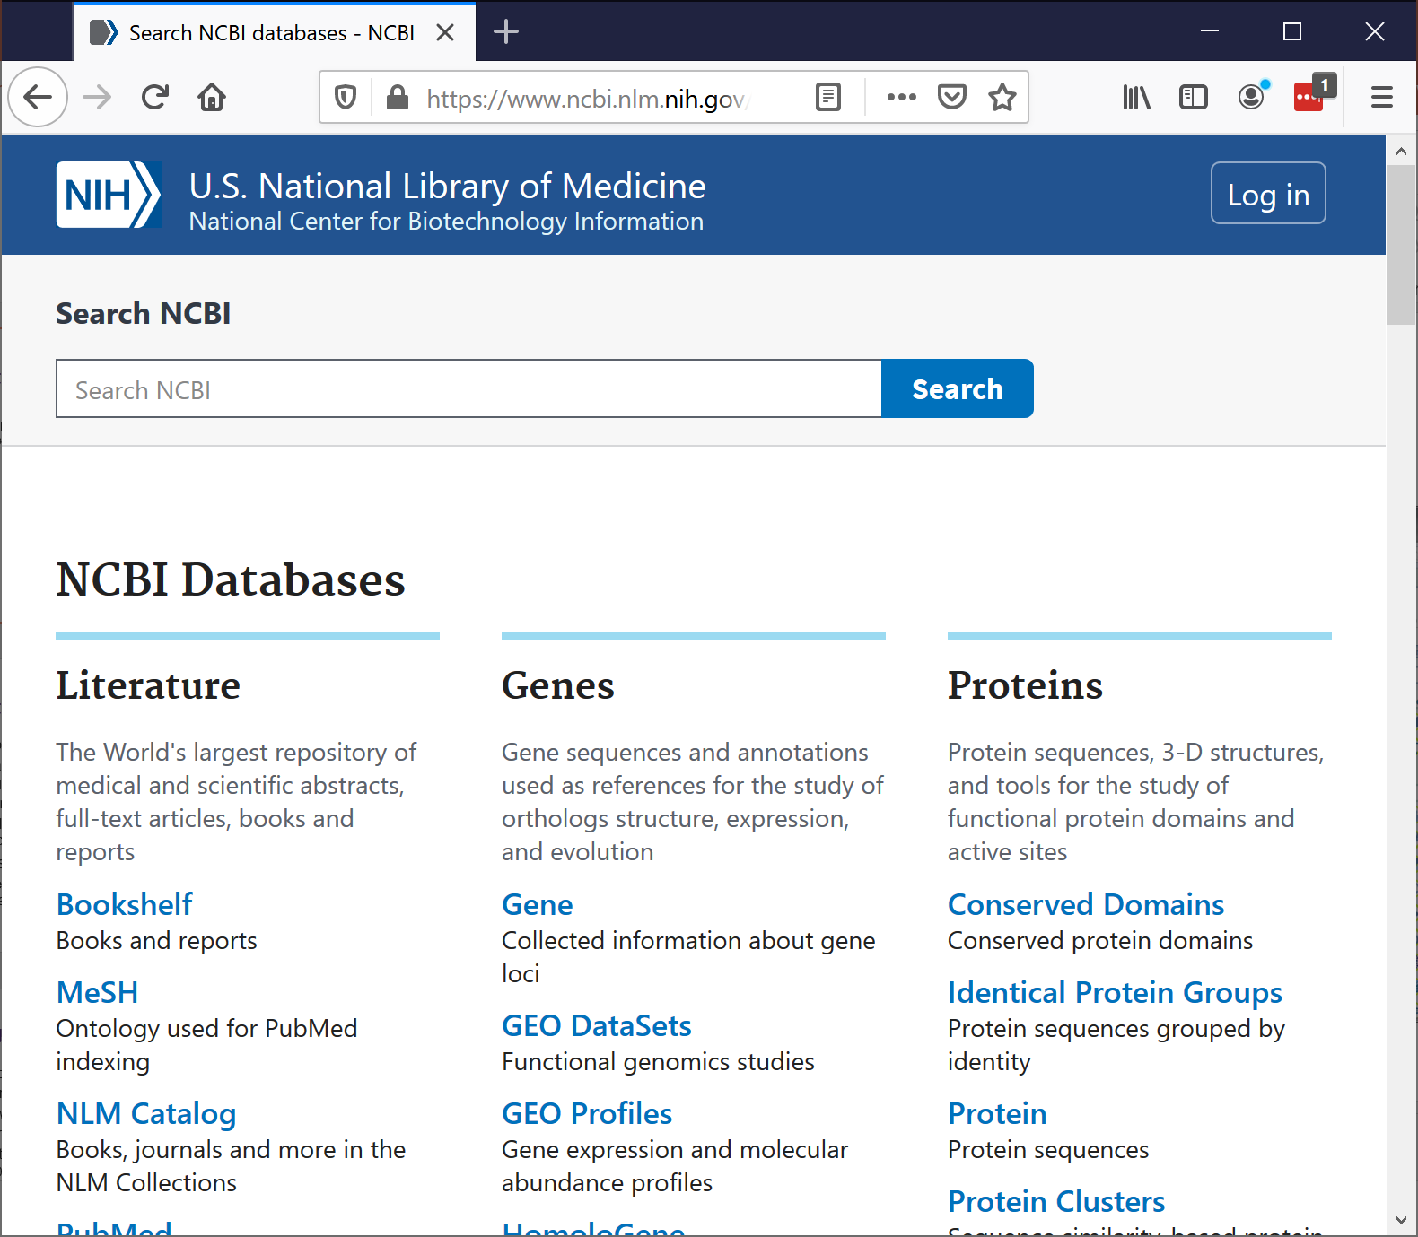
NCBI Entrez
Powerful web-portal for NCBI's online databases
  Nucleotide
  Protein
  PubMed
  Gene
  Structure
  Taxonomy
  OMIM
  etc…
BCHB524 - Edwards

Slide 4
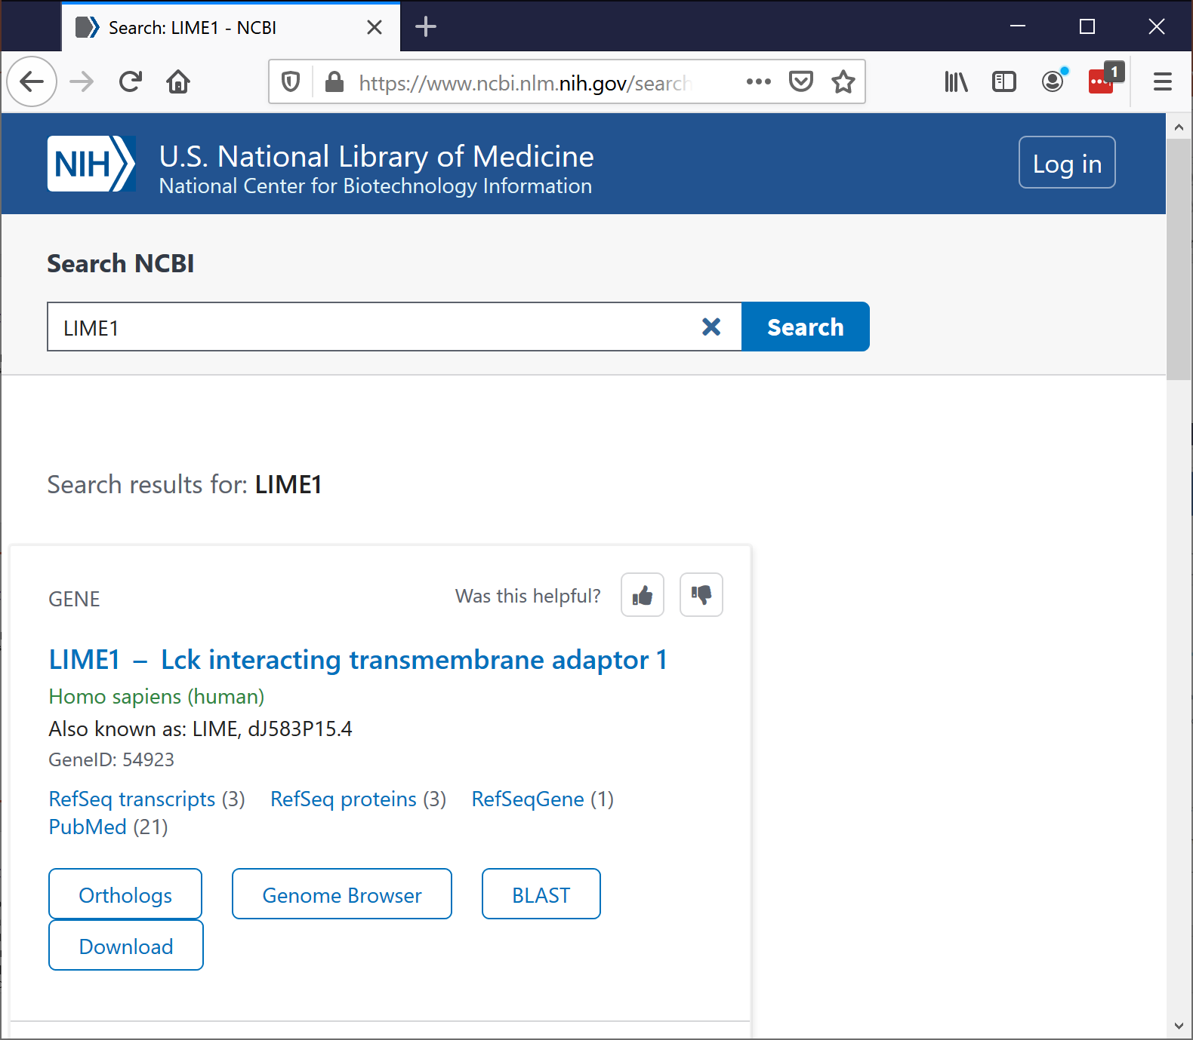
NCBI Entrez
Powerful web-portal for NCBI's online databases
  Nucleotide
  Protein
  PubMed
  Gene
  Structure
  Taxonomy
  OMIM
  etc…
BCHB524 - Edwards

Slide 5
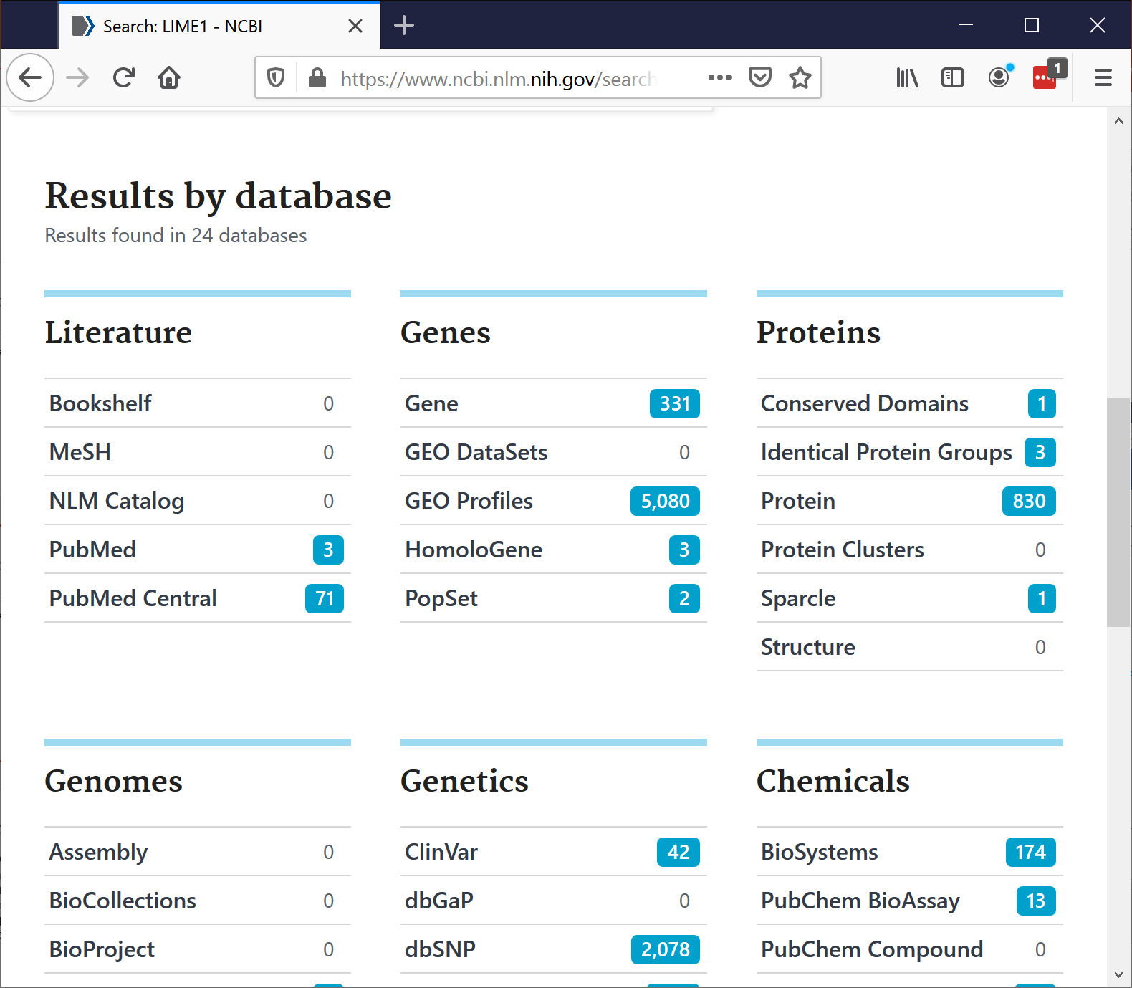
NCBI Entrez
Powerful web-portal for NCBI's online databases
  Nucleotide
  Protein
  PubMed
  Gene
  Structure
  Taxonomy
  OMIM
  etc…
BCHB524 - Edwards

Slide 6
NCBI Entrez
We can do a lot using a web-browser
  Look up a specific record
    nucleotide, protein, mRNA, EST, PubMed, structure,…
  Search for matches to a gene or disease name
  Download sequence and other data associated with a nucleotide or protein
Sometimes we need to automate the process
  Use Entrez to select and return the items of interest, rather than download, parse, and select.
BCHB524 - Edwards

Slide 7
NCBI E-Utilities
Used to automate the use of Entrez capabilities.
Google: Entrez Programming Utilities
  https://www.ncbi.nlm.nih.gov/books/NBK25500/
  https://www.ncbi.nlm.nih.gov/books/NBK25501/
See also, Chapter 9 of the BioPython tutorial
Play nice with the Entrez resources!
  At most 100 requests during the day
  Supply your email address
  Use history for large requests
  …otherwise you or your computer could be banned!
  BioPython automates many of the requirements...
BCHB524 - Edwards

Slide 8
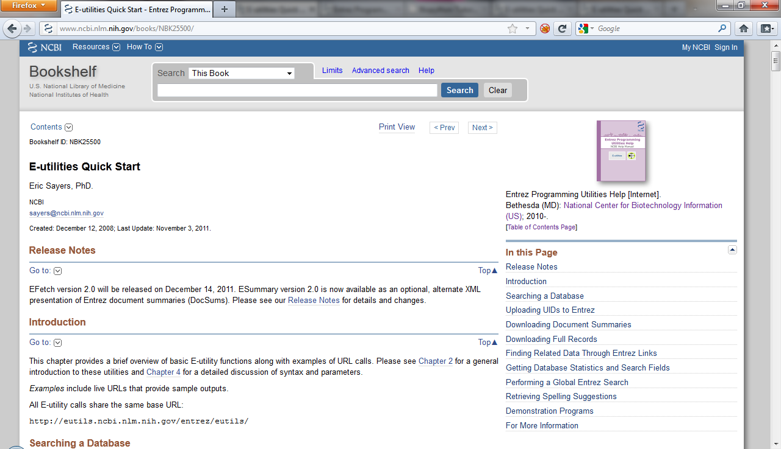
NCBI E-Utilities
No need to use Python, BioPython
Can form urls and parse XML directly.
E-Info
PubMed Info
BCHB524 - Edwards

Slide 9
BioPython and
Entrez E-Utilities
As you might expect BioPython provides some nice tools to simplify this process
from Bio import Entrez
Entrez.email = 'netid@georgetown.edu'
handle = Entrez.einfo()
result = Entrez.read(handle)
print(result["DbList"])
handle = Entrez.einfo(db='pubmed')
result = Entrez.read(handle)
print(result["DbInfo"]["Description"])
print(result["DbInfo"]["Count"])
print(result["DbInfo"].keys())
BCHB524 - Edwards

Slide 10
BioPython and Entrez E-Utililities
"Thin" wrapper around E-Utilities web-services
  Use E-Utilities argument names
    db for database name, for example
Use Entrez.read to make a simple dictionary from the XML results.
  Could also parse XML directly (ElementTree), or get results in genbank format (for sequence)
Use result.keys() to "discover" structure of returned results.
BCHB524 - Edwards

Slide 11
E-Utilities Web-Services
E-Info
  Discover database names and fields
E-Search
  Search within a particular database
  Returns "primary ids"
E-Fetch
  Download database entries by primary ids
Others:
  E-Link, E-Post, E-Summary, E-GQuery
BCHB524 - Edwards

Slide 12
Using ESearch
By default only get back some of the ids:
  Use retmax to get back more…
  Meaning of returned id is database specific…
from Bio import Entrez
Entrez.email = 'netid@georgetown.edu'
handle = Entrez.esearch(db="pubmed", term="BRCA1")
result = Entrez.read(handle)
print(result["Count"])
print(result["IdList"])
handle = Entrez.esearch(db="nucleotide",
term="Cypripedioideae[Orgn] AND matK[Gene]")
result = Entrez.read(handle)
print(result["Count"])
print(result["IdList"])
BCHB524 - Edwards

Slide 13
Using EFetch
from Bio import Entrez, SeqIO
Entrez.email = 'netid@georgetown.edu'
handle = Entrez.efetch(db="nucleotide",
id="186972394,187372713",
rettype="gb")
print(handle.read())
handle = Entrez.esearch(db="nucleotide",
term="Cypripedioideae[Orgn] AND matK[Gene]")
result = Entrez.read(handle)
idlist = ','.join(result["IdList"])
handle = Entrez.efetch(db="nucleotide",
id=idlist,
rettype="gb")
for r in SeqIO.parse(handle, "genbank"):
print(r.id, r.description)
BCHB524 - Edwards
Notes:
,187372714

Slide 14
ESearch and EFetch together
Entrez provides a more efficient way to combine ESearch and EFetch
  After esearch, Entrez already knows the ids you want!
  Sending the ids back to you is more work for Entrez
  Requesting specific ids to efetch is more work for Entrez
Use the history mechanism to "remind" Entrez that it already knows the ids
Access large result sets in "chunks".
BCHB524 - Edwards

Slide 15
ESearch and EFetch using esearch history
from Bio import Entrez, SeqIO
Entrez.email = 'netid@georgetown.edu'
handle = Entrez.esearch(db="nucleotide", term="Cypripedioideae[Orgn]",
usehistory="y")
result = Entrez.read(handle)
handle.close()
count = int(result["Count"])
session_cookie = result["WebEnv"]
query_key = result["QueryKey"]
print(count, session_cookie, query_key)
# Get the results in chunks of 100
chunk_size = 100
for chunk_start in range(0,count,chunk_size) :
handle = Entrez.efetch(db="nucleotide", rettype="gb",
retstart=chunk_start, retmax=chunk_size,
webenv=session_cookie, query_key=query_key)
for r in SeqIO.parse(handle,"genbank"):
print(r.id, r.description)
handle.close()
BCHB524 - Edwards

Slide 16
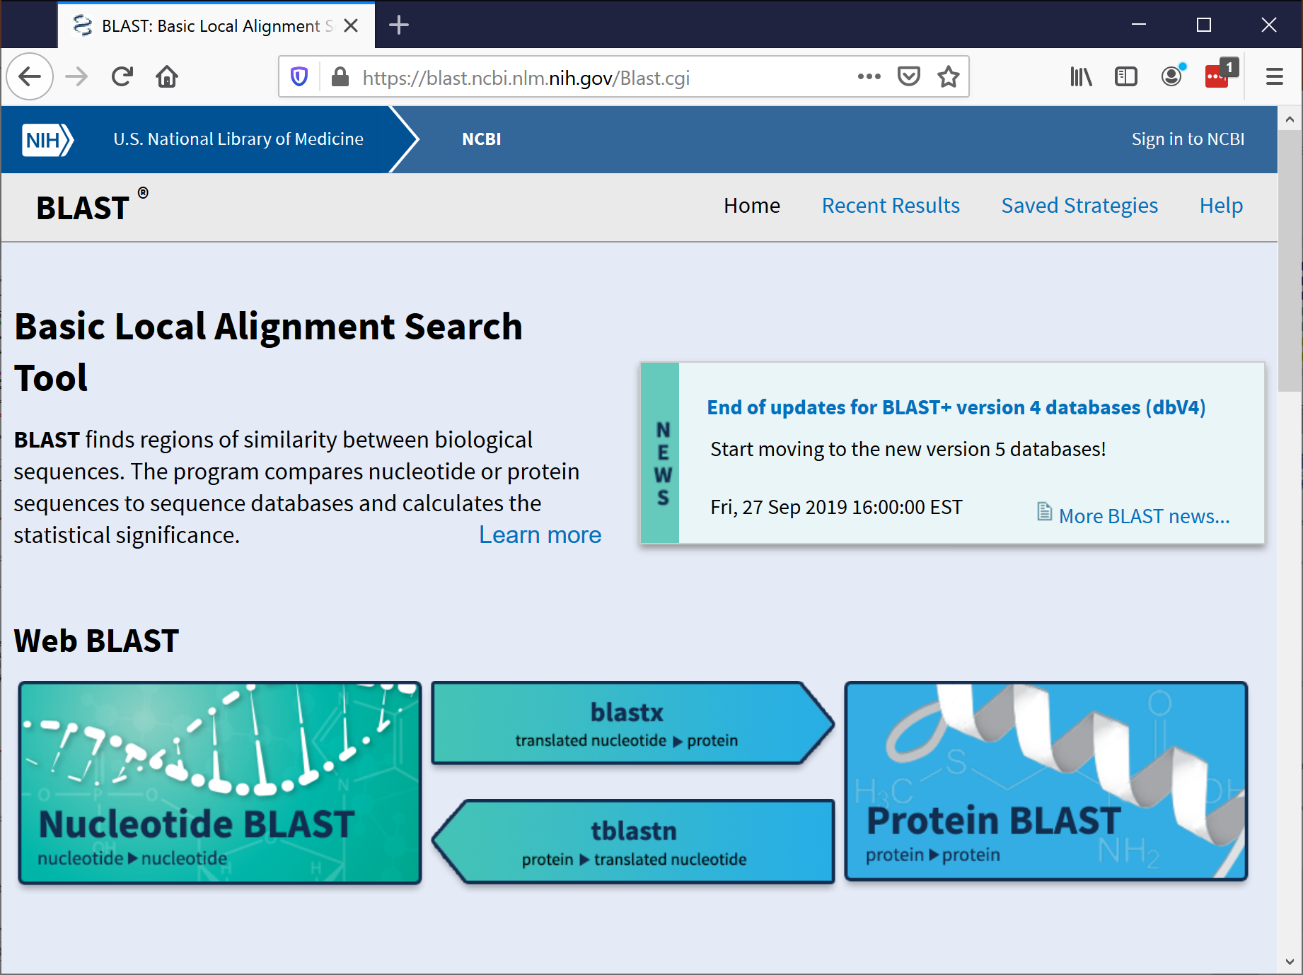
NCBI Blast
NCBI provides a very powerful blast search service on the web
We can access this infrastructure as a web-service
BioPython makes this easy!
  Ch. 7.1 in Tutorial
BCHB524 - Edwards

Slide 17
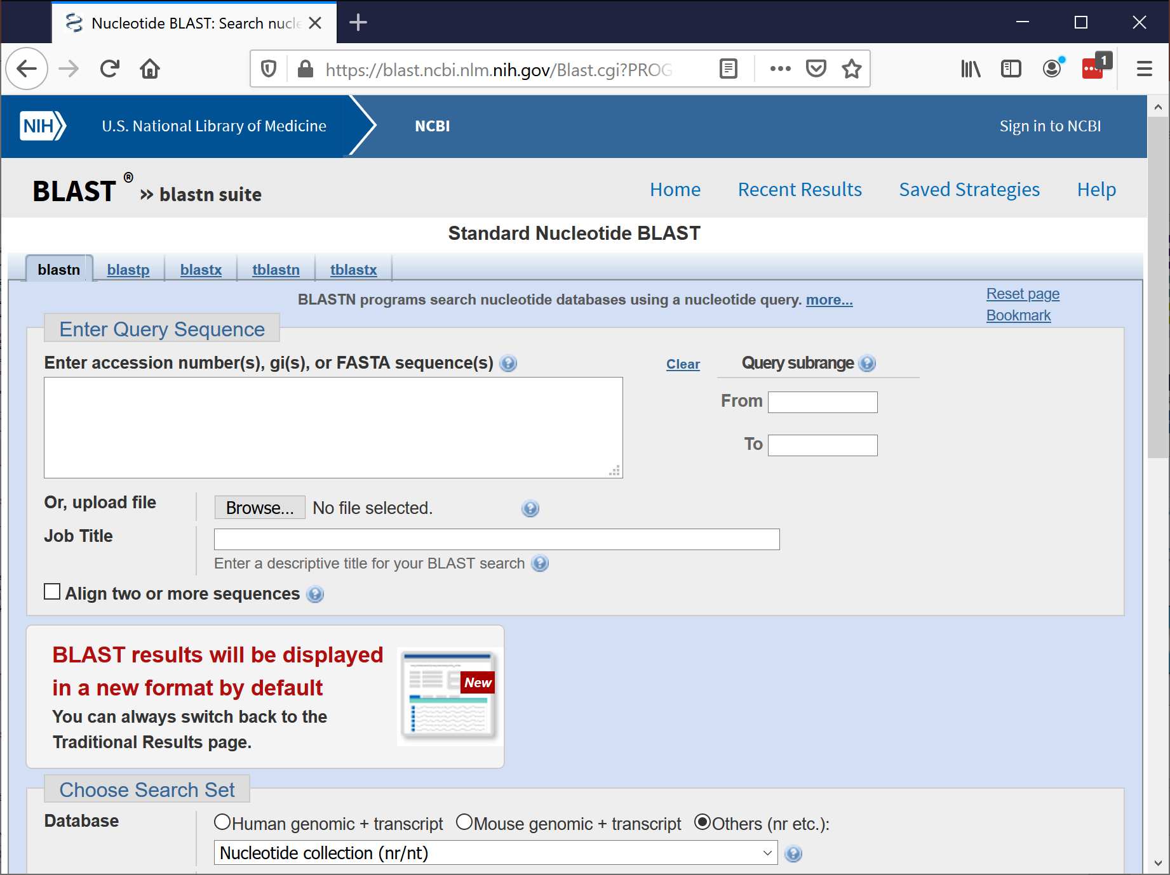
NCBI Blast
NCBI provides a very powerful blast search service on the web
We can access this infrastructure as a web-service
BioPython makes this easy!
  Ch. 7.1 in Tutorial
BCHB524 - Edwards

Slide 18
NCBI Blast
Lots of parameters…
Essentially mirrors blast options
You need to know how to use blast first!
Help on function qblast in module Bio.Blast.NCBIWWW:
qblast(program, database, sequence, url_base='https://blast.ncbi.nlm.nih.gov/Bla
st.cgi', auto_format=None, composition_based_statistics=None, db_genetic_code=No
ne, endpoints=None, entrez_query='(none)', expect=10.0, filter=None, gapcosts=No
ne, genetic_code=None, hitlist_size=50, i_thresh=None, layout=None, lcase_mask=N
one, matrix_name=None, nucl_penalty=None, nucl_reward=None, other_advanced=None,
perc_ident=None, phi_pattern=None, query_file=None, query_believe_defline=None,
query_from=None, query_to=None, searchsp_eff=None, service=None, threshold=None
, ungapped_alignment=None, word_size=None, short_query=None, alignments=500, ali
gnment_view=None, descriptions=500, entrez_links_new_window=None, expect_low=Non
e, expect_high=None, format_entrez_query=None, format_object=None, format_type='
XML', ncbi_gi=None, results_file=None, show_overview=None, megablast=None, templ
ate_type=None, template_length=None)
BLAST search using NCBI's QBLAST server or a cloud service provider.
Supports all parameters of the old qblast API for Put and Get.
Please note that NCBI uses the new Common URL API for BLAST searches
on the internet (http://ncbi.github.io/blast-cloud/dev/api.html). Thus,
some of the parameters used by this function are not (or are no longer)
officially supported by NCBI. Although they are still functioning, this
may change in the future.
BCHB524 - Edwards

Slide 19
NCBI Blast
Lots of parameters…
Essentially mirrors blast options
You need to know how to use blast first!
Some useful parameters:
- program blastn, blastp, blastx, tblastn, or tblastx (lower case)
- database Which database to search against (e.g. "nr").
- sequence The sequence to search.
- ncbi_gi TRUE/FALSE whether to give 'gi' identifier.
- descriptions Number of descriptions to show. Def 500.
- alignments Number of alignments to show. Def 500.
- expect An expect value cutoff. Def 10.0.
- matrix_name Specify an alt. matrix (PAM30, PAM70, BLOSUM80, BLOSUM45).
- filter "none" turns off filtering. Default no filtering
- format_type "HTML", "Text", "ASN.1", or "XML". Def. "XML".
- entrez_query Entrez query to limit Blast search
- hitlist_size Number of hits to return. Default 50
- megablast TRUE/FALSE whether to use MEga BLAST algorithm (blastn only)
- short_query TRUE/FALSE whether to adjust the search parameters for a
short query sequence. Note that this will override
manually set parameters like word size and e value. Turns
off when sequence length is > 30 residues. Default: None.
- service plain, psi, phi, rpsblast, megablast (lower case)
This function does no checking of the validity of the parameters
BCHB524 - Edwards

Slide 20
NCBI Blast
Required parameters:
  Blast program, Blast database, Sequence
  Returns XML format results, by default.
import os.path
from Bio.Blast import NCBIWWW
result_handle = NCBIWWW.qblast("blastn", "nr", "8332116")
blast_results = result_handle.read()
print(blast_results)
BCHB524 - Edwards

Slide 21
NCBI Blast
Required parameters:
  Blast program, Blast database, Sequence
  Returns XML format results, by default.
Save results to a file, for parsing…
import os.path
from Bio.Blast import NCBIWWW
if not os.path.exists("blastn-nr-8332116.xml"):
result_handle = NCBIWWW.qblast("blastn", "nr", "8332116")
blast_results = result_handle.read()
result_handle.close()
save_file = open("blastn-nr-8332116.xml", "w")
save_file.write(blast_results)
save_file.close()
# Do something with the blast results in blastn-nr-8332116.xml
BCHB524 - Edwards

Slide 22
NCBI Blast Parsing
Results need to be parsed in order to be useful…
from Bio.Blast import NCBIXML
result_handle = open("blastn-nr-8332116.xml")
for blast_result in NCBIXML.parse(result_handle):
for desc in blast_result.descriptions:
if desc.e < 1e-5:
print('****Alignment****')
print('sequence:', desc.title)
print('e value:', desc.e)
BCHB524 - Edwards

Slide 23
Exercises
Putative Human – Mouse BRCA1 Orthologs
  Write a program using NCBI's E-Utilities to retrieve the ids of RefSeq human BRCA1 proteins from NCBI. Use the query:
  "Homo sapiens"[Organism] AND BRCA1[Gene Name] AND REFSEQ
  Extend your program to search these protein ids (one at a time) vs RefSeq proteins (refseq_protein) using the NCBI blast web-service.
  Further extend your program to filter the results for significance (E-value < 1.0e-5) and to extract mouse sequences (match "Mus musculus" in the description).
  Note: you may need to
    Request at least 200 alignments from qblast to see the first mouse protein (keyword parameter hitlist_size, default is 50), or
    Restrict the qblast search to mouse refseq proteins (keyword parameter entrez_query)
BCHB524 - Edwards

