Slide 1
Using Local Tools: BLAST
BCHB524
Lecture 22
BCHB524 - Edwards

Slide 2
Outline
Running blast
  Format sequence databases
  Run by hand
Running blast and interpreting results
  Directly and using BioPython
Exercises
BCHB524 - Edwards

Slide 3
Local Tools
Sometimes web-based services don't do it.
For blast:
  Too many query sequences
  Need to search a novel sequence database
  Need to change rarely used parameters
  Web-service is too slow
For other tools:
  No web-service?
  No interactive web-site?
  Insufficient back-end computational resources?
BCHB524 - Edwards

Slide 4
Download / install standalone blast
Google "NCBI Blast"
  …or go to http://www.ncbi.nlm.nih.gov/BLAST
Click on "Help" tab
Under "Other BLAST Information",
  Click on "Download BLAST Software and Databases"
“What are the next steps?”
  FTP site has executables…
Blast is already installed in BCHB524 Linux virtual box instance:
  Type "blastn -help" in the terminal
BCHB524 - Edwards

Slide 5
Download BLAST databases
Create folder for Blast sequence databases
  Create folder or "mkdir blastdb"
Follow the link for database FTP site:
  ftp://ftp.ncbi.nlm.nih.gov/blast/db/
The FASTA directory contains compressed (.gz) FASTA format sequence databases.
  We'll download yeast.aa.gz and yeast.nt.gz from the FASTA folder to the blastdb folder
BCHB524 - Edwards

Slide 6
Uncompress FASTA databases
Open up the blastdb folder
Select "Extract here" for each
From the terminal:
  cd blastdb
  gunzip *.gz
  ls –l
BCHB524 - Edwards

Slide 7
Format FASTA databases
cd blastdb
ls –l
makeblastdb –help
makeblastdb -in yeast.aa -dbtype prot
makeblastdb -in yeast.nt -dbtype nucl
ls –l
BCHB524 - Edwards

Slide 8
Running BLAST from the command-line
We need a query sequence to search:
Copy and paste this FASTA file into IDLE and save as "query.fasta" in your home folder.
>gi|6319267|ref|NP_009350.1| Yal049cp
MASNQPGKCCFEGVCHDGTPKGRREEIFGLDTYAAGSTSPKEKVIVILTDVYGNKFNNVLLTADKFASAGYMVFVPDILF
GDAISSDKPIDRDAWFQRHSPEVTKKIVDGFMKLLKLEYDPKFIGVVGYCFGAKFAVQHISGDGGLANAAAIAHPSFVSI
EEIEAIDSKKPILISAAEEDHIFPANLRHLTEEKLKDNHATYQLDLFSGVAHGFAARGDISIPAVKYAKEKVLLDQIYWF
NHFSNV
>gi|6319268|ref|NP_009351.1| Yal048cp
MTKETIRVVICGDEGVGKSSLIVSLTKAEFIPTIQDVLPPISIPRDFSSSPTYSPKNTVLIDTSDSDLIALDHELKSADV
IWLVYCDHESYDHVSLFWLPHFRSLGLNIPVILCKNKCDSISNVNANAMVVSENSDDDIDTKVEDEEFIPILMEFKEIDT
CIKTSAKTQFDLNQAFYLCQRAITHPISPLFDAMVGELKPLAVMALKRIFLLSDLNQDSYLDDNEILGLQKKCFNKSIDV
NELNFIKDLLLDISKHDQEYINRKLYVPGKGITKDGFLVLNKIYAERGRHETTWAILRTFHYTDSLCINDKILHPRLVVP
DTSSVELSPKGYRFLVDIFLKFDIDNDGGLNNQELHRLFKCTPGLPKLWTSTNFPFSTVVNNKGCITLQGWLAQWSMTTF
LNYSTTTAYLVYFGFQEDARLALQVTKPRKMRRRSGKLYRSNINDRKVFNCFVIGKPCCGKSSLLEAFLGRSFSEEYSPT
IKPRIAVNSLELKGGKQYYLILQELGEQEYAILENKDKLKECDVICLTYDSSDPESFSYLVSLLDKFTHLQDLPLVFVAS
KADLDKQQQRCQIQPDELADELFVNHPLHISSRWLSSLNELFIKITEAALDPGKNTPGLPEETAAKDVDYRQTALIFGST
VGFVALCSFTLMKLFKSSKFSK
BCHB524 - Edwards

Slide 9
Running BLAST from the command-line
Step out of the blastdb folder
  cd ..
Check the contents of the query.fasta file
  more query.fasta
Run blast from the command-line (one-line)
  blastp -db blastdb/yeast.aa
  -query query.fasta
  -out results.txt
…and check out the result in results.txt.
  more results.txt
BCHB524 - Edwards

Slide 10
Running BLAST from the command-line
Parsing text-format BLAST results is hard:
  Use XML format output where possible
Run blast from the command-line (one-line)
  blastp -db blastdb/yeast.aa
  -query query.fasta
  -outfmt 5 -out results.xml
…and check out the result in results.xml.
  more results.xml
BCHB524 - Edwards

Slide 11
Interpreting blast results
Use BioPython's BLAST parser
from Bio.Blast import NCBIXML
result_handle = open("results.xml")
for blast_result in NCBIXML.parse(result_handle):
for alignment in blast_result.alignments:
for hsp in alignment.hsps:
if hsp.expect < 1e-5:
print('****Alignment****')
print('sequence:', alignment.title)
print('length:', alignment.length)
print('e value:', hsp.expect)
BCHB524 - Edwards

Slide 12
Running BLAST from Python: Generic Python Technique
Python can run other programs, including blast and capture the output
# Special module for running other programs
from subprocess import Popen, PIPE, STDOUT
# Set the blast program and arguements as strings
blast_prog = '/usr/local/bin/blastp'
blast_args = '-query query.fasta -db blastdb/yeast.aa'
# The Popen instance runs a program
proc = Popen(blast_prog + " " + blast_args,
stdout=PIPE, stderr=STDOUT, shell=True)
# proc.stdout behaves like an open file-handle...
for l in proc.stdout:
l = l.decode('utf-8').rstrip()
if l.startswith('Query='):
print('\n'+l+'\n')
if l.startswith('gi|'):
print(l)
BCHB524 - Edwards

Slide 13
Running BLAST from BioPython with Text-Parsing
Use BioPython to make command and run
# Special modules for running blast
from Bio.Blast.Applications import NcbiblastpCommandline
blast_prog = '/usr/local/bin/blastp'
blast_query = 'query.fasta'
blast_db = 'blastdb/yeast.aa'
# Build the command-line
cmdline = NcbiblastpCommandline(cmd=blast_prog,
query=blast_query,
db=blast_db,
out="results.txt")
# ...and execute.
stdout, stderr = cmdline()
# Parse the results by opening the output file
result = open("results.txt")
for l in result:
l = l.rstrip()
if l.startswith('Query='):
print('\n'+l+'\n')
if l.startswith('gi|'):
print(l)
BCHB524 - Edwards

Slide 14
Running BLAST from BioPython with ElementTree XML-Parsing
# Special modules for running blast
from Bio.Blast.Applications import NcbiblastpCommandline
# Set the blast program and arguments as strings
blast_prog = '/usr/local/bin/blastp'
blast_query = 'query.fasta'
blast_db = 'blastdb/yeast.aa'
# Build the command-line
cmdline = NcbiblastpCommandline(cmd=blast_prog,
query=blast_query,
db=blast_db,
outfmt=5,
out="results.xml")
# ...and execute.
stdout, stderr = cmdline()
# Parse the results by opening the output file
from xml.etree import ElementTree as ET
result = open("results.xml")
doc = ET.parse(result)
root = doc.getroot()
for ele in root.getiterator('Iteration'):
queryid = ele.findtext('Iteration_query-def')
for hit in ele.getiterator('Hit'):
hitid = hit.findtext('Hit_id')
for hsp in hit.getiterator('Hsp'):
evalue = hsp.findtext('Hsp_evalue')
print('\t'.join([queryid,hitid,evalue]))
break
BioPython to make command and run
ElementTree to parse the resulting XML
BCHB524 - Edwards

Slide 15
NCBI Blast Parsing
Results need to be parsed in order to be useful…
from Bio.Blast import NCBIXML
result_handle = open("results.xml")
for blast_result in NCBIXML.parse(result_handle):
for alignment in blast_result.alignments:
for hsp in alignment.hsps:
if hsp.expect < 1e-5:
print('****Alignment****')
print('sequence:', alignment.title)
print('length:', alignment.length)
print('e value:', hsp.expect)
print(hsp.query[0:75] + '...')
print(hsp.match[0:75] + '...')
print(hsp.sbjct[0:75] + '...')
BCHB524 - Edwards
Notes:
from Bio.Blast import NCBIXML
result_handle = open("query.xml")
for blast_result in NCBIXML.parse(result_handle):
for alignment in blast_result.alignments:
for hsp in alignment.hsps:
if hsp.expect < 1e-5:
print '****Alignment****'
print 'sequence:', alignment.title
print 'length:', alignment.length
print 'e value:', hsp.expect
print hsp.query[0:75] + '...'
print hsp.match[0:75] + '...'
print hsp.sbjct[0:75] + '...'

Slide 16
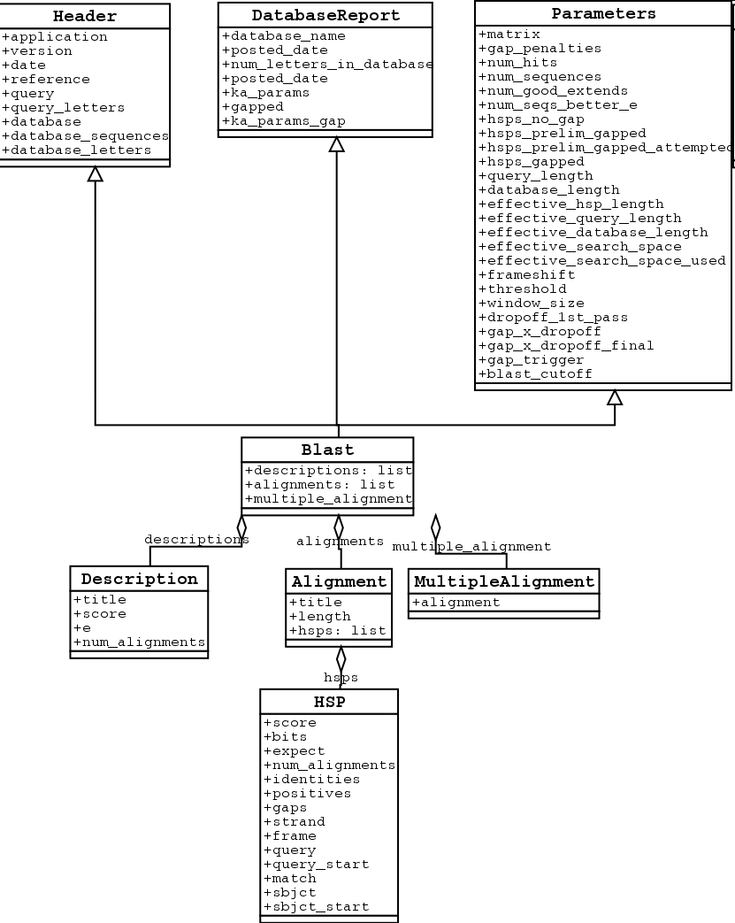
NCBI Blast Parsing
Each blast result contains multiple alignments of a query sequence to a database sequence
Each alignment consists of multiple high-scoring pairs (HSPs)
Each HSP has stats like expect, score, gaps, and aligned sequence chunks
BCHB524 - Edwards

Slide 17
NCBI Blast Parsing Skeleton
from Bio.Blast import NCBIXML
result_handle = # ...
# each blast_result corresponds to one query sequence
for blast_result in NCBIXML.parse(result_handle):
# blast_result.query is query description, etc.
print(blast_result.query)
# Each description contains a one-line summary of an alignment
for desc in blast_result.descriptions:
# title, score, e
print(desc.title, desc.score, desc.e)
# We can get the alignments one at a time, too
# Each alignment corresponds to one database sequence
for alignment in blast_result.alignments:
# alignment.title is database description
print(alignment.title)
# each query/database alignment consists of multiple
# high-scoring pair alignment "chunks"
for hsp in alignment.hsps:
# HSP statistics are here
# hsp.expect, hsp.score, hsp.positives, hsp.gaps
print(hsp.expect, hsp.score, hsp.positives, hsp.gaps)
BCHB524 - Edwards

Slide 18
Exercise
Find potential fruit fly / yeast orthologs
  Download FASTA files drosoph-ribosome.fasta.gz and yeast-ribosome.fasta.gz from the course data-directory.
  Uncompress and format each FASTA file for BLAST
  Search fruit fly ribosomal proteins against yeast ribosomal proteins
  For each fruit fly query, output the best yeast protein if it has a significant E-value.
    What ribosomal protein is most highly conserved between fruit fly and yeast?
BCHB524 - Edwards

