Slide 1
Basic Python Review
BCHB524
Lecture 9
BCHB524 - Edwards

Slide 2
Python Data-Structures
Mutable and changeable storage of many items
  Lists - Access by index or iteration
  Dictionaries - Access by key or iteration
  Sets - Access by iteration, membership test
  Files - Access by iteration, as string
Lists of numbers (range)
Strings → List (split), List → String (join)
Reading sequences, parsing codon table.
BCHB524 - Edwards

Slide 3
Class Review Exercises
DNA sequence length *
Are all DNA symbols valid? *
DNA sequence composition *
Pretty-print codon table **
Compute codon usage **
Read chunk format sequence from file *
Parse and print NCBI taxonomy names **
BCHB524 - Edwards

Slide 4
DNA Sequence Length
Write a program to determine the length of a DNA sequence provided in a file.
BCHB524 - Edwards
Notes:
# Import the required modules
import sys
# Check there is user input
if len(sys.argv) < 2:
print "Please provide a DNA sequence file on the command-line."
sys.exit(1)
# Assign the user input to a variable
seqfile = sys.argv[1]
# and read the sequence
seq = ''.join(file(seqfile).read().split())
# Compute the sequence length
seqlen = len(seq)
# Output a summary of the user input and the result
print "Input DNA sequence:",seq
print "Input DNA sequence length:",seqlen

Slide 5
DNA Sequence Length
# Import the required modules
import sys
# Check there is user input
if len(sys.argv) < 2:
print("Please provide a DNA sequence file on the command-line.")
sys.exit(1)
# Assign the user input to a variable
seqfile = sys.argv[1]
# and read the sequence
seq = ''.join(open(seqfile).read().split())
# Compute the sequence length
seqlen = len(seq)
# Output a summary of the user input and the result
print("Input DNA sequence:",seq)
print("Input DNA sequence length:",seqlen)
BCHB524 - Edwards
Notes:
# Import the required modules
import sys
# Check there is user input
if len(sys.argv) < 2:
print "Please provide a DNA sequence file on the command-line."
sys.exit(1)
# Assign the user input to a variable
seqfile = sys.argv[1]
# and read the sequence
seq = ''.join(file(seqfile).read().split())
# Compute the sequence length
seqlen = len(seq)
# Output a summary of the user input and the result
print "Input DNA sequence:",seq
print "Input DNA sequence length:",seqlen

Slide 6
Valid DNA Symbols
Write a program to determine if a DNA sequence provided in a file contains any invalid symbols.
BCHB524 - Edwards

Slide 7
DNA Composition
Write a program to count the proportion of each symbol in a DNA sequence, provided in a file.
BCHB524 - Edwards

Slide 8
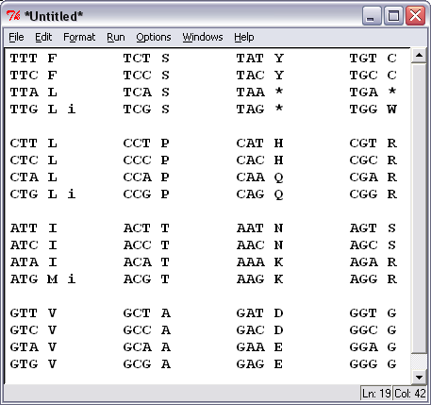
Pretty-print codon table
Write a program which takes a codon table file (standard.code) as input, and prints the codon table in the format shown.
  Hint: Use 3 (nested) loops though the nucleotide values
BCHB524 - Edwards

Slide 9
Pretty-print codon table
# read codons from a file
def readcodons(codonfile):
f = open(codonfile)
data = {}
for l in f:
sl = l.split()
key = sl[0]
value = sl[2]
data[key] = value
f.close()
b1 = data['Base1']
b2 = data['Base2']
b3 = data['Base3']
aa = data['AAs']
st = data['Starts']
codons = {}
init = {}
n = len(aa)
for i in range(n):
codon = b1[i] + b2[i] + b3[i]
codons[codon] = aa[i]
init[codon] = (st[i] == 'M')
return codons,init
BCHB524 - Edwards

Slide 10
Pretty-print codon table
# Import the required modules
import sys
# Check there is user input
if len(sys.argv) < 2:
print("Please provide a codon-table on the command-line.")
sys.exit(1)
# Assign the user input to variables
codonfile = sys.argv[1]
# Call the appropriate functions to get the codon table and the sequence
codons,init = readcodons(codonfile)
# Loop through the nucleotides (position 2 changes across the row).
# Bare print starts a new line
for n1 in 'TCAG':
for n3 in 'TCAG':
for n2 in 'TCAG':
codon = n1+n2+n3
print(codon,codons[codon], end=" ")
if init[codon]:
print("i ", end=" ")
else:
print(" ", end=" ")
print()
print()
BCHB524 - Edwards

Slide 11
Codon usage
Write a program to compute the codon usage of gene whose DNA sequence provided in a file.
  Assume translation starts with the first symbol of the provided gene sequence.
  Use a dictionary to count the number of times each codon appears, and then output the codon counts in amino-acid order.
BCHB524 - Edwards

Slide 12
Chunk format sequence
Write a program to compute the sequence composition from a DNA sequence file in "chunk" format.
  Download these files from the data-directory
    SwissProt_Format_Ns.seq
    SwissProt_Format.seq
  Check that your program correctly reads these sequences
  Download and check these files from the data-directory, too:
    chunk.seq, chunk_ns.seq
BCHB524 - Edwards

Slide 13
Taxonomy names
Write a program to list all the scientific names from a NCBI taxonomy file.
  Download the names.dmp file from the data-directory
  Look at the file and figure out how to parse it
  Read the file, line by line, and print out only those names that represent scientific names of species.
BCHB524 - Edwards

Slide 14
Exercise 1
Modify your DNA translation program to translate in each forward frame (1,2,3)
Modify your DNA translation program to translate in each reverse (complement) translation frame too.
Modify your translation program to handle 'N' symbols in the third position of a codon
  If all four codons represented correspond to the same amino-acid, then output that amino-acid.
  Otherwise, output 'X'.
BCHB524 - Edwards

