Slide 1
Graphics & Plots: matplotlib & pylab
BCHB524
Lecture 26
BCHB524 - Edwards

Slide 2
Outline
Testing pylab
Download data
Basic plots
  scatter plots, histograms, boxplots
Exercises
BCHB524 - Edwards

Slide 3
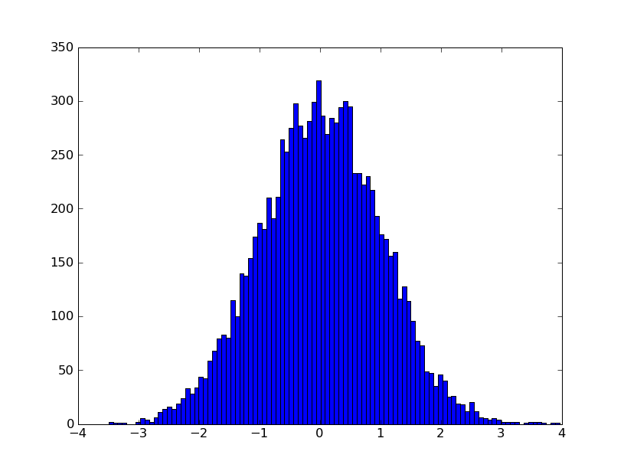
Test the pylab installation
Create the python script shown on the right
python test_pylab.py
test_pylab.py
from pylab import *
x = randn(10000)
hist(x, 100)
show()
BCHB524 - Edwards

Slide 4
Download some data
Download the data and the module for handling it, from the course homepage
  data.txt, data.py
Take a look!
  Open data.txt in a text-editor (IDLE or notepad)
  Run look.py
look.py
from data import *
print(genes)
print(data['AA055368'])
print(t1data['AA055368'])
BCHB524 - Edwards

Slide 5
Scatter plot
Use the plot function
for a scatter plot
  list of values
  x vs y
Choose to plot dots
or lines with last argument
  '.' for dots
  '-' for lines (default)
scatter_plot1.py
from pylab import *
from data import *
plot(data['AA055368'])
show()
scatter_plot2.py
from pylab import *
from data import *
plot(data['AA055368'],
data['R31679'],'.')
show()
BCHB524 - Edwards

Slide 6
Heatmap
heatmap1.py
from pylab import *
from data import *
pcolor(tmdata)
show()
Use the pcolor
function for a
heatmap
  list of lists, or
  numpy 2-D matrix
Choose colormap
  cool()
  hot()
Lots of tweaking options to make it
look just right
heatmap2.py
from pylab import *
from data import *
pcolor(tmdata)
clim((-6,6))
gci().set_cmap(cm.RdYlGn)
colorbar()
ylim([nsmpl,0])
axis('tight')
xlabel('Gene')
ylabel('Sample')
show()
# savefig('colormap.png',dpi=150)
BCHB524 - Edwards

Slide 7
Histogram & Boxplot
Use the hist function
for a histogram
  list of values
  number of bins
Use the boxplot
function for a boxplot
  useful for comparing distributions
  list of list of values
hist_plot1.py
from pylab import *
from data import *
hist(data['AA055368'])
show()
hist_plot2.py
from pylab import *
from data import *
hist(data['AA055368'],5)
show()
box_plot.py
from pylab import *
from data import *
boxplot([t1data['AA055368'],
t2data['AA055368']])
show()
BCHB524 - Edwards

Slide 8
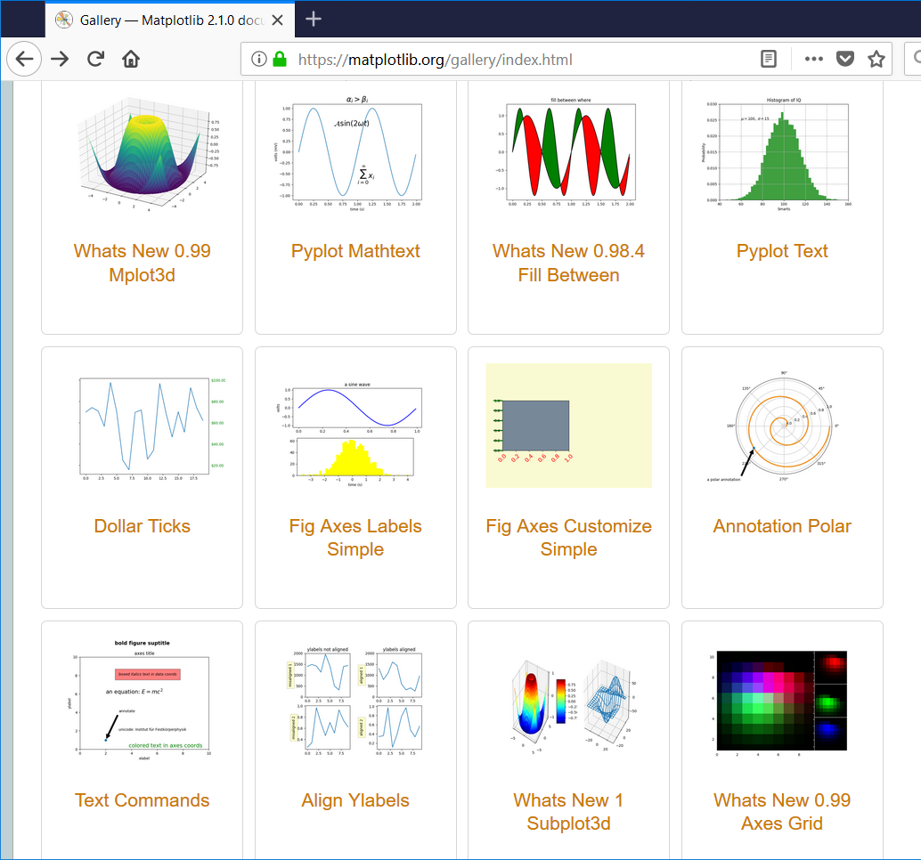
Check out the matplotlib gallery!
BCHB524 - Edwards

Slide 9
Lets analyze this dataset!
Find differentially expressed genes!
differential.py
from pylab import *
from data import *
g2t = {}
for g in genes:
g2t[g] = tstatistic(t1data[g],t2data[g])
x = g2t.values()
hist(x)
show()
bytstat = sorted(genes,key=g2t.get)
print("Min:", bytstat[0], min(x))
print("Max:", bytstat[-1], max(x))
BCHB524 - Edwards

Slide 10
Lets analyze this dataset!
Find differentially expressed genes!
differential1.py
from pylab import *
from data import *
g2t = {}
for g in genes:
g2t[g] = tstatistic(t1data[g],t2data[g])
bytstat = sorted(genes,key=g2t.get)
gene = bytstat[0]
boxplot([t1data[gene],t2data[gene]])
title(gene)
show()
BCHB524 - Edwards

Slide 11
Find correlated genes
correlated.py
from pylab import *
from data import *
gp2rho = {}
for i in range(ngene):
for j in range(i+1,ngene):
gi = genes[i]
gj = genes[j]
gp2rho[(gi,gj)] = corrcoef(data[gi],data[gj])[0,1]
hist(gp2rho.values())
show()
sx = sorted(gp2rho.keys(),key=gp2rho.get)
print(sx[0],sx[-1])
BCHB524 - Edwards

Slide 12
Find correlated genes
correlated1.py
from pylab import *
from data import *
gp2rho = {}
for i in range(ngene):
for j in range(i+1,ngene):
gi = genes[i]
gj = genes[j]
gp2rho[(gi,gj)] = corrcoef(data[gi],data[gj])[0,1]
sx = sorted(gp2rho.keys(),key=gp2rho.get)
bestpair = sx[-1]
gi = bestpair[0]
gj = bestpair[1]
plot(data[gi],data[gj],'.')
show()
BCHB524 - Edwards

Slide 13
Exercises
Try each of the examples shown in these slides.
Check out the gallery of figures on the matplotlib web-site.
Write a program to plot the GC % of 20-mer DNA windows from a DNA sequence.
BCHB524 - Edwards

