Slide 1
Web-Applications:
TurboGears
BCHB524
Lecture 27
BCHB524 - Edwards

Slide 2
Web-Applications
Use the web-browser as the user-interface
All application specific functionality comes directly from the web-server
No installation impediments for the user
Fast way to provide your tools to others with little operating system or user-interface barrier
Natural way to supply views into complex datasets that cannot feasibly be installed elsewhere.
BCHB524 - Edwards

Slide 3
Web-Servers
Respond to requests:
  http://google.com
  http://edwardslab.bmcb.georgetown.edu/
with static:
  files, images, etc...
and dynamic:
  your facebook page, google search results
content.
BCHB524 - Edwards

Slide 4
Web-servers
A URL is made up of many parts.
port #
(80 if omitted)
http://hoyataxa.georgetown.edu:8080/index.html
protocol
(http,https)
computer name
resource
BCHB524 - Edwards

Slide 5
Web-servers
A URL is made up of many parts.
A dynamic resource may return different results depending on its parameters
Additional request parameters may not be visible in the URL
  Cookies, POST requests
port #
(80 if omitted)
resource/request
parameters
http://hoyataxa.georgetown.edu:8080/taxa?taxid=9606&format=XML
protocol
(http,https)
computer name
resource
BCHB524 - Edwards

Slide 6
Web-server
Web-servers return data in HTML format for display by the web-browser.
Any program can request URL resources and store (and display) the response.
Any program can handle the URL request and return data in whatever format they like.
TurboGears provides a pythonic web-framework for building dynamic data-driven web-application servers.
BCHB524 - Edwards

Slide 7
TurboGears 2
One of many web-stacks which simplify development of web-apps
Model-View-Controller (MVC) paradigm
  Model stores the data/information required
  View decides how to format/display the results
  Controller takes requests and determines the data to output
BCHB524 - Edwards

Slide 8
TurboGears 2
http://www.turbogears.org
We will install TurboGears 2.4
To install for the student user in the course virtual machine, copy-and-paste the following in the terminal:
wget -q -O - "http://grg.tn/tginstall" | sh
BCHB524 - Edwards

Slide 9
Hoya Taxa
TurboGears web-application for exploring the NCBI taxonomy of organism names
Simple search and browse of data stored in a relational database
Read-only (no modification of the data)
No users (no login or accounts)
No fancy javascript (AJAX or otherwise)
BCHB524 - Edwards

Slide 10
Application creation
Execute the tgsetup.sh script to make a new web-application:
Check the web-application is working...
Start a web-browser and access the url:
http://localhost:8080/
cd
./tgsetup.sh hoyataxa
cd ~/hoyataxa
./tgserve.sh
BCHB524 - Edwards

Slide 11
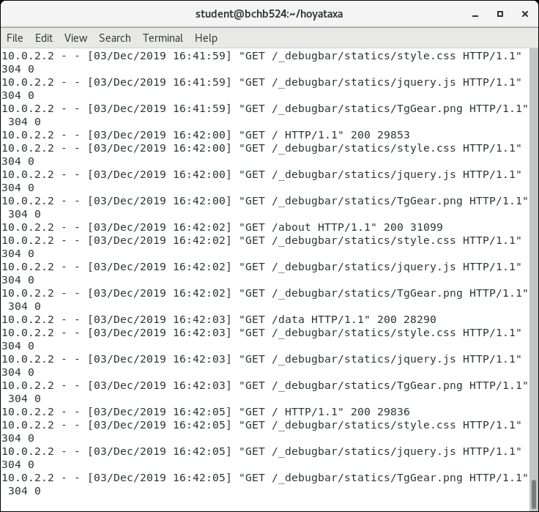
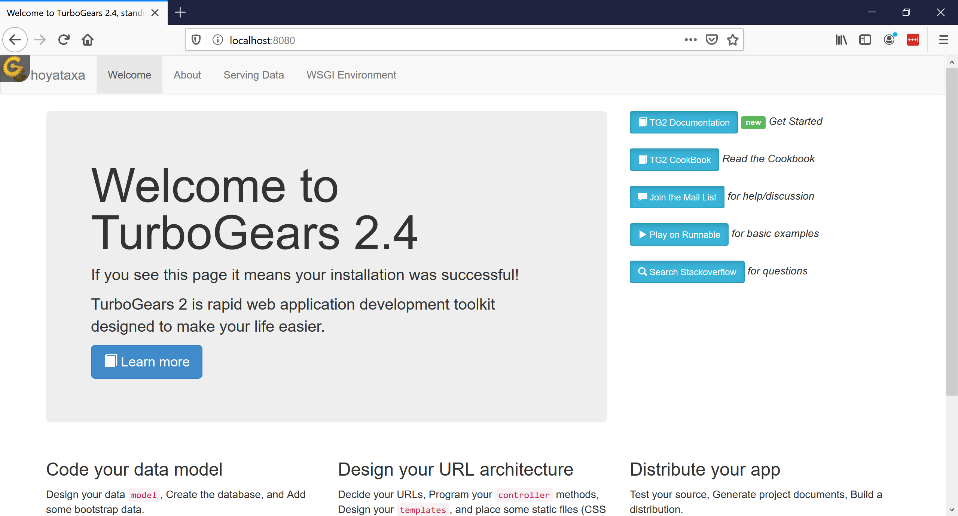
Start web-app and check
BCHB524 - Edwards

Slide 12
Start web-app and check
BCHB524 - Edwards

Slide 13
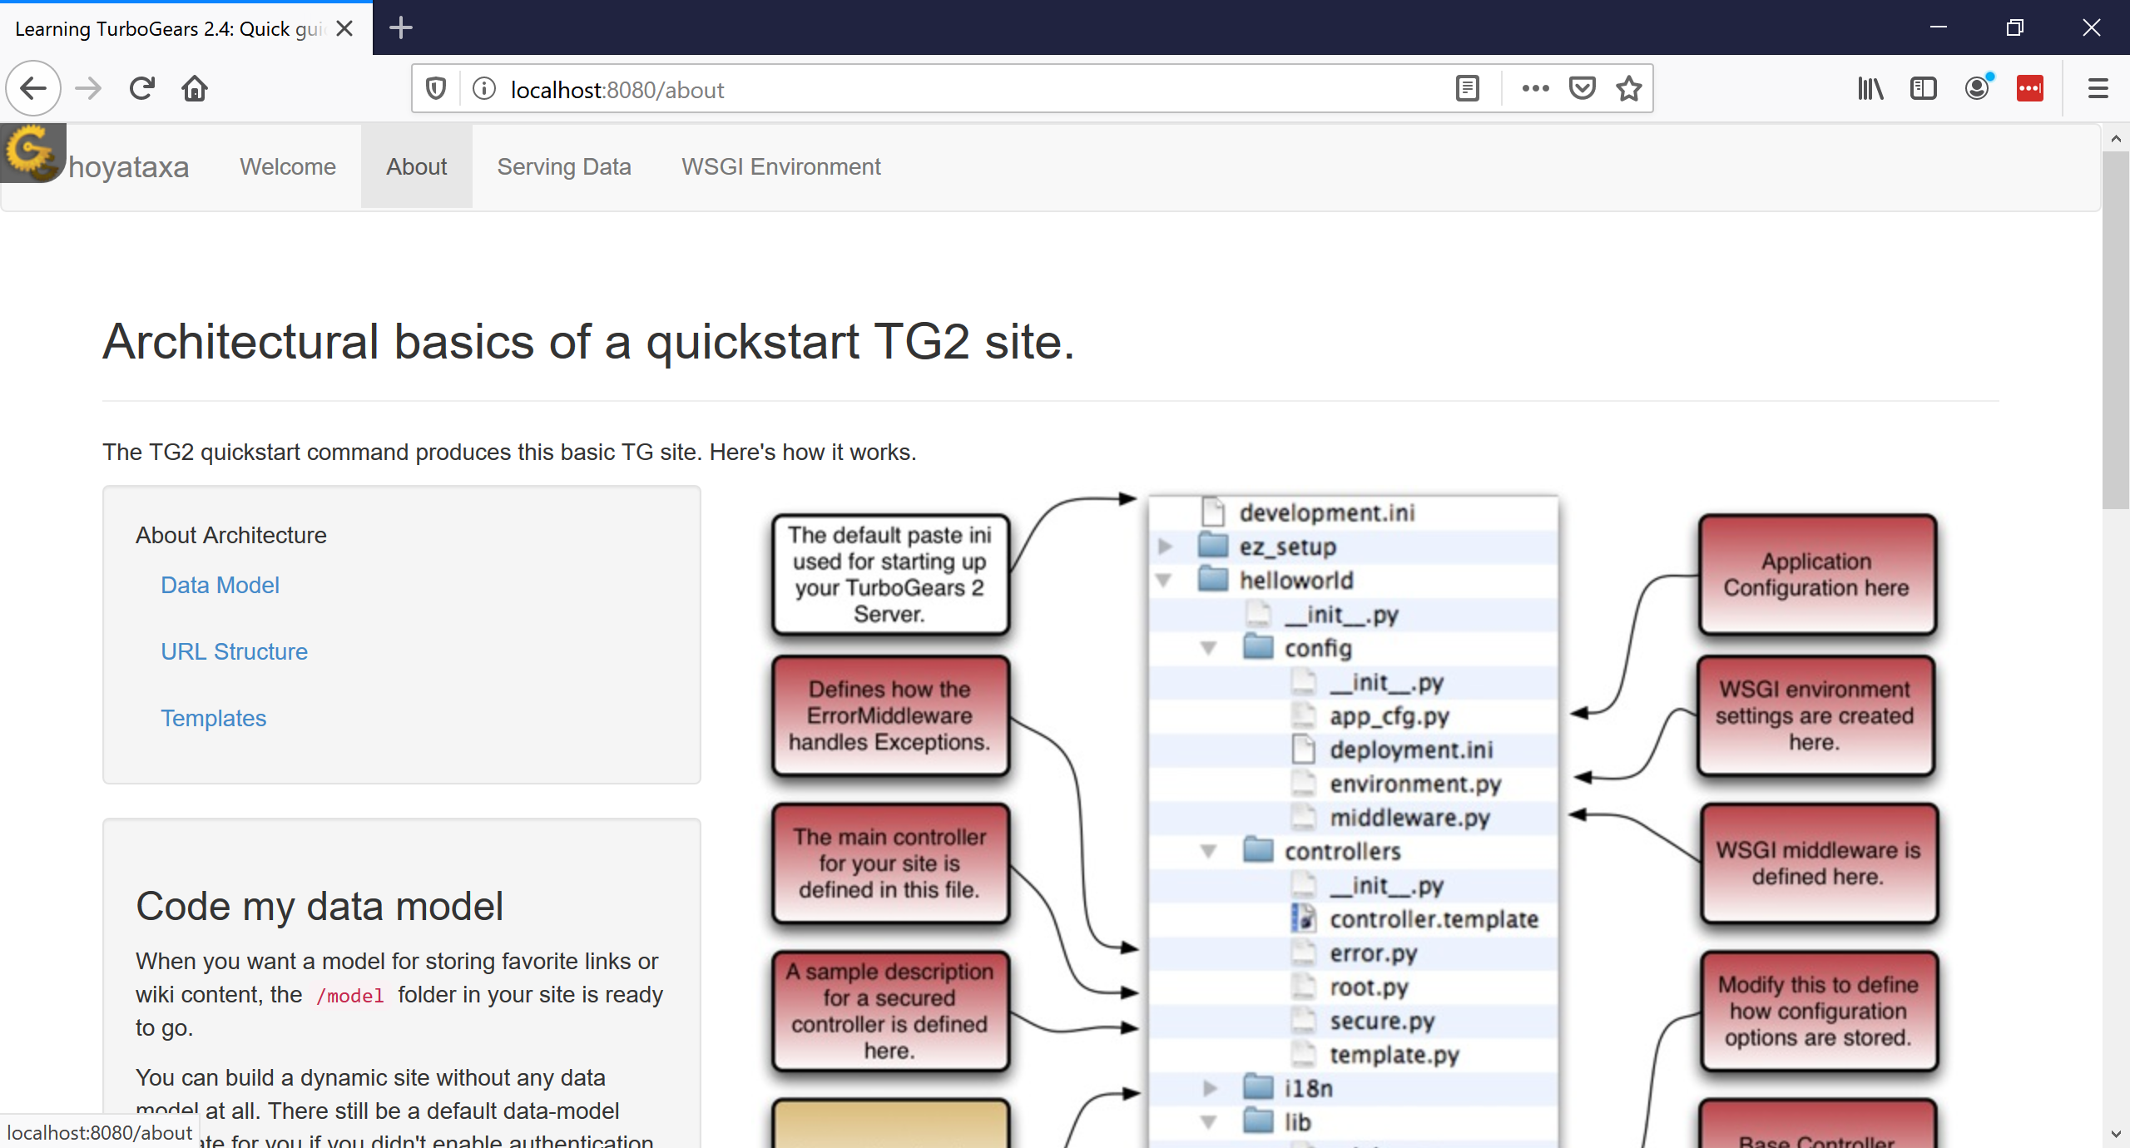
Start web-app and check
BCHB524 - Edwards

Slide 14
Tour the primary files
Lets take a tour of the hoyataxa folder:
  Controller:
    hoyataxa/controllers/root.py
  (Data) Model:
    hoyataxa/model/taxa.py
  View / Template:
    hoyataxa/templates/index.xhtml
    hoyataxa/templates/master.xhtml
BCHB524 - Edwards

Slide 15
Trace the execution path
Spend some time to understand how these modules interact. Things to notice:
  Request is translated to method call in root.py controller
  Lots of crazy stuff in the index.xhtml and master.xhtml templates, but we can remove a lot.
Edit controllers/root.py, templates/index.xhtml, and templates/master.xhtml to make an "empty" application.
BCHB524 - Edwards

Slide 16
Edit templates/index.xhtml
In index.xhtml:
  Delete the text between the <title></title> HTML tags.
  Delete everything between the <body></body> HTML tags.
  Reload the web-site
    use the reload button in web-browser
  Check the result...
    Still have some stuff from master.xhtml but otherwise empty.
    master.xhtml provides common design elements (titles, menus) on every page
BCHB524 - Edwards

Slide 17
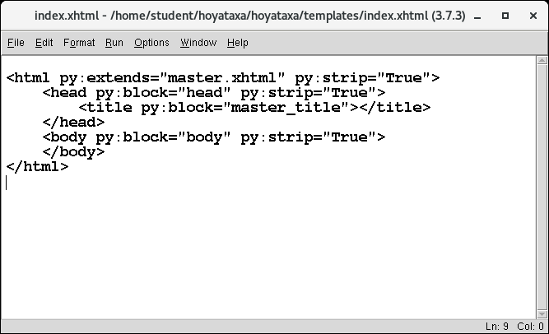
Edit templates/index.xhtml
Now looks like this
BCHB524 - Edwards

Slide 18
Edit controllers/root.py
In the index method in controllers/root.py:
  Get rid of everything in the RootController class, except for the index method (and its @expose decorator)
  Remove the page key from the dictionary being returned from the index method.
Notice that the server program "restarts" every time you change root.py.
BCHB524 - Edwards

Slide 19
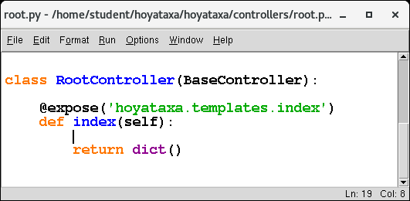
Edit controllers/root.py
RootController class should look like this:
BCHB524 - Edwards

Slide 20
Edit templates/master.xhtml
In templates/masterx.html (reload often!)
  Remove the navbar from the <body> </body> block.
  Add a new header just after the <body> start tag:
  <div align="center">
  <font size="+6">Hoya Taxa</font>
  </div>
  Remove everything between the <footer> </footer> tags and replace with:
  <div align="center">
  All your taxa are belong to us!
  </div>
BCHB524 - Edwards

Slide 21
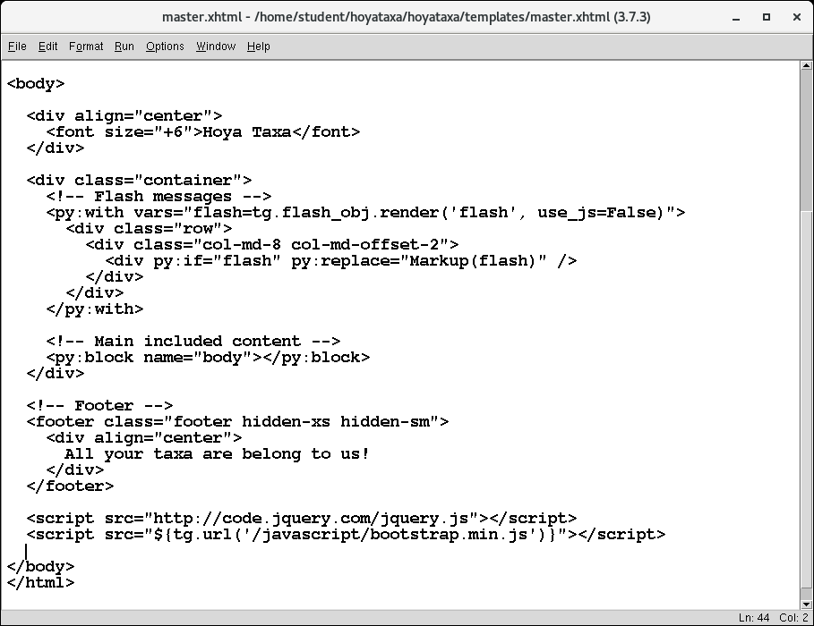
Edit templates/master.xhtml
Relevant section should look like this:
BCHB524 - Edwards

Slide 22
Empty web-app
Rather than making the changes one step at a time…
cd ~/hoyataxa
./tgempty.sh
BCHB524 - Edwards

Slide 23
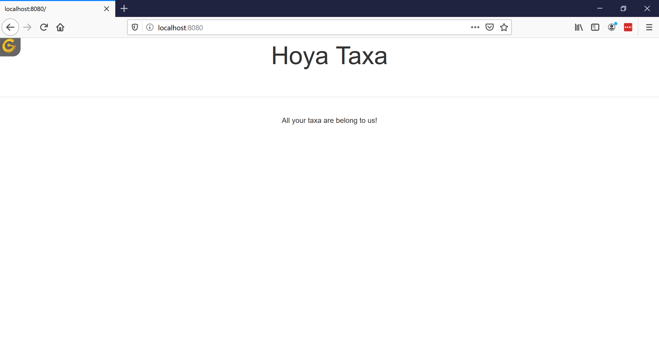
Empty web-app
Empty web-application looks like:
BCHB524 - Edwards

Slide 24
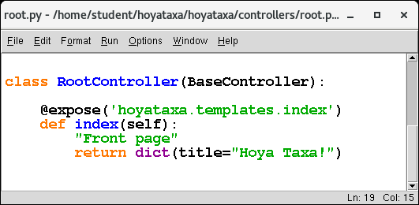
Dynamic title
In root.py, let's send a dynamic title to the index.xhtml template.
BCHB524 - Edwards

Slide 25
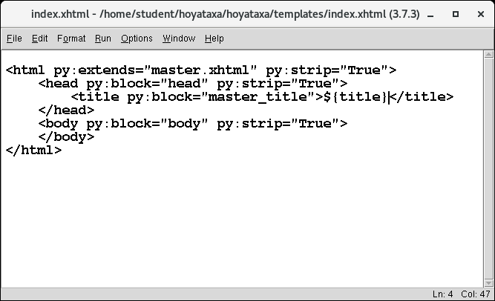
Dynamic title
In index.xhtml, insert ${title} between the <title></title> tags.
BCHB524 - Edwards

Slide 26

Dynamic Title
BCHB524 - Edwards

Slide 27
Dynamic Title
BCHB524 - Edwards

Slide 28
Setup the model: model/taxa.py
from sqlobject import *
import os.path, sys
dbfile = 'devdata.sqlite'
def initdb():
# Magic formatting for database URI
conn_str = os.path.abspath(dbfile)
conn_str = 'sqlite:'+ conn_str
# Connect to database
sqlhub.processConnection = connectionForURI(conn_str)
BCHB524 - Edwards

Slide 29
Setup the model: model/taxa.py
class Taxonomy(SQLObject):
taxid = IntCol(alternateID=True)
scientific_name = StringCol()
rank = StringCol()
parent = ForeignKey("Taxonomy")
children = MultipleJoin("Taxonomy",
joinColumn='parent_id')
names = MultipleJoin("Name")
class Name(SQLObject):
taxonomy = ForeignKey("Taxonomy")
name = StringCol()
name_class = StringCol()
BCHB524 - Edwards

Slide 30
Let's add some functionality
In controllers.py, let's add a new request
  Add necessary imports from model
  Add new method taxa with parameter taxid
  Use taxid to lookup Taxonomy object
  Create dynamic title string
  Send the title and taxa object to taxa.html template
Access this page/resource as:
  http://localhost:8080/taxa?taxid=9606
  http://localhost:8080/taxa/9606
Try it!
BCHB524 - Edwards

Slide 31
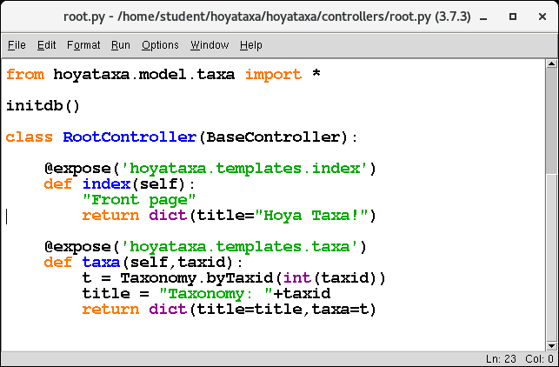
Let's add some functionality
In controllers/root.py, add a new request
BCHB524 - Edwards
Notes:
@expose(template="hoyataxa.templates.taxa")
def taxa(self,taxid):
""""Return the Taxonomy object."""
t = Taxonomy.byTaxid(int(taxid))
title = "Taxonomy: "+taxid
return dict(title=title, taxa=t)

Slide 32
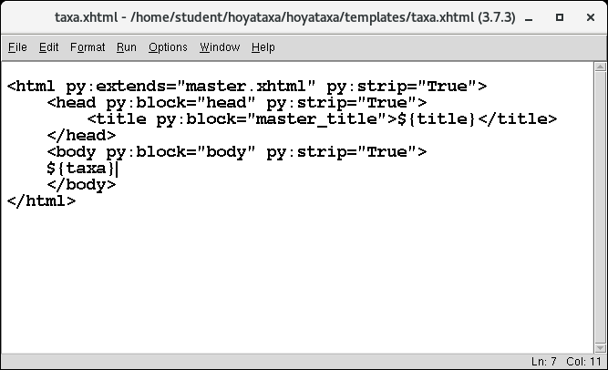
Let's add some functionality
Need to create taxa.xhtml too
  Save index.xhtml as taxa.xhtml
  Change taxa.xhtml
BCHB524 - Edwards

Slide 33
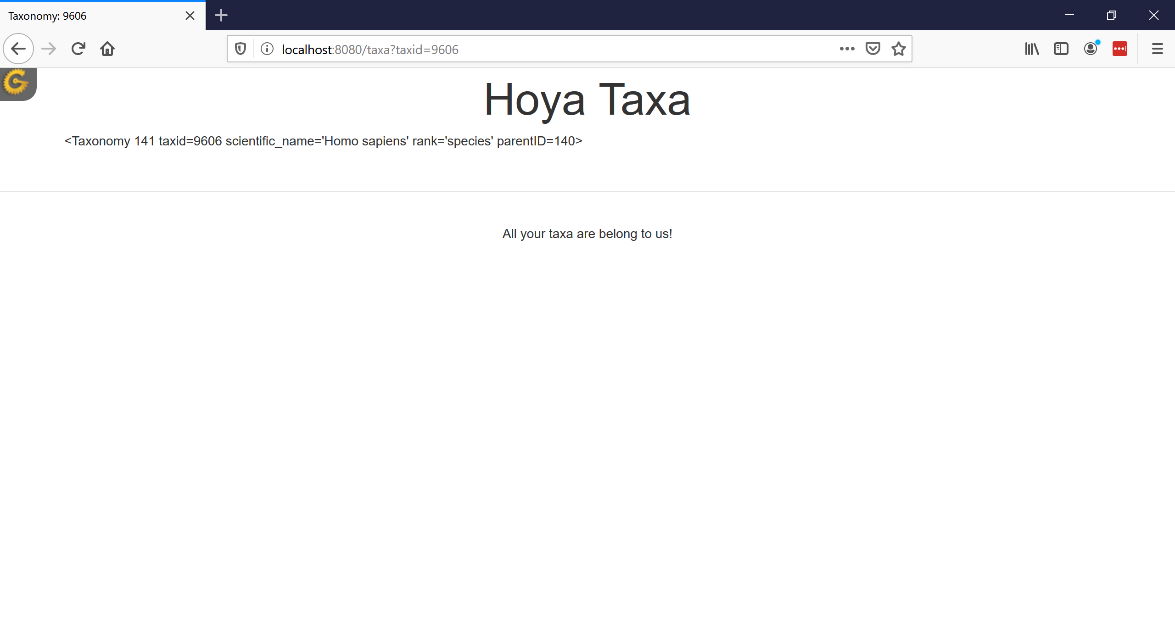
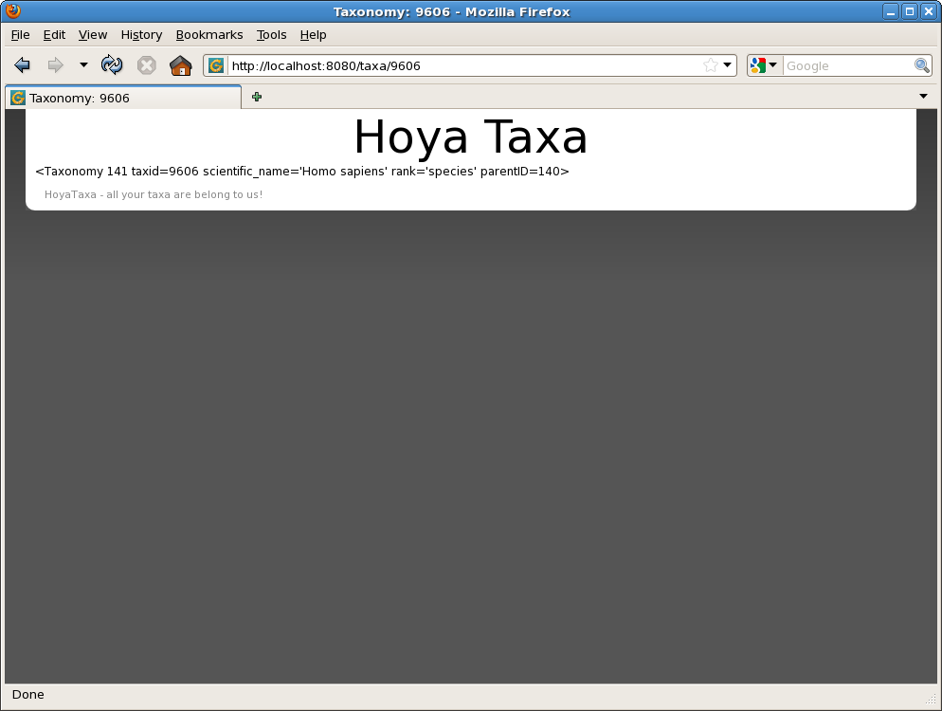
Let's add some functionality
Not pretty, but now we have dynamic title and dynamic content...
BCHB524 - Edwards

Slide 34
Lets make it pretty
Place the following HTML between the body tags in taxa.xhtml:
<P/>
<table class="table">
<tr><th>Scientific&nbsp;Name</th><td>${taxa.scientific_name}</td></tr>
<tr><th>NCBI&nbsp;Taxonomy&nbsp;ID</th><td>${taxa.taxid}</td></tr>
<tr><th>Rank</th><td>${taxa.rank}</td></tr>
<tr><th>Parent</th><td>${taxa.parent}</td></tr>
</table>
BCHB524 - Edwards
Notes:
<P/>
<table class="table">
<tr><th>Scientific&nbsp;Name</th><td>${taxa.scientific_name}</td></tr>
<tr><th>NCBI&nbsp;Taxonomy&nbsp;ID</th><td>${taxa.taxid}</td></tr>
<tr><th>Rank</th><td>${taxa.rank}</td></tr>
<tr><th>Parent</th><td>${taxa.parent}</td></tr>
</table>

Slide 35

Let's make it pretty
BCHB524 - Edwards

Slide 36
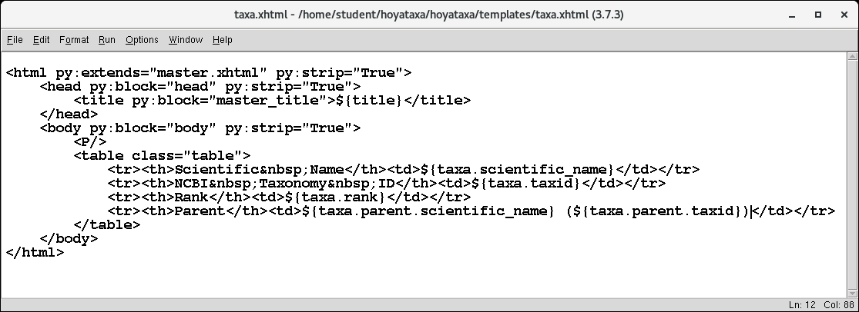
Fix the parent value
BCHB524 - Edwards

Slide 37
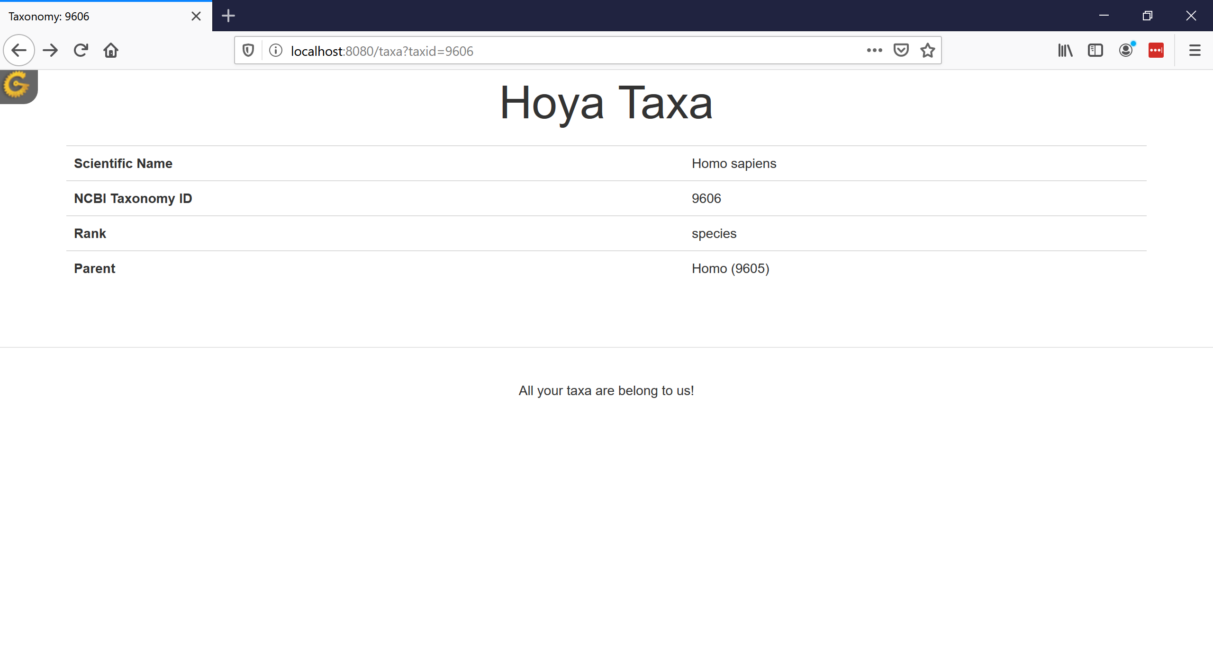
Fix the parent value
BCHB524 - Edwards

Slide 38
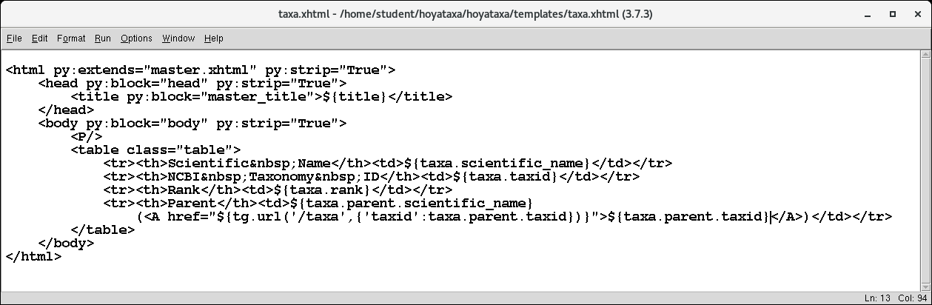
And make it clickable
BCHB524 - Edwards
Notes:
<A href="${tg.url('/taxa',{'taxid': taxa.parent.taxid})}">${taxa.parent.taxid}</A>

Slide 39
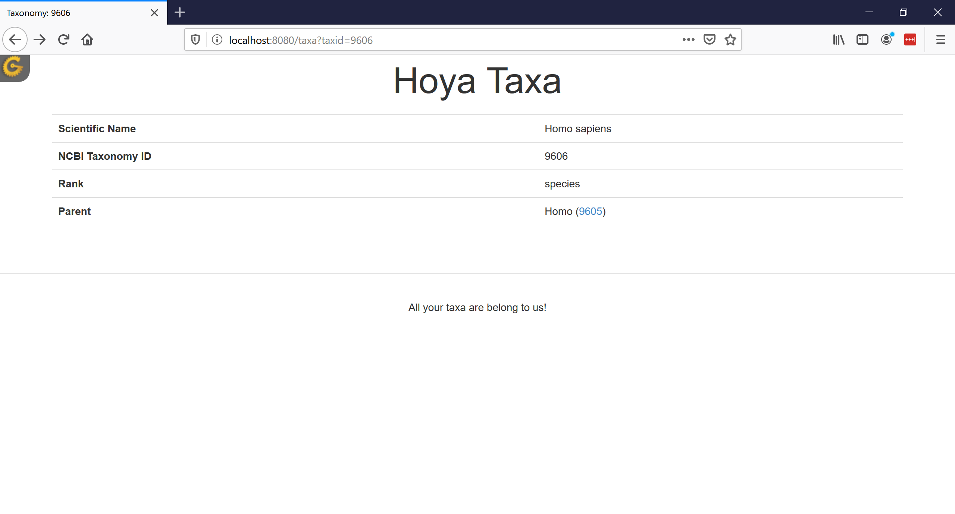
And make it clickable
BCHB524 - Edwards

Slide 40
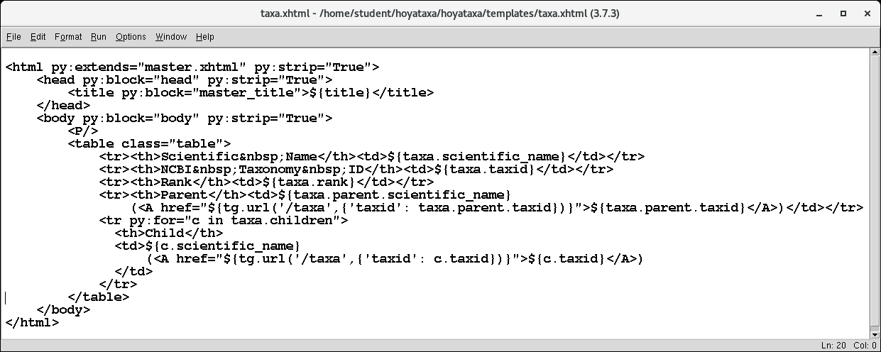
List all the children
BCHB524 - Edwards
Notes:
<tr py:for="c in taxa.children">
<th>Child</th>
<td>${c.scientific_name}
(<A href="${tg.url('/taxa',{'taxid': c.taxid})}">${c.taxid}</A>)
</td>
</tr>

Slide 41
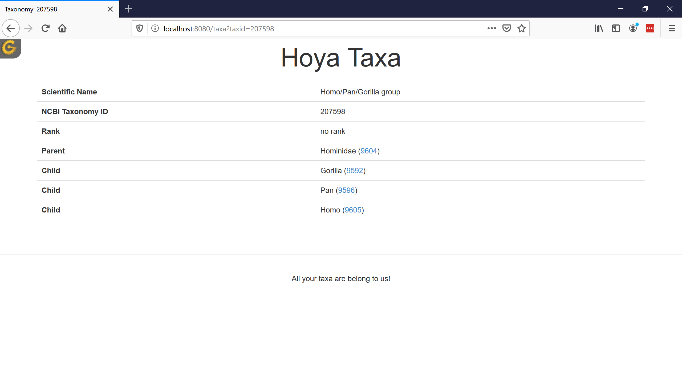
List all children
BCHB524 - Edwards

Slide 42
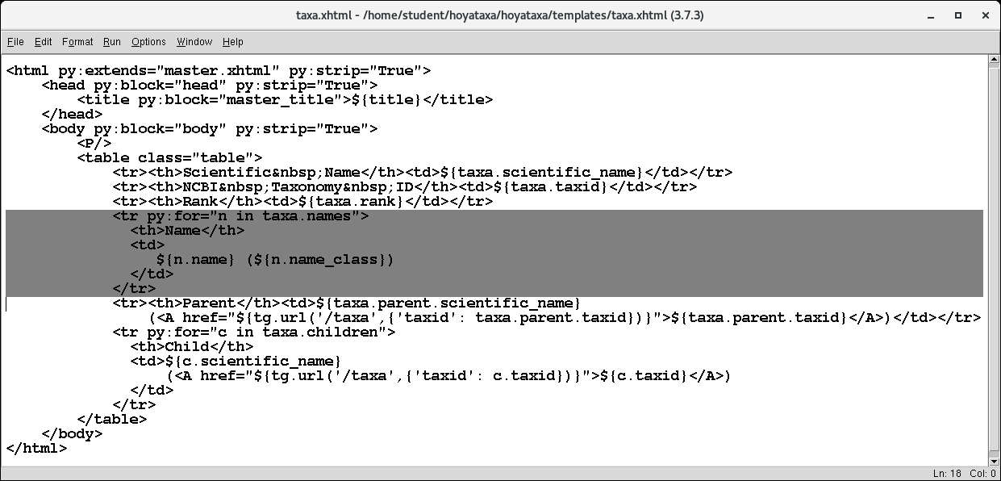
List all names
BCHB524 - Edwards
Notes:
<tr py:for="n in taxa.names">
<th>Name</th>
<td>
${n.name} (${n.name_class})
</td>
</tr>

Slide 43
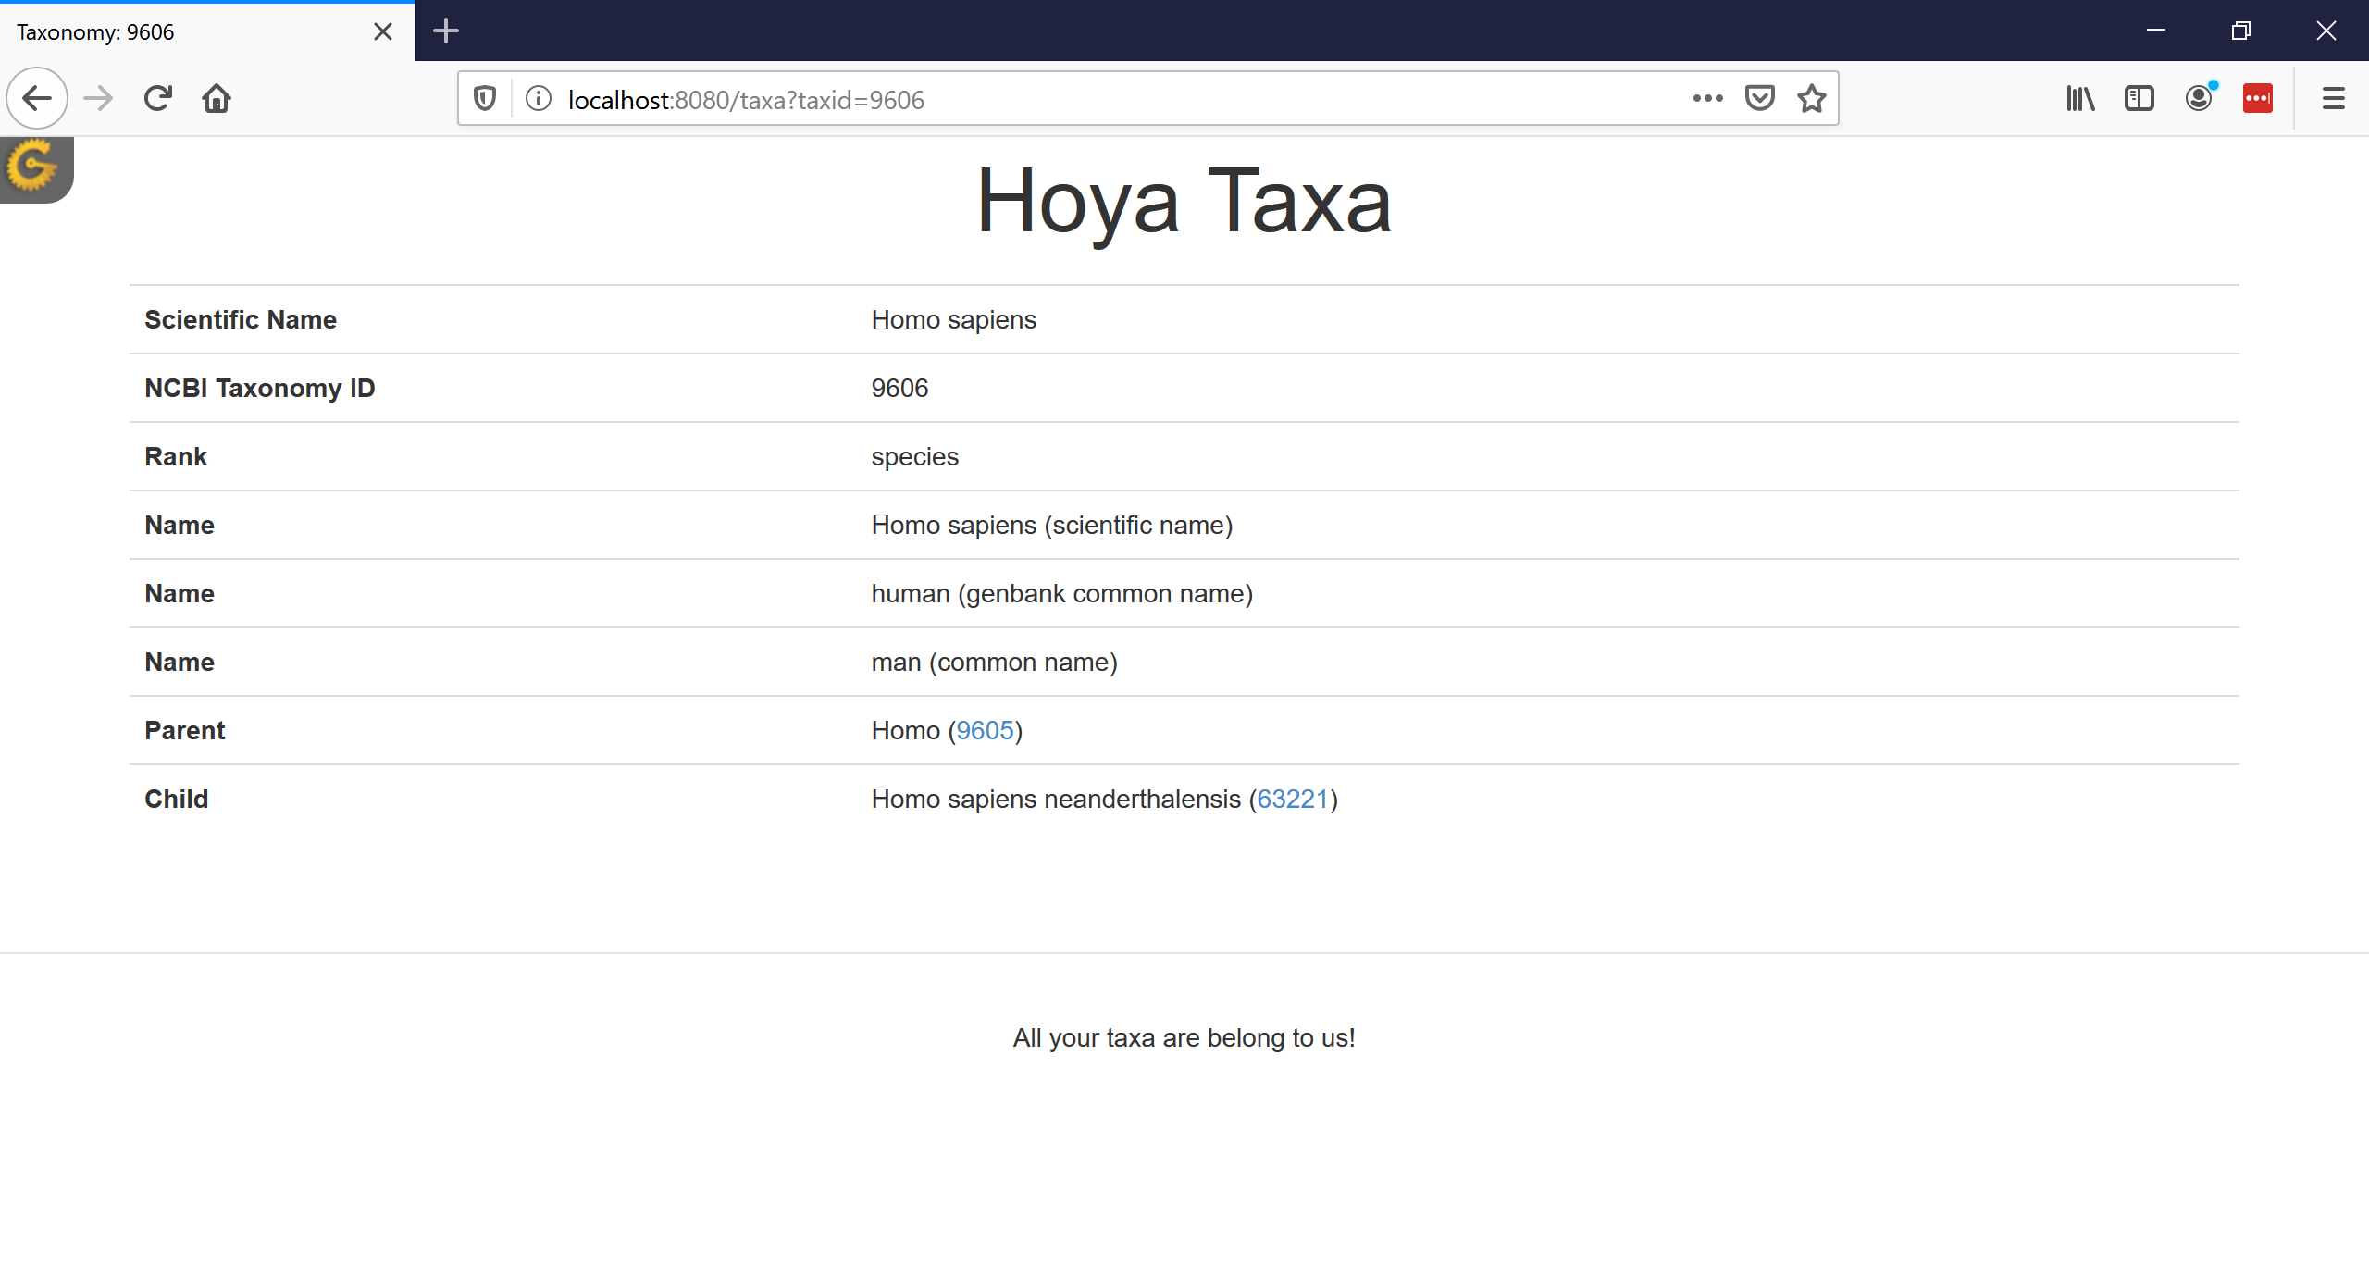
List all names
BCHB524 - Edwards

Slide 44
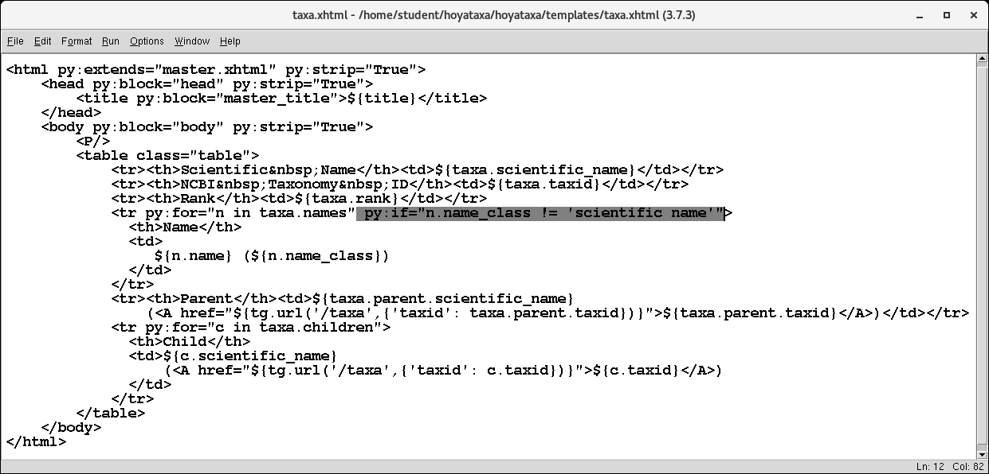
Remove the scientific name
BCHB524 - Edwards
Notes:
py:if="n.name_class != 'scientific name'"

Slide 45
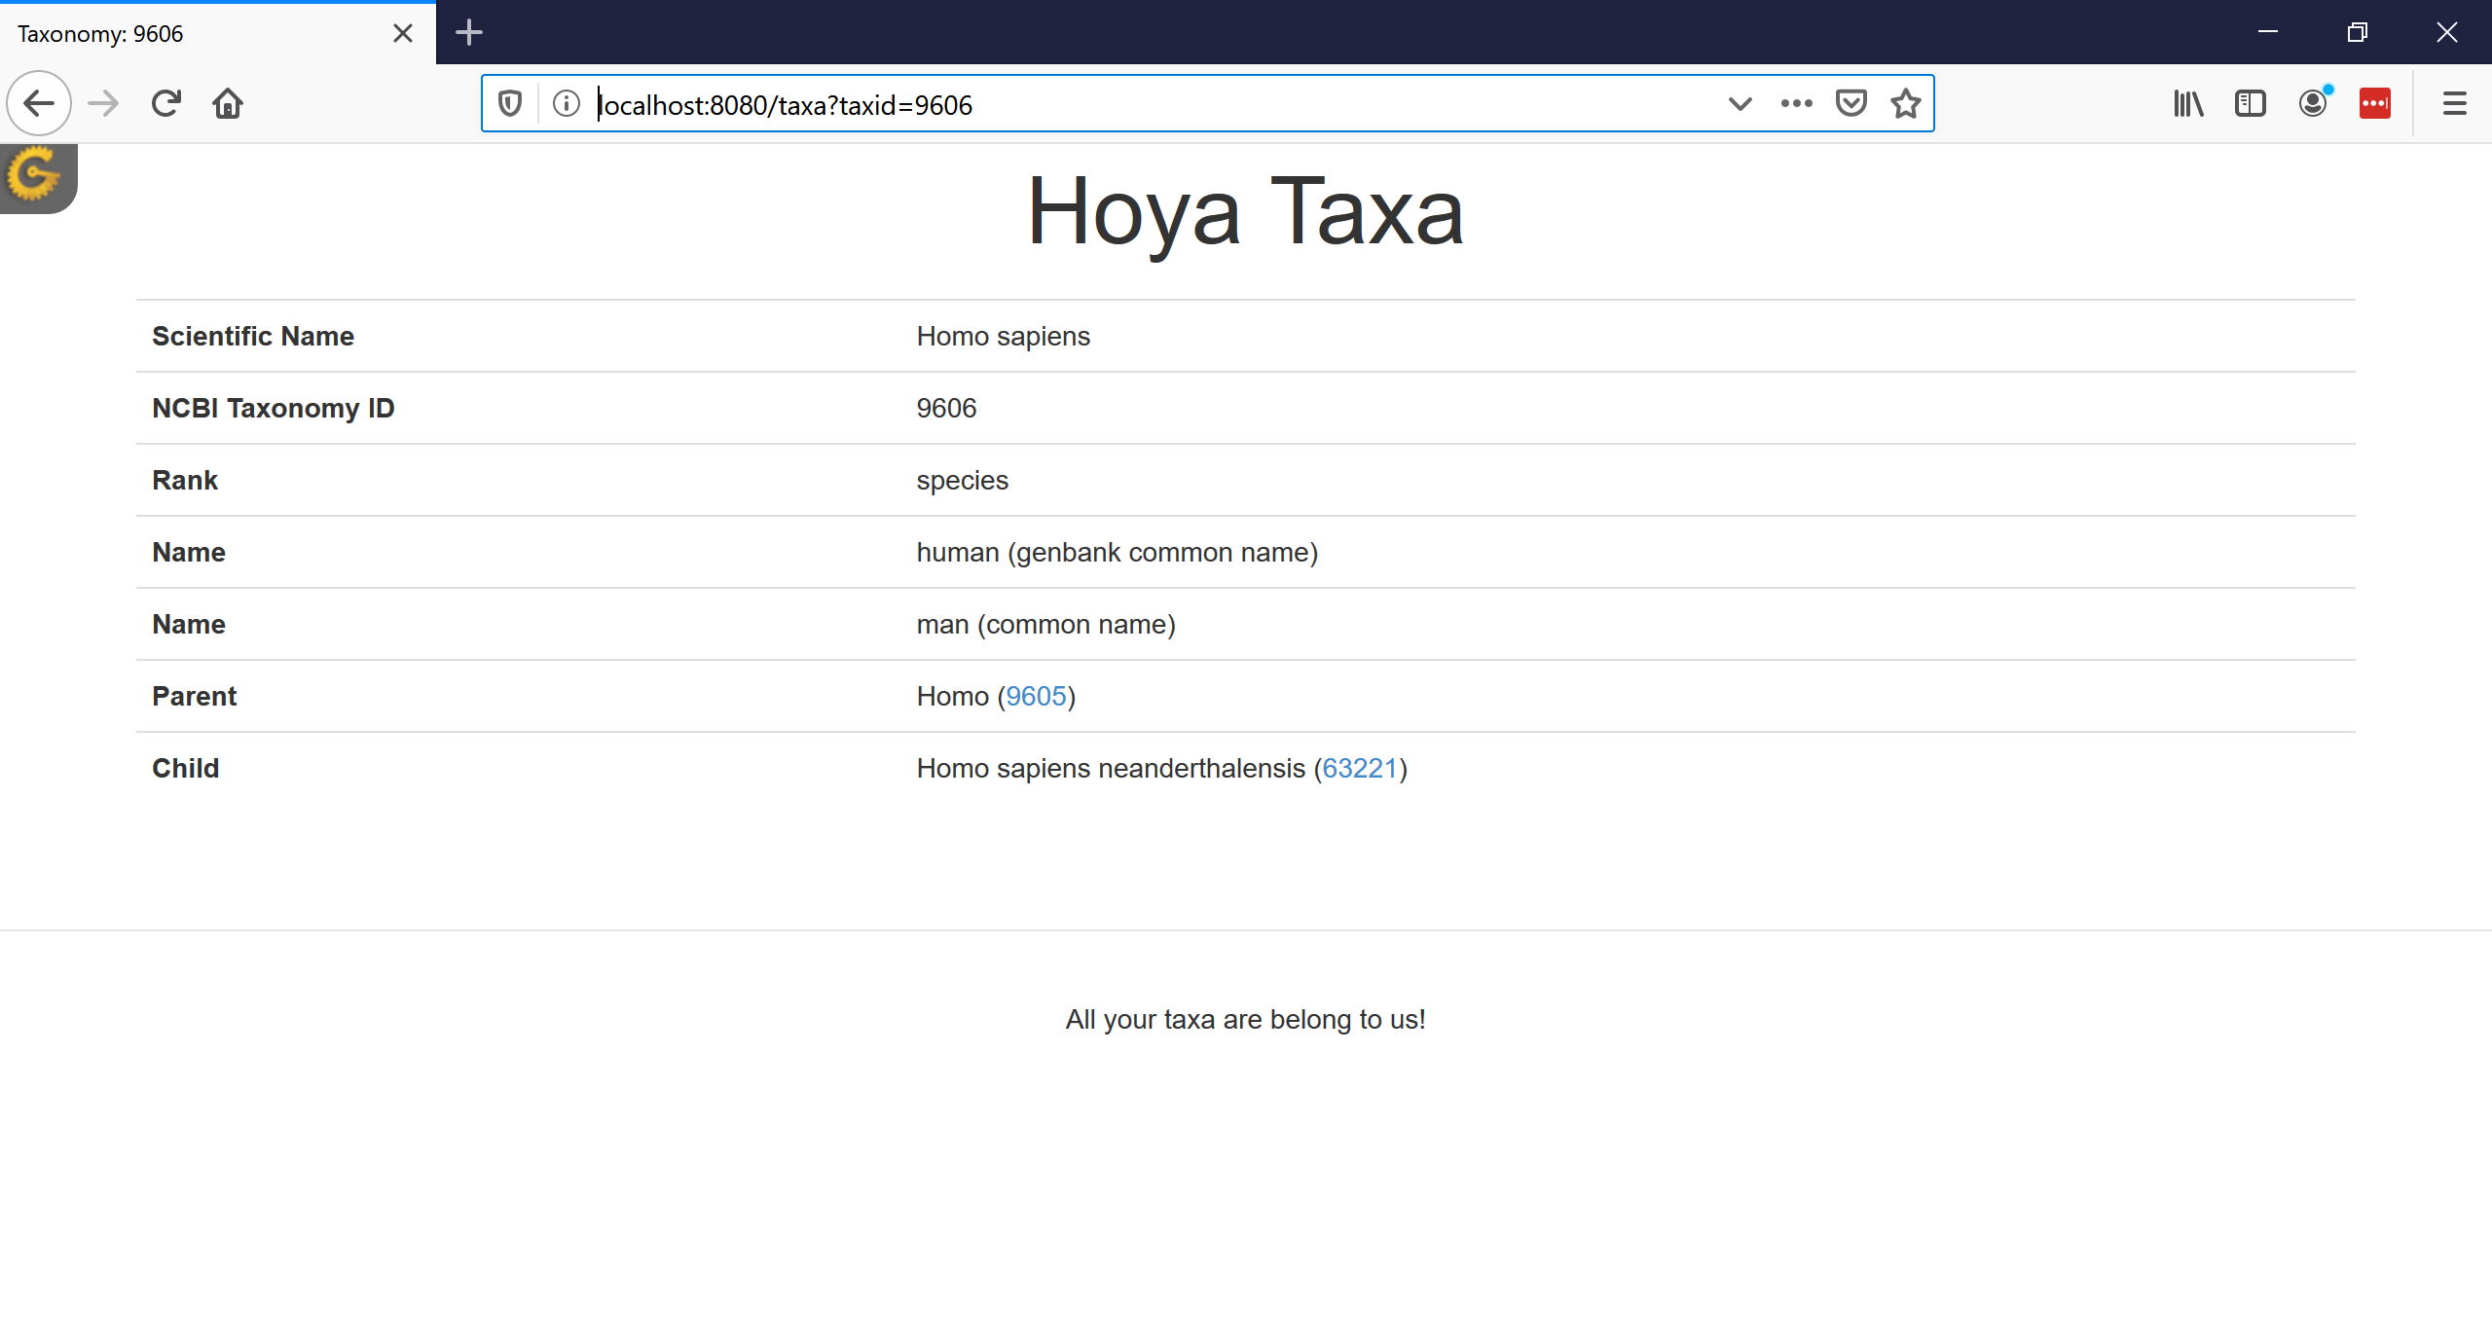
Remove scientific name
BCHB524 - Edwards

Slide 46
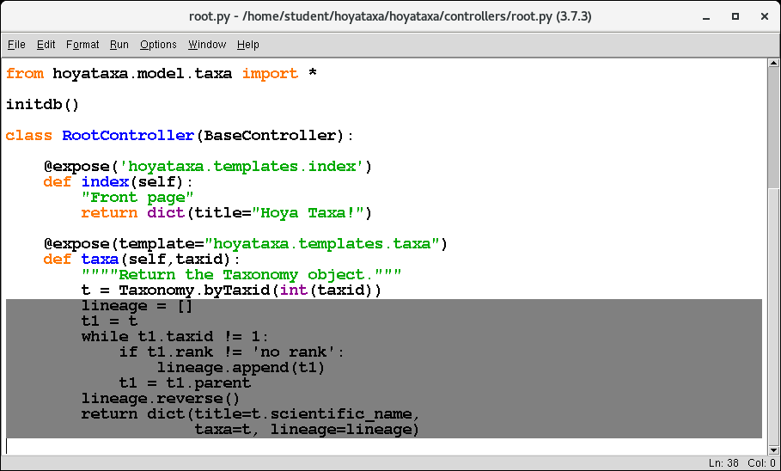
Let's add the lineage
BCHB524 - Edwards
Notes:
lineage = []
t1 = t
while t1.taxid != 1:
if t1.rank != 'no rank':
lineage.append(t1)
t1 = t1.parent
lineage.reverse()
return dict(title=t.scientific_name,
taxa=t, lineage=lineage)

Slide 47
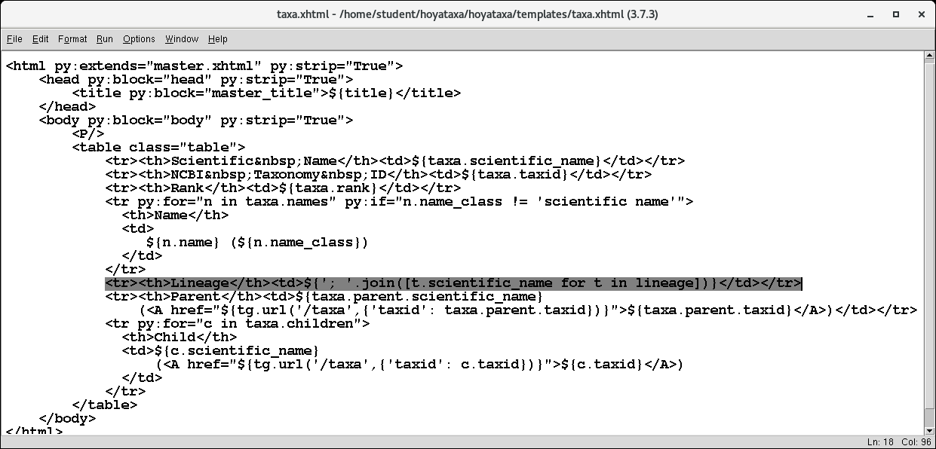
Let’s add the lineage
BCHB524 - Edwards
Notes:
<tr><th>Lineage</th><td>${'; '.join([t.scientific_name for t in lineage])}</td></tr>

Slide 48
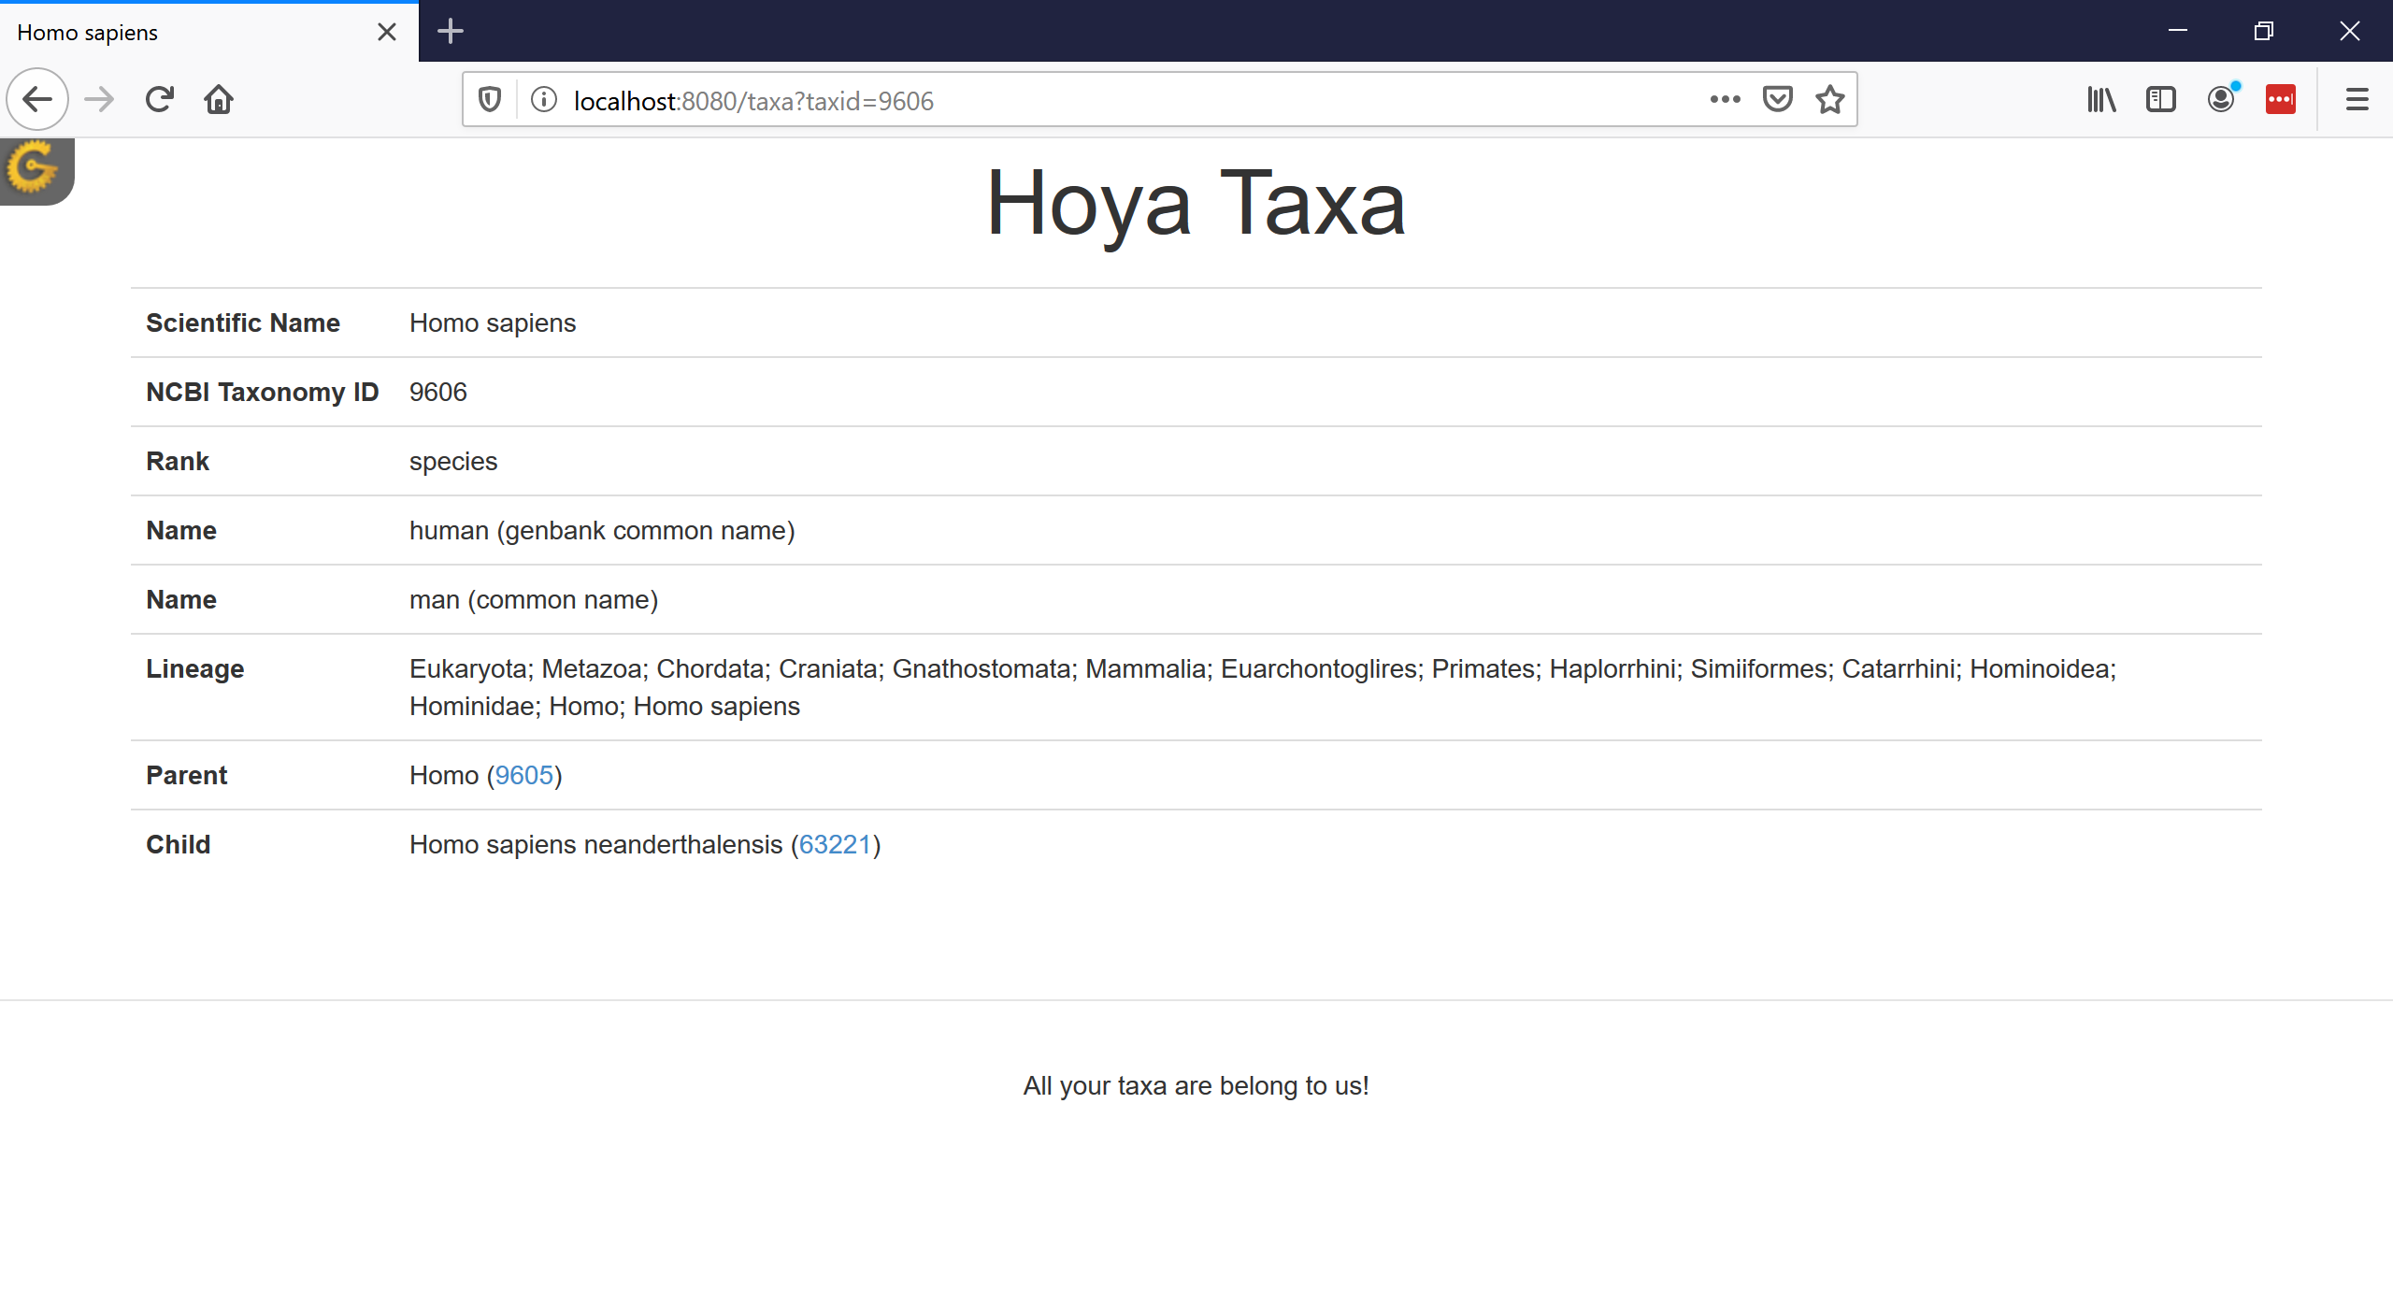
Let’s add the lineage
BCHB524 - Edwards

Slide 49
End of stage 1
Bring all files up to the end of this lecture:
cd ~/hoyataxa
./hoyataxa.sh --stage 1
BCHB524 - Edwards

Slide 50
Next time
We can now display a taxonomy record nicely if the user types a URL
  ...and then navigate about its heirachy.
Need to be able to search the names based on a user query.
  Search form, list of matching results, etc...
XML output for web-services.
BCHB524 - Edwards

